Slide 1
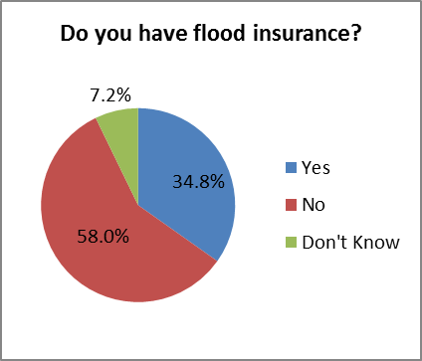
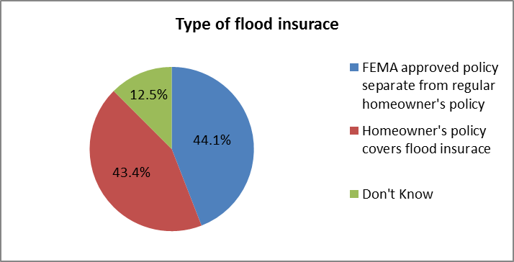
Misconceptions about Flood Coverage
According to the 2014 Life in Hampton Roads survey, many Hampton Roads homeowners appear to believe they have flood insurance when they actually do not. Only FEMA policies cover flooding.

Slide 2

McShane_Horn Research Issues: Flood Insurance
Increasing the US flood insurance penetration rate
Bringing private insurance back into the US flood insurance market.
Assessing the effectiveness of the flood risk reduction leg of the National Flood Insurance Program
Flood mapping
Flood insurance
Flood risk reduction

Slide 3
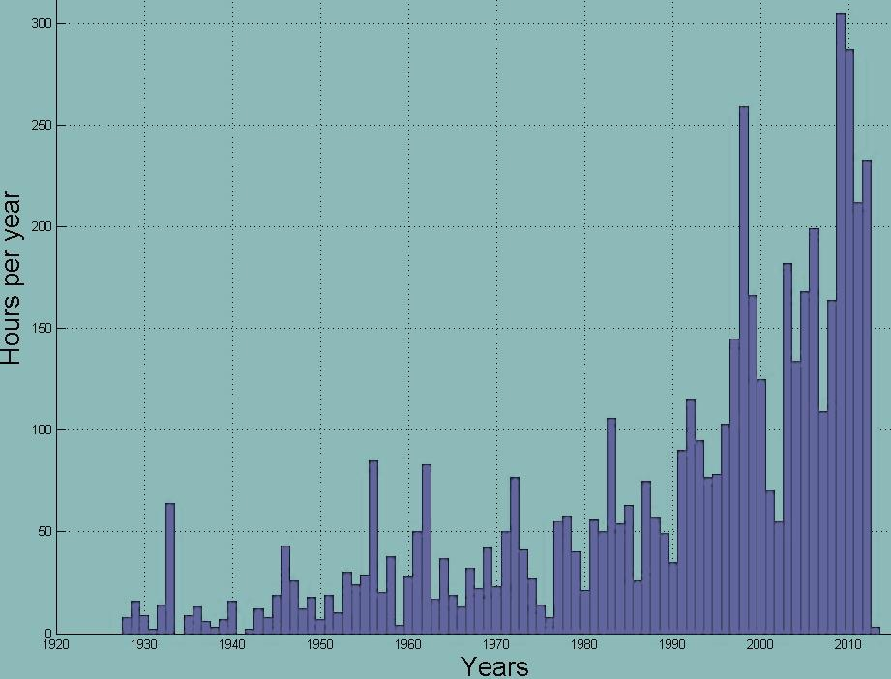

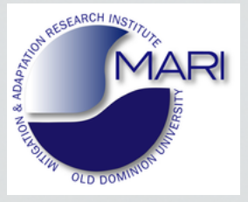
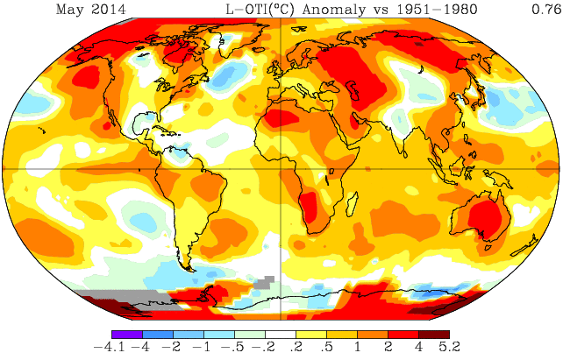
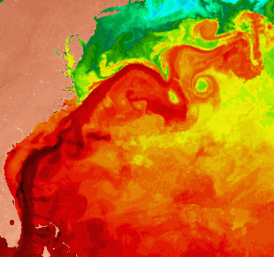
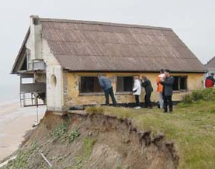
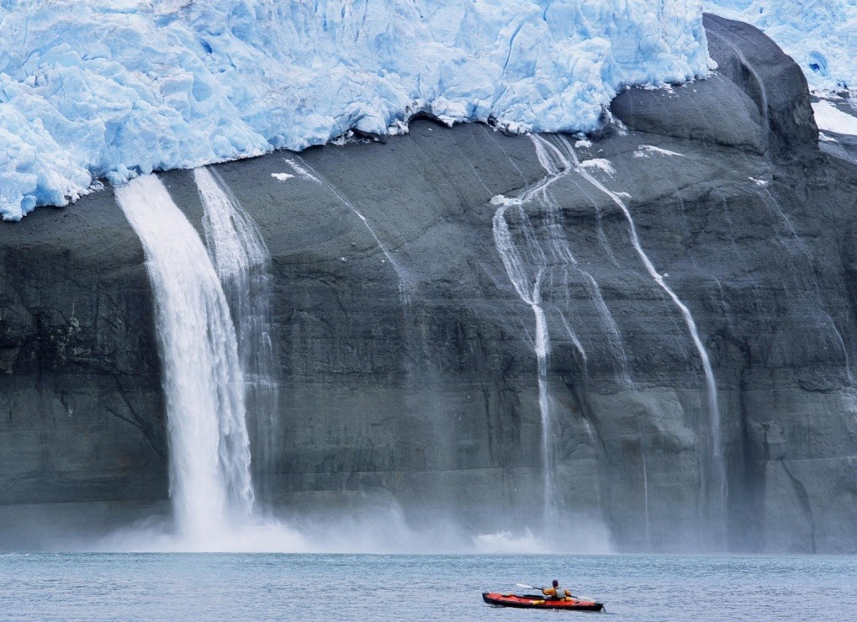
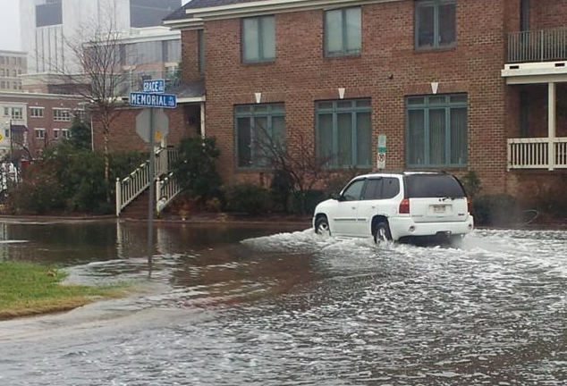
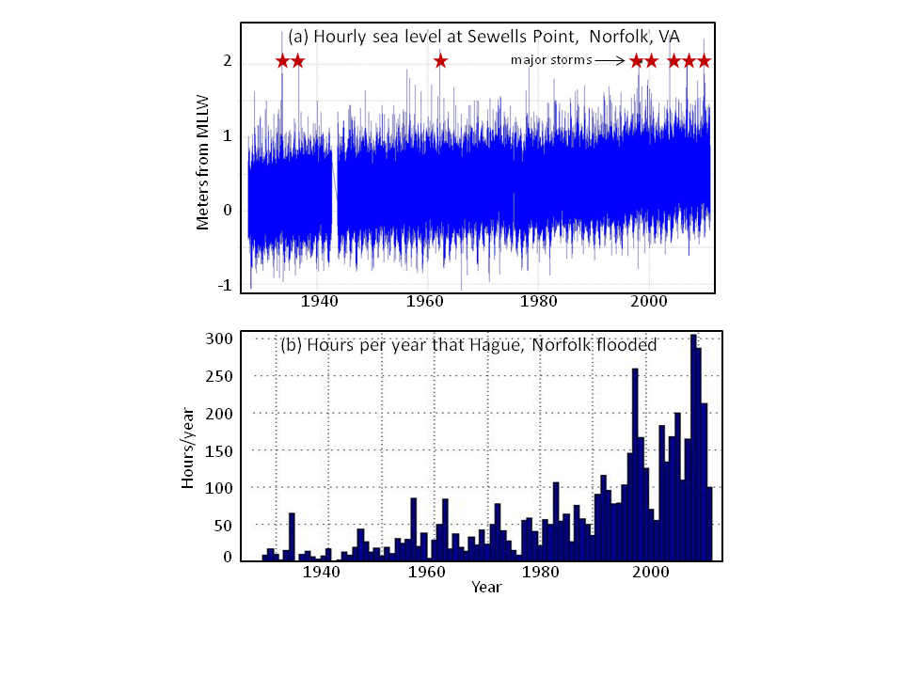
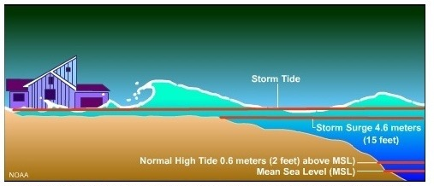
Summary of research by Tal Ezer, CCPO, ODU
The relation between global climate change, Atlantic Ocean circulation and impact on coastal sea level rise and flooding
coastal erosion
global warming
Gulf Stream
glacier melt
Climate change
impact on ocean currents and sea level rise
Storm surge →
tidal flooding
Sea level rise
storm surge
Research: ♦detect climate change♦analyze ocean & sea level data♦project future flooding

Slide 4
Recent selected publications (http://www.ccpo.odu.edu/~tezer/Pub.html)
- on climate change and sea level rise:
Ezer, T. (2015), Detecting changes in the transport of the Gulf Stream and the Atlantic overturning circulation from coastal sea level data: The extreme decline in 2009-2010 and estimated variations for 1935-2012, Global & Planetary Change, 129, 23-36, doi:10.1016/j.gloplacha.2015.03.002.
Ezer, T. (2013), Sea level rise, spatially uneven and temporally unsteady: Why the U.S. East Coast, the global tide gauge record and the global altimeter data show different trends, Geophysical Research Letters, 40(20), 5439-5444, doi:10.1002/2013GL057952.
Ezer, T., L. P. Atkinson, W. B. Corlett and J. L. Blanco (2013), Gulf Stream's induced sea level rise and variability along the U.S. mid-Atlantic coast, Journal of Geophysical Research, 118(2), 685-697, doi:10.1002/jgrc.20091.
Ezer, T. and W. B. Corlett (2012), Is sea level rise accelerating in the Chesapeake Bay? A demonstration of a novel new approach for analyzing sea level data, Geophysical Research Letters, 39(19), L19605, doi:10.1029/2012GL053435.
on impact of sea level rise:
Ezer, T. and L. Atkinson (2015), Sea level rise in Virginia- causes, effects and response. Virginia Journal of Science, Virginia Academy of Science Publ., submitted.
Ezer, T. and L. P. Atkinson (2014), Accelerated flooding along the U. S. East Coast: On the impact of sea level rise, tides, storms, the Gulf Stream and the North Atlantic Oscillations. Earth's Future, 2(8), 362-382.
Saramul, S. and T. Ezer (2014), Spatial variations of sea level along the coast of Thailand: Impacts of extreme land subsidence, earthquakes and the seasonal monsoon, Global & Planetary Change, 122,70-81.
Atkinson, L. P., T. Ezer and E. Smith (2013), Sea level rise and flooding risk in Virginia, Sea Grant Law and Policy Journal, Vol. 5, No. 2, 3-14.

Slide 5
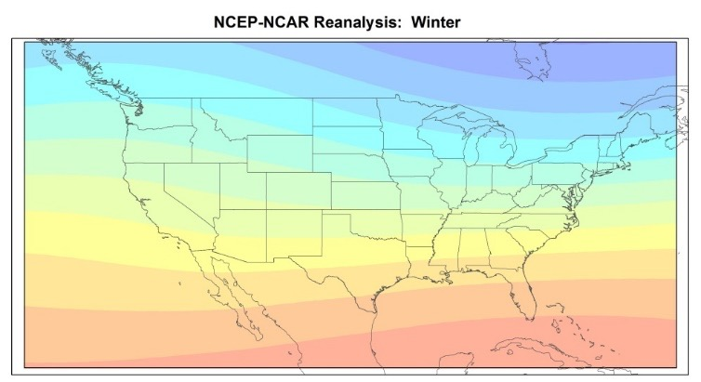
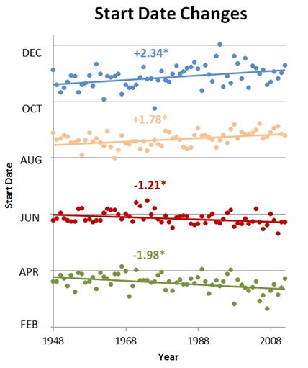
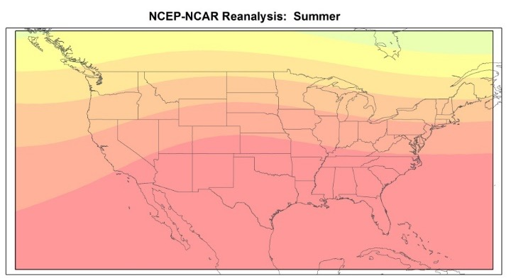
Michael Allen. Political Science and Geography

Slide 6


http://greenninja.org

Slide 7
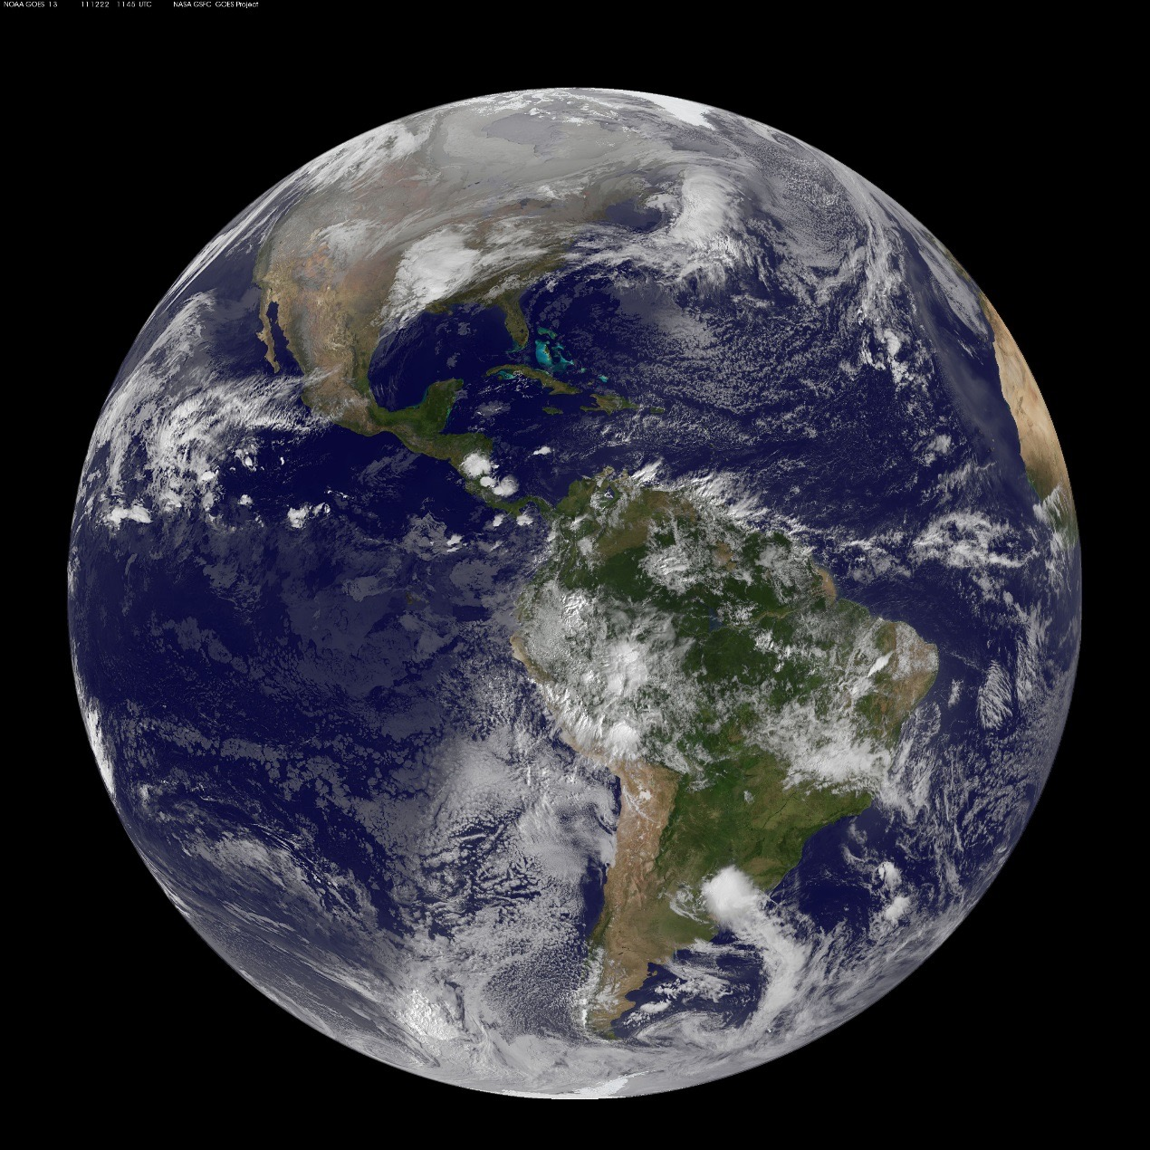
Home.
Notes:
http://www.soglutheran.org/helpinghands.htm

Slide 8
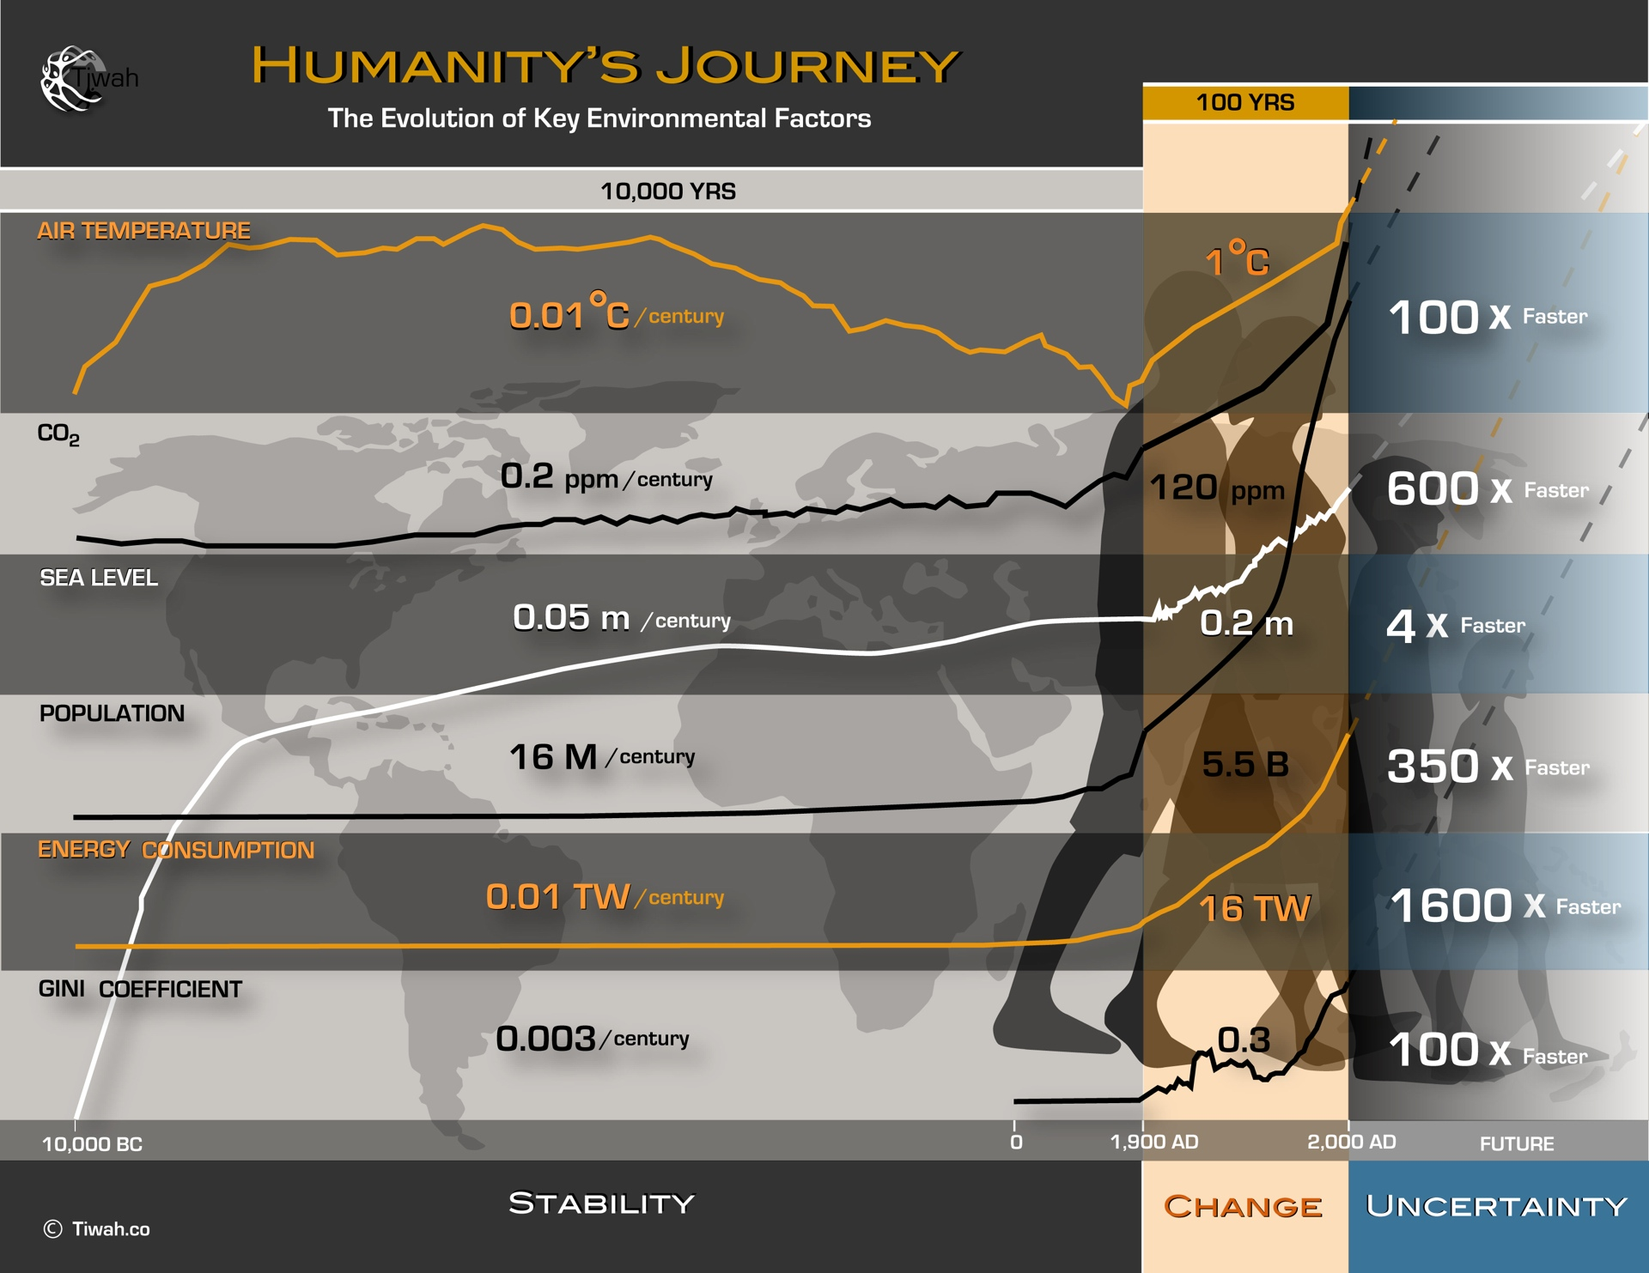
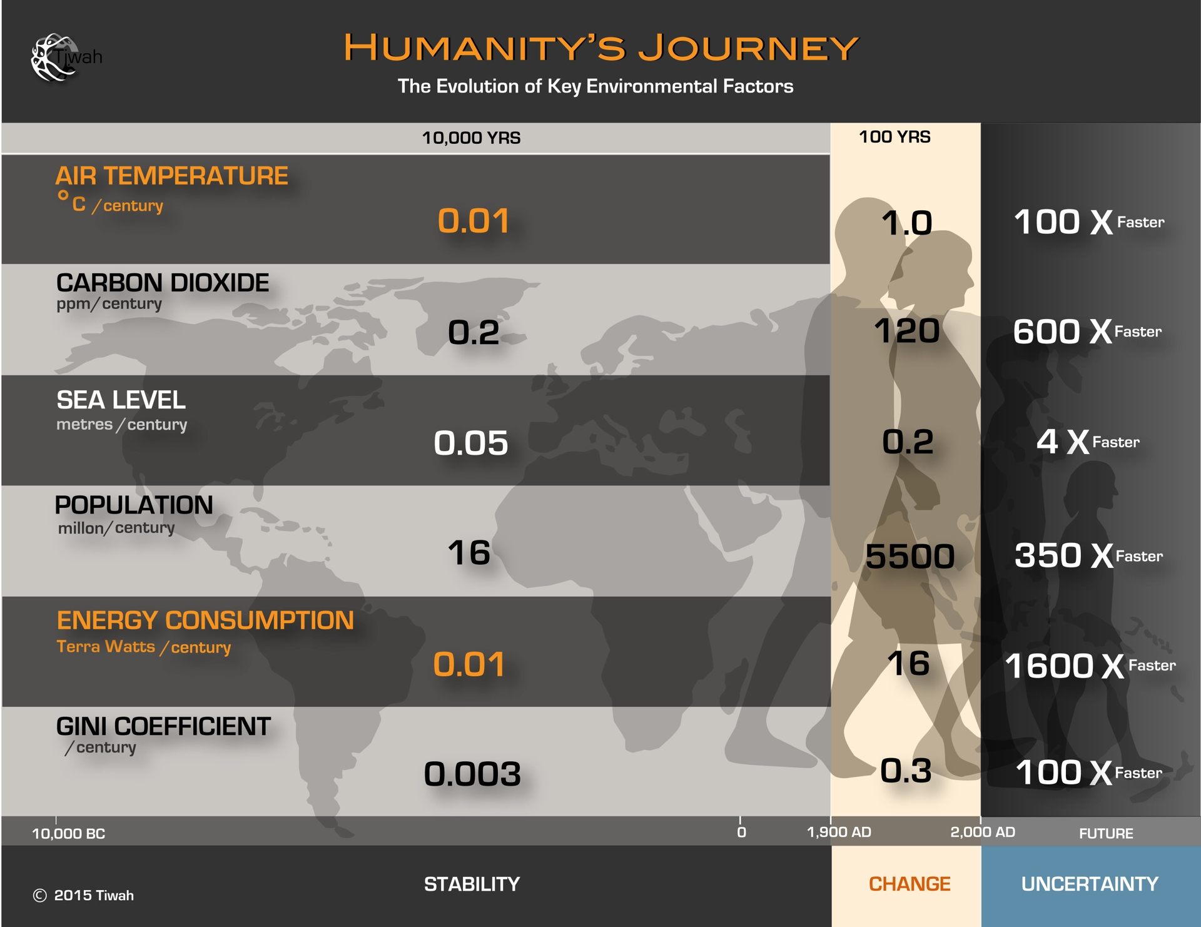
Humanity is in the “Emergency Room”
Best news from the Emergency Room?
“The patient is stable”
Holocene
20th and 21st Century
Future

Slide 9

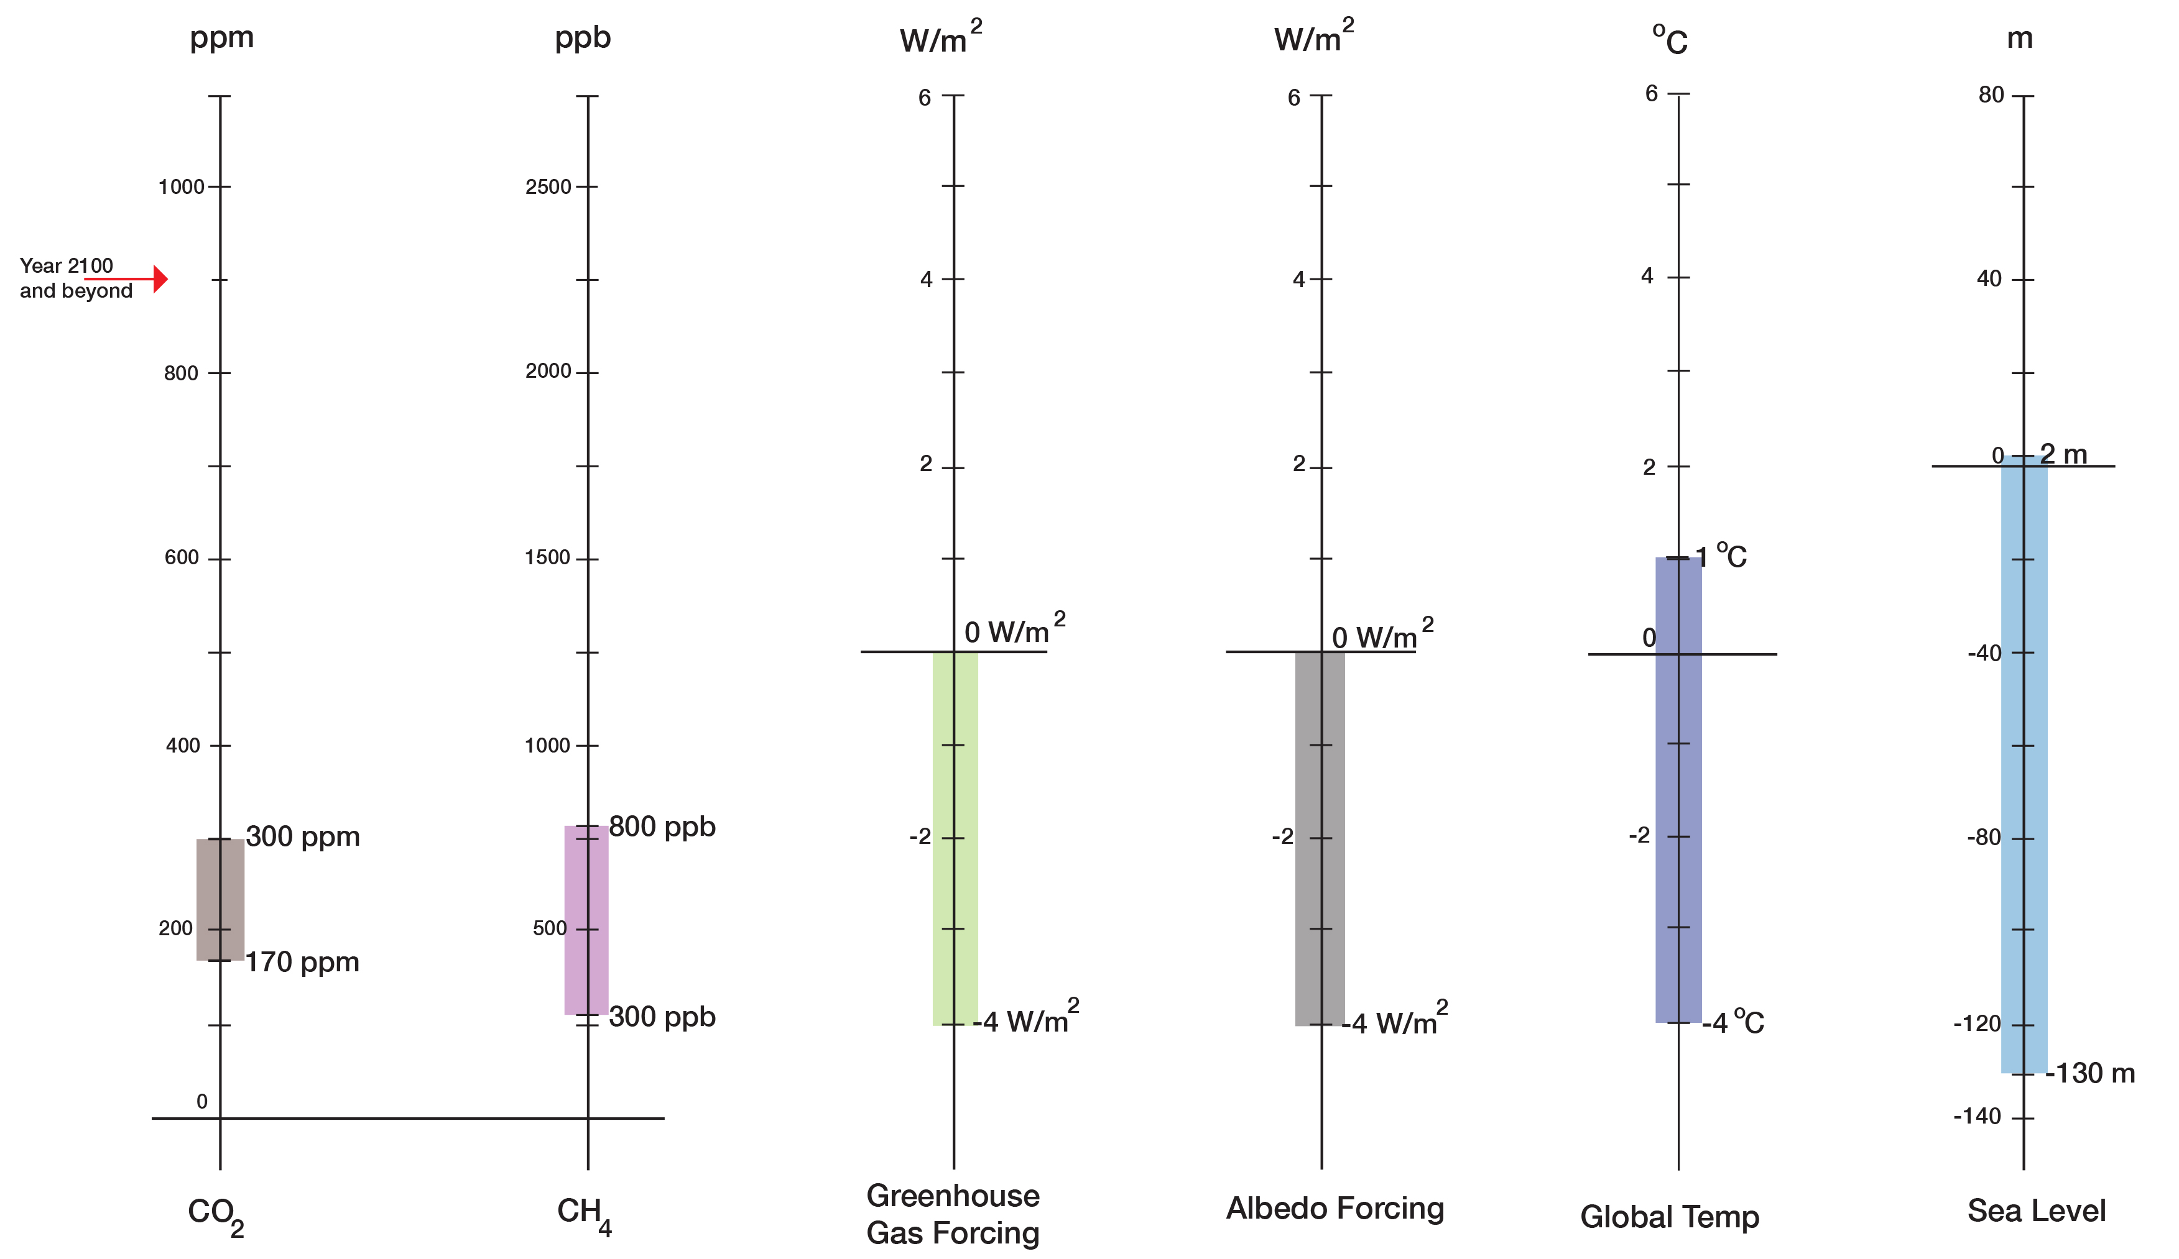
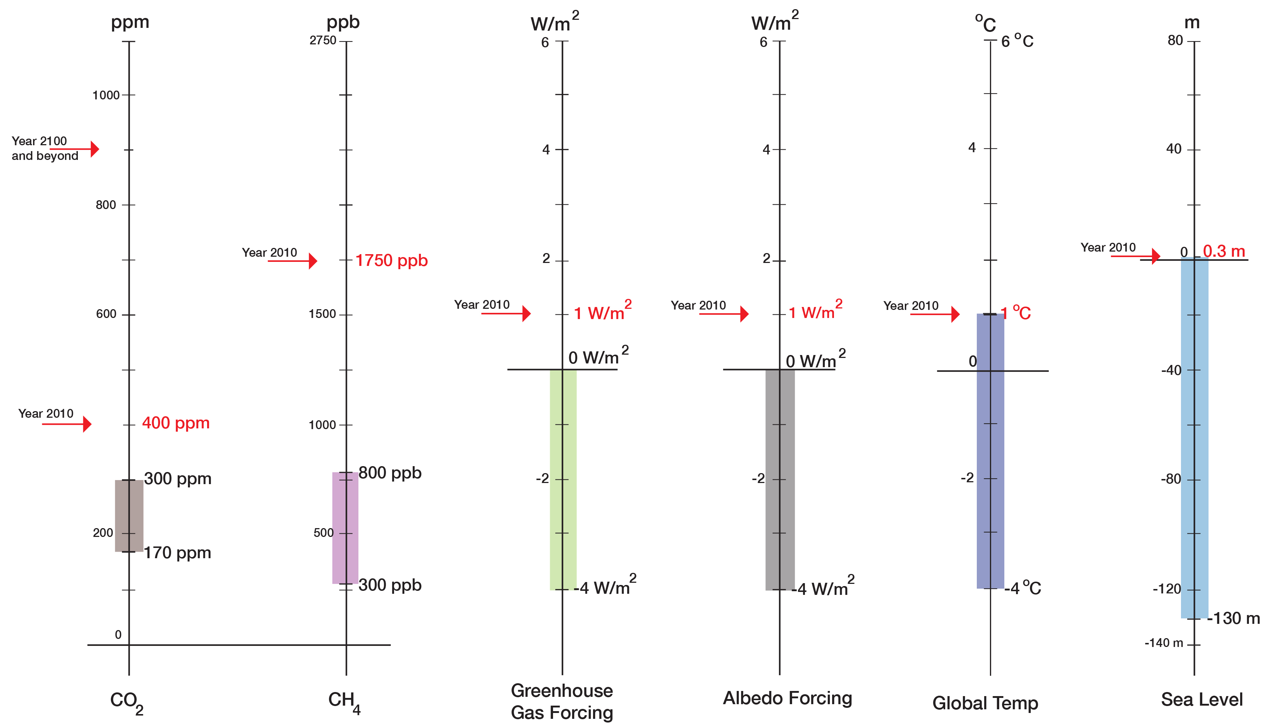
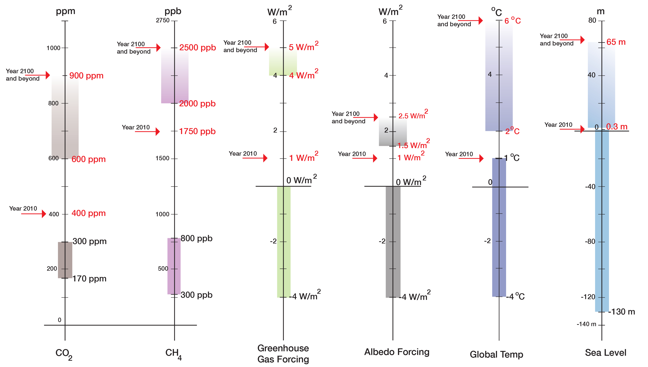
“Prognosis”
“Current State”
“Normal Range”
(800,000 years)

