Slide 1
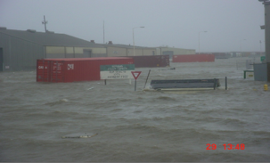
Building seaport resilience to climate change: Stakeholder perceptions of strategies from the Ports of Gulfport (MS) and Providence (RI)
Austin Becker, PhD
Assistant Professor of Coastal Planning, Policy, and Design
College of the Environment and Life Sciences
University of Rhode Island
Old Dominion University - European Union Sea Level Rise Conference, October 30-31, 2013
Notes:
I am so excited to be share some of the work I have been doing over the past five years.
I am going to talk to you today about what climate change means for ports and those who depend on them.
I got interested in this through my previous work as a sailing ship captain
Next slide

Slide 2
Ports: Critical, complex, constrained
Critical - Economic engines at every scale
Complex – Multiple stakeholders across space and time
Constrained - Dependent on specific and environmentally-sensitive locations
(Asariotis and Benamara 2012; Notteboon and Winkelmans 2003; EPA 2011; AAPA 2013)
Notes:
CRITICAL
>80% of world freight moves by ship
13 million U.S. jobs, critical resources, facilitate trade of goods and energy
COMPLEX
Public/private, overlapping jurisdictions, long lifespans
CONSTRAINED
Deep water, protective harbors, multi-modal connections
Estuaries or river deltas that provide ecosystem services
DISTINCT MANAGEMENT CHALLENGE ON A NORMAL DAY

Slide 3
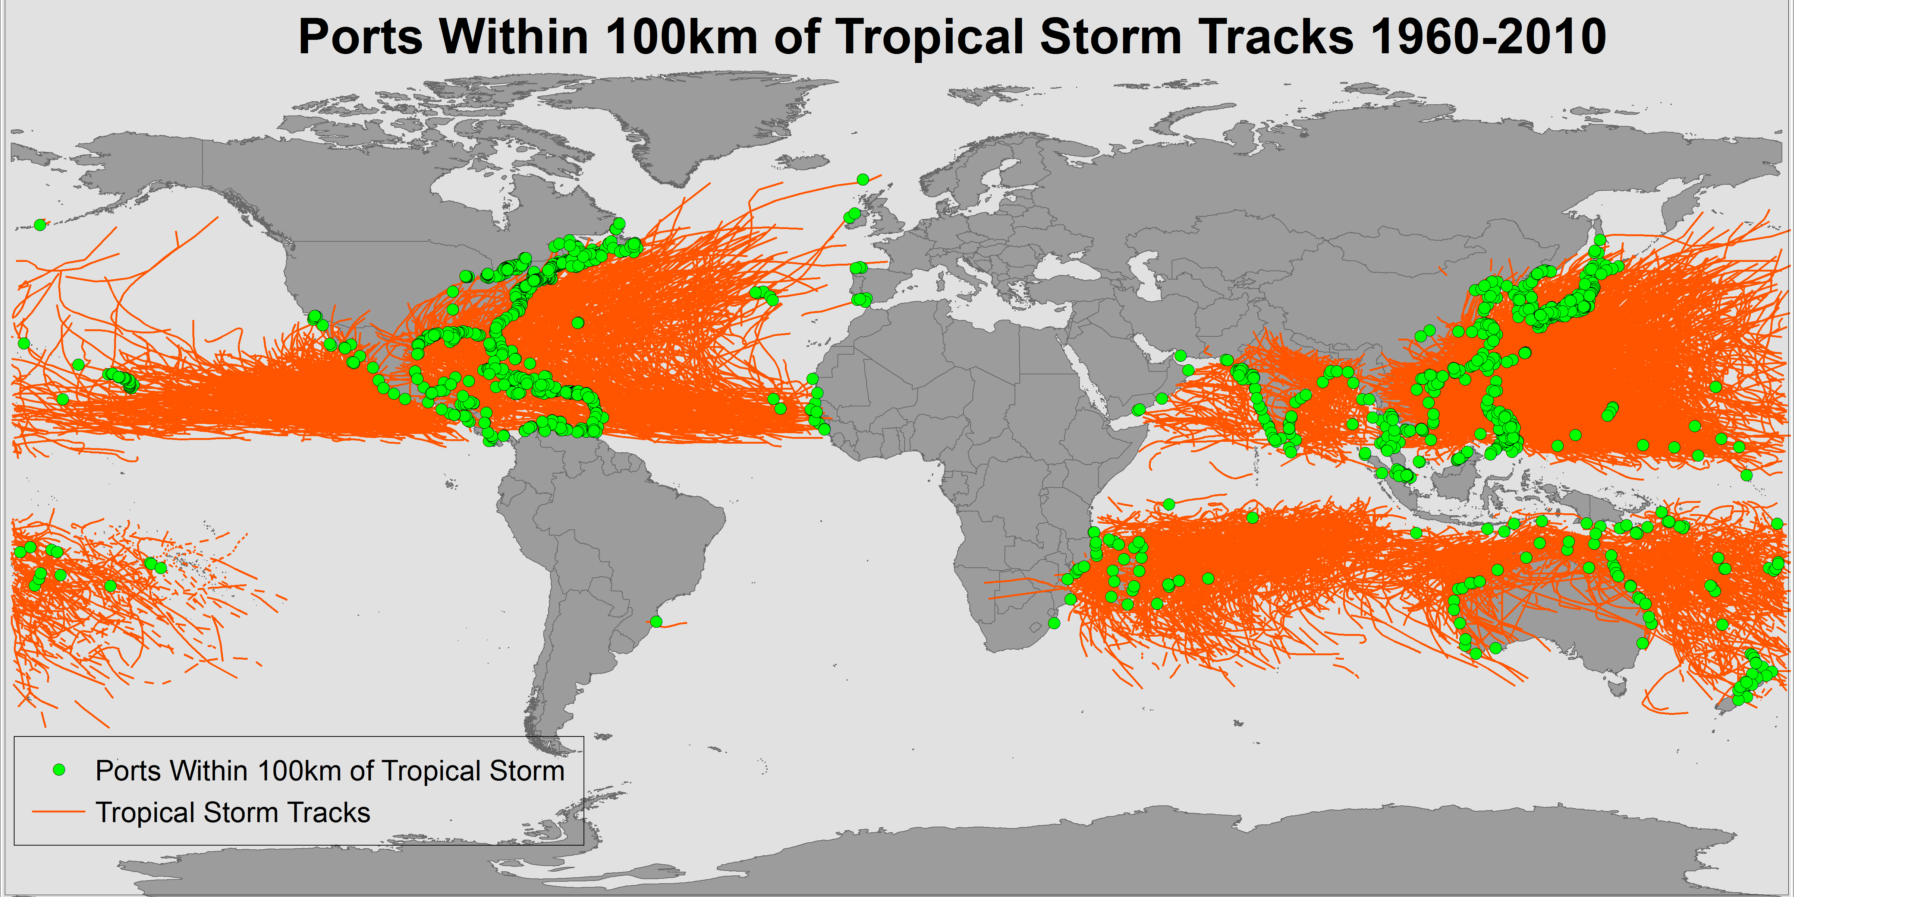
Ports are in harm’s way
Becker, A., et al. (2013), “A note on climate change adaptation for seaports: A challenge for global ports,
a challenge for global society.” Journal of Climatic Change.
Notes:
Sandy shut down NY/NJ for 8 days
5 years after Katrina, Gulfport only up to 80% of pre Katrina business
- Already a problem without climate change
- 32% of the world’s seaports have been come close to a storm in the last 50 years (about 1330 ports)

Slide 4
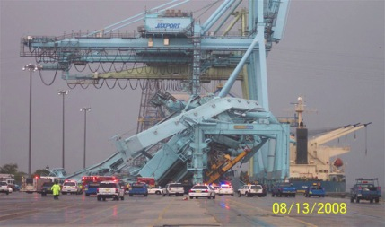
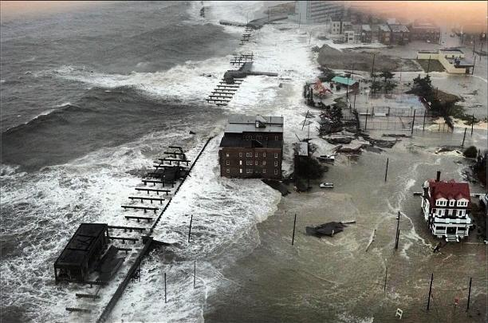
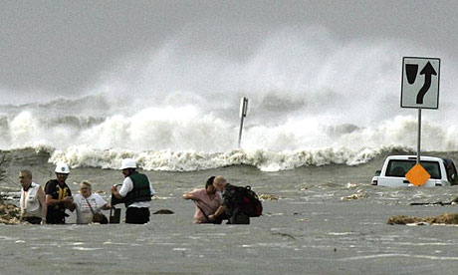
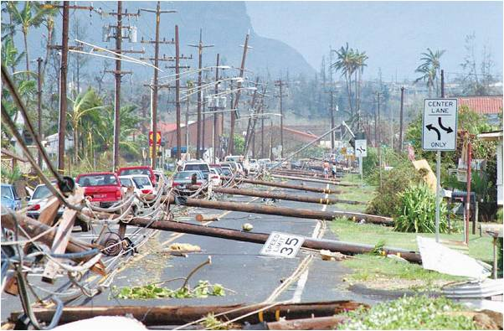
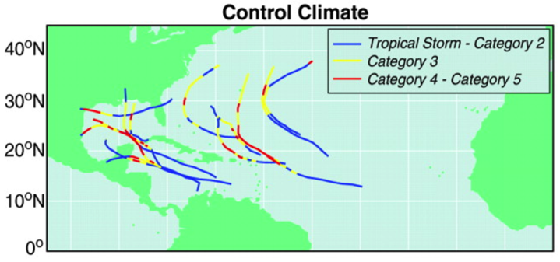
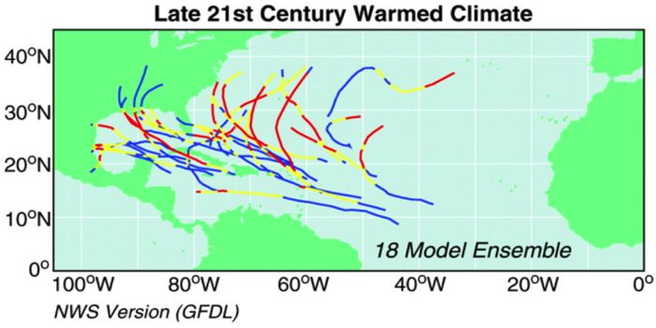
Climate change challenges
http://www.cargolaw.com/2008nightmare_jaxcrane.html
Photograph: Guy Reynolds/Dallas Morning News/AP
Doubling of Cat 4 and 5 tropical storms
1-in-100 year storm event of today
1-in-3 year storm event of 2100
Sea levels to rise 0.75 – 1.9 meters by 2100
(Images from Bender et al. 2013)
Inland flooding
4
(Bender et al. 2010; Grinsted et al. 2013; Rahmstorf 2010; Emanuel 2013; IPCC 2012; Tebaldi et al. 2012)
Notes:
Distracting text
If a 1 in 100 year storm becomes a 1 in 3 year event, port like Gulfport could mean losses on the order of Esteban’s study
Risks are increasing, costs are increasing
String in narrative of costs here….
Sandy shut down port of NY/NJ for 8 days
Katrina caused $100m in direct damages to Mississippi’s ports

Slide 5
An “ideal” resilient port system
Robust port and connecting infrastructure withstands shock of hurricanes
Redundancy allows for substitutions and alternate choices
Capacity to mobilize resources to handle an emergency
Quick resumption of normal conditions
Minimal social disruption, economic losses, and environmental harm
(Smythe 2013; Bruneau et al 2003)
Notes:
Can conceptualize it as having these qualities
Do not yet have a good definition of this. Means different things to different people. Including
Economic, physical, social, environmental
QUESTION – WHAT IS A MEASURE OF RESILIENCE? HOW LONG SHOULD IT TAKE TO BOUNCE BACK?
STRUGGLING WITH HOW WE DEFINE SUCCESS.
COMMUNITY NOT IN A POSITION TO PUT HARD NUMBERS ON THE MEASURES AND SUCCESSES
DEMARKATING THE PROBLEM SPACE
Next slide, how do we get there?
----- Meeting Notes (8/13/13 18:52) -----
This isn't defined,
Here's what I am proposing
Guidepost

Slide 6
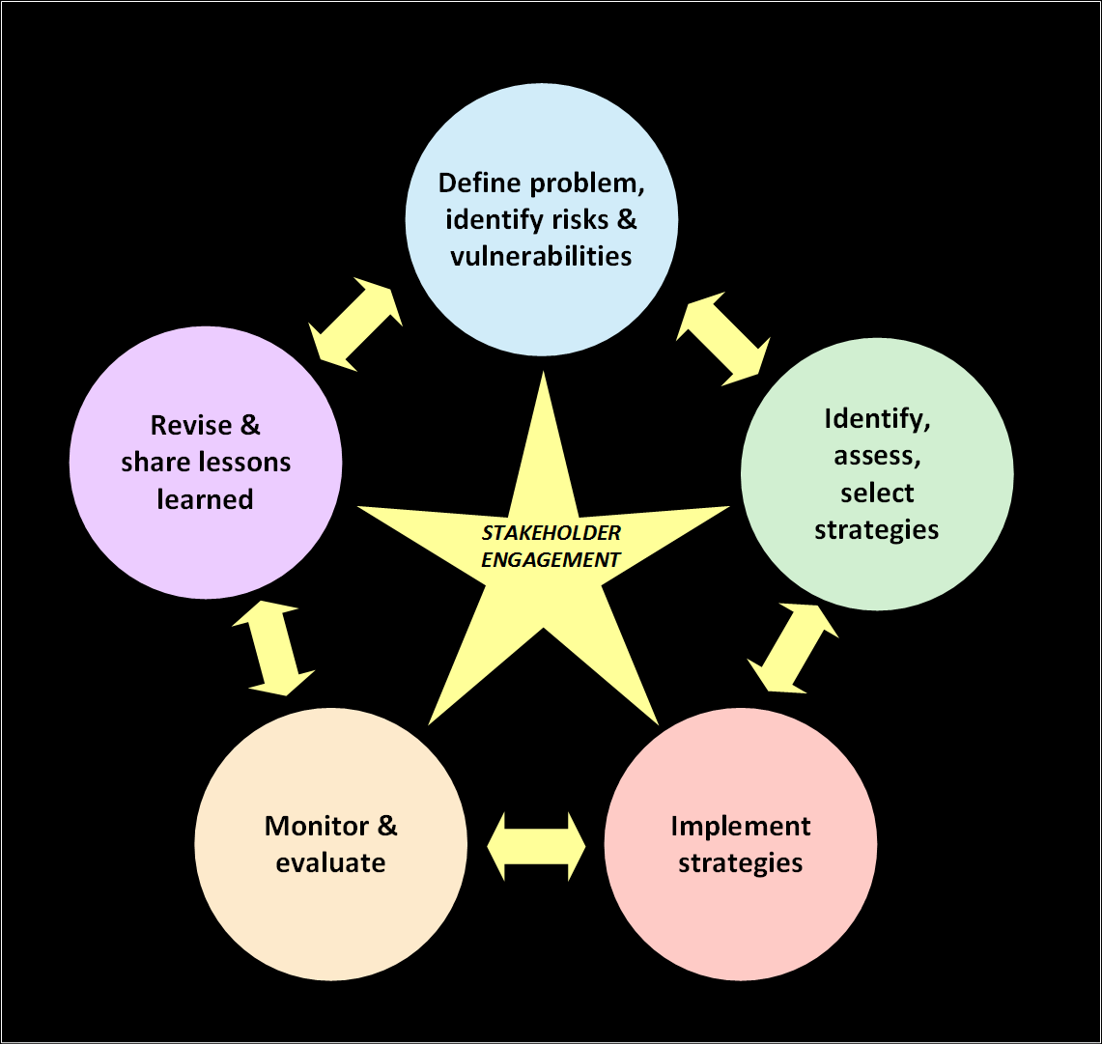
How do we get to resilience?
UNDERSTANDING
MANAGING
THE
PROBLEM
PLANNING/DECISION
MAKING
(Moser and Ekstrom 2010)
Notes:
Number these?
Planned adaptation process
Type of adaptation we're thinking about for ports
This is one way
Customize it -
identify stakeholders
----- Meeting Notes (8/13/13 18:52) -----
Get rid of shading and make solid colors

Slide 7
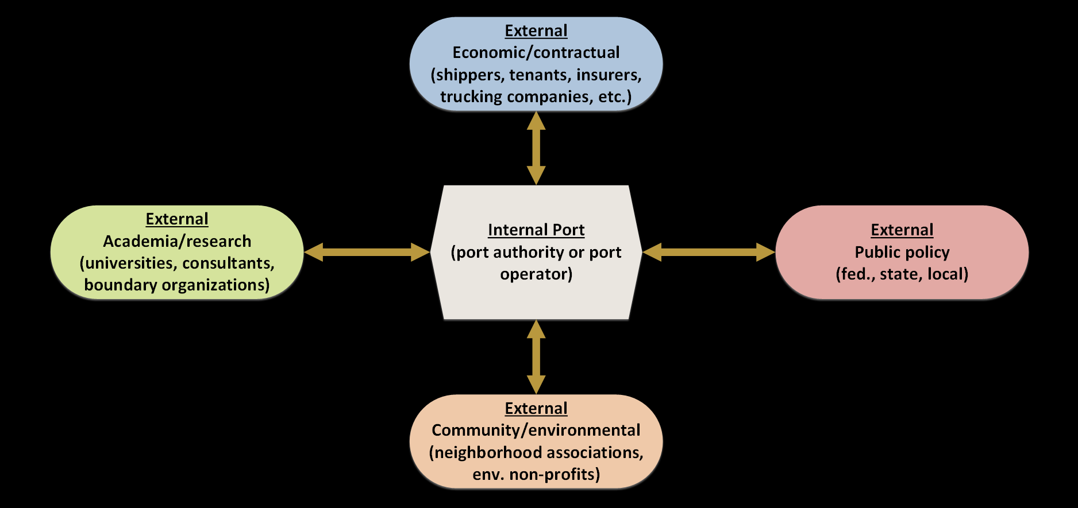
The seaport stakeholder cluster
Generate profits
Facilitate commerce
Steward for public health/well being
Environmental protection
Provide research assistance
Generate new knowledge
Generate profit
Make port an economic engine
Create jobs
Protect adjacent communities
Environmental advocacy
(Winkelmans and Notteboom 2007)
Notes:
Give examples
Distinction I should make is they are trying to generate profit for the PORT, economic/contractual for their own firms
Says who has motivation, willingness to pay, can pick up and move
Some actors are amorphous, are there too many actors?
Bounding is very difficult.
Winkelmans Wan, T., (2007) Port master planning: Balancing stakeholders’ interests. In: Dobrowolski K, Zurek, J. (ed) The reality and dilemmas of globalization. Gdansk: The Foundation of the Development of
Gdansk University.

Slide 8
How can stakeholders of a port contribute to port resilience?

Slide 9
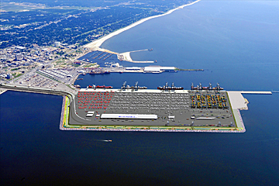
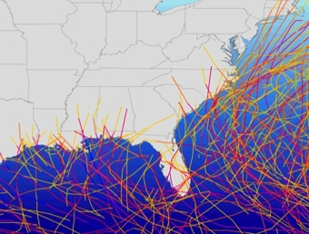
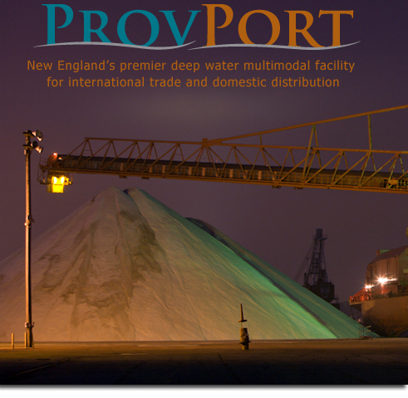
Case study selection
1) GULFPORT, MS
2) PROVIDENCE, RI
Port of Gulfport
High vulnerability
Recent hurricane (Katrina)
Unique resilience strategy
High vulnerability
NO recent hurricane
Adaptation focus
Access
Becker, A., Matson, P., Fischer, M. (in review), “A method and typology to assess impacts of hurricanes on seaport stakeholder clusters: A case study of Gulfport (MS) and Providence (RI).” Progress in Planning.
Notes:
Not a comparative
Mention rationale for choosing Providence
----- Meeting Notes (8/1/13 11:40) -----
Why these two cases…
Justify these two case studies better
Both vulnerable
Key differences
Unique characteristics
Choosing case studies
two strong messages
Gulfport has experience in storm recently
Providence does not, but are planning
Access
Know the port, know the people, had access
Their vulnerability makes them a best case to look at
Especially vulnerable, but vary in recent exposure.

Slide 10
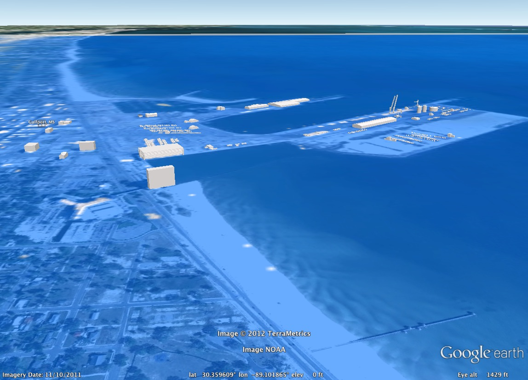
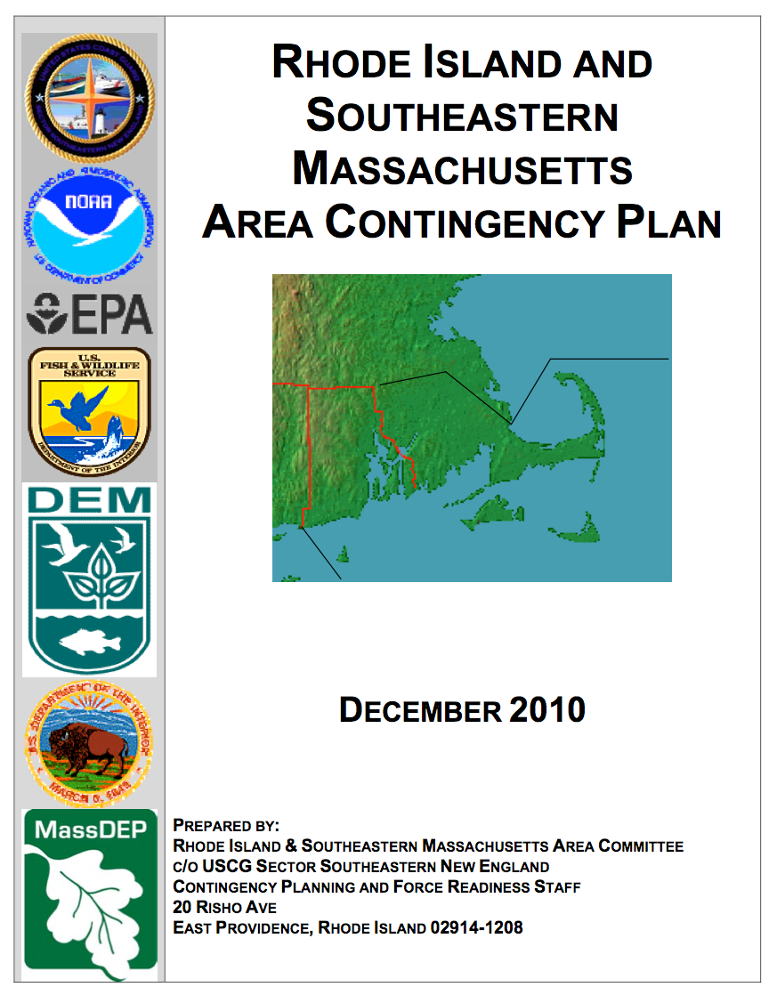
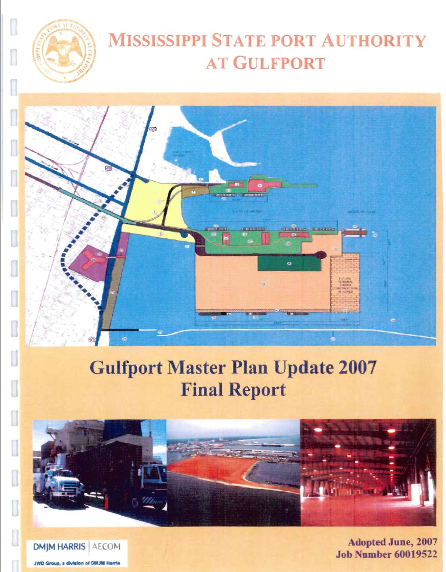
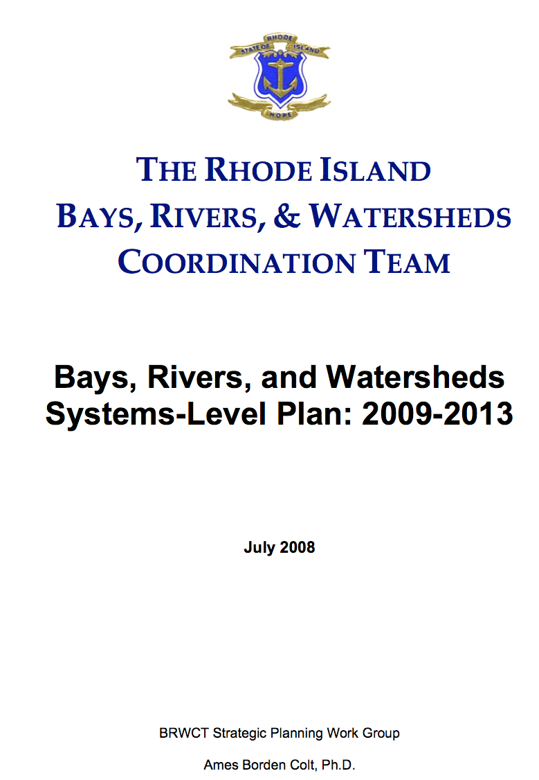
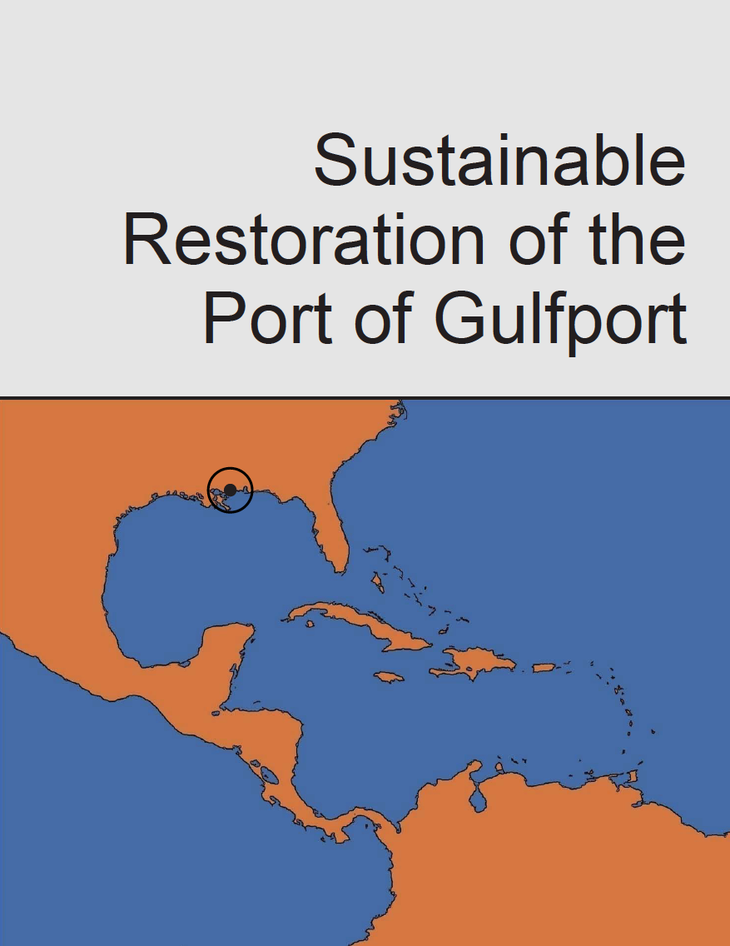
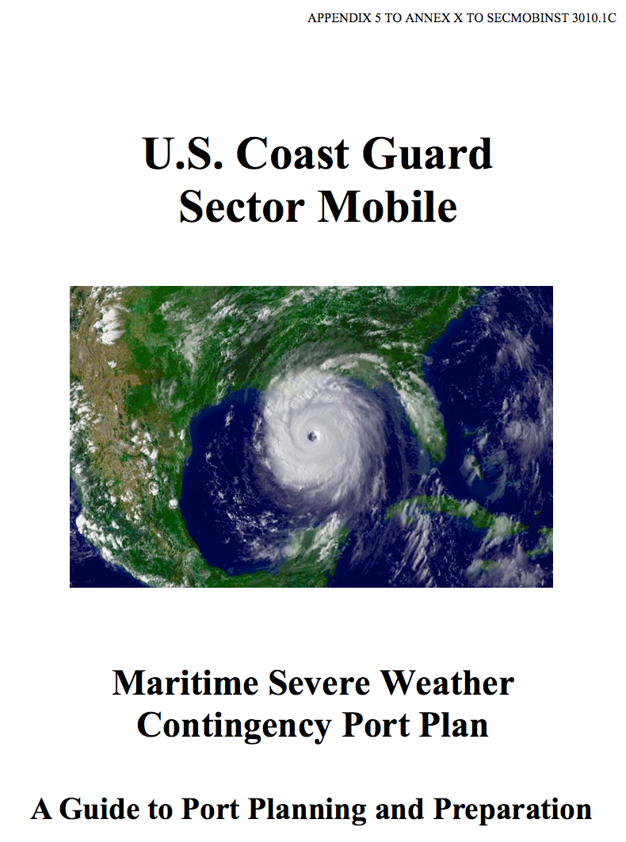
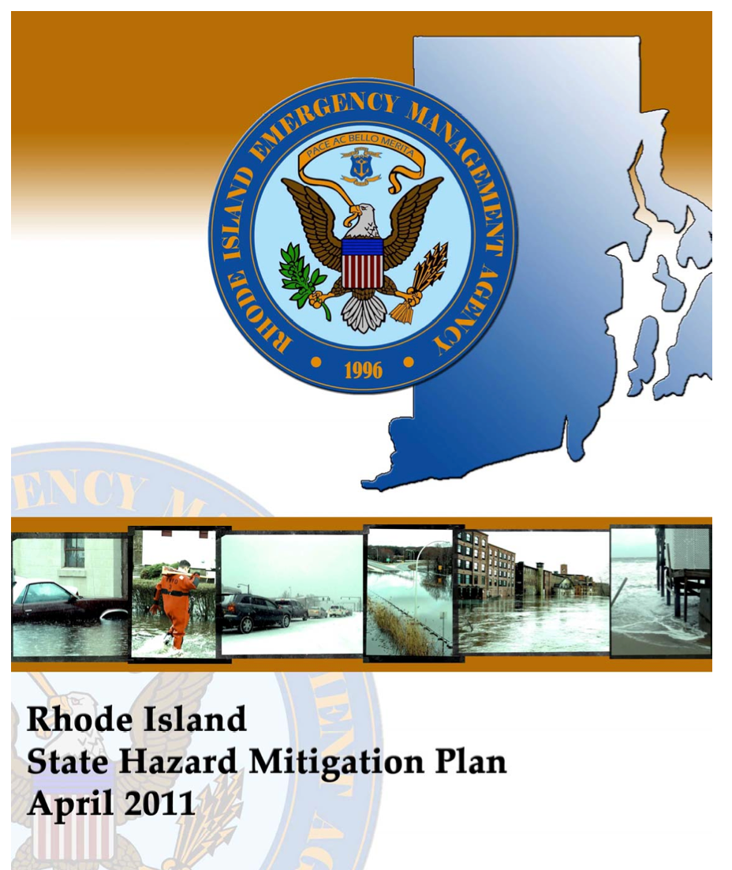
Case study methods
1. Create hurricane scenario (Chermack 2004; Tompkins et al 2008)
2. Identify port stakeholders (30 Gulfport, 27 Providence)
3. Interview stakeholders on storm impacts & resilience strategies
4. Review planning/policy documents (16 Gulfport, 6 Providence)
5. Code data (Nvivo)
Notes:
955 Pages of transcripts from interviews…
Chermack T (2004) Improving decision-making with scenario planning. Futures 36 (3):295-309
Tompkins E, Few R, Brown K (2008) Scenario-based stakeholder engagement: Incorporating stakeholders preferences into coastal planning for climate change. Journal of environmental management 88 (4):1580-1592
Charmaz K (2003) Qualitative interviewing and grounded theory analysis. Inside interviewing: New lenses, new concerns:311-330
----- Meeting Notes (8/13/13 18:52) -----
Say we developed

Slide 11
What strategies could
build resilience for the port?
Notes:
Mention transformation vs. incremental
-

Slide 12
Examples (Off port land)
Build a breakwater or dike
Elevate connecting infrastructure
Move the port
Examples (On port lands)
Build with better materials
Design structures to be submersible
Notes:
Based on jurisdiction mandate management responsibilities
Need to mention how I used expert judgment

Slide 13
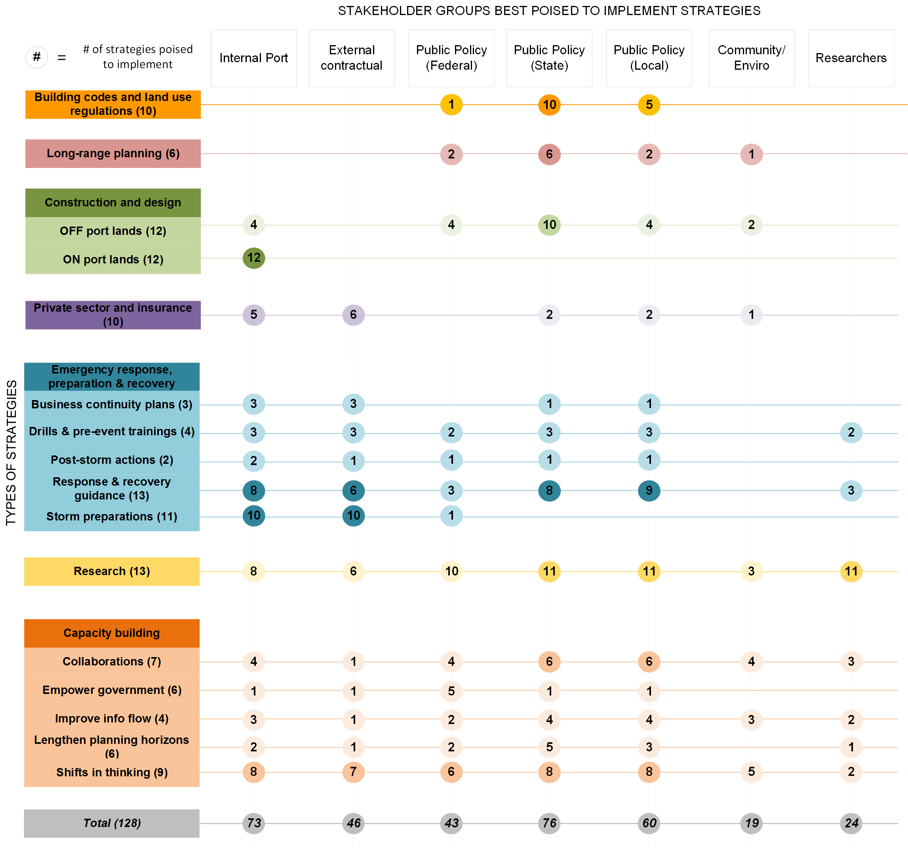
Notes:
Implications:
- since port has control, they are best positioned
- partly the explanation for why nothing has been done
- other stakeholder don’t understand the problem yet
But in construction and design of ports, you’d want a greater diversity of stakeholders to weigh in
What methods you use to assign domains of responsibility to the stakeholders
Also a tool for problem identification
----- Meeting Notes (8/13/13 18:52) -----
say what circles mean
i've highlighted hightest numbers
Distribution of interviews

Slide 14
Summary
128 strategies identified in Gulfport and Providence.
Internal and external stakeholders can implement strategies to build port resilience.
The port, state, and local government positioned to implement the highest number.
Becker A, Caldwell M, Matson P (in prep.) Building seaport resilience in the face of climate change: What role for port stakeholders? (Working title).

Slide 15
Questions raised, future work
Who should/can lead?
How can stakeholder clusters share information and resources to build resilience?
On what timeline should adaptation strategies be implemented?
Implementation and assessment of decision support tools for multi-criteria decision analysis
(Haymaker and Chachere 2006)
Notes:
$60-80Billion to elevate 426 US Ports
Mention URI
Presented parts of this work at many conferences
Met with many stakeholders, like any new research area, it raises many more questions such as…
For practitioners, planners, researchers, investors
Problem space/Solution space with future works….
Scale
Only the beginning of understanding the problem space
----- Meeting Notes (8/8/13 12:13) -----
streamline…
motivations
priorities
scale
jurisdictions
Moving into implementation…
Mention students

Slide 16
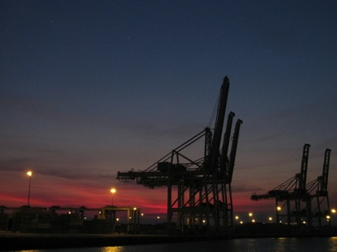
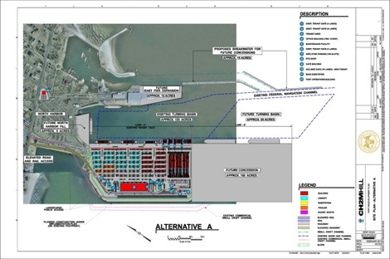
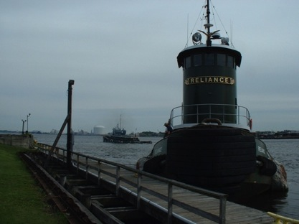
Photo by Austin Becker
www.mspa.com
Photo by Austin Becker
Questions?
Contact Austin Becker abecker@mail.uri.edu
www.stanford.edu/~austinb
Notes:
Say conclusions….
Here’s what I’ve seen.
Ports are complex
Found things that are important xyz
Lots of work to be done etc.

Slide 17
Acknowledgements
Students/interviewees
Ernestine Fu, David Newell, Nathan Chase, Suejung Shin,
all the interviewees in Gulfport and Providence
Faculty/staff/cohort
Pam Matson, Martin Fischer, Meg Caldwell, Mike Mastrandrea
Funding support
Stanford University Graduate Fellowship in Environment and Resources
Stanford University Lieberman Fellowship

Slide 18
References
AAPA (American Association of Port Authorities) (2013) Port Industry Information - Trade and Economic Growth. http://www.aapa-ports.org/Industry/content.cfm?ItemNumber=1024&navItemNumber=1027. Accessed July 4 2013
Asariotis R, Benamara H (eds) (2012) Maritime Transport and the Climate Change Challenge. Earthscan/Routledge, New York, NY
Becker A, Acciaro M, Asariotis R, Carera E, Cretegny L, Crist P, Esteban M, Mather A, Messner S, Naruse S, Ng AKY, Rahmstorf S, Savonis M, Song D, Stenek V, Velegrakis AF (2013) A Note on Climate change adaptation for seaports: A challenge for global ports, a challenge for global society. Climatic Change. doi:10.1007/s10584-013-0843-z
Becker A, Caldwell M, Matson P (in prep.-a) Building seaport resilience in the face of climate change: What role for port stakeholders? (Working title).
Becker A, Inoue S, Fischer M, Schwegler B (2012) Climate change impacts on international seaports: knowledge, perceptions, and planning efforts among port administrators. Climatic Change 110 (1-2):5-29. doi:10.1007/s10584-011-0043-7
Becker A, Matson P, Fischer M (in review) Assessing impacts of hurricanes on seaport stakeholder clusters: A case study of Gulfport, Mississippi (USA). Journal of Progress in Planning
Becker A, Matson P, Fischer M, Mastrandrea MD (in prep.-b) Anticipated impacts of hurricanes at the stakeholder cluster scale: A case study of the Port of Providence, Rhode Island (USA).
Bender MA, Knutson TR, Tuleya RE, Sirutis JJ, Vecchi GA, Garner ST, Held IM (2010) Modeled impact of anthropogenic warming on the frequency of intense Atlantic hurricanes. Science 327 (5964):454-458. doi:10.1126/science.1180568
Blodget, H, Wile R (2012) Hey, it will only cost $7 Billion to build a storm surge barrier for New York -- Whaddya say? Business Insider,
Bruneau M, Chang SE, Eguchi RT, Lee GC, O'Rourke TD, Reinhorn AM, Shinozuka M, Tierney K, Wallace WA, von Winterfeldt D (2003) A framework to quantitatively assess and enhance the seismic resilience of communities. Earthquake spectra 19 (4):733-752Bryson JM (2004) What to do when stakeholders matter: Stakeholder identification and analysis techniques. Public management review 6 (1):21-53
Charmaz K (2003) Qualitative interviewing and grounded theory analysis. Inside interviewing: New lenses, new concerns:311-330
Davidson R (1997) An Urban Earthquake Disaster Risk Index.
De Langen PW (2004) The Performance of Seaport Clusters; A Framework to Analyze Cluster Performance and an Application to the Seaport Clusters of Durban, Rotterdam and the Lower Mississippi. Erasmus University Rotterdam,
Emanuel KA (2013) Downscaling CMIP5 climate models shows increased tropical cyclone activity over the 21st century. Proceedings of the National Academy of Sciences 110 (30):12219-12224. doi:10.1073/pnas.1301293110
EPA (United States Environmental Protection Agency) (2008) Planning for Climate Change Impacts at U.S. Ports. White Paper prepared by ICF International for the USEPA.
Freeman RE (2010) Strategic management: A stakeholder approach. Cambridge University Press,
Grinsted A, Moore JC, Jevrejeva S (2013) Projected Atlantic hurricane surge threat from rising temperatures. Proceedings of the National Academy of Sciences. doi:10.1073/pnas.1209980110
Haymaker J, Chachere J (2006) Coordinating goals, preferences, options, and analyses for the Stanford Living Laboratory feasibility study. Intelligent Computing in Engineering and Architecture:320-327
IPCC (Intergovernmental Panel on Climate) (2012) IPCC Special Report on Managing the Risks of Extreme Events and Disasters to Advance Climate Change Adaptation. A Special Report of Working Groups I and II of the Intergovernmental Panel on Climate Change. Cambridge University Press.
McCulloch K (2007) Living at sea: learning from communal life aboard sail training vessels. Ethnography and Education 2 (3):289-303
Moser S, Ekstrom J (2010) A framework to diagnose barriers to climate change adaptation. Proceedings of the National Academy of Sciences 107 (51):22026
NCADAC (National Climate Assessment and Development Advisory Committee) (Draft) National Cimate Assessment. http://ncadac.globalchange.gov/. Accessed July 25 2013
Notteboom T, Winkelmans W (2003) Dealing with stakeholders in the port planning process.
Osthorst W, Mänz C (2012) Types of cluster adaptation to climate change. Lessons from the port and logistics sector of Northwest Germany. Maritime Policy & Management 39 (2):227-248
Rahmstorf S (2010) A new view on sea level rise. Nature Reports Climate Change:44-45
Ratcliff DE (1994) Analytic induction as a qualitative research method of analysis. http://finntrack.co.uk/shift/analytic.pdf. Accessed May 13 2013
Smythe T (2013) Assessing the Impacts of Hurricane Sandy on the Port of New York and New Jersey’s Maritime Responders and Response Infrastructure.
Tebaldi C, Strauss BH, Zervas CE (2012) Modelling sea level rise impacts on storm surges along US coasts. Environmental Research Letters 7 (1):014032
Winkelmans WaN, T., (2007) Port master planning: Balancing stakeholders’ interests. In: Dobrowolski K, Zurek, J. (ed) The reality and dilemmas of globalization. Gdansk: The Foundation of the Development of
Gdansk University.
Notes:
Boin A, McConnell A (2007) Preparing for critical infrastructure breakdowns: the limits of crisis management and the need for resilience. Journal of Contingencies and Crisis Management 15 (1):50-59

Slide 19
EXTRA SLIDES BELOW

Slide 21
Stakeholders interviewed

Slide 22
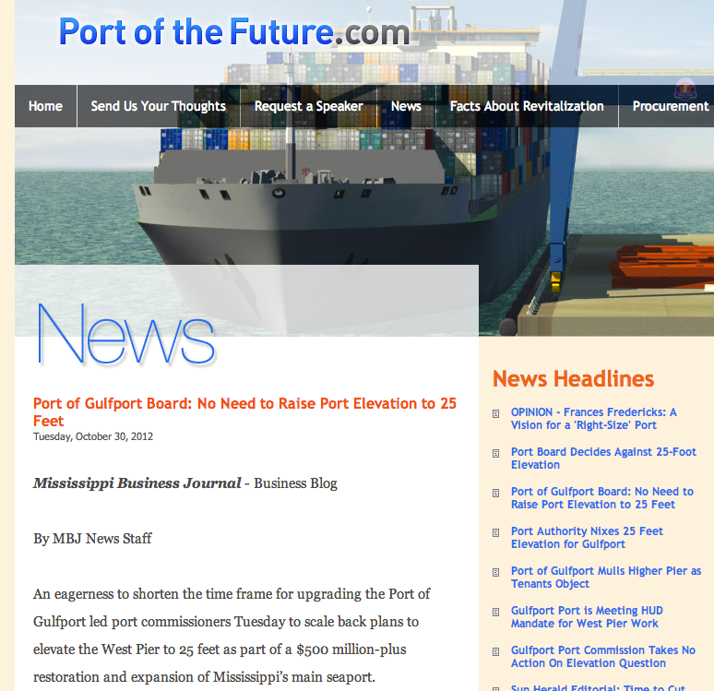
Port decisions do not always account for stakeholder concerns
Oct. 29, 2012
“Super storm” Sandy
Notes:
Wide range of consequences
Gulfport planning documents do not address intangibles
NEED TO ADD CONCLUSION ABOUT PROVIDENCE
External stakeholders bear the costs of indirect costs and intangible consequences
Clear need/opportunity for wider stakeholder engagement in resilience planning
----- Meeting Notes (8/1/13 11:40) -----
Conclusion slide
Example of kind of decsion that is made...
Bring in as conclusion to everything?
----- Meeting Notes (8/8/13 12:07) -----
Start with headline, then add sandy (reverse animation)
Then say why this really matters….
here's how it manifests…
Tone it down a bit…
How much $600m of aid
Tone down irony of Sandy

Slide 23
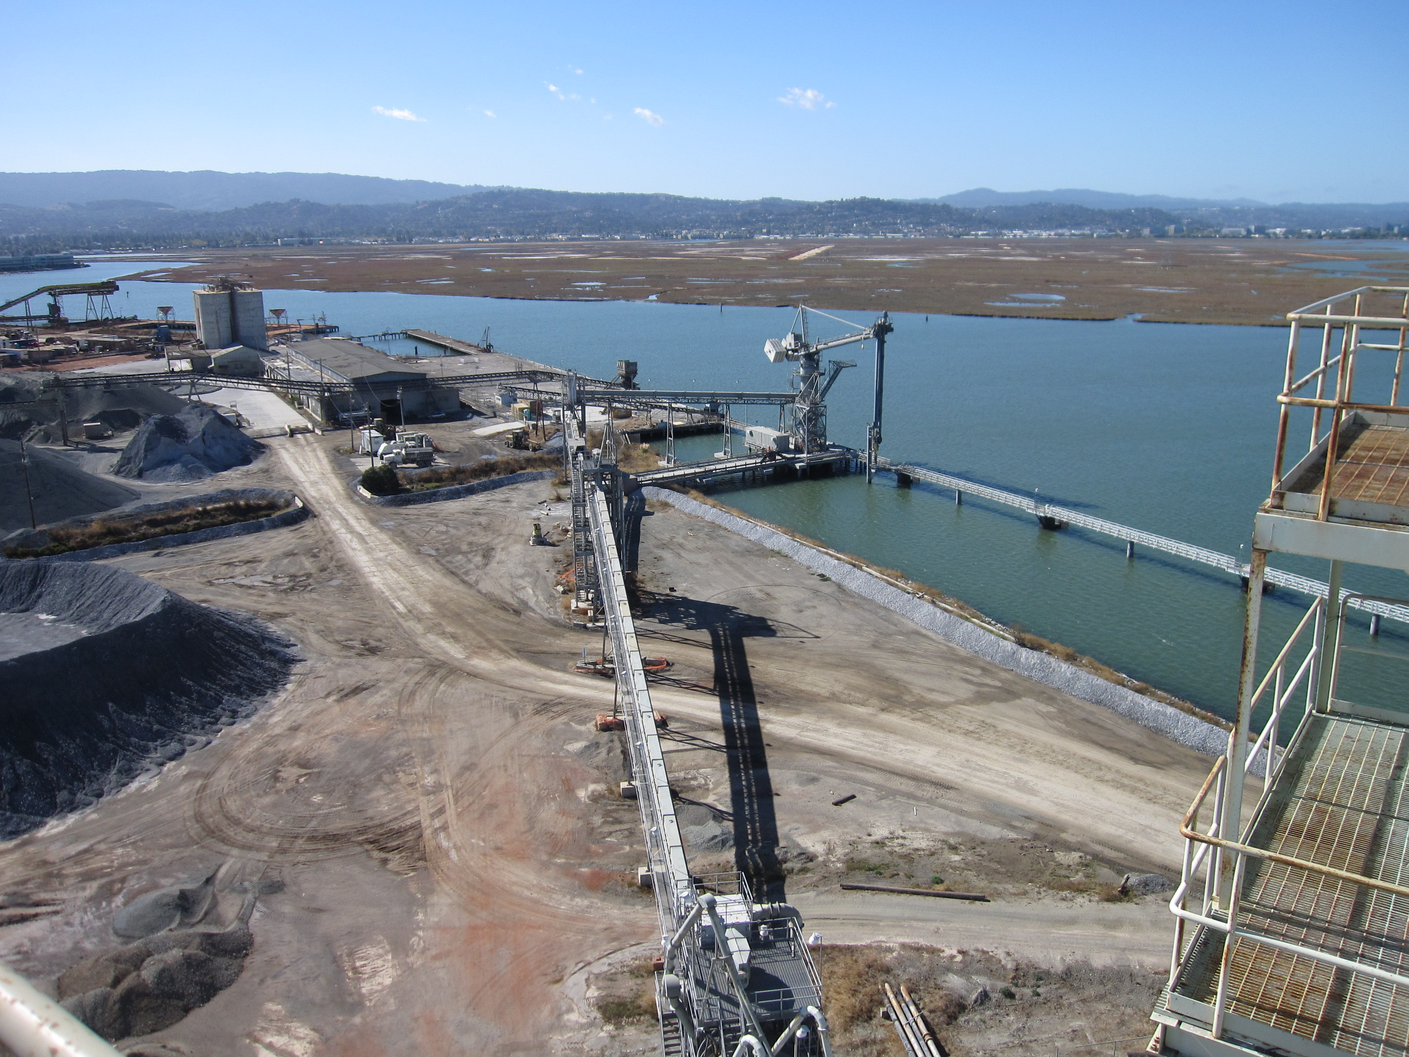
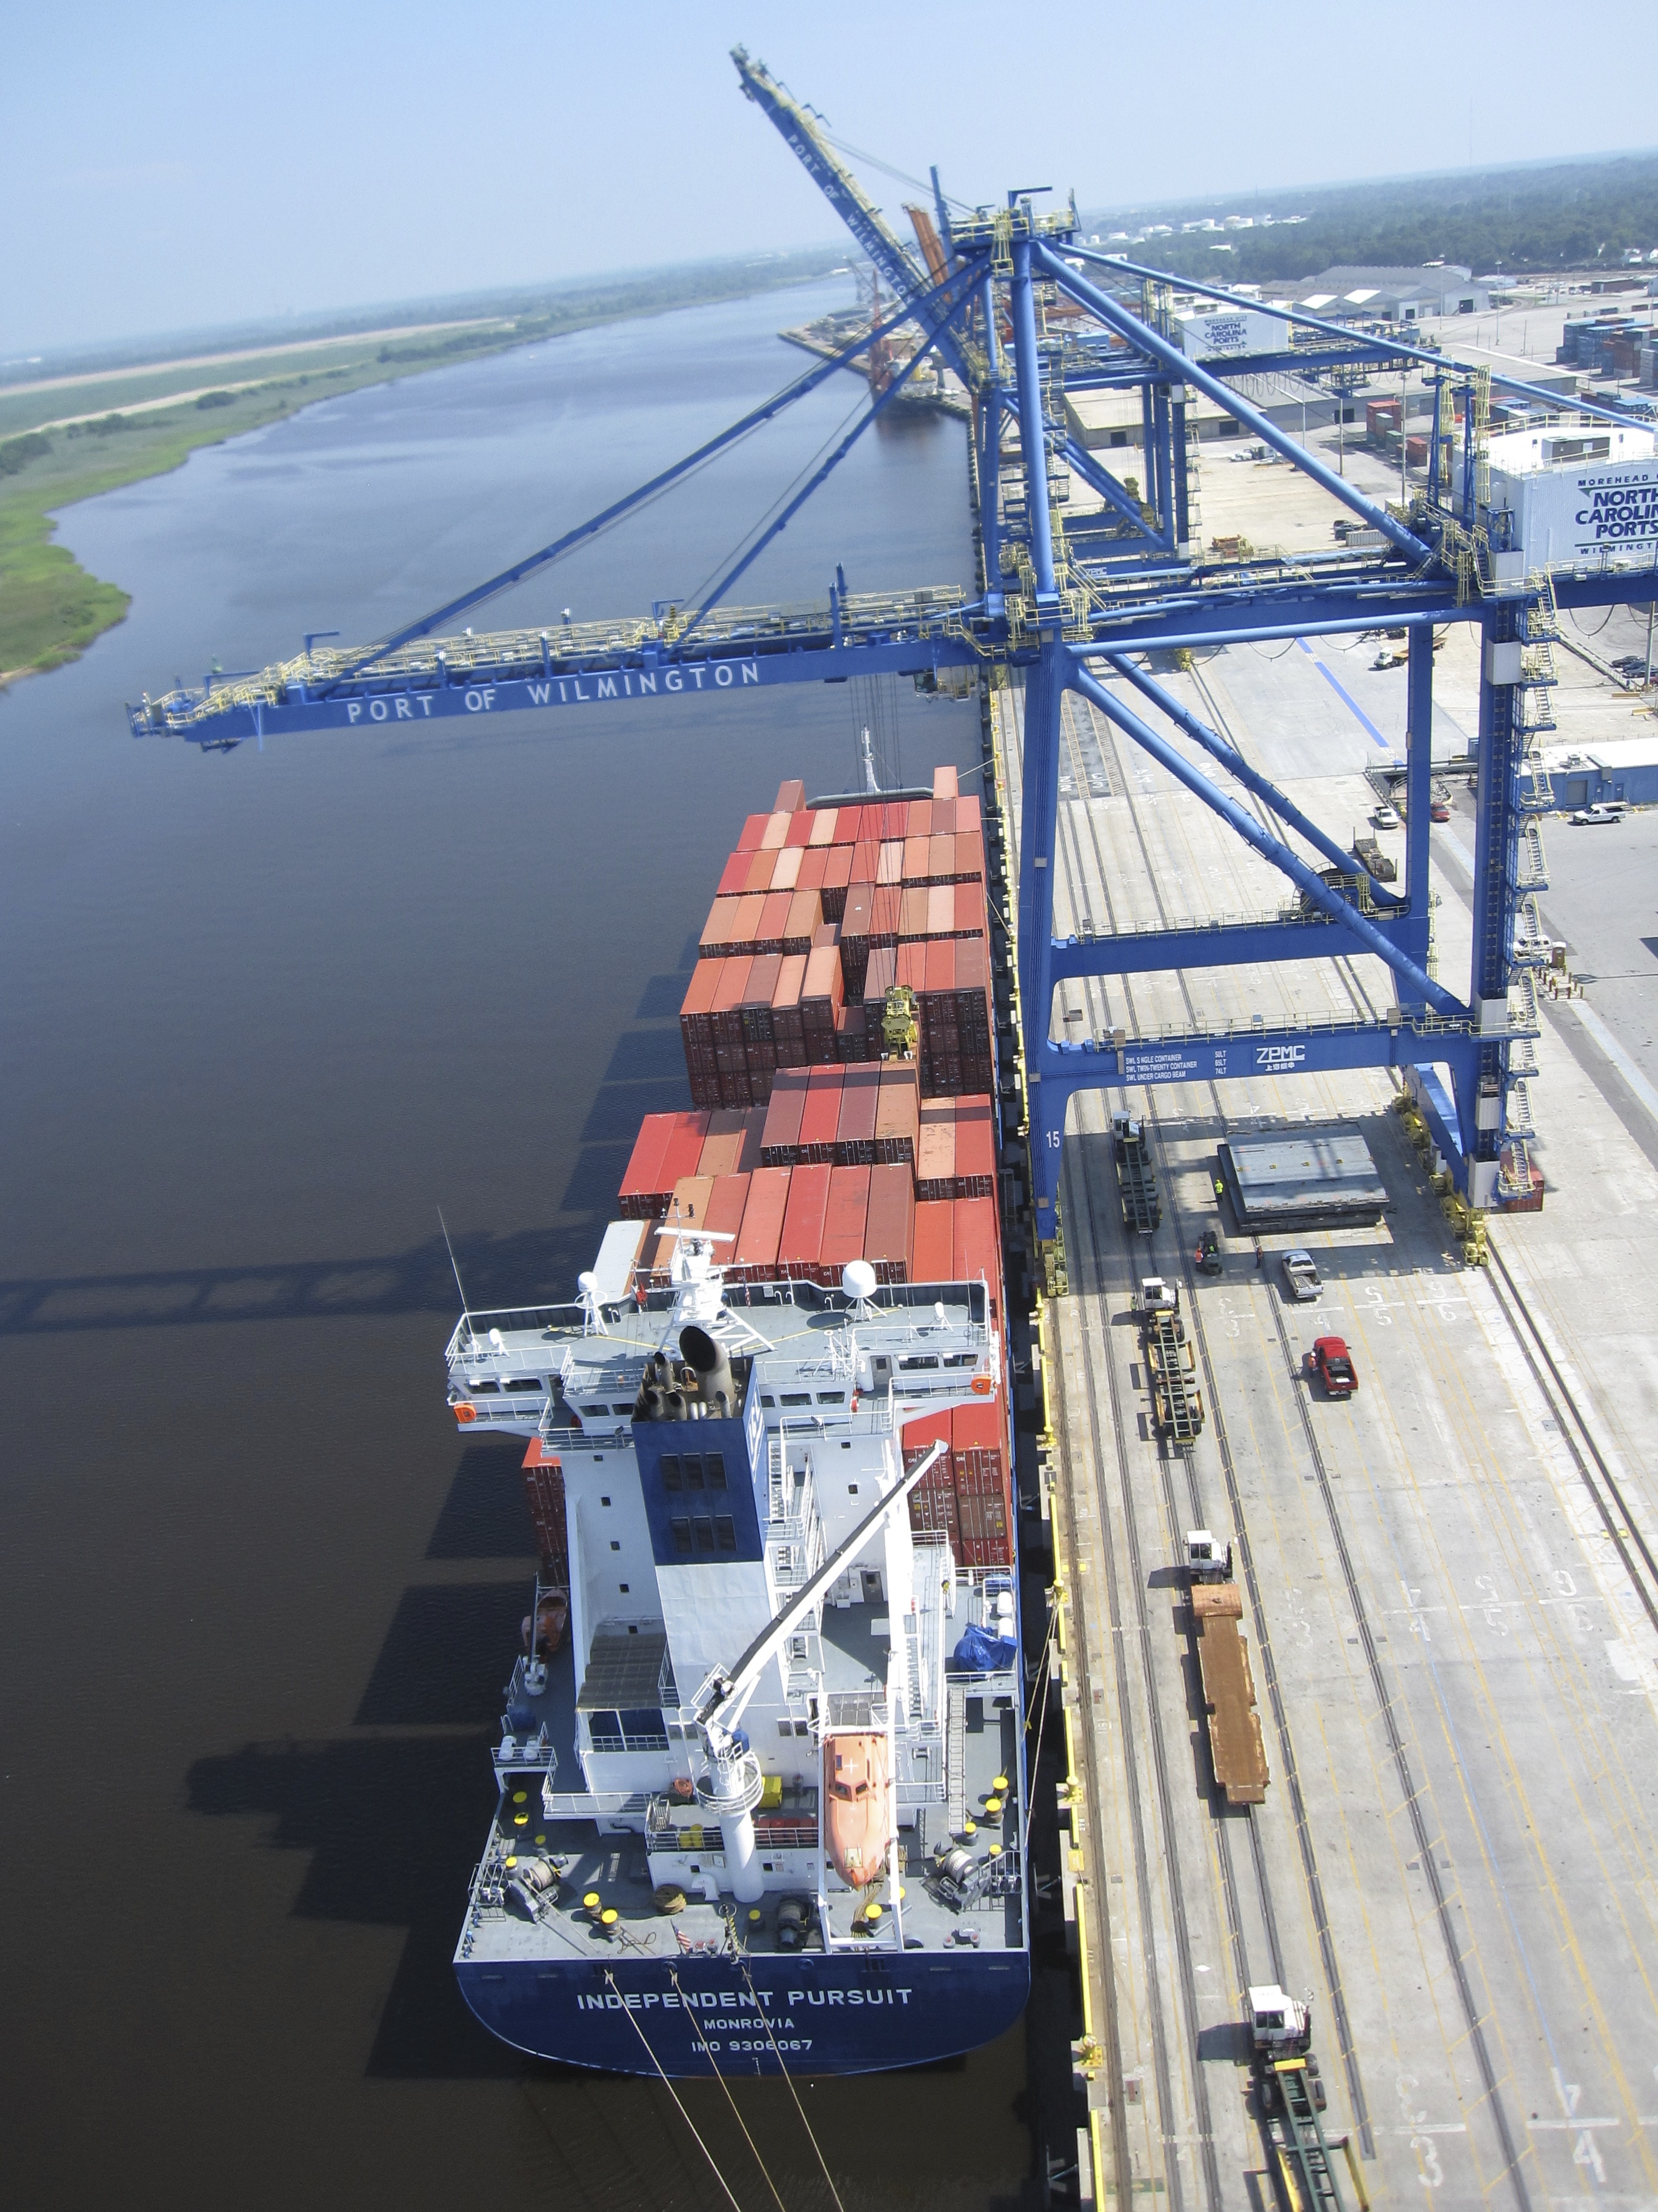
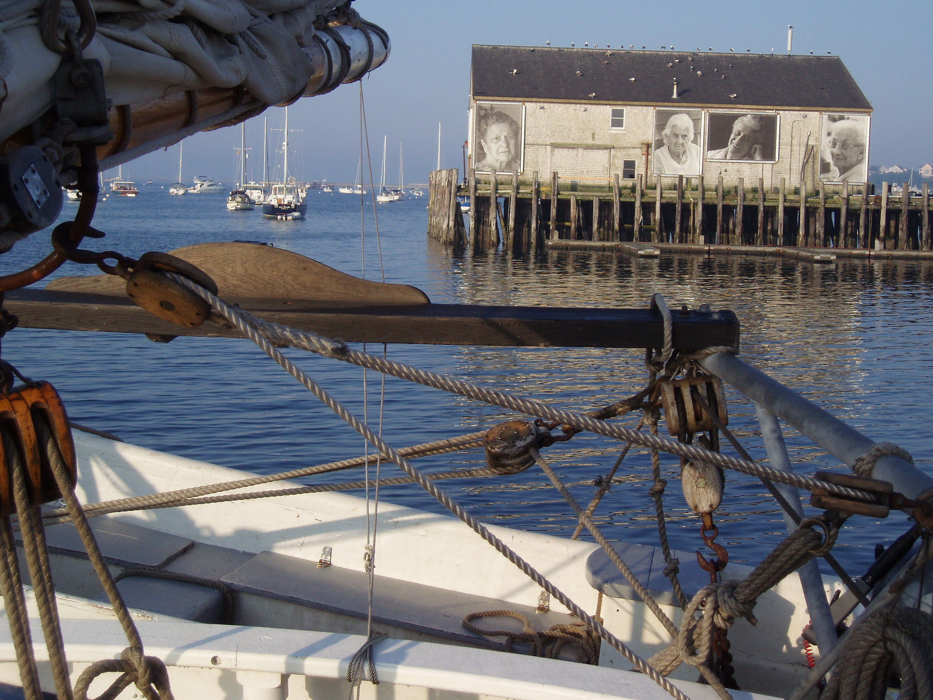
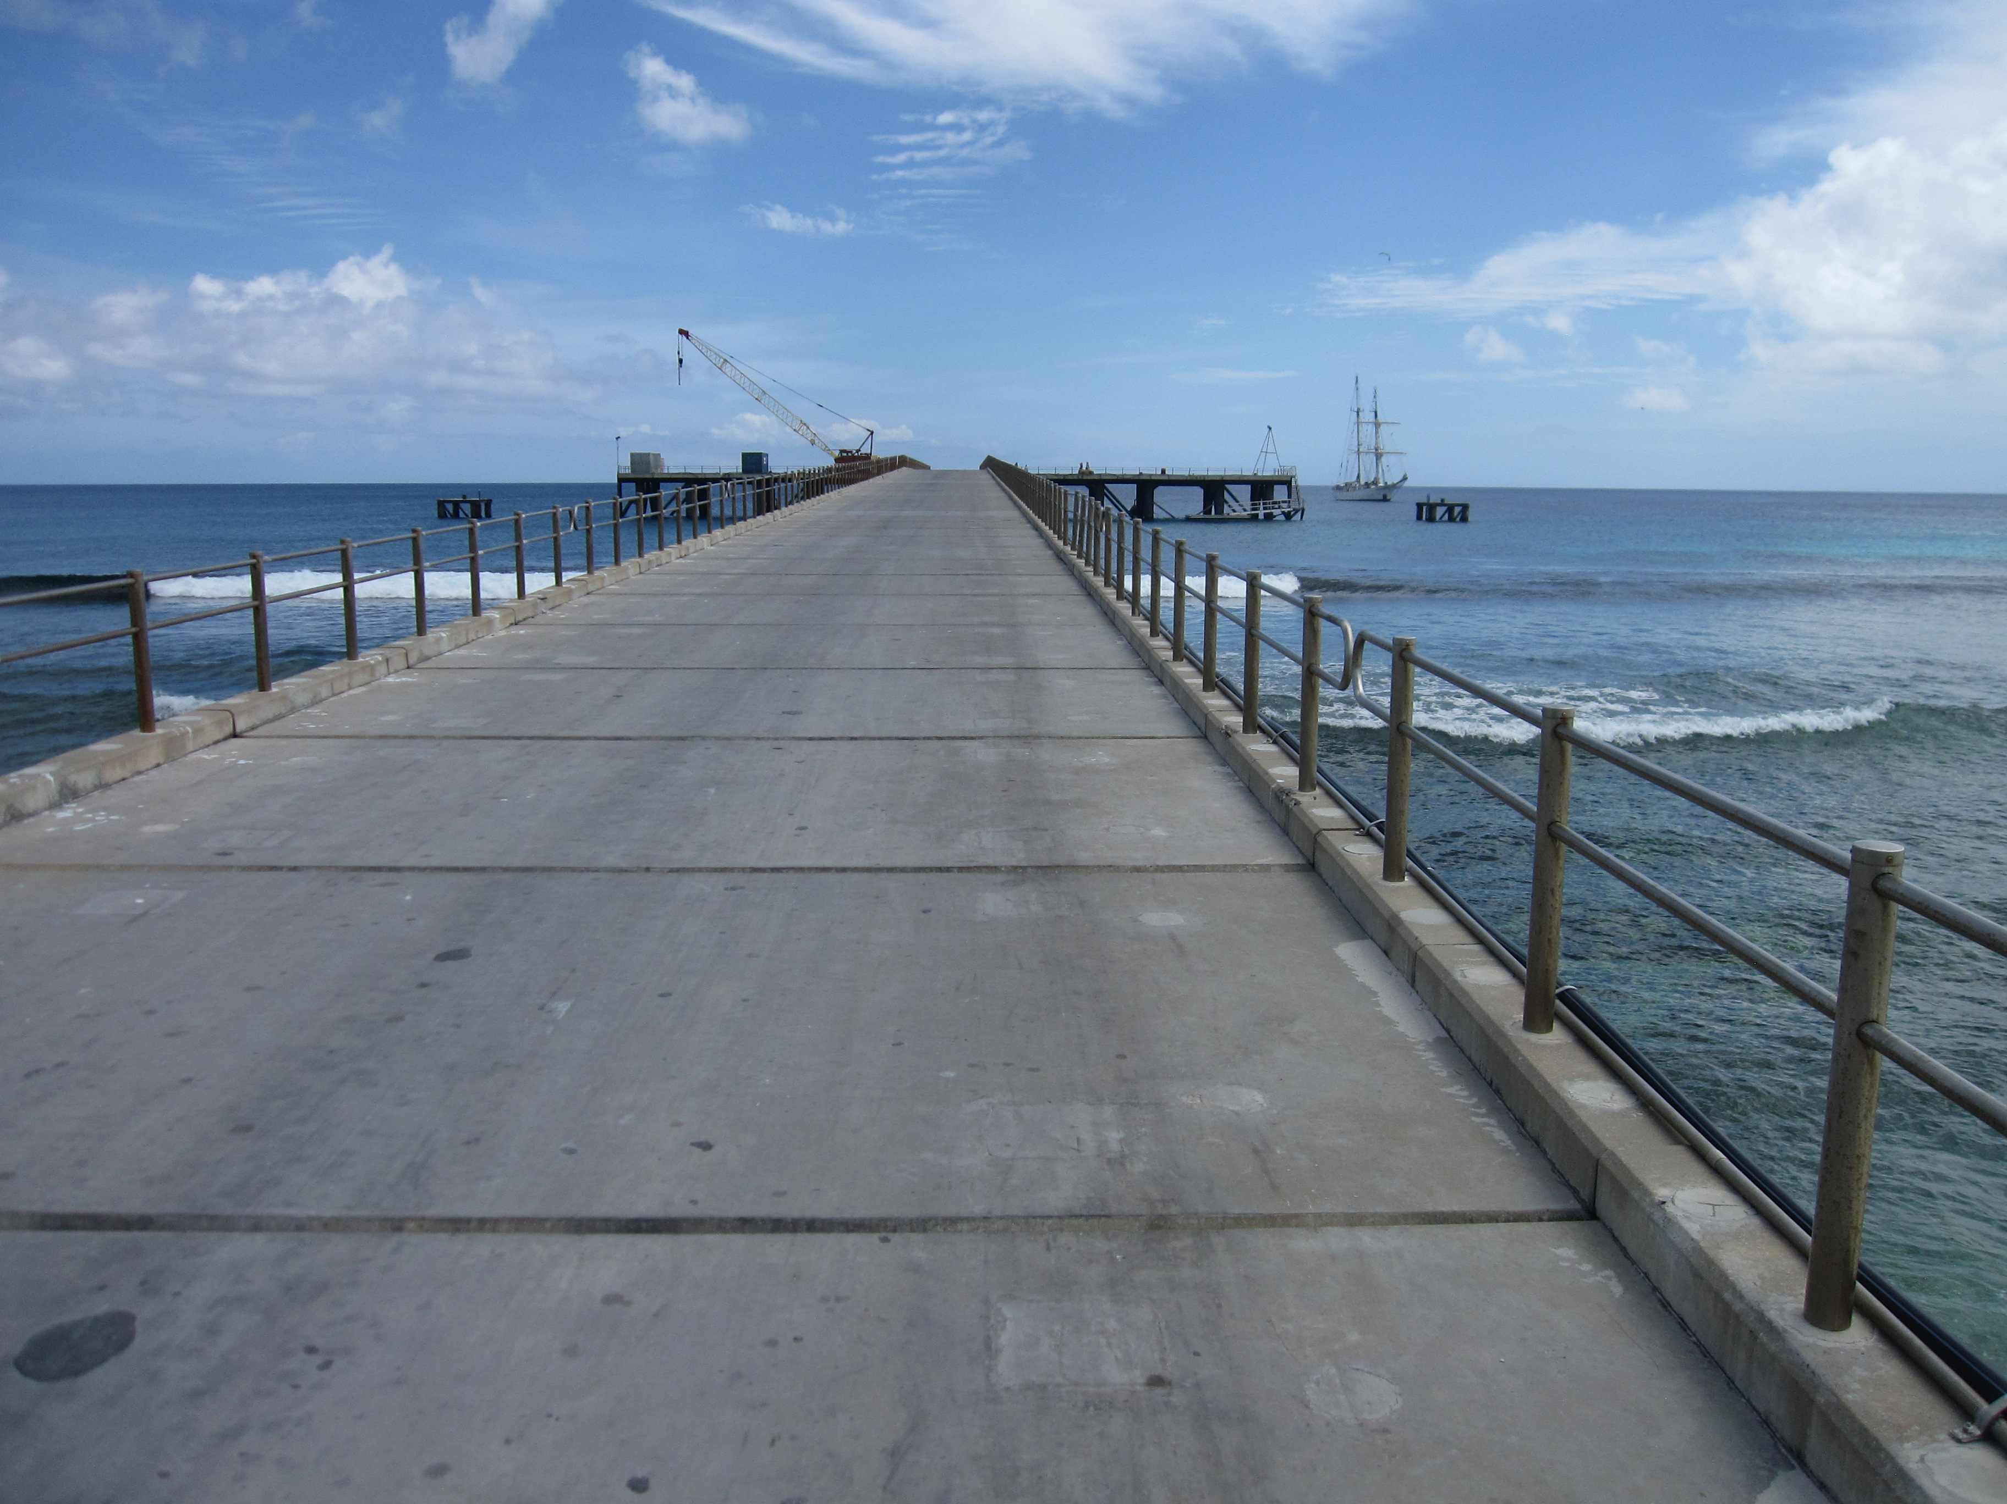
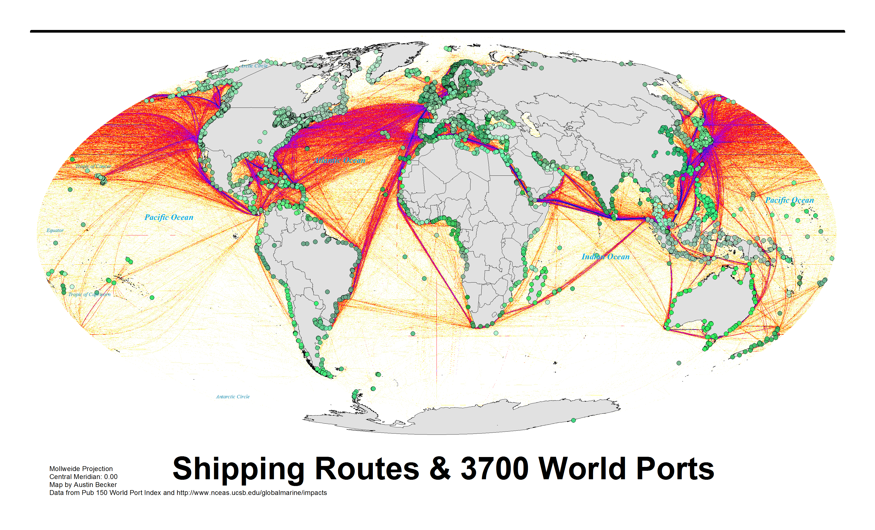
Provincetown, Massachusetts
“You’ve seen one port,
you’ve seen one port.”
Mike Giari, Port Director of Redwood City
Redwood City, CA
Wilmington, North Carolina
Kiritimati, Republic of Kiribati
Notes:
Lots of ports
Very different
Large, small
Types of cargo
Env. conditions
----- Meeting Notes (8/13/13 18:52) -----
Add summary slide before
Use case study selection term
Selected on basis of vulnerability (a characteristic - dimension of interest)
Chose vulnerability
Add quotes to seen one port seen one port

