Slide 1

Quantifying Coastal Storm and Sea Level Rise Risks to Naval Station Norfolk (SERDP RC-1701)
Ms. Kelly A. Burks-Copes
Environmental Laboratory
US Army Engineer Research
and Development Center
Vicksburg, MS
30 October 2013

Slide 2
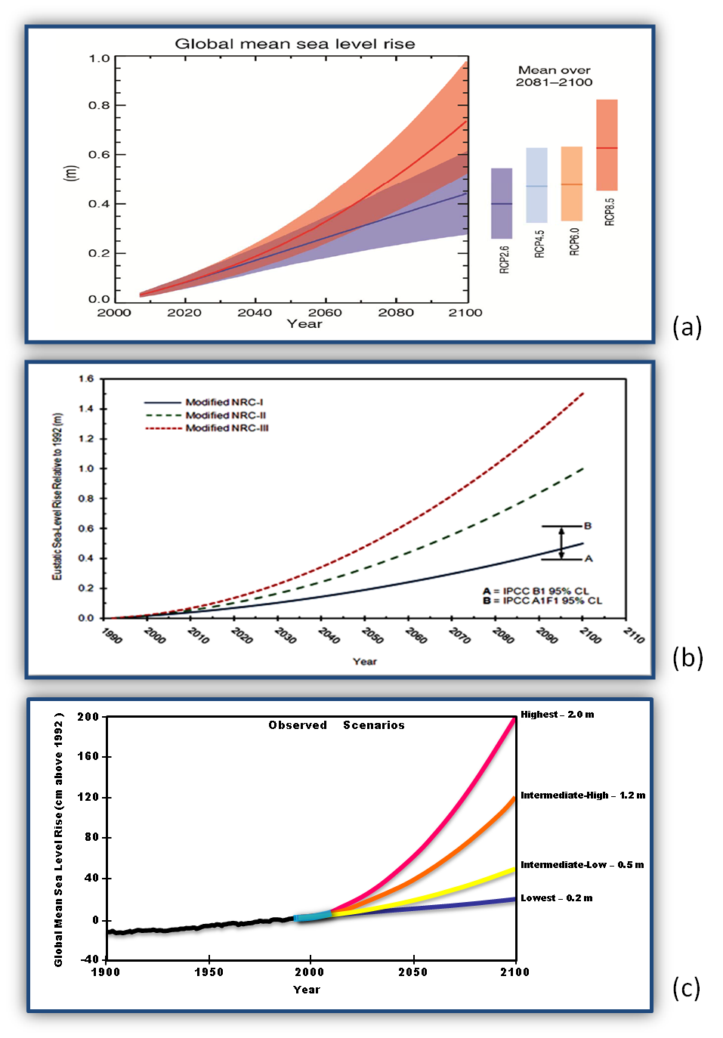
Case Study:
Quantifying Coastal Storm and Sea Level Rise Risks to Naval Station Norfolk (SERDP RC-1701)
IPCC 2013
Problem Statement
  Devise and demonstrate a rigorous yet flexible systems-scale approach
  Quantitatively evaluate natural hazard risks to critical military assets (i.e., infrastructure) and mission capabilities
  Address a range of SLR, tidal fluctuation, and storm stage-frequencies
Technical Goals
  Characterize impacts
  Decompose mission & infrastructure systems
  Pinpoint vulnerabilities
  Quantify performance sustainability risks
  Identify adaptive capacity tipping points
  Communicate results to field
NRC 1987
USACE 2011

Slide 3
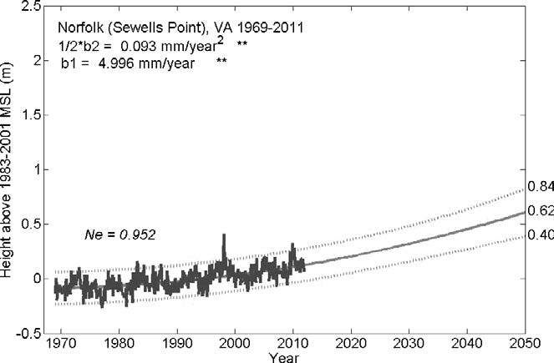
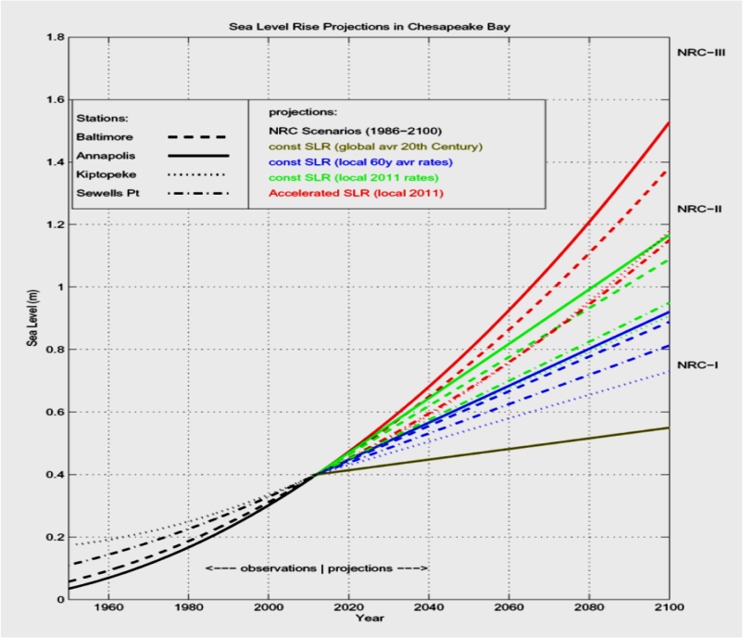
Technical Approach
This is a Demonstration Project –
  Select missions, capabilities, assets, hazards, and forcings are modeled
  Coastal storm parameters are not altered due to potential climate change effects
Datums
  Horizontal datum = North American Datum of 1983 (NAD83)
  Vertical datum = North American Vertical Datum of 1988 (NAVD 88)
Period of Analysis
  Start Date = 2000
  End Date = 2100 (100 yr period of analysis)
Sea Level Rise
(local MSL between 2000-2100)
  0.5m
  1.0m
  1.5m
  2.0m
Storm Return Intervals
Boon (2012)
Ezer and Corlett (2012)
  Prescribed SERDP scenarios are reasonably supported in the peer reviewed literature
Recurrence interval | Probability of occurrence in any given year | Percent chance of occurrence in any given year
100-yr | 1 in 100 | 1%
50-yr | 1 in 50 | 2%
10-yr | 1 in 10 | 10%
1-yr | 1 in 1 | 100%

Slide 4
SLR Scenario (0, 0.5, 1, 1.5, 2m)
Tiered Risk Assessment Approach:
  Step 1: Site Selection
Geomorphic and Geologic Assessment
  Step 2: Regional Assessment
  Step 3: Installation Specific Assessment
Shoreline characterization
Ecology and Land Use Conversion Assessment
(Straight-line & SLAMM)
Asset Capability Network Development – Infrastructure Network
(ArcGIS)
Bathymetry and land cover changes
Regional Surge and Waves Assessment
(TC96 + ADCIRC + SWAN)
MAXIMUM WIND,
SURGE, & WAVES
Max IMUM Water Level, Wave HEIGHT, Current Speed, EROSION, Accretion, & SEDIMENT Transport Rate
SLR Scenario- and event-based time history of surge, waves & wind
ASSET IDENTITY,
CHARACTERISTICS
AND CONNECTIVITTY
Nearshore Waves , Current, Water Levels, and Sediment Transport Assessment
(CMS)
Risk Assessment
(Netica)
Structural Analysis
(ISS3D + HAZUS MR-4)
Water level, waves, and morphology changes
Probability
of the
damage states
given the loadings
Groundwater Assessment
(AdH)
Groundwater table position
WATER DEPTH AND DURATION
Surface Flood Routing
(GSSHA)
RISK OF MISSION IMPAIRMENT
Notes:
Notes:
This is an animated slide that will run on its own. . . . The blue boxes are the models we deployed . . . . They provide “forcings” in red that “push” against the infrastructure. The green boxes are the asset decomp & the structural analysis . . . They provide the “fragility” of each asset system . . . the probability of the storms and the fragility of the infrastructure are combined & the probability o f mission performance is assessed in the Bayesian network.
The demo site for the study was Naval Station Norfolk (Virginia, USA), but the coastal storm analysis covered the Chesapeake Bay area. . . . We conducted a “tiered” analysis at the North Atlantic, Regional (Hampton Roads Area), and Local (NNS) scales.
All models deployed were either open source or ERDC-developed.
It took more than 22 researchers with varied backgrounds in coastal modeling, engineering and risk assessment to get the job done.
We analyzed 500+ FEMA-derived simulated hurricanes to conduct the study, and selected “representatives of the 1, 10, 50 & 100 year events to focus our efforts – we also included a Nor’easter at the request of the naval base.
Model outputs:
Straight-line & SLAMM captured inundation due to SLR
ADCIRC/SWAN/TC96 handled hurricane simulation
CMS incorporated bathymetry, wave run-up, sediment transport & tides
GSSHA & AdH/WASH123D incorporated infiltration, flood routing & precipitation
We decomposed the mission (into capabilities & critical assets) and focused the analysis on infrastructure systems such as electricity wastewater, steam, etc.
Structural analysis of these systems was conducted to generate fragility curves to assess system vulnerability to storm forcings (winds, waves, surge, inundation)
We used a Bayesian network to combine the “forcings” from the storms with asset fragility and interconnectivity to assess probabilistic mission failure.
More than 13,000 conditional probabilities were computed.

Slide 5
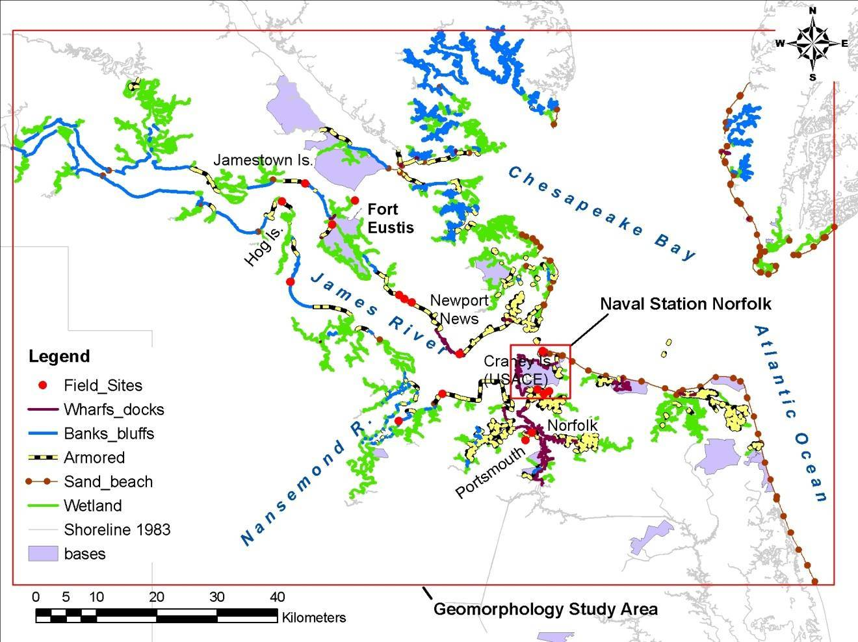
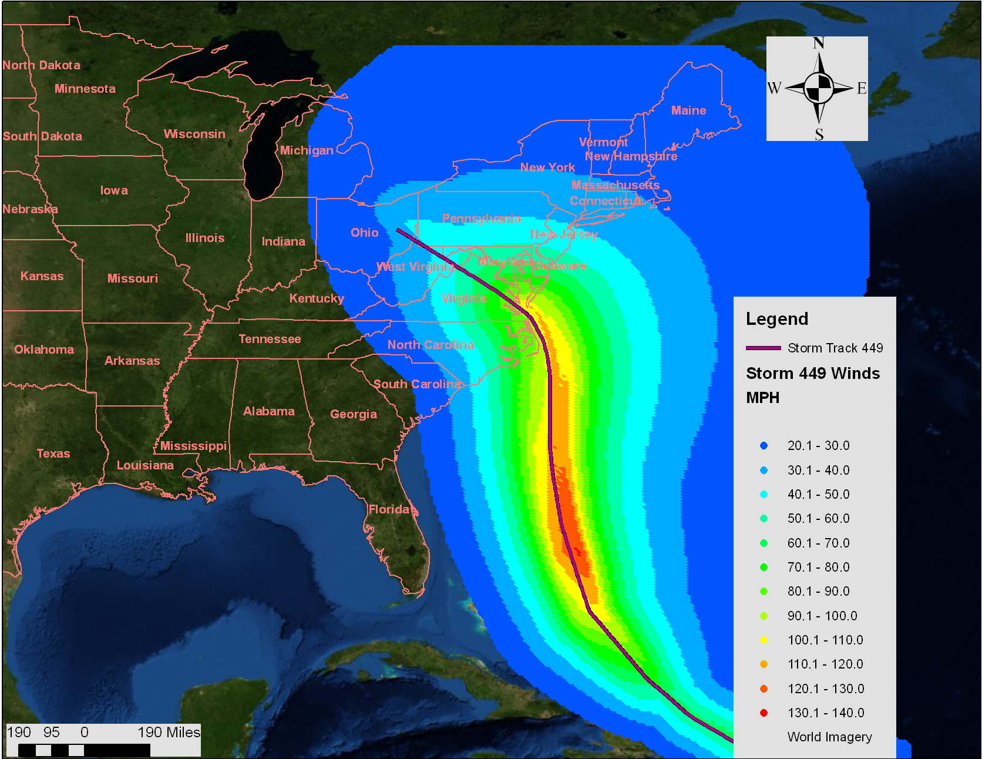
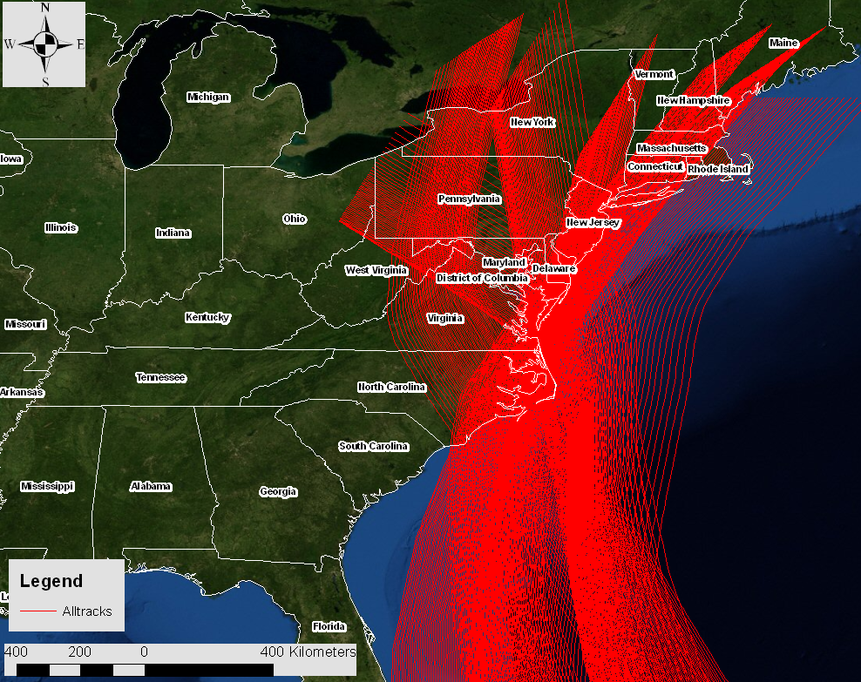
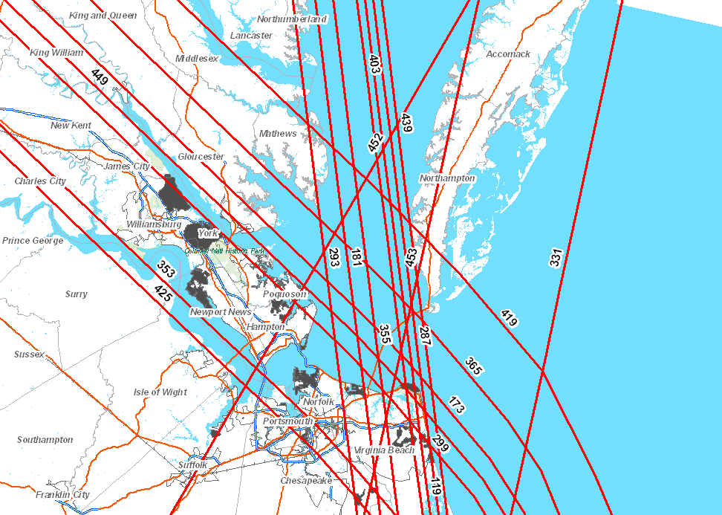
Regional Assessments
^Videos 2012\1_SLAMM.ppsx
Geomorphological Assessment
  Modeled geomorphic evolution as sea levels rise
  Inventory natural and engineered coastal features
  Assess stability of features as sea levels rise
  Provided inputs on base conditions in the bay for sediment transport modeling
Ecological Assessment
  Sea Level Affecting Marsh Model (SLAMM)
  Biome Shifts
  Open Water Surface Increases
Coastal Storm Simulations
  Used Joint Probability Method with Optimal Sampling (JPM-OS) for storm parameterization
    Nor’easters included (3 total)
    Parameters:
      C_{p} (central pressure)
      R_{max} (radius of maximum winds)
      Tracks / heading
      V_{f} (forward speed)
      Holland B (landfall decay)
    Wind Forcings using TC96 Model
    Envelope of maximum wind speed
    Inputs to circulation and wave models at both region and nearshore scales
    Storm parameters not modified to reflect climate change
    Same wind fields used for modeling in all SLR scenarios
Hurricane tracks impacting the project region.
Maximum wind speed in miles per hour for
Hurricane 449
Notes:
Geomorphological Assessment
Modeled geomorphic evolution as sea levels rise
Inventory natural and engineered coastal features
Assess stability of features as sea levels rise
Provided inputs on base conditions in the bay for sediment transport modeling
Ecological Assessment
Used SLAMM – Sea Level Rise Affecting Marsh Model
Regional Storm Modeling
Used Joint Probability Method with Optimal Sampling (JPM-OS) for storm parameterization
Used subset of 460 synthetic hurricanes to produce 50- and 100-yr approx water levels (17 total)
Nor’easters included (3 total)
Parameters:
C_{p} (central pressure)
R_{max} (radius of maximum winds)
Tracks / heading
V_{f} (forward speed)
Holland B (landfall decay)
Wind Forcings using TC96 Model
Envelope of maximum wind speed
Inputs to circulation and wave models at both region and nearshore scales
Storm parameters not modified to reflect climate change
Same wind fields used for modeling in all SLR scenarios

Slide 6
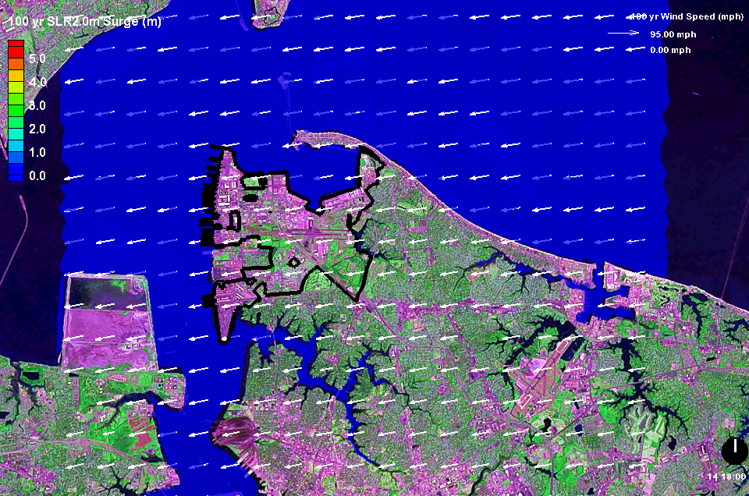
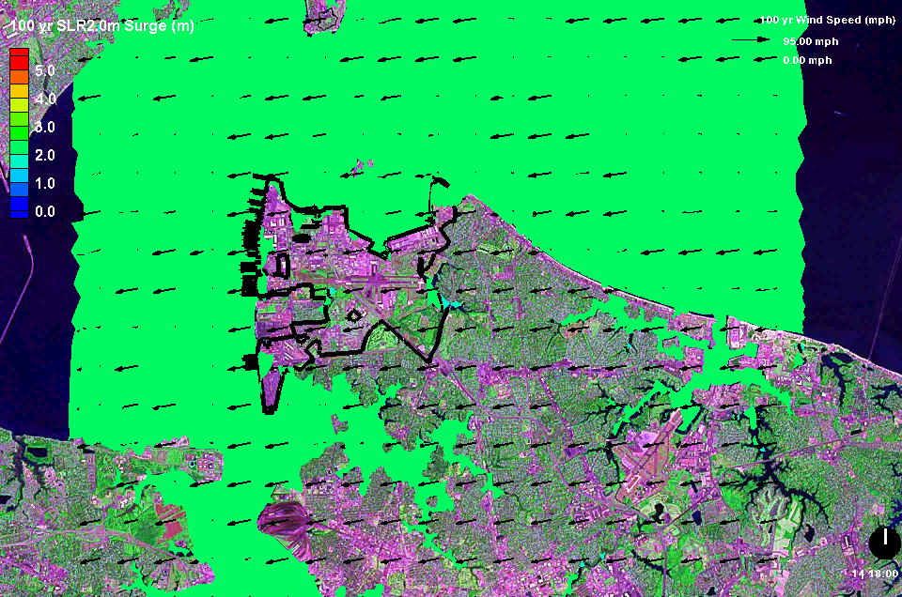
Regional Storm Results
Regional surge/wave water levels were generated for each of the storms with Advanced Circulation (ADCIRC) and Simulating Waves Nearshore (SWAN) models
Models driven using wind fields, considering topo/bathy contours and friction coefficients derived from land cover and interpolated onto the model mesh
100 ADCIRC, SWAN & TC96 Runs Made (17 hurricanes & 3 nor’easters x 5 SLR Scenarios)
Storm 449 0m SLR (max surge = 3.0 m)
Storm 449 2m SLR (max surge = 5.8 m)
Notes:
High-resolution spatially-explicit regional coastal flood-stage frequency results are made possible using a proven set of hydrodynamic models and supporting high-performance computing resources at ERDC
ADCIRC provides storm surge elevations across the region, based on principles of conservation of mass and momentum in the movement of coastal storm water
SWAN provides regional significant wind wave heights, periods, directions, and spectra
ADCIRC is run separately from SWAN initially, then ADCIRC is re-run to add in wind-wave radiation stresses to surges for estimating wave setup, and therefore, contributions to water surface elevations on top of surges due to wave action
CMS gets from ADCIRC and SWAN the water levels, as well as significant wind wave heights, periods, directions, and spectra, for the nearshore perimeter around the installation to compute nearshore waves, runup, and overtopping onto the installation
GSSHA gets water levels and flows into the installation from CMS to compute interior flood routing and stages on the installation

Slide 7
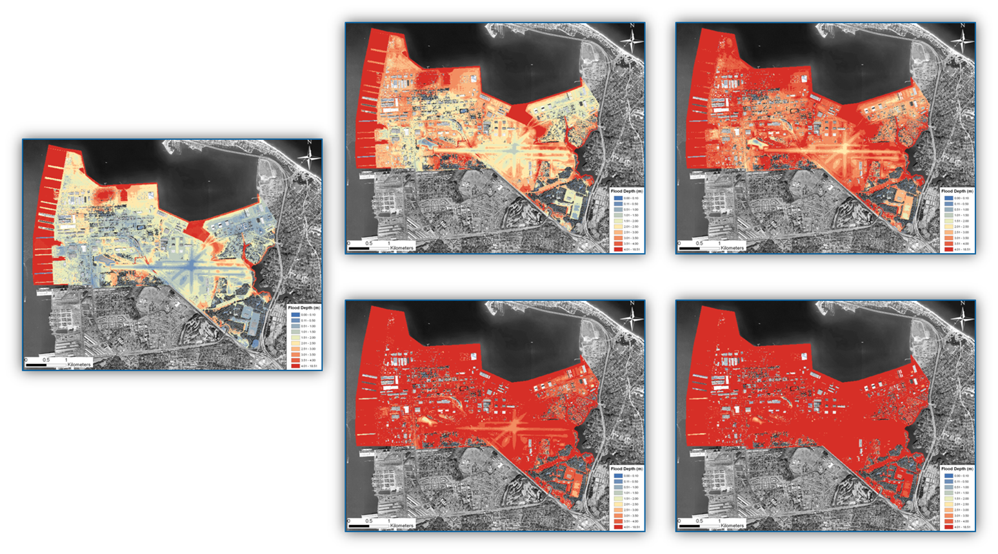
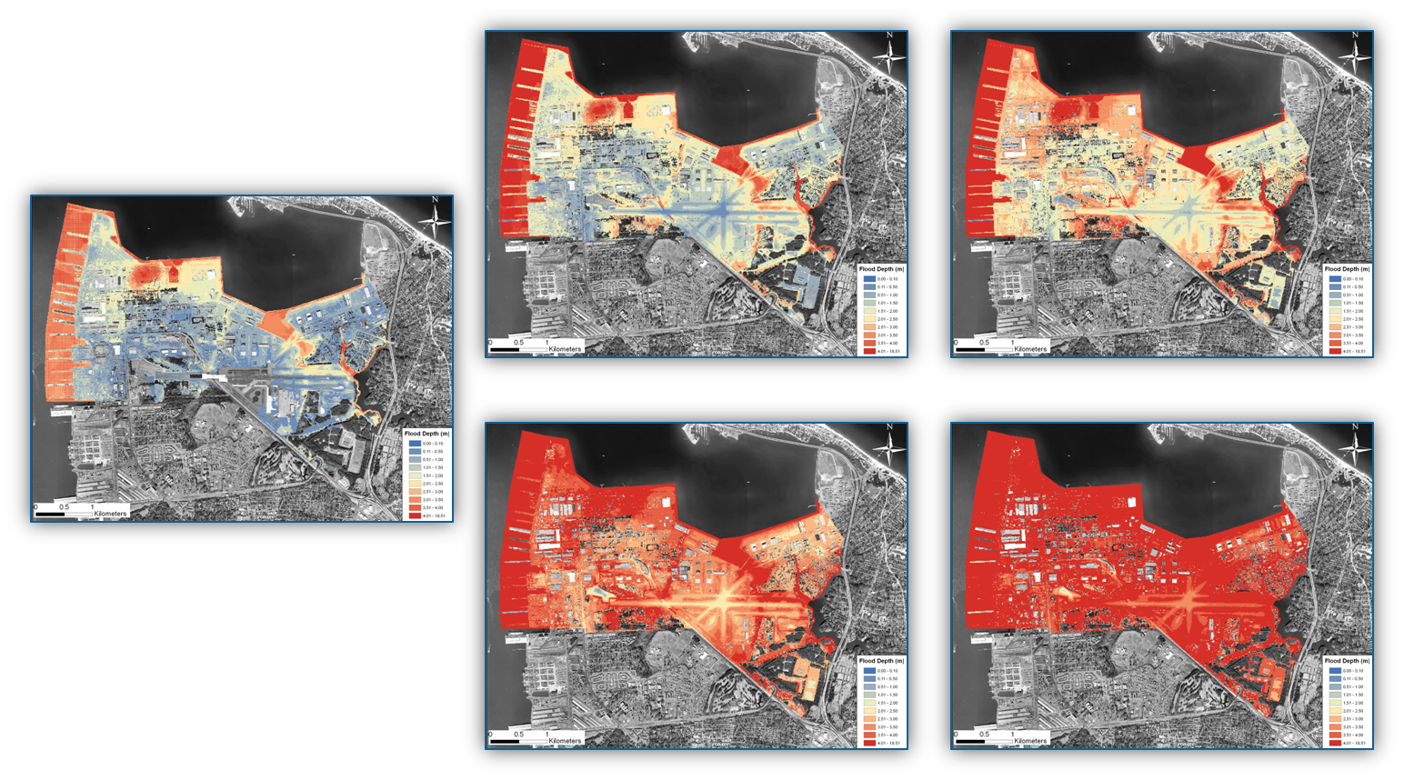
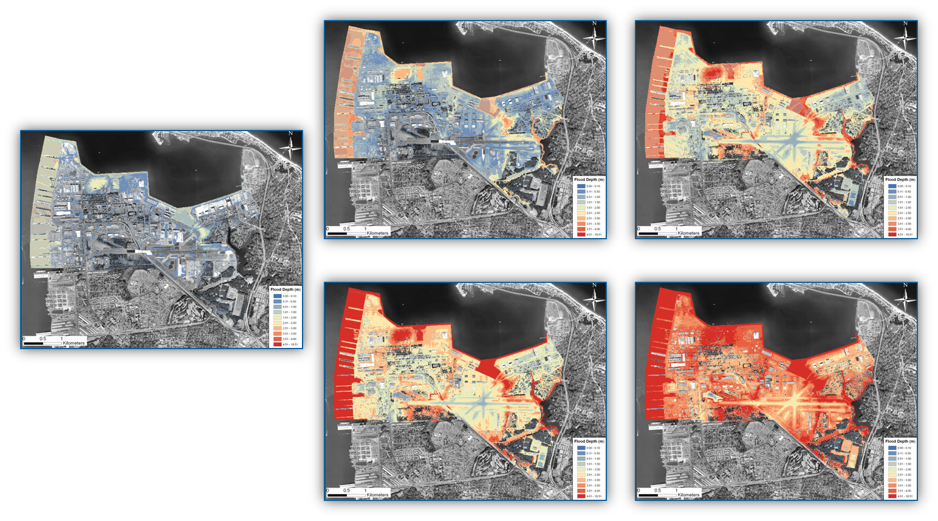
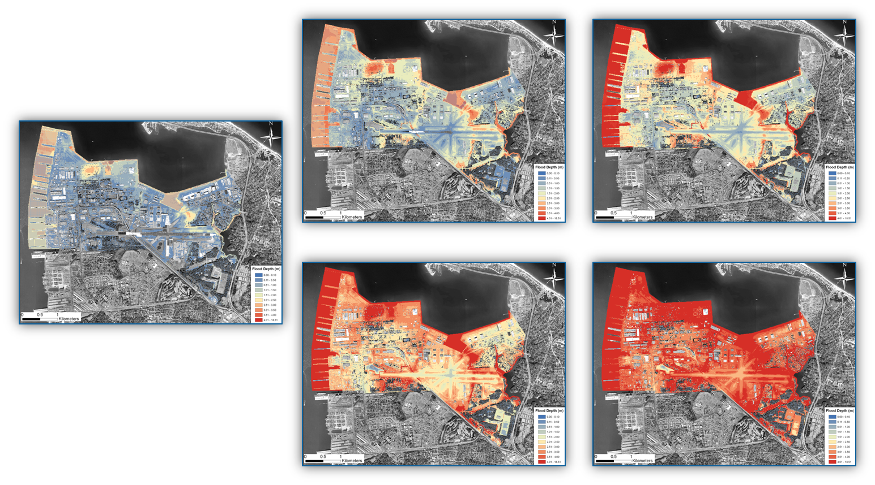
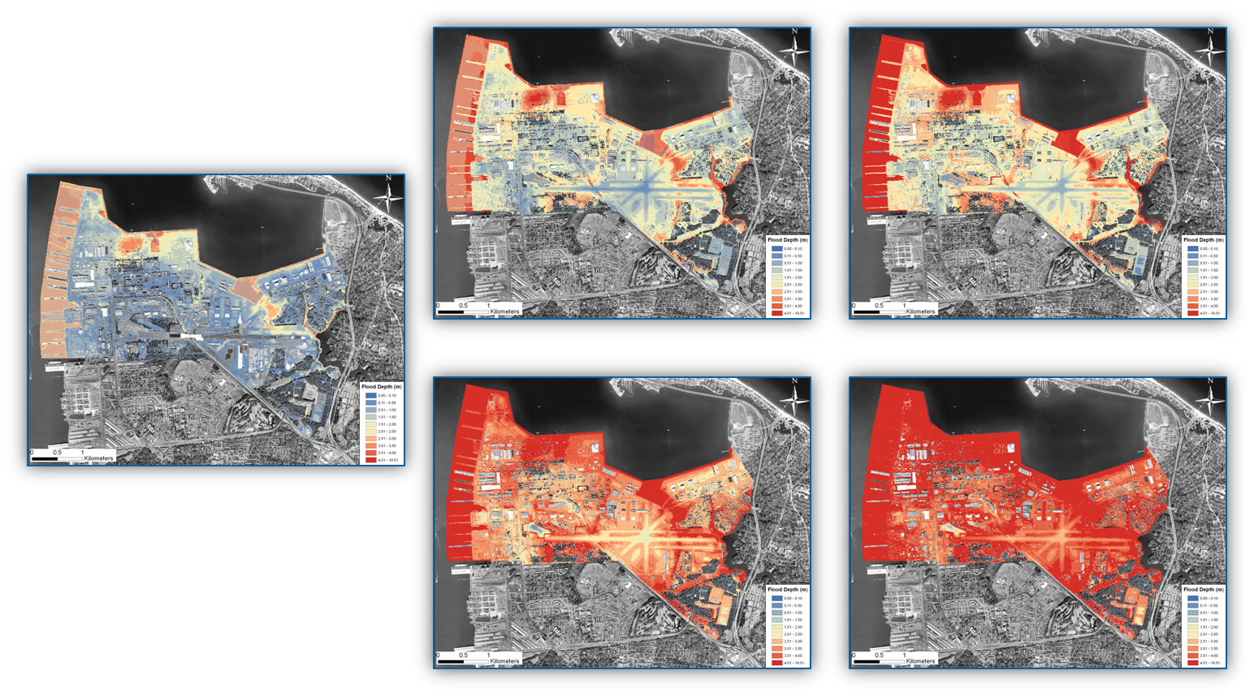
Surface Flood Routing –
Gridded Surface-Subsurface Hydraulic Assessment (GSSHA)
0.5 m SLR
1.0 m SLR
1-yr Storm
10-yr Storm
50-yr Storm
Nor’easter
100-yr Storm
0.0 m SLR
1.5 m SLR
2.0 m SLR

Slide 8
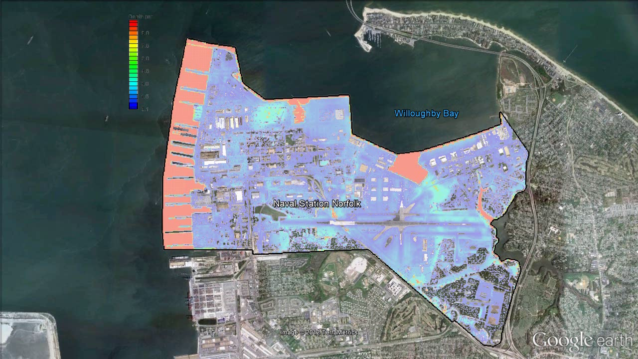

Slide 9
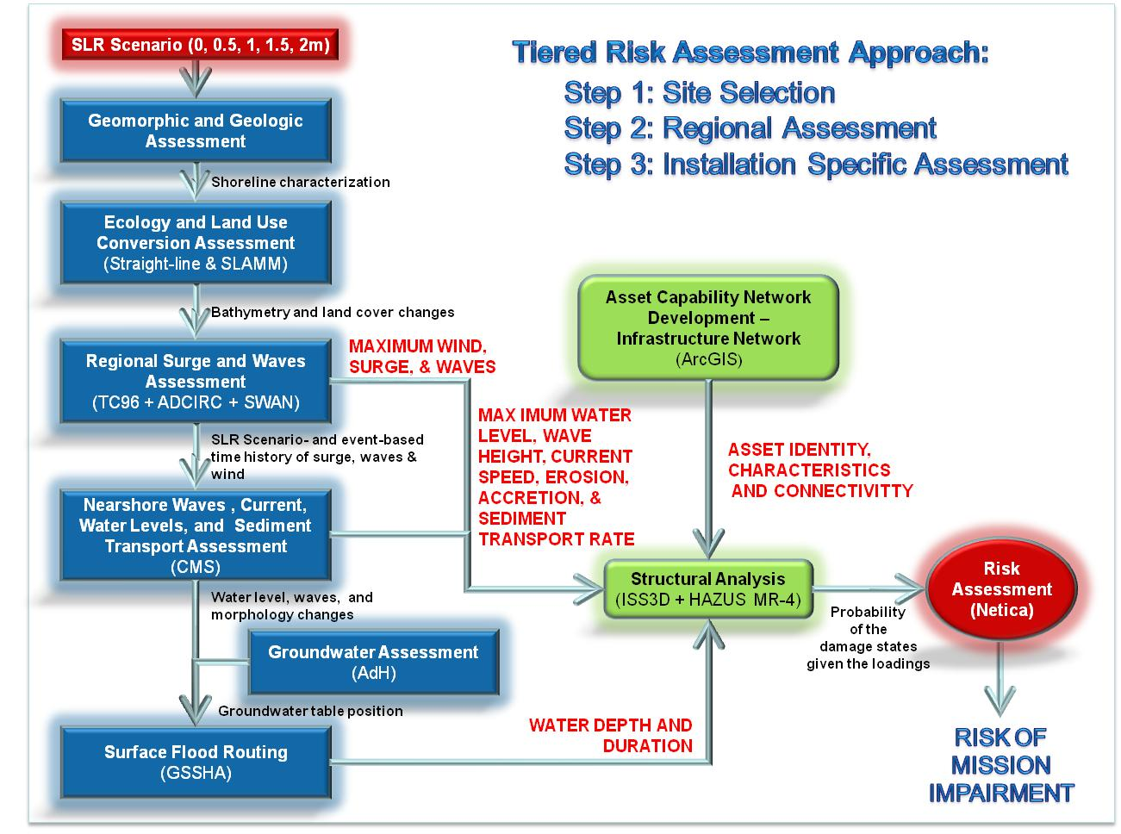
Infrastructure Vulnerability Assessment

Slide 10
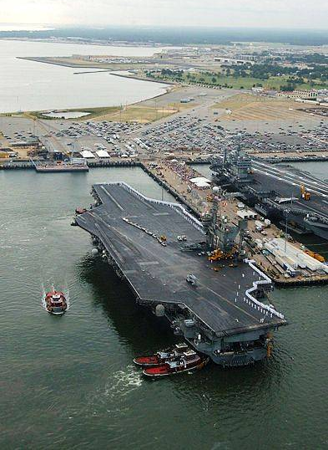
Asset Network Diagramming
Asset
Capability
Mission
Pier #
Provide Berthing
Space
Water
Treatment Plant
Water
Storage
Water Distribution System
Provide
Water
Electrical
Transmission System
Provide Electric
Power
Electrical
Supply
Electrical
Substation
Provide CHT
(Sewage, OW)
Sewage and Oily Waste
Treatment
FISC
Warehouses
Provide
Supplies
Provide
At-Berth
Support
Untreated Water
Supply
Base Road
Network
Ammunition
Bunkers
Provide Ammunition
Off-Base Road
Network
Pier Parking
Areas
Provide
Personnel Support
Commercial Goods Suppliers
Natural Gas
Supply
Steam Plant
Steam Distribution System
Provide Steam
POL
Supply
POL Storage Tanks
POL Distribution System
Provide POL
(Fuel, Oil)
Off-Base
Communications
NCTAMS Building
Provide
Communications

Slide 11
Asset Connectivity
Electrical
Water
Oily Waste
Berthing
Steam
Pier 12
Pier 11
Pier 14

Slide 12
Utilization of the RC-1701 Approach:
The model is used for inference about the infrastructure system and management.
        Probability of asset damage states and functionality.
        Probability of a loss in capability (service interruption).
        Probability potential losses in mission performance.
        How would alternative system design or retrofits affect mission performance?
        Where should better information on structural reliability be obtained?

Slide 13
Final Bayesian Network
Storm Severity
Sea Level Rise
Score Card:
217 Nodes (boxes)
  2 Risk drivers
  95 Asset damage
  97 Function
  23 Capability
  3 Mission performance
437 Edges (lines)
13,068 Probabilities

Slide 14
Final Risk Assessment Results
Service Interruption
Loss in Capability
Loss in Mission Performance
Tipping point is between 0.5 and 1.0 m SLR.

Slide 15
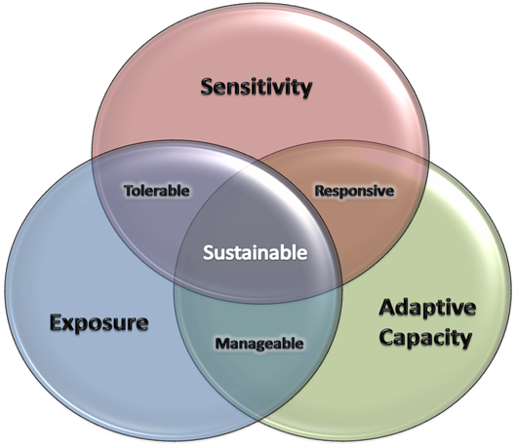

Future Directions for Client-Partnering
Portable, Scalable Approach
  Demo Project - NSN Master Planning,
  Adaptive Management (Retrofits),
  Contingency Planning
  Assist with Informing Policy and Planning
  Portfolio Risk Management
  Navy’s Task Force Climate Change
  Worldwide Installation Vulnerability
  Assessment
Dependencies
Outside the Fence Line
  Stakeholders Forum(s)
  Hampton Roads Installations
  VA Recurrent Flooding Study
    (Molly Roggero, VIMS)
Notes:
Portfolio Risk Management at a Global Scale – Interdependencies of the bases & how they interact at a global scale to perform the missions
Assist TFCC in developing a high-level vulnerability assessment to come up with the most vulnerable
2. Explicitly evaluate these most vulnerable sites and report back common vulnerabilities and good defensible practices that could be used to update Policy & Guidance.
3. Implicitly provide Engineering Guidance Updates that could be rolled out to the other bases around the world to address CC threats
So what are our next steps – how or when can we get back with you to talk about next steps
Could we get with your working staff and client-partner with them and maybe come back in three months and brief you on our efforts
Allude to the fact that we might have cost-sharing potentials

Slide 16


Points of Contact
Kelly A. Burks-Copes
  SERDP RC-1701 Project Team Leader
  Environmental Laboratory
  US Army Engineer Research & Development Center
  3909 Halls Ferry Rd., Vicksburg, MS 39180
  Office: 601-634-2290, Mobile: 601-618-5565
  Email: Kelly.A.Burks-Copes@usace.army
Edmond J. Russo, Jr., Ph.D., P.E.
  Chief, Ecosystem Evaluation and Engineering Division
  Environmental Laboratory
  US Army Engineer Research & Development Center
  3909 Halls Ferry Rd., Vicksburg, MS 39180
  Office: 601-634-2067
  Email: Edmond.J.Russo@usace.army

Slide 17


