Slide 1
Sea-Level Rise: Impacts and Responses
Prof. Robert J. Nicholls
Faculty of Engineering and the Environment and
Tyndall Centre for Climate Change Research
University of Southampton
United Kingdom
Email: R.J.Nicholls@soton.ac.uk
Transatlantic Solutions to Sea Level Rise Adaptation: Moving Beyond the Threat
Ted Constant Convocation Center, Old Dominion University, Norfolk, Virginia
October 30-31, 2013

Slide 2
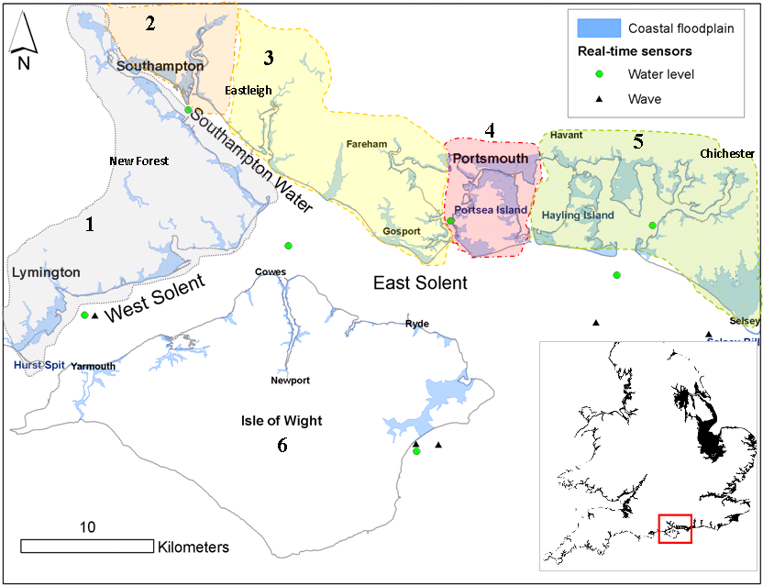
Flood Case Study: The Solent
Source: Wadey et al., 2012

Slide 3
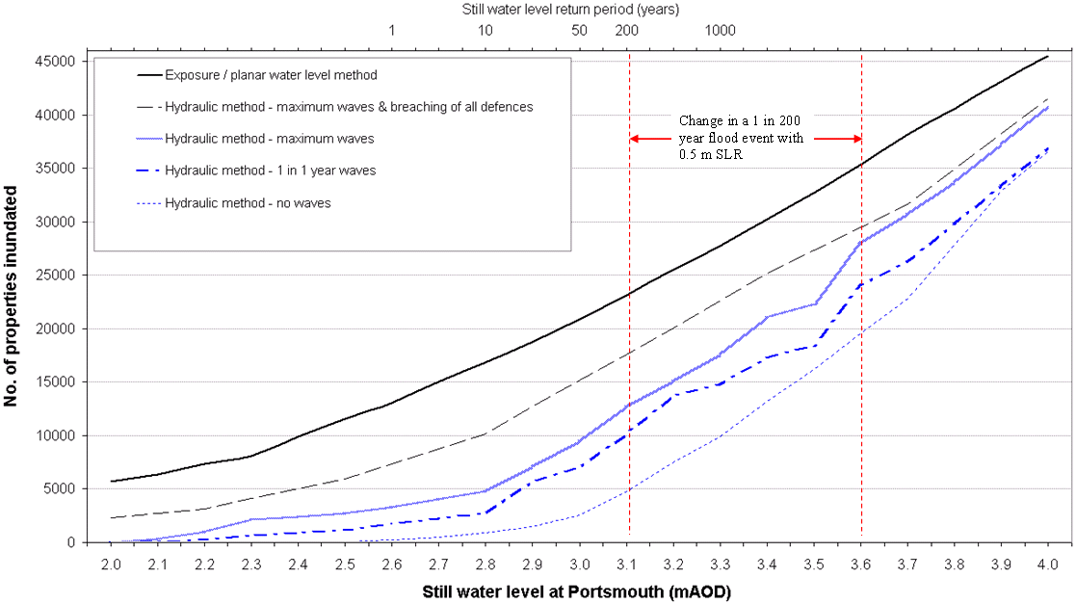
Modelled flood events in the Solent Loads & failure mechanisms vs. number of properties flooded
10 March 2008
Source: Wadey et al., 2012

Slide 4
Issues (1)
Southern England vs. Tidewater Virginia
Understanding sea levels
Impacts of sea-level rise
Planning for sea-level rise
Integrated Assessment – linking to wider issues – risk management

Slide 5
Issues (2)
Strategic planning approaches – 100 year time frame
Adaptive management approaches
Linking to the coastal economy
maintaining confidence and the economic and political base for adaptation
Barriers to strategic analysis and decision-making

Slide 6
How? (1)
Link to Tyndall Centre for Climate Change Research
Partners: University of East Anglia, Cardiff University, Newcastle University, Oxford University, University of Cambridge, University of Sussex, Manchester University, Fudan University
Tyndall Coastal Simulator
Integrated Assessment of Coastal Systems

Slide 7
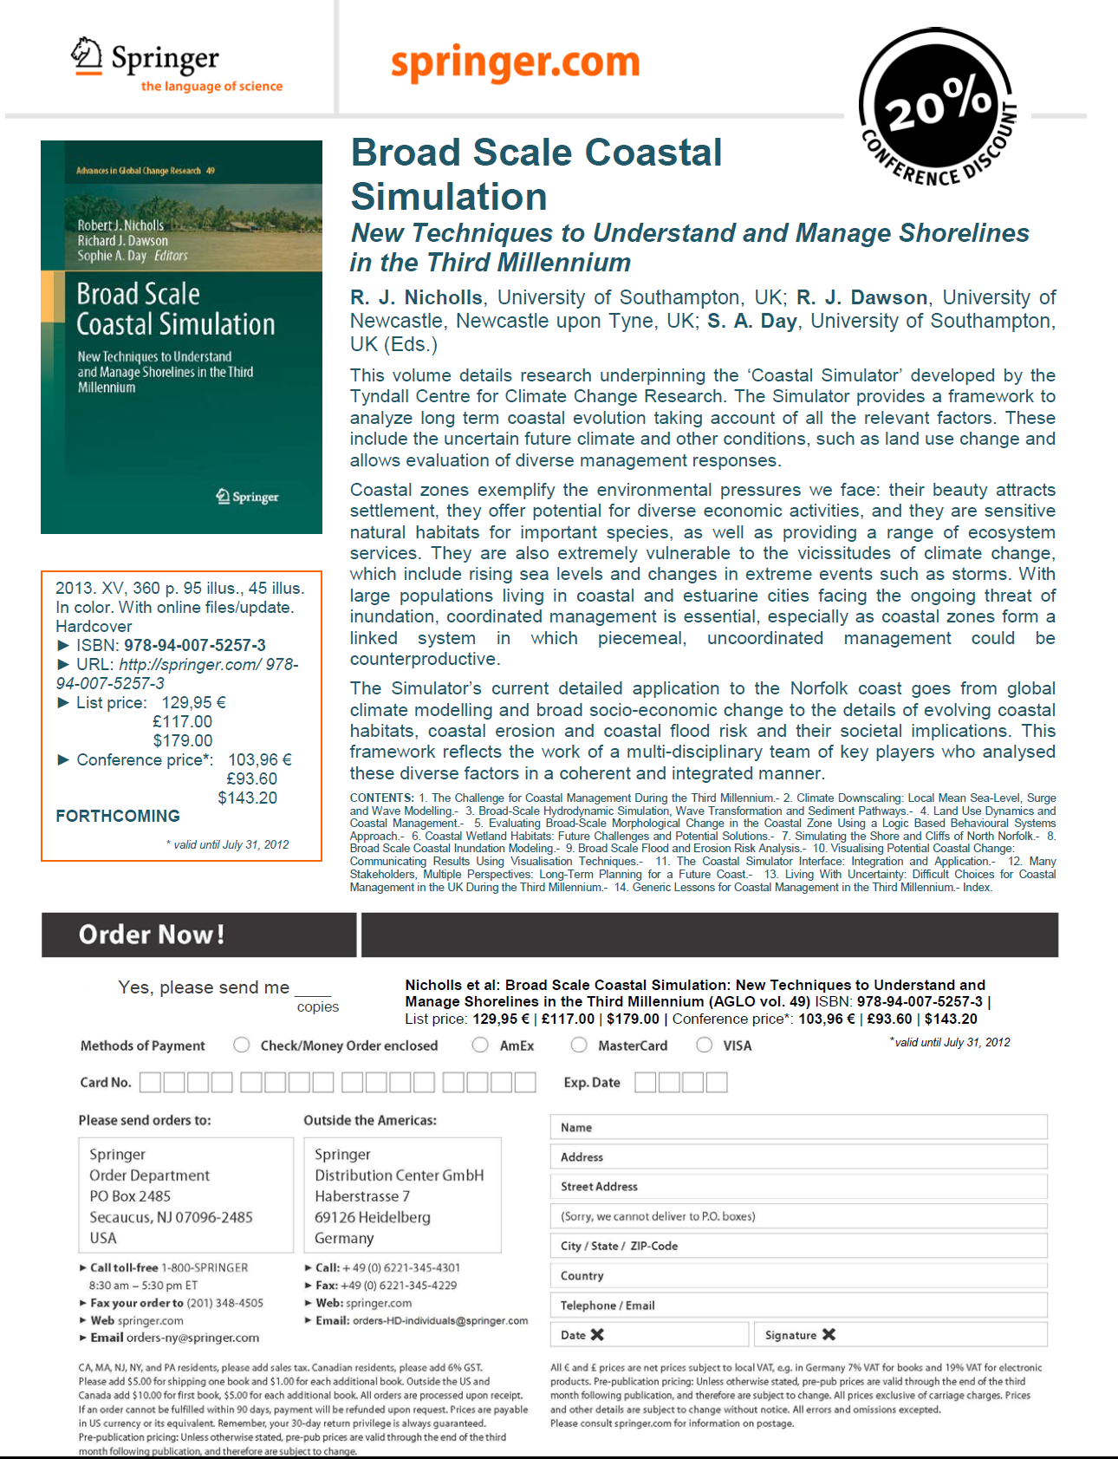

Slide 8
How? (2)
UK Government interest in promoting linkages and exchange?
Link to EU 7th Framework RISES
Responses To Coastal Climate Change: Innovative Strategies For High End Scenarios –Adaptation And Mitigation
Kick-Off Meeting – 18 November 2013

Slide 9
RISES partners
1. Universitat Politècnica de Catalunya (UPC) – Coordinator -- Spain
2. National Institute for Research and Development of Marine Geology and Geoecology, Romania
3. Institut de Recerca i Tecnologia Agroalimentàries, Spain
4. University of Southampton, UK
5. Deltares, The Netherlands
6. Christian-Albrechts-Universitaet, Kiel, Germany
7. National Oceanography Centre, Liverpool, UK
8. Helmholtz-Zentrum Geesthacht, Germany
9. VU-IVM Stichting VU-Vumc, The Netherlands
10. Global Climate Forum, Germany
11. Centro Euro-Mediterranea sui Cambiamenti Climatici S.c.a.r.l., Italy
12. University of Sussex, UK

Slide 10
Sea-Level Rise: Impacts and Responses
Prof. Robert J. Nicholls
Faculty of Engineering and the Environment and
Tyndall Centre for Climate Change Research
University of Southampton
United Kingdom
Email: R.J.Nicholls@soton.ac.uk
Transatlantic Solutions to Sea Level Rise Adaptation: Moving Beyond the Threat
Ted Constant Convocation Center, Old Dominion University, Norfolk, Virginia
October 30-31, 2013

