Slide 1

Sea-Level Rise:
Impacts and Responses
Prof. Robert J. Nicholls
Faculty of Engineering and the Environment and
Tyndall Centre for Climate Change Research
University of Southampton
United Kingdom
Email: R.J.Nicholls@soton.ac.uk
Transatlantic Solutions to Sea Level Rise Adaptation: Moving Beyond the Threat
Ted Constant Convocation Center, Old Dominion University, Norfolk, Virginia
October 30-31, 2013

Slide 2
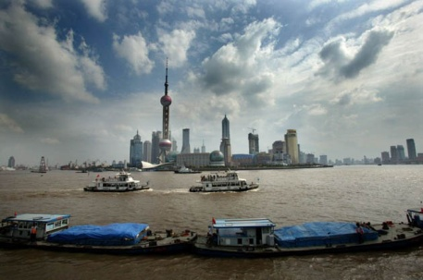
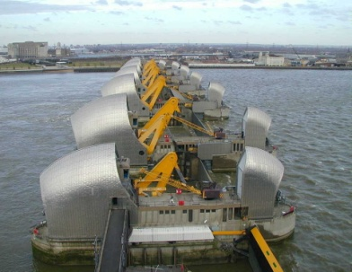
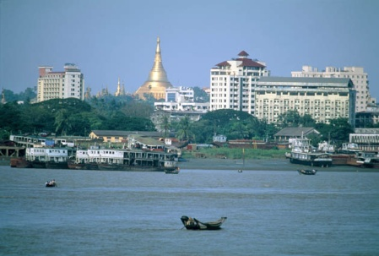
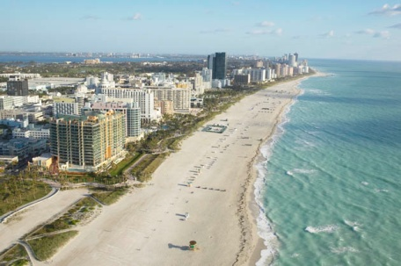
PLAN
Sea-level rise and its components
Sea-level rise impacts, especially flooding
Sea-level rise responses
  Climate mitigation
  Adaptation
Concluding remarks

Slide 3

< 1mm/year
6mm/year
> 20mm/year

Slide 4
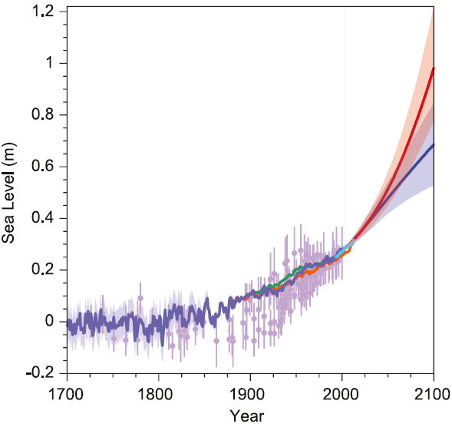
Global-Mean Sea-Level Rise:
1700 to 2100
Compiled paleo-sea-level data, tide gauge data, altimeter data, and central estimates and likely ranges for RCP2.6 (blue) and RCP8.5 (red) scenarios
Source: IPCC, 2013, AR5 WG1

Slide 5
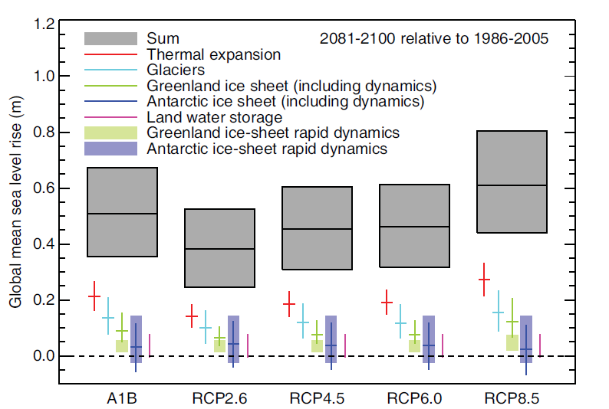
Global Sea-Level Components
Source: IPCC, 2013, AR5 WG1

Slide 6
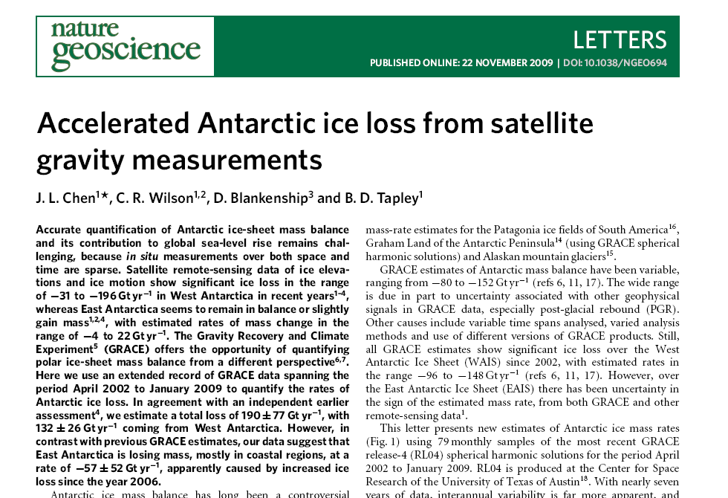

Slide 7
Global-Mean Sea-Level Rise:
1700 to 2100
Compiled paleo-sea-level data, tide gauge data, altimeter data, and central estimates and likely ranges for RCP2.6 (blue) and RCP8.5 (red) scenarios
?
?
?
?
Source: IPCC, 2013, AR5 WG1

Slide 8
Local sea-level components
Where,
∆RSL is the change in relative sea level
∆SL_{G} is the change in global mean sea level
∆SL_{RM} is the regional variation in sea level from the global mean due to meteo-oceanographic factors
∆SL_{RG} is the regional variation in sea level due to changes in the earth’s gravitational field
∆SL_{RLM} is the change in sea level due to vertical land movement
Source: Nicholls et al., 2013 WIRES Climate Change

Slide 9
Local Sea-Level Rise
Norfolk, VA
1962 to 2012 (50 years) – 5.2 mm/yr
Data from Permanent Service for Mean Sea Level

Slide 10
Impacts of Sea-Level Rise
NATURAL SYSTEM EFFECT
1. Inundation, flood and storm damage | a. Surge
 | b. Backwater effect
2. Wetland loss (and change)
3. Erosion (of ‘soft’ morphology)
4. Saltwater Intrusion | a. Surface Waters
 | b. Ground-water
5. Rising water tables/ impeded drainage
Source: Nicholls (2010) Book on “Understanding Sea-Level Rise and Variability”

Slide 11
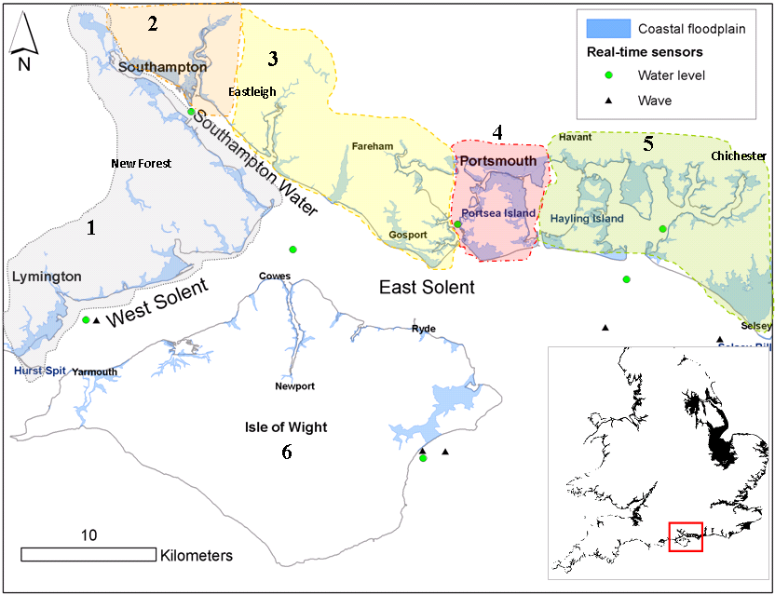
Flood Case Study: The Solent
Source: Wadey et al., 2012

Slide 12
Southampton
Annual sea levels:1935 to 2010
10 March 2008
Annual extreme
level
Trend = 1.2 mm/yr
Mean level
Trend = 1.4 mm/yr

Slide 13
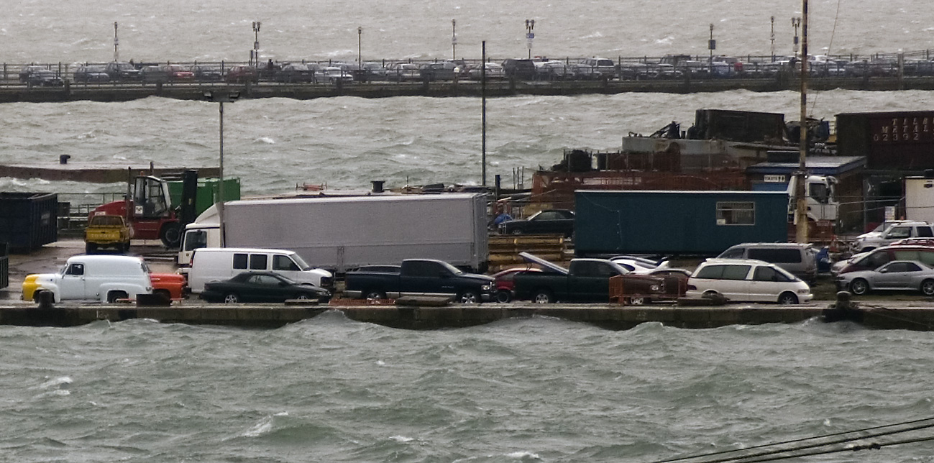
Southampton
10 March 2008, high tide

Slide 14
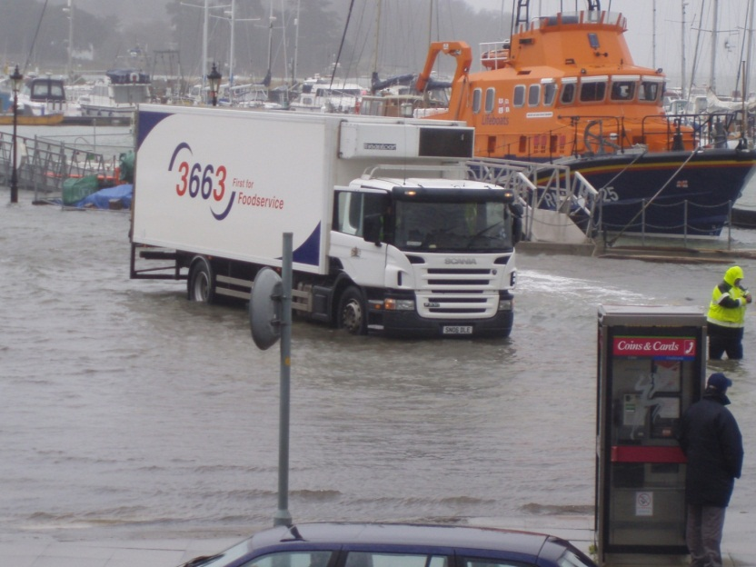
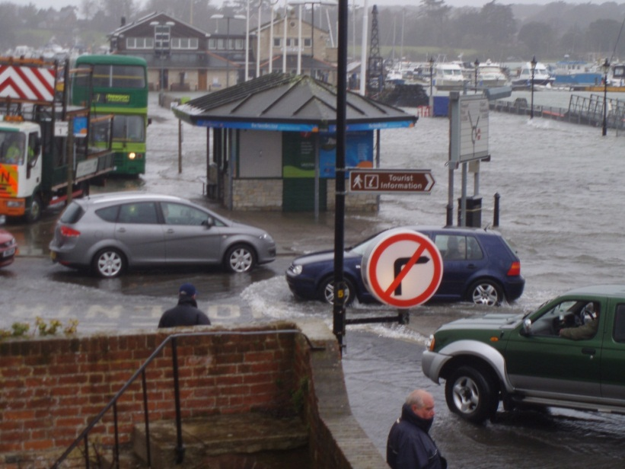
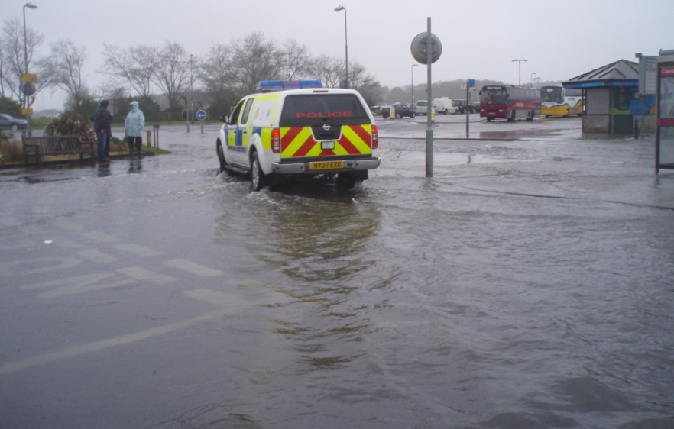
Yarmouth
10 March 2008, high tide

Slide 15
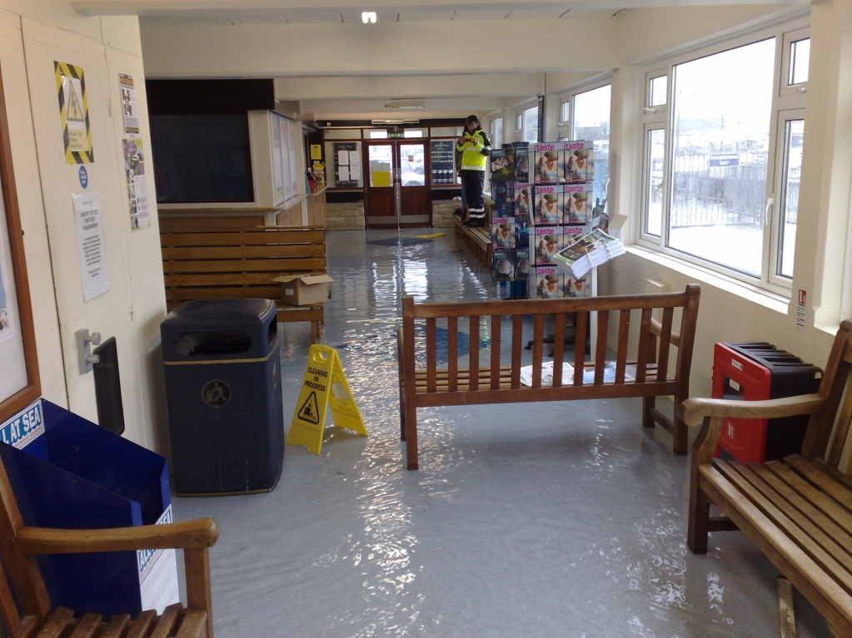
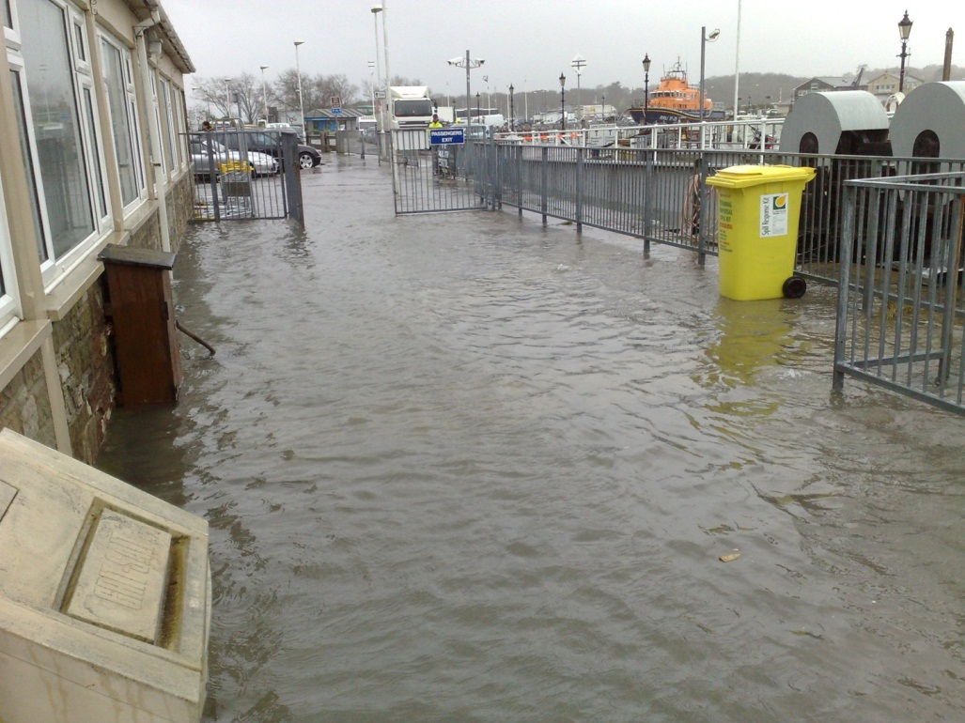
Yarmouth
10 March 2008, high tide

Slide 16
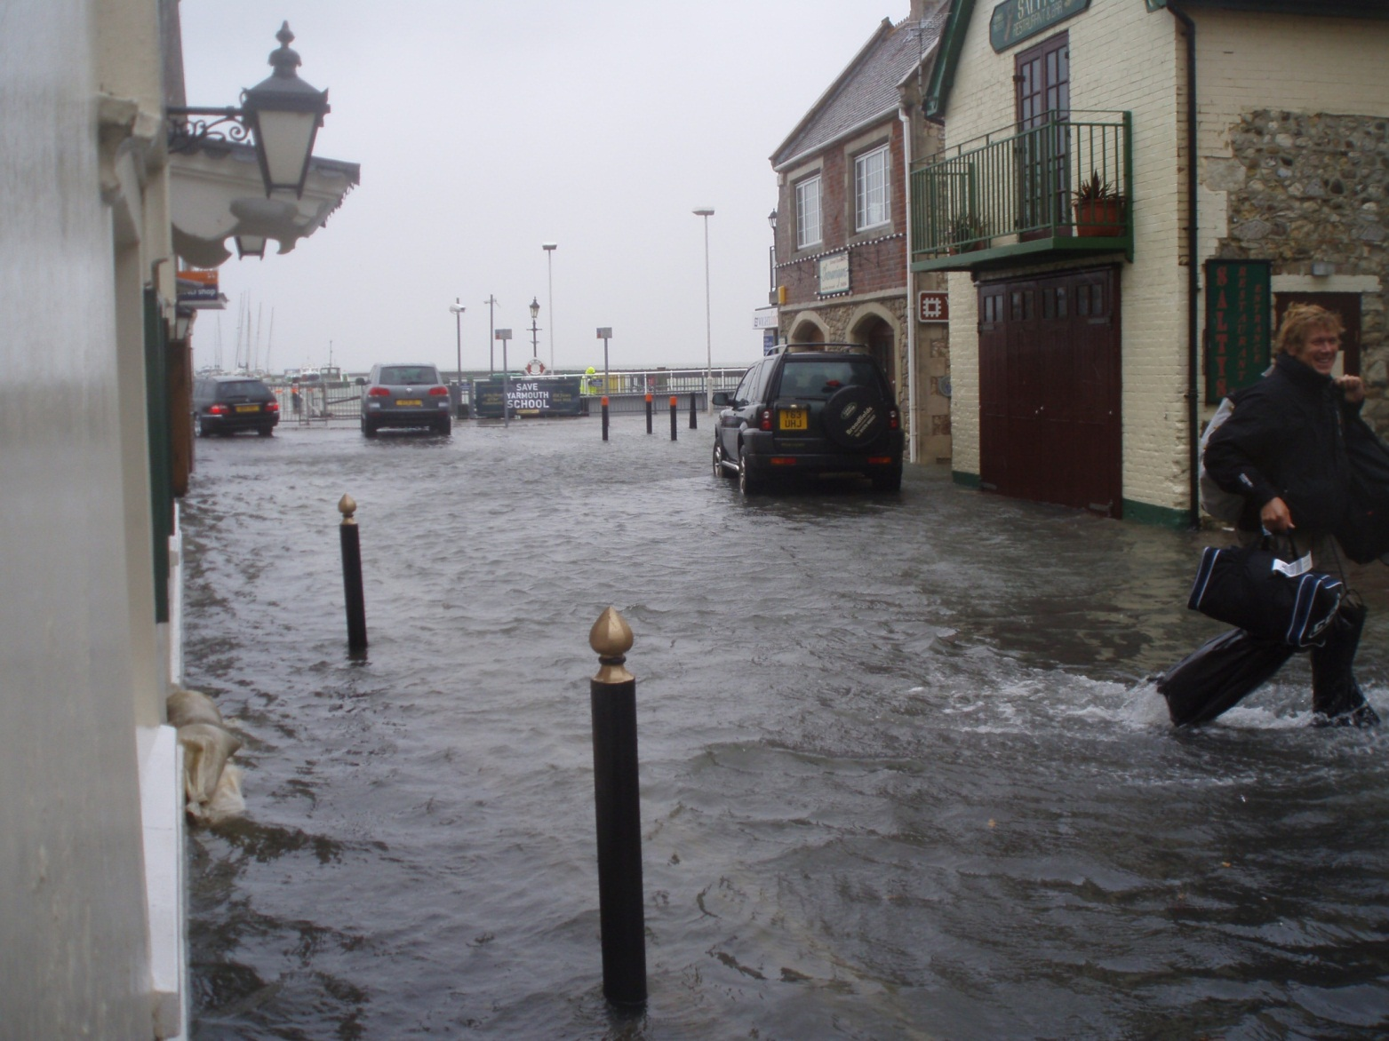
Yarmouth
10 March 2008, high tide

Slide 17
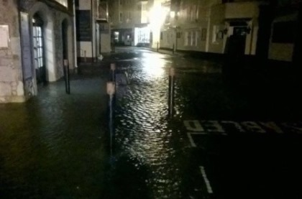
Yarmouth
29 October 2013, high tide

Slide 18
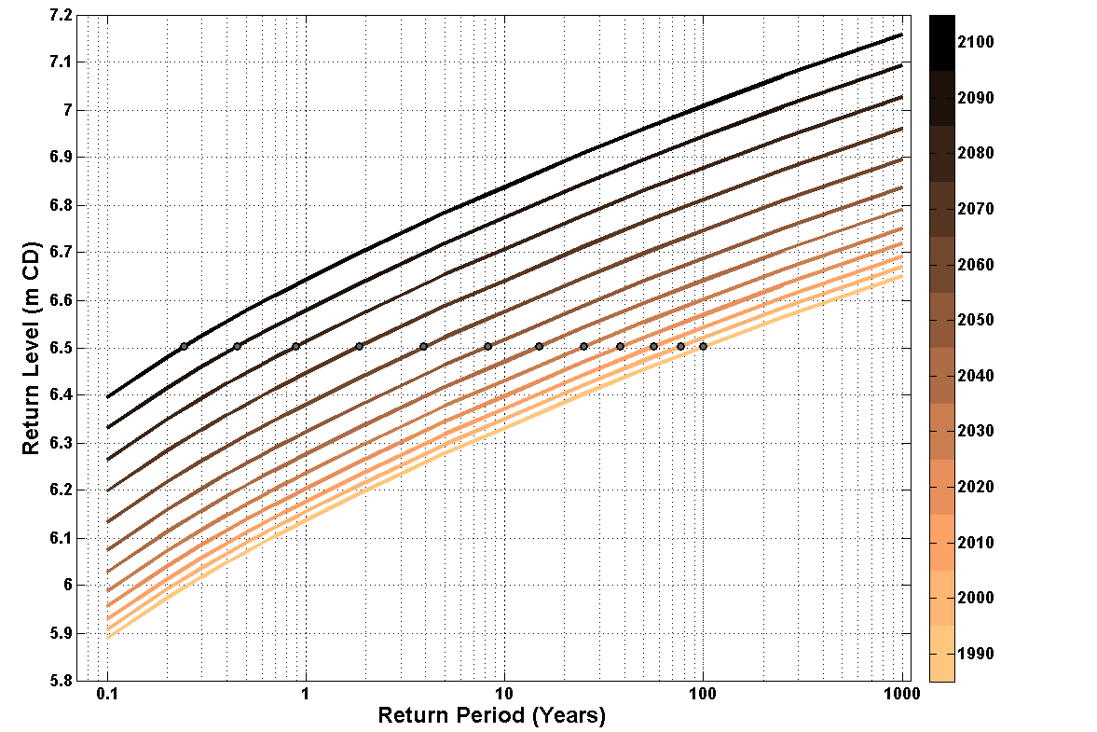
Sea level in the English Channel
Changes at Newlyn (50cm rise in 100 years)
Notes:
Isopleths are lines of sea level rise from 2000 to 2100 at intervals of 10 years. eg Take sea level of 6.5 m above datum at Newlyn. light grey ( in 2000) shows that 6.5m could be exceeded every 100 years,
Whilst in 2100 ( top dark line) 6.5m could be exceeded every 6 months

Slide 19
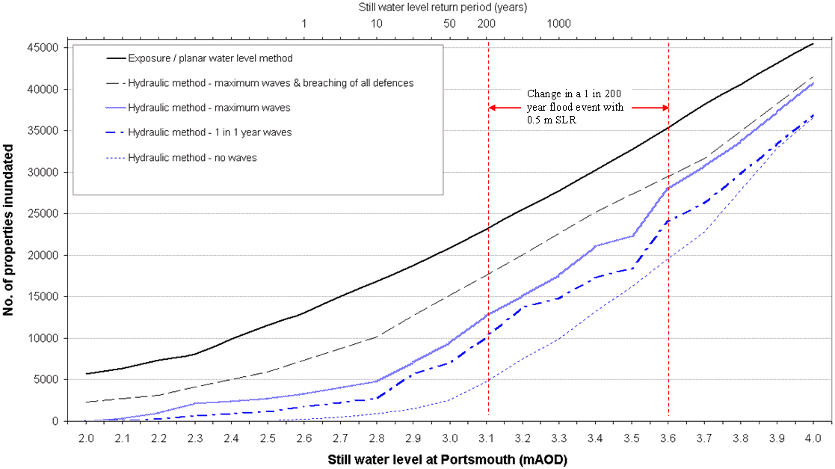
Modelled flood events in the Solent
Loads & failure mechanisms vs. number of properties flooded
10 March 2008
Source: Wadey et al., 2012

Slide 20
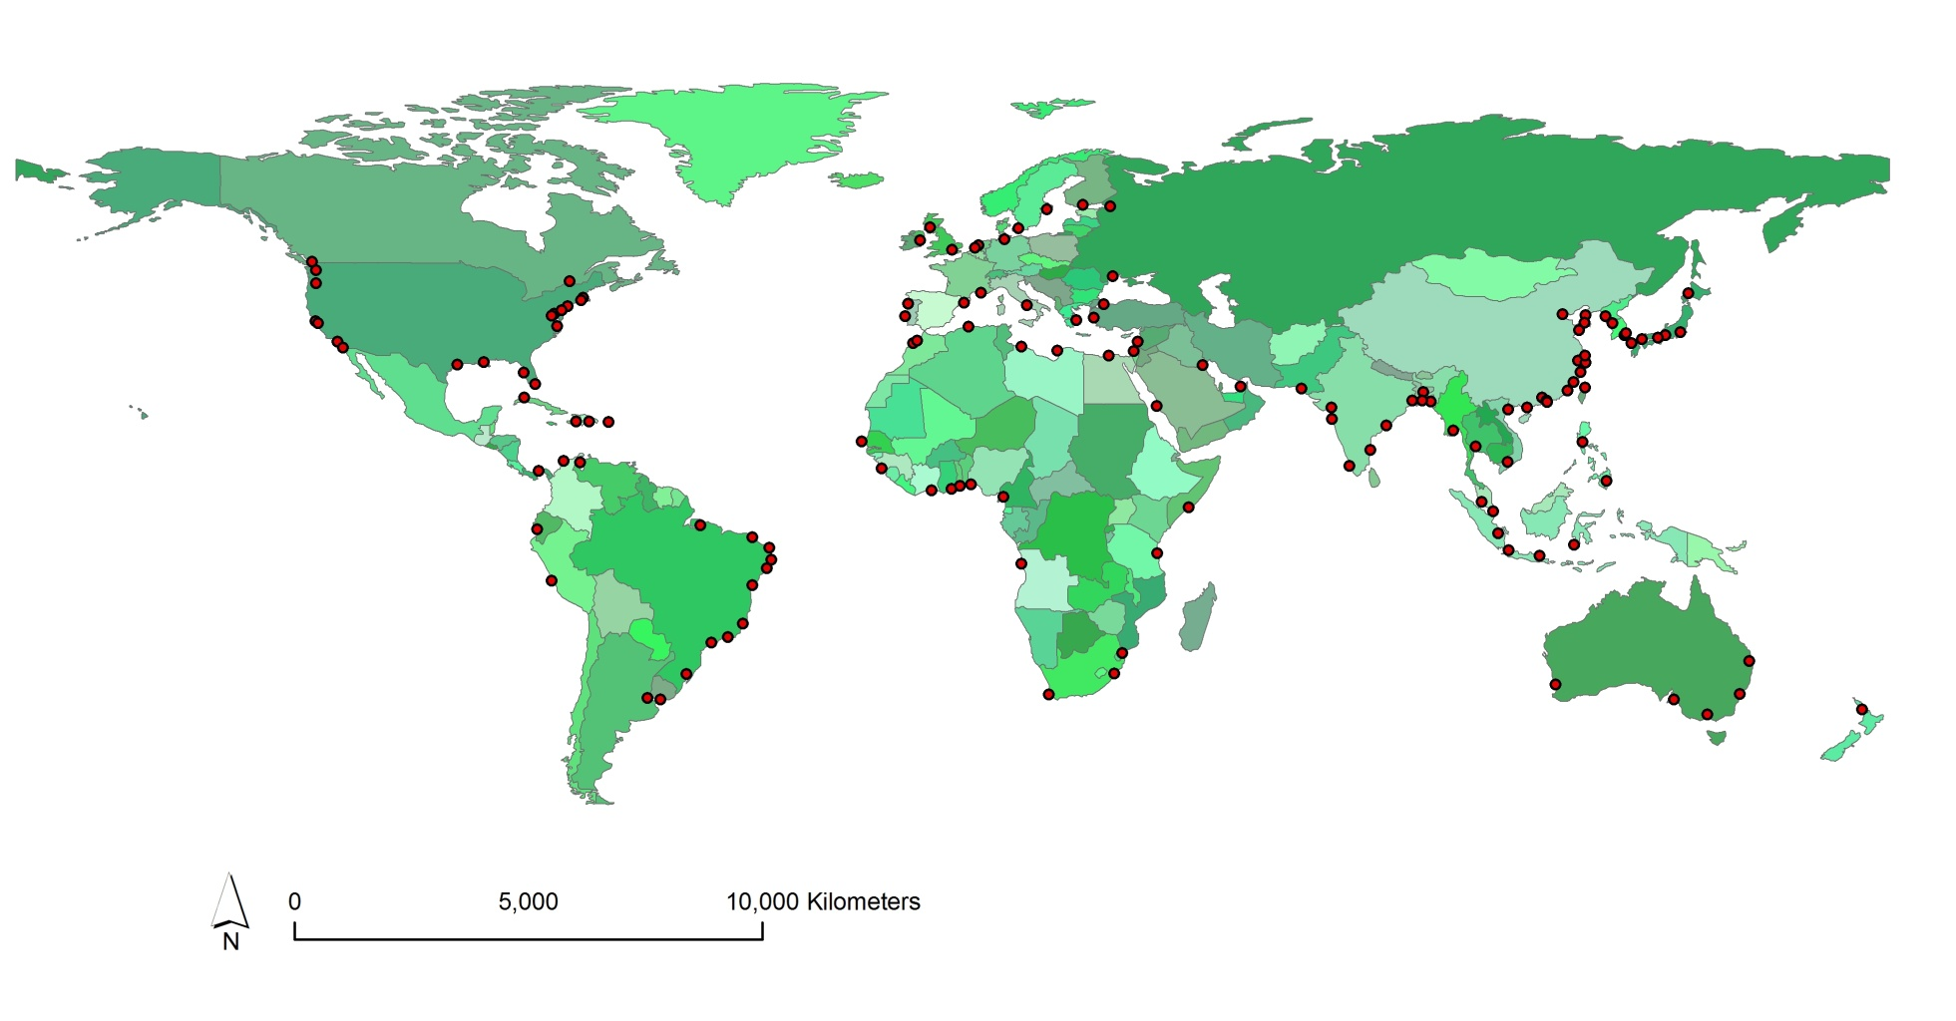
Port City Locations
>1 million population in 2005 (136 locations)
Port Cities
USA 17 locations
China 14 locations
Brazil 10 locations
Key global results for the flood plain
40 million people
  0.6% of global population
  (10% of port city population)
US $3000 billion of assets
  5% of global GDP

Slide 21
Flood Risk (1)
(Hallegatte et al., 2013)
Risk – expected annual losses
Average global coastal flood losses with no adaptation
  $6 billion per year in 2005
  $52 billion per year in 2050 with socio-economic change alone.
  With additional sea-level rise of 20 cm by 2050 and subsidence in susceptible cities, losses rise to $1 trillion per year.
  Conclusion: Adaptation is essential

Slide 22
Flood Risk (2)
(Hallegatte et al., 2013)
Indicative adaptation costs are a few billion US dollars per city in initial investment, plus approximately 2% annual operation and maintenance costs.
This is approximately $50 billion per year for the 136 cities.
When losses do occur, we should expect larger coastal flood disasters than we experience today –due to greater exposure and larger flood depths.

Slide 23
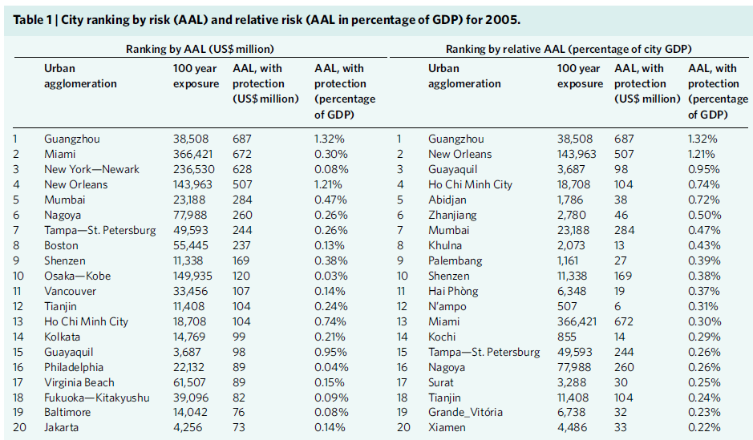
City Risk Ranking in 2005
Source Hallegatte et al. (2013)

Slide 24
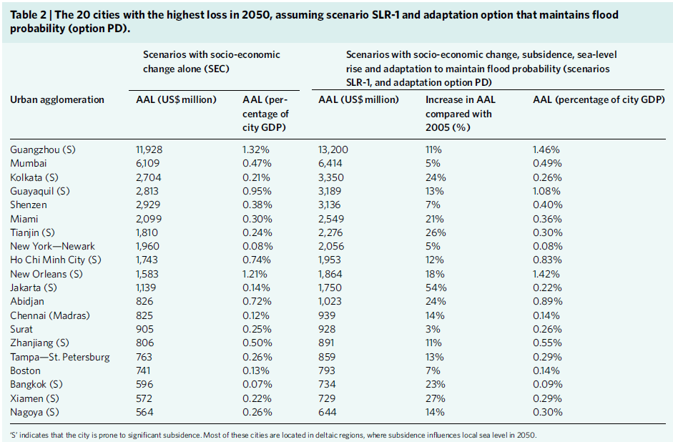
City Risk Ranking in 2050
Source Hallegatte et al. (2013)

Slide 25
Climate Mitigation
Responses

Slide 26
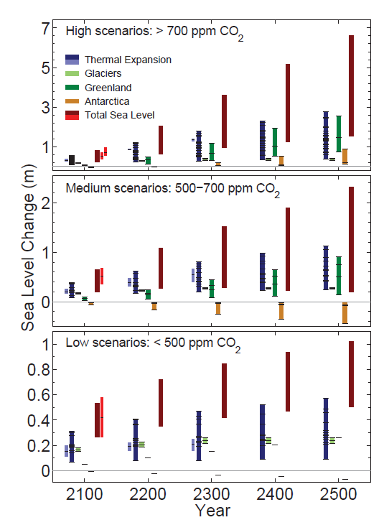
Post-2100 Sea-Level Rise
Commitment to sea-level rise
Source: IPCC, 2013, AR5 WG1

Slide 27
Coastal Adaptation

Slide 28
The Adaptation Process
Klein et al. (1999)
Mitigation
Climate
Climate
variability
change
Impacts
Information,
Planning,
Implemen
-
Monitoring,
Awareness
Design
tation
Evaluation
Existing
management
practices
Other
Policy
Coastal
development
stresses
criteria
objectives
Adaptation

Slide 29
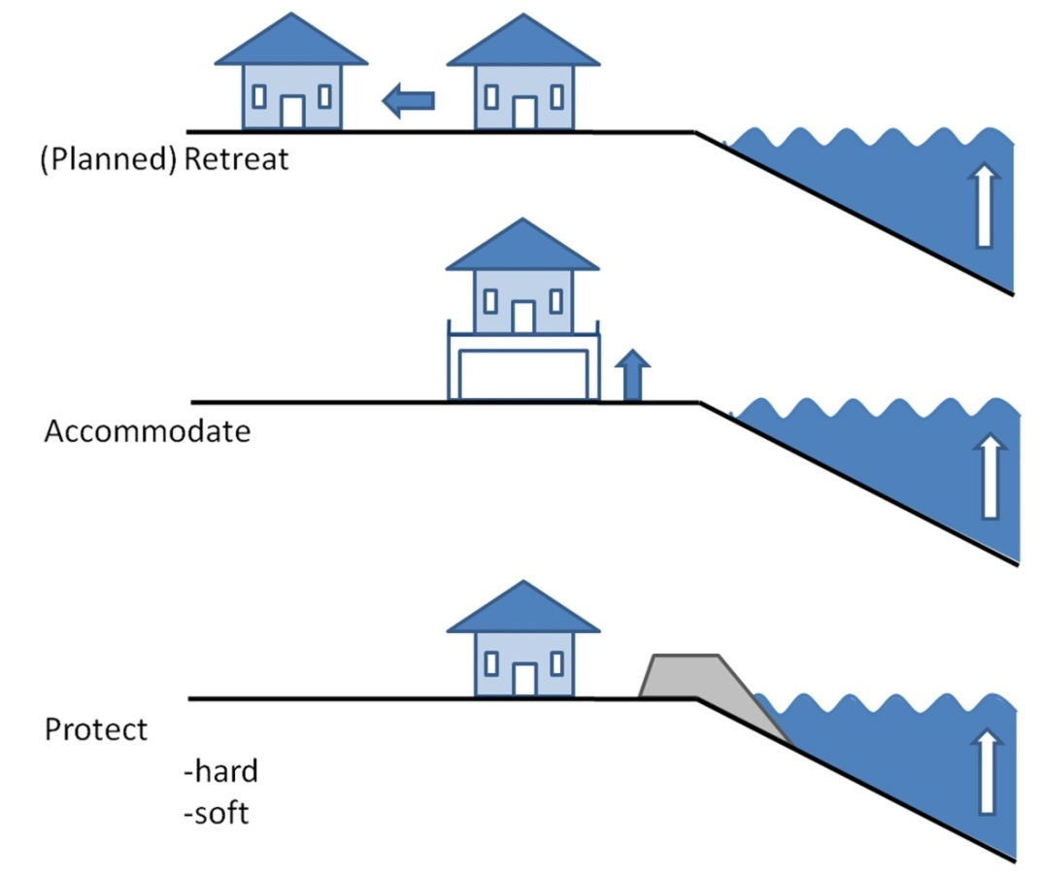
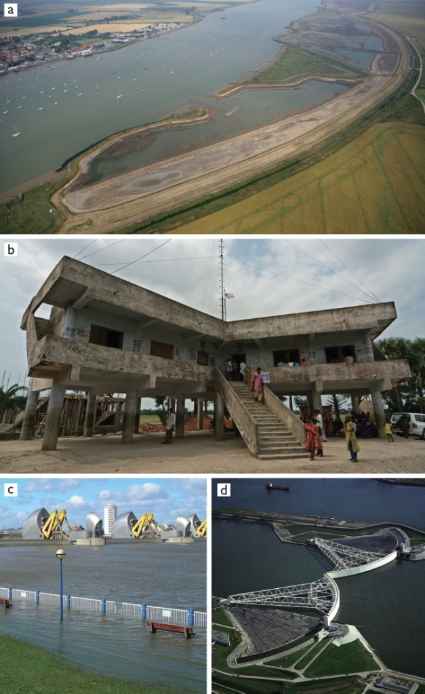
Planned Adaptation
The IPCC Approach
Source: Nicholls (2010) Book on “Understanding Sea-Level Rise and Variability”

Slide 30
Many Adaptation Options are Available
P – Protection; A – Accommodation; R – Retreat.
NATURAL SYSTEM EFFECT |  | POSSIBLE ADAPTATION RESPONSES
1. Inundation, flood and storm damage | a. Surge | Dikes/surge barriers [P], Building codes/floodwise buildings [A], Land use planning/hazard delineation [A/R].
 | b. Backwater effect
2. Wetland loss (and change) |  | Land use planning [A/R], Managed realignment/ forbid hard defences [R], Nourishment/sediment management [P].
3. Erosion (of ‘soft’ morphology) |  | Coast defences [P], Nourishment [P], Building setbacks [R].
4. Saltwater Intrusion | a. Surface Waters | Saltwater intrusion barriers [P], Change water abstraction [A/R].
 | b. Ground-water | Freshwater injection [P], Change water abstraction [A/R].
5. Rising water tables/ impeded drainage |  | Upgrade drainage systems [P], Polders [P], Change land use [A], Land use planning/hazard delineation [A/R].
Source: Nicholls (2010) Book on “Understanding Sea-Level Rise and Variability”

Slide 31
Portfolio of Adaptation Measures for Coastal Cities
Flood warning systems
Subsidence mitigation (in susceptible cities)
Upgraded defences (availability of land)
Flood resilient construction
Land use planning
Disaster preparedness
Source: Nicholls et al., 2008, OECD Report

Slide 32
Managing Flood Risk
Contrasting approaches
Risk
more people/property
climate change
ageing FD
Unacceptable
Tolerable
As low as reasonably possible
2007
2050
2100
Source: Tim Reeder, Environment Agency
Time

Slide 33
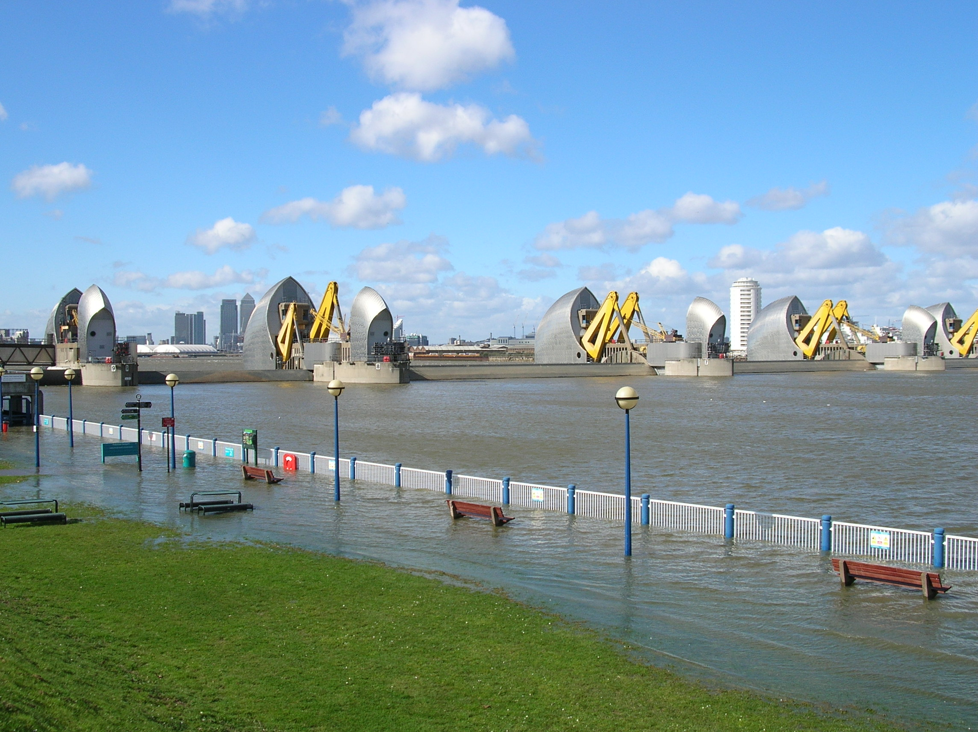
London’s Future Flood Defences

Slide 34
Defra and upper part of new TE2100 likely range
Top of new H++ range
Previous Extreme
Max water level rise:
0m
1m
2m
3m
4m
HLO 1
Improve Thames Barrier and raise d/s defences
HLO 2
Over-rotate Thames Barrier and restore interim defences
Flood storage, improve Thames Barrier, raise u/s & d/s defences
Existing system
Raise Defences
Flood storage, over rotate Thames Barrier, raise u/s & d/s defences
Flood storage, restore interim defences
HLO 3a
New barrier, retain Thames Barrier, raise defences
HLO 4
HLO 3b
New barrier, raise defences
New barrage
London: Adaptation Pathways
Source: Tim Reeder, Environment Agency

Slide 35
Concluding Remarks
Sea-level rise is occurring with climate change being a fundamental component;
This is almost certain to accelerate, but with substantial uncertainty and a long timescale;
Sea-level rise exacerbates coastal hazards (e.g., flooding during coastal storms);
Mitigation (global scale) and adaptation (local scale) need to applied together;
Adaptation is an ongoing process, with technical, social and political dimensions;
Planning via adaptation pathways that explicitly include learning is effective to the uncertainties.

Slide 36
Sea-Level Rise:
Impacts and Responses
Prof. Robert J. Nicholls
Faculty of Engineering and the Environment and
Tyndall Centre for Climate Change Research
University of Southampton
United Kingdom
Email: R.J.Nicholls@soton.ac.uk
Transatlantic Solutions to Sea Level Rise Adaptation: Moving Beyond the Threat
Ted Constant Convocation Center, Old Dominion University, Norfolk, Virginia
October 30-31, 2013

