Slide 1
The Evolving Understanding of Climate Risk: The Challenge that won’t go away…
Rear Admiral Dave Titley, USN (ret.), Ph.D.
Director, Center for Solutions to Weather and Climate Risk
Penn State University
Climate Change. Challenges. Solutions
30 October 2013
UNCLASSIFIED

Slide 2
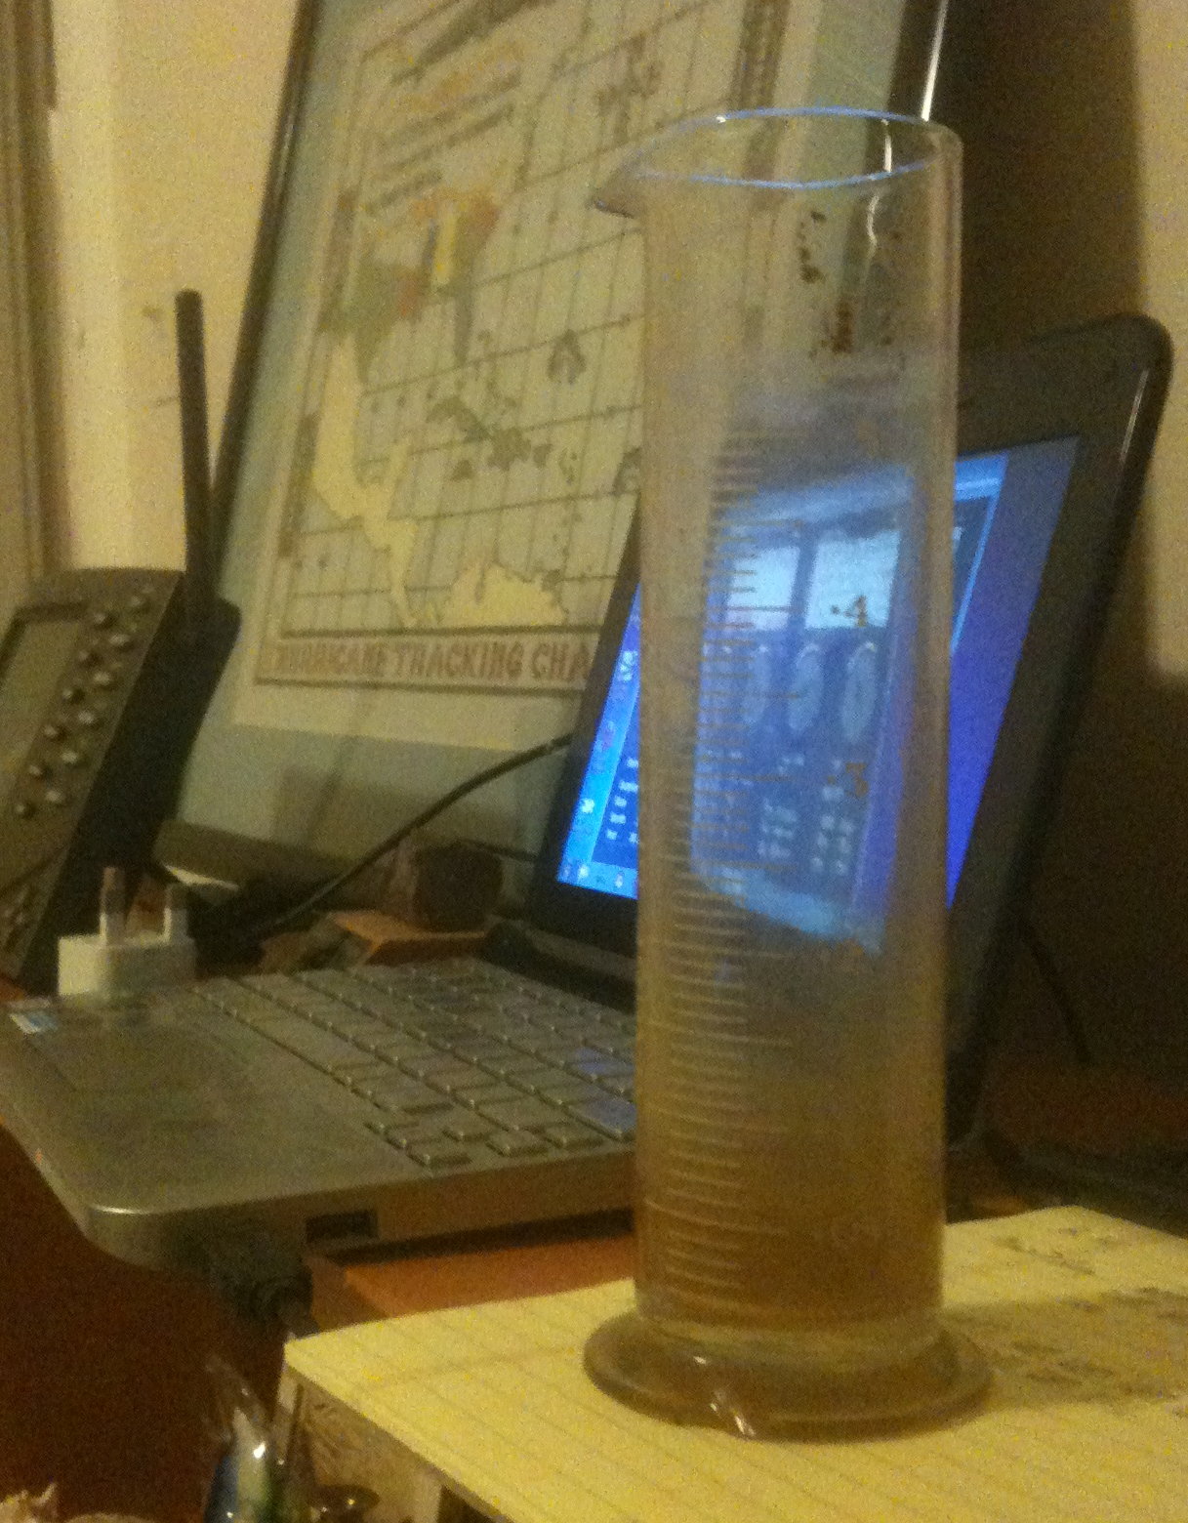

Slide 3
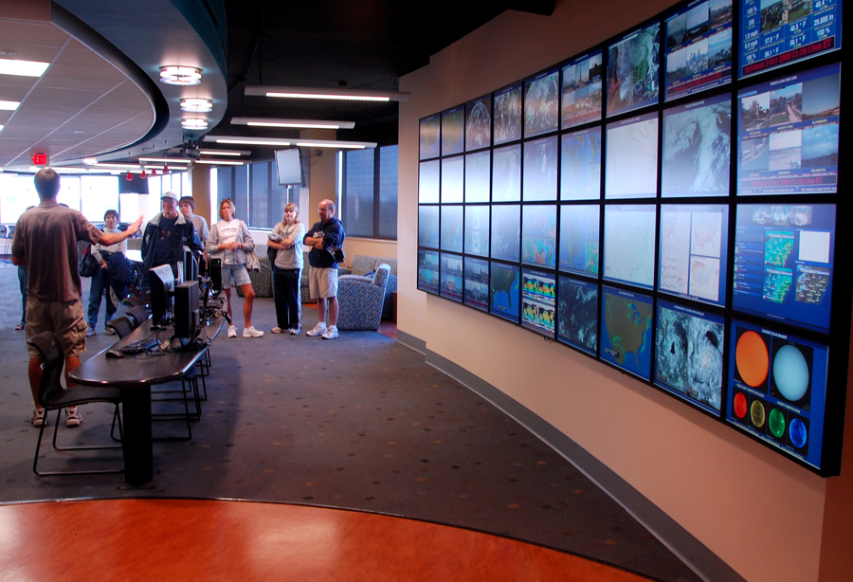
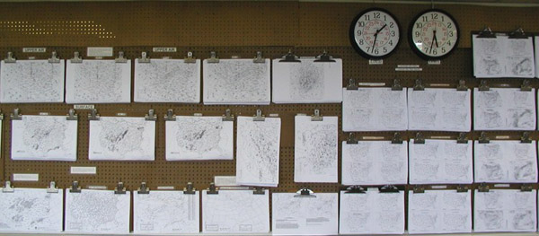

Slide 4
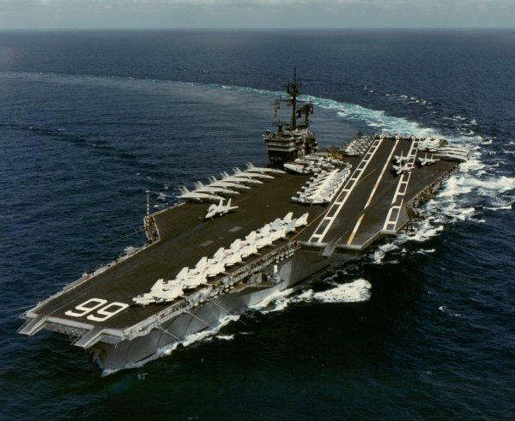
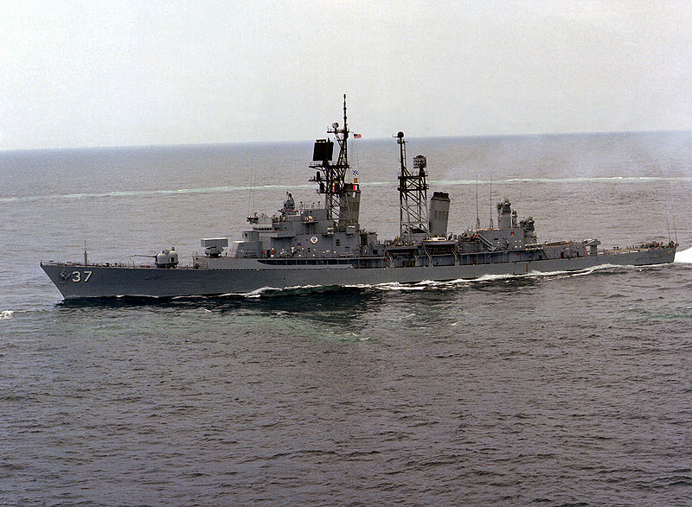
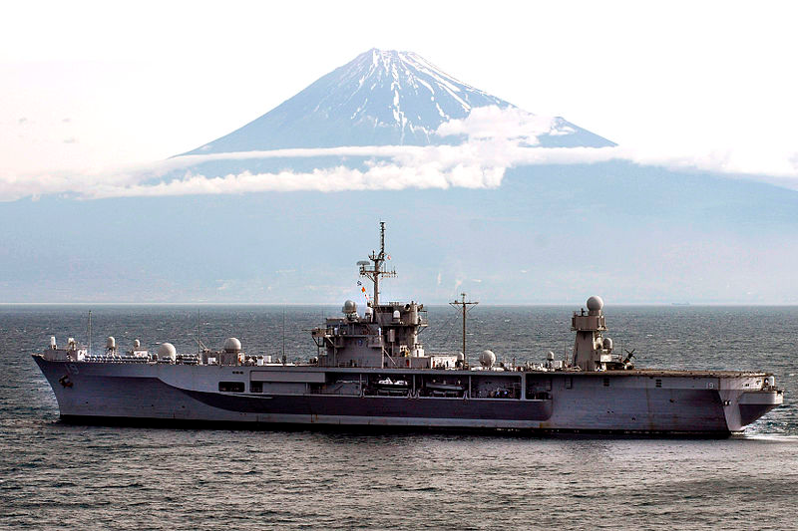
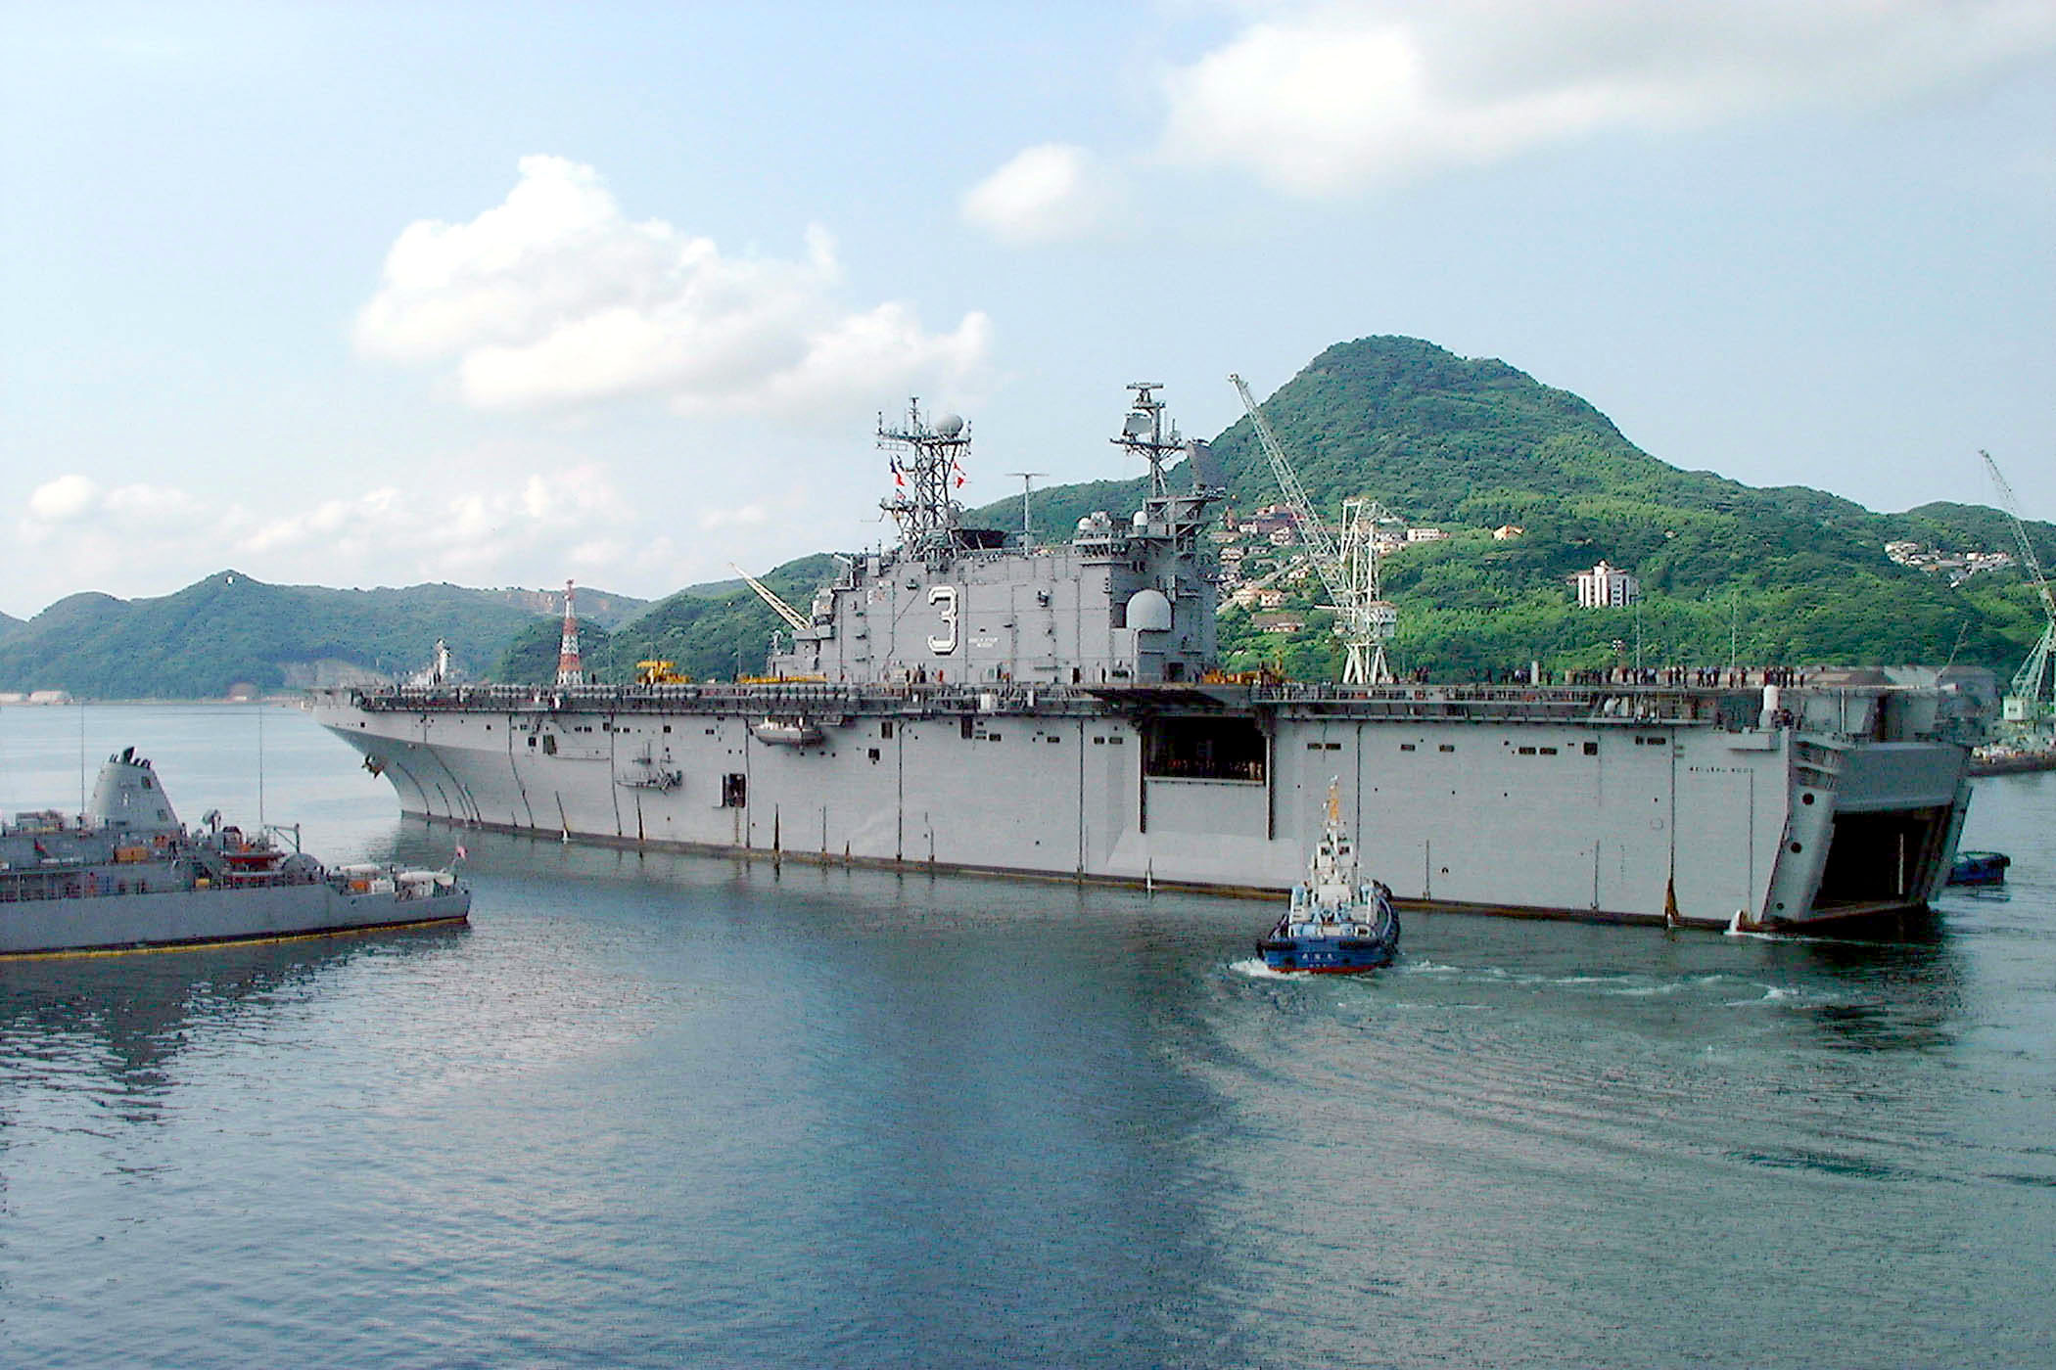
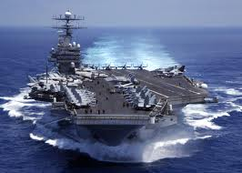

Slide 5
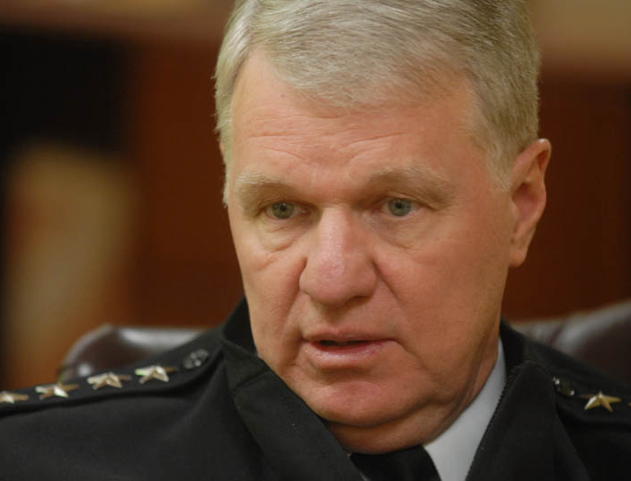

Slide 6
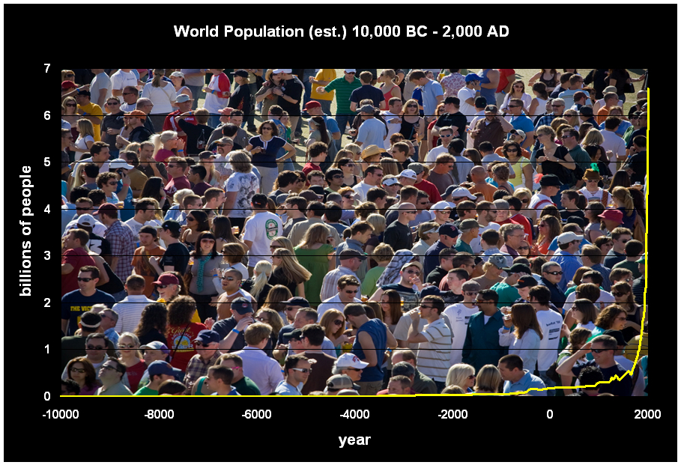
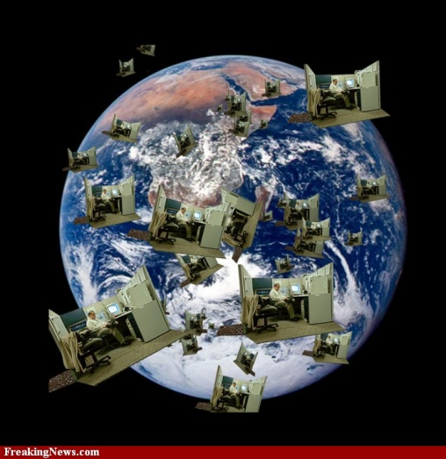
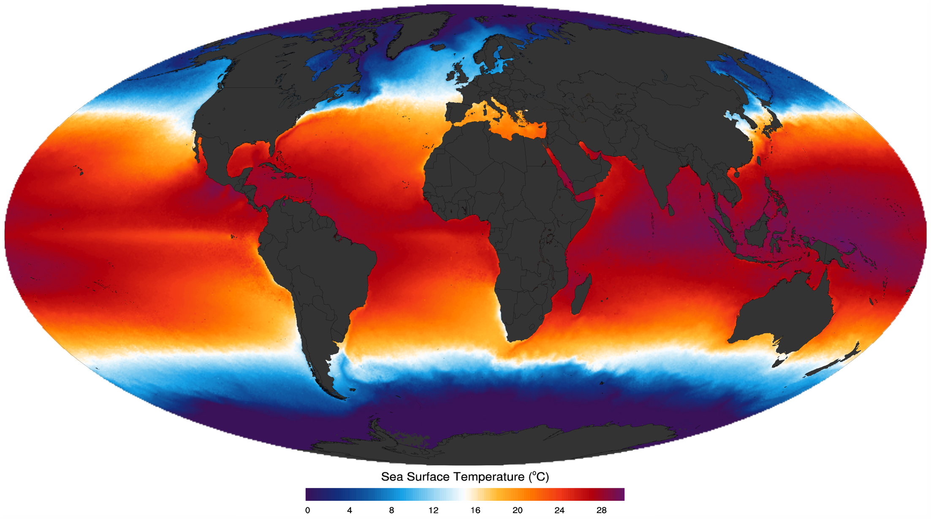
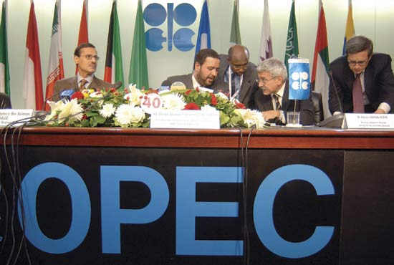
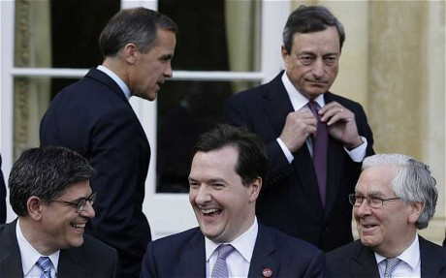
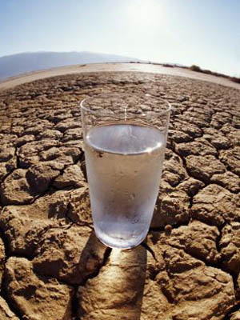

Slide 7
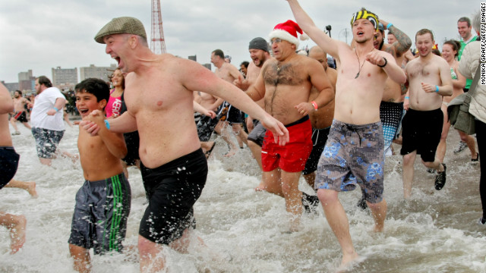
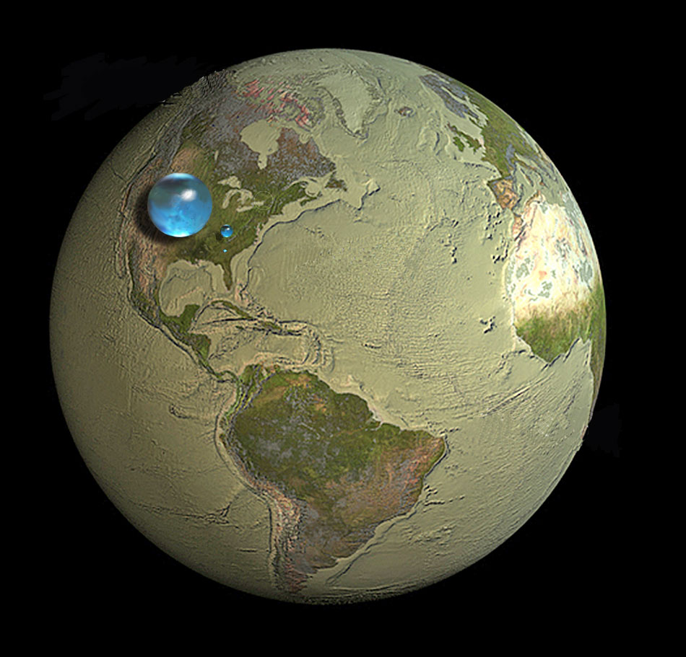
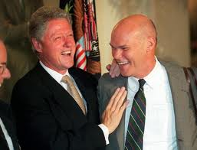
Why Care?
It’s About People
It’s About
Water
It’s About Change

Slide 8
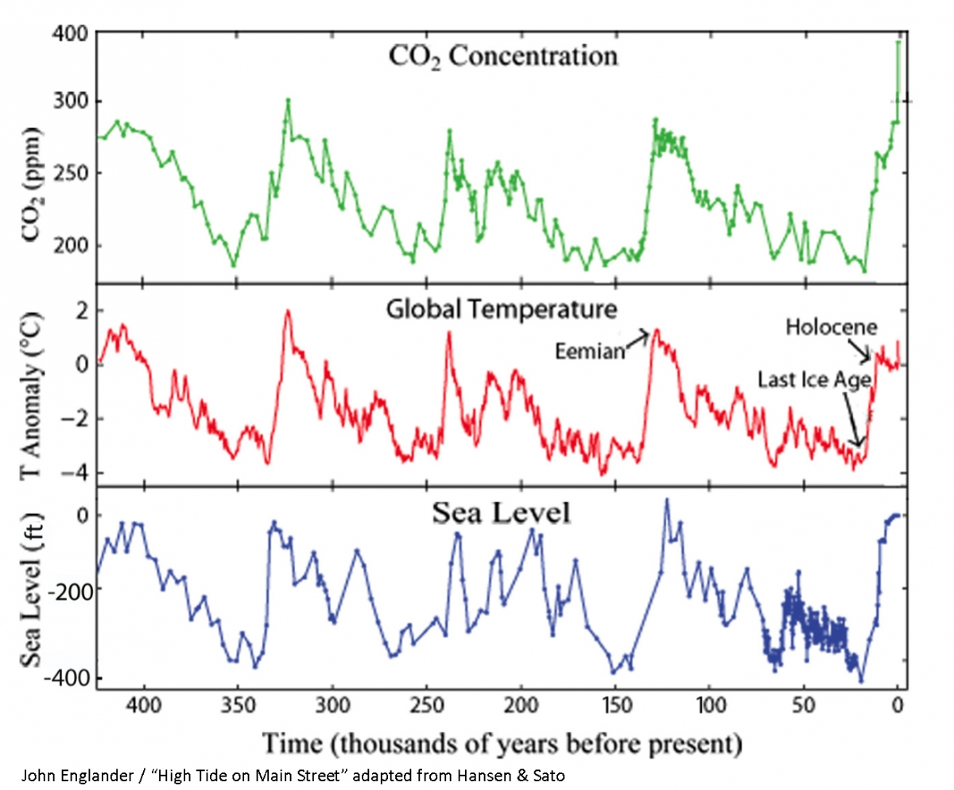
450K Years of Variability…

Slide 9
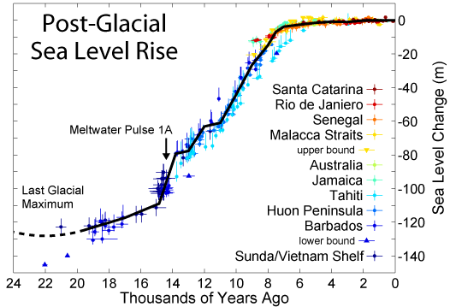
…but 8K Years of Stability

Slide 10
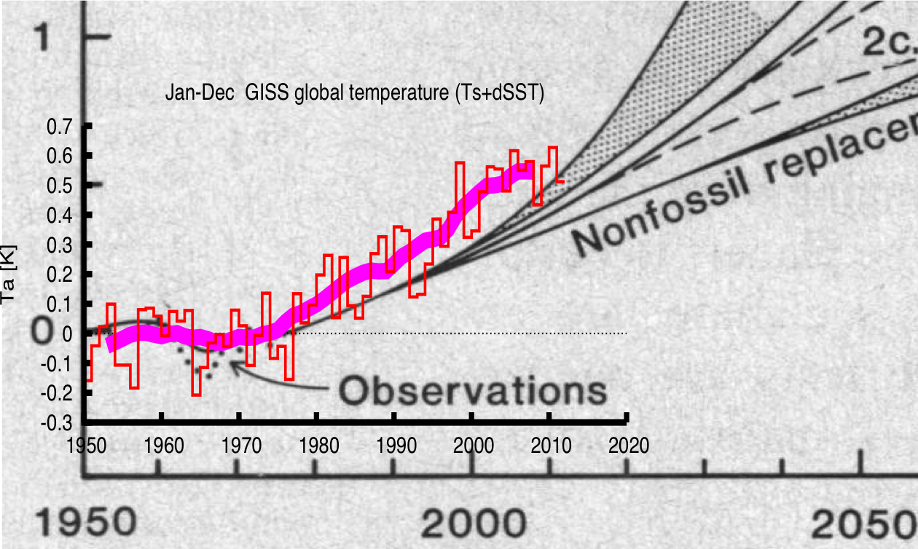
How are the models doing?

Slide 11
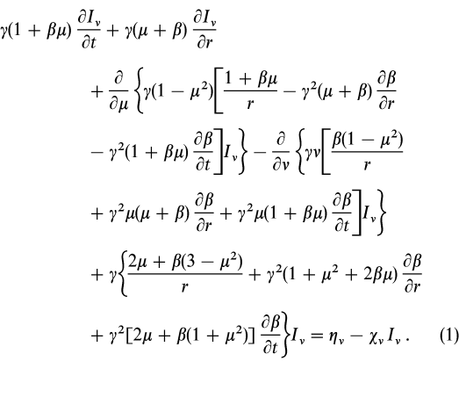
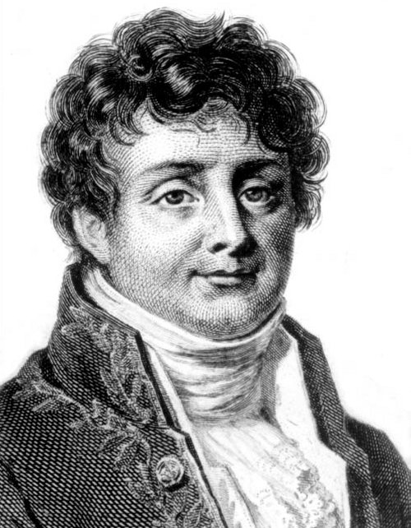
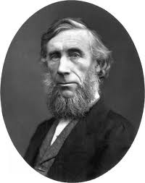
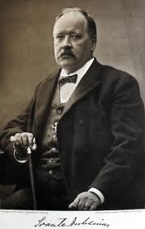
Notes:
1824 Jean-Baptiste Fourier calculates that the Earth would be far colder if it lacked an atmosphere. 1859 John Tyndall discovers that some gases block infrared radiation. He suggests that changes in the concentration of the gases could bring climate change.
1863
Abraham Lincoln establishes National Academy of Sciences 1896 Svante August Arrhenius publishes first calculation of global warming from human emissions of CO2

Slide 12
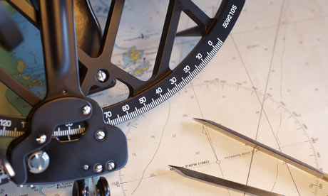

Slide 13
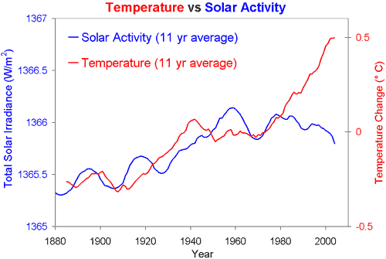

Slide 14
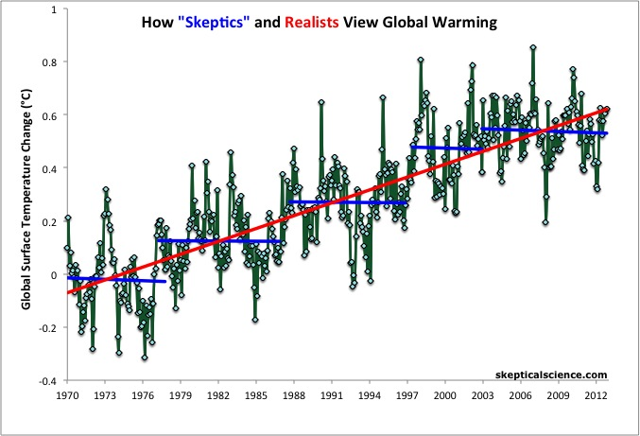
Global Air Temperature Anomalies

Slide 15
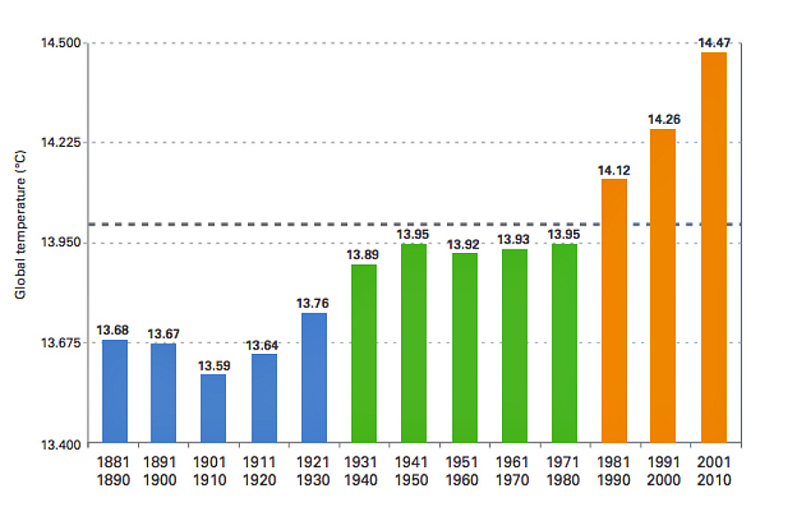
Decadal Global Sfc Temperatures
The Global Climate 2001-2010; WMO 2013

Slide 16
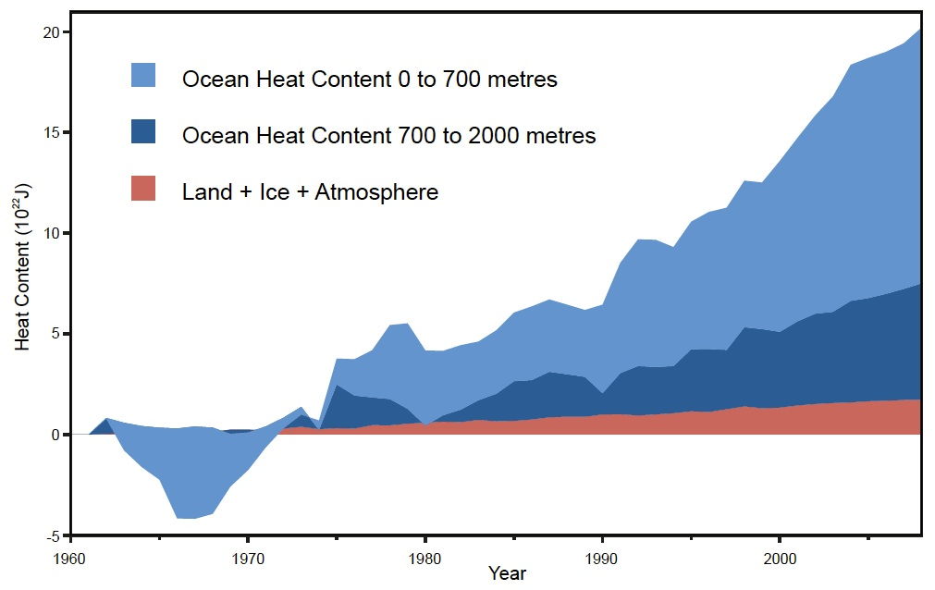
UNCLASSIFIED
Notes:
The Navy recognizes that the earth is warming, the ocean is storing most of the heat (and that’s important to the Navy, and that the Arctic is warming twice as fast as the rest of the planet.
Arctic warming is causing summer sea ice to rapidly melt and thin, thereby opening the region to increasing access and maritime activity.

Slide 17
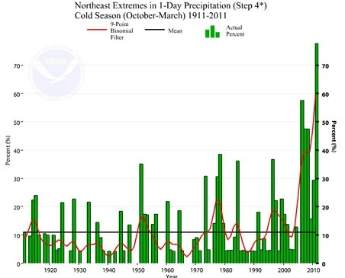

Slide 18
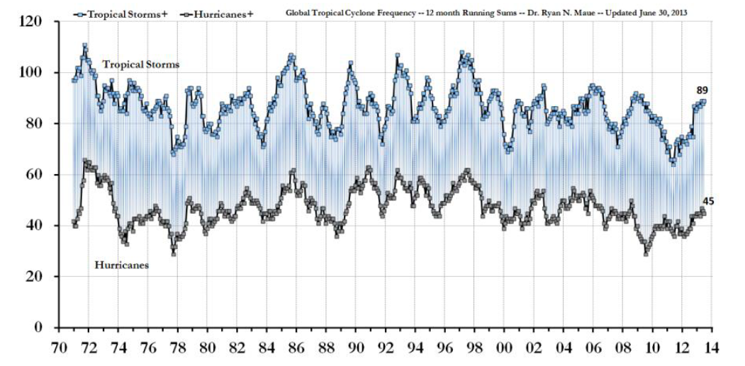
Global Hurricane / Typhoon Energy

Slide 19
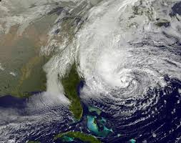
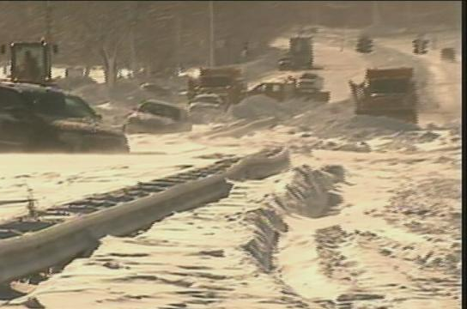
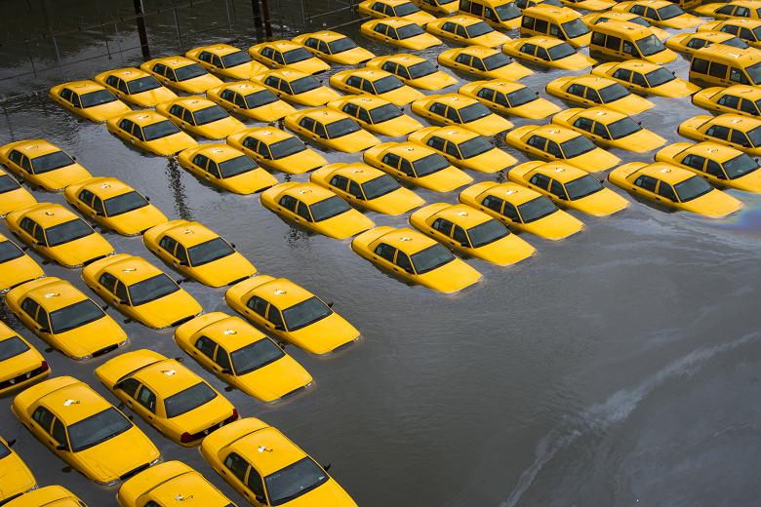
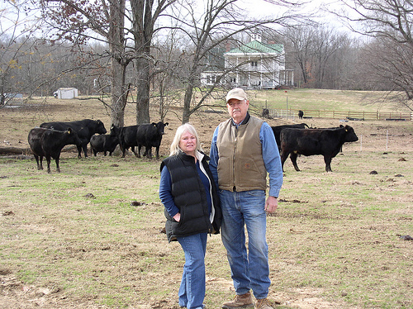

Slide 20
Arctic Sea Ice (1994 – 2012)

Slide 21
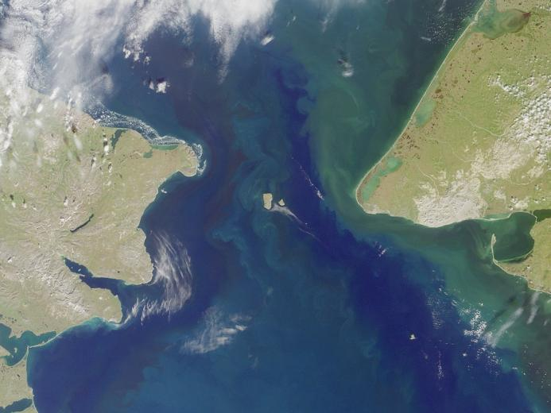
It’s an Ocean
It’s Changing
It’s not a Vacuum

Slide 22
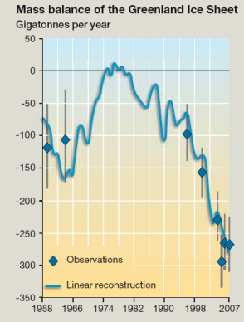
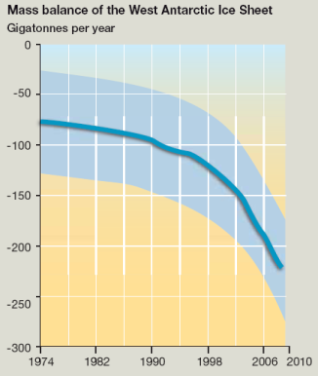
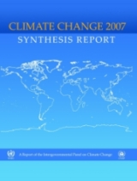
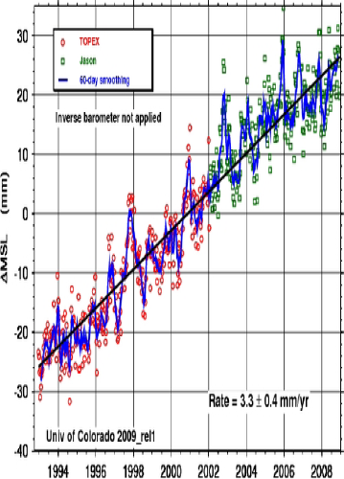
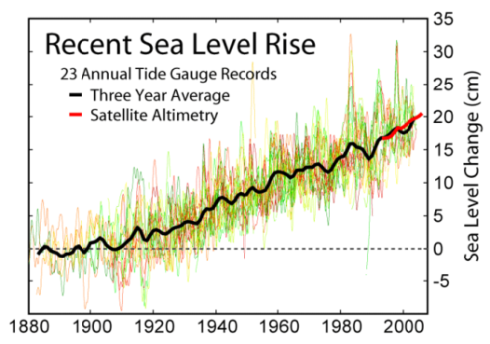
Sea Level Rise
21st Century
Sea Level Rise
?
Accelerating Ice Sheet
Mass Loss
Satellite Observations
Tide Stations
The Copenhagen Diagnosis, 2009
University of Colorado, Boulder, 2009
Douglas, 1997
Observation:
~2mm/yr
Observation:
~3.1mm/yr
Projection:
~2-6mm/yr
Projection:
10-20mm/yr?
Observation:
>50 Gt/yr
2007 IPCC AR4
1870-1992
1993-2006
2009
2010-2100

Slide 23
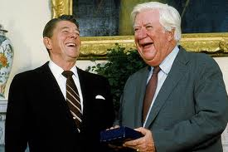

Slide 24
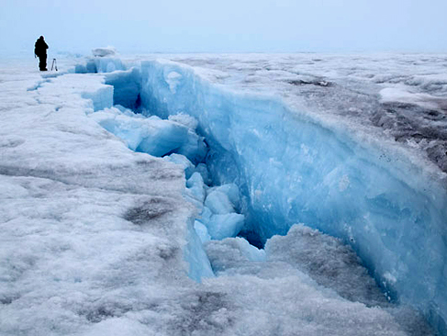

Slide 25
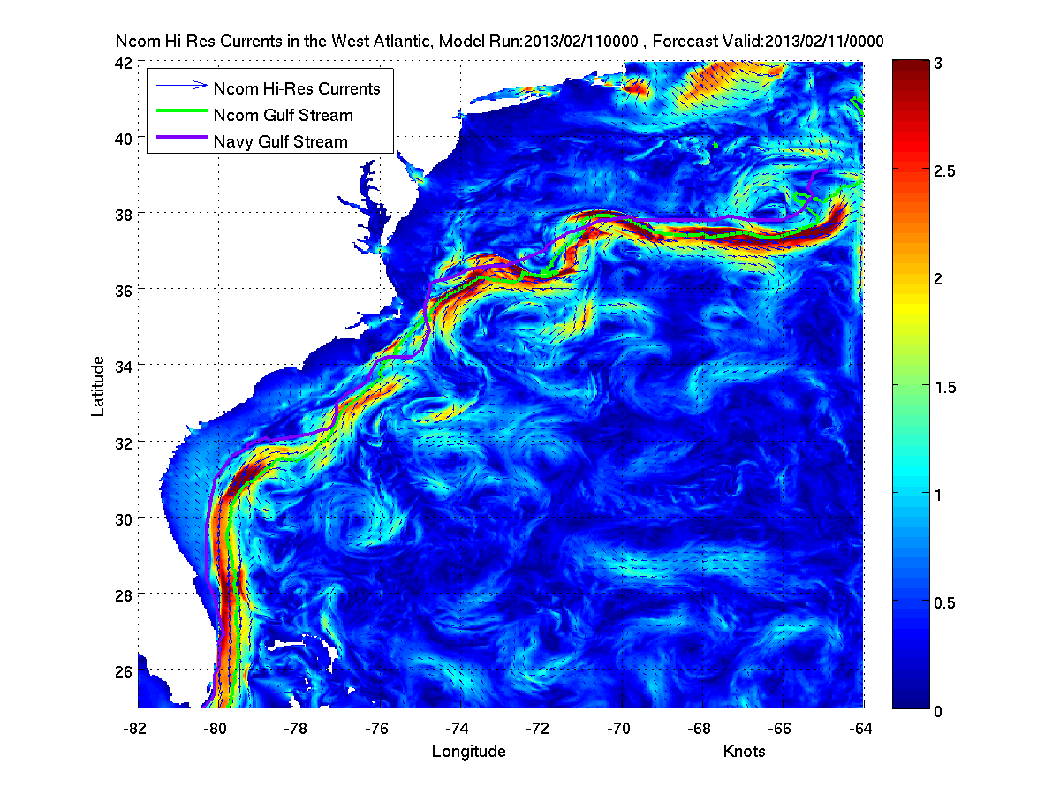

Slide 26
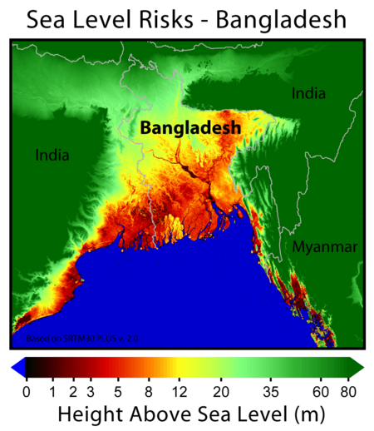
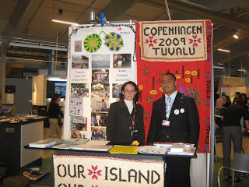
Where we usually think about…

Slide 27
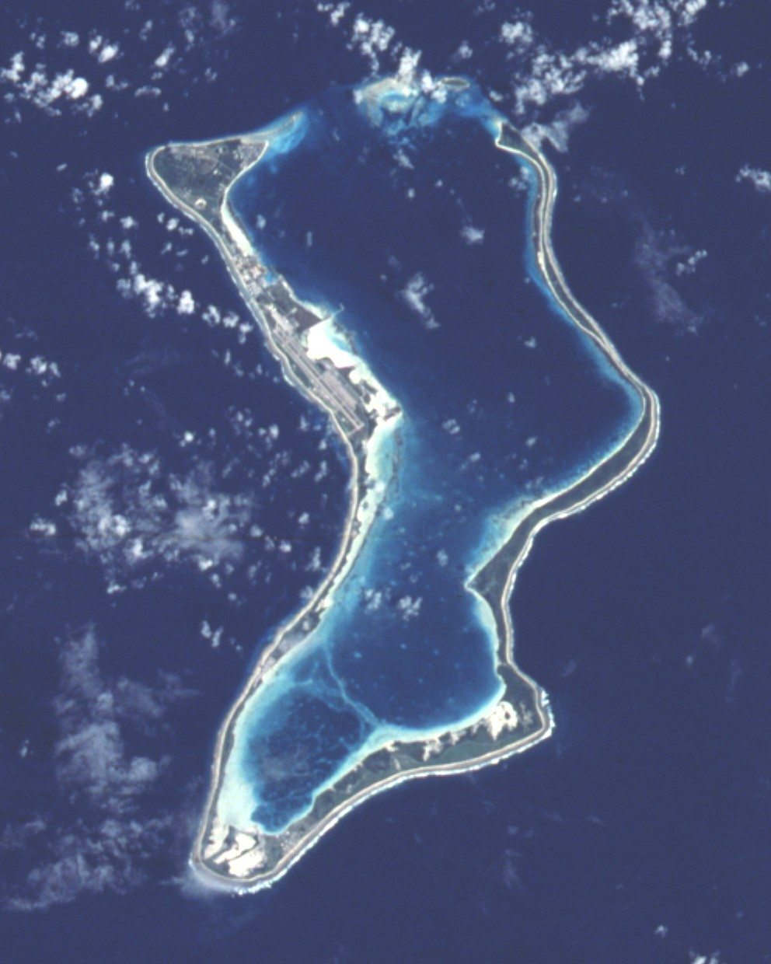

Slide 28
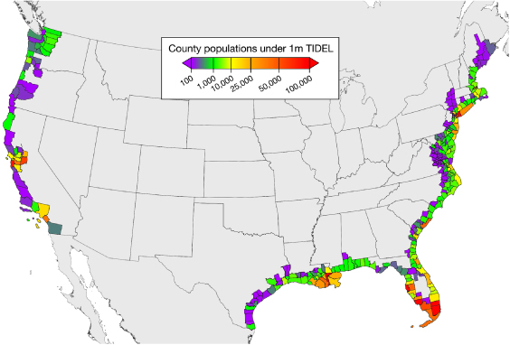
3.7M people within 1m of high tide
Benjamin H Strauss et al 2012 Environ. Res. Lett. 7

Slide 29
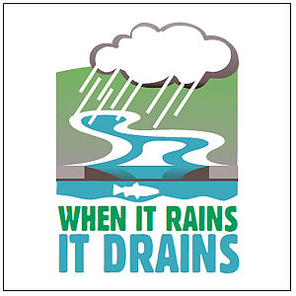
Additional impacts…

Slide 30
Some recent data and projections
Contribution to NYC Storm Surge
Kemp & Horton, J. Quaternary Sci, 2013

Slide 31
What about the Netherlands?

Slide 32
Assessing & Managing Climate Security Risk
An Adaptation Methodology
Climate Change
Projections
Uncertainty
Quantification
Climate Change
Observations
Adaptive
Management
Impact
Assessment
Risk Assessment
UNCLASSIFIED
32

Slide 35
Surprises still to come…

Slide 36
Initial Navy investments in today’s budget
Improving Prediction Capability
Earth System Prediction Capability
Recapitalize aging suite of global atmospheric models
Interagency collaboration
TC Forecasts
Sea Level Rise
GHG Monitoring
Revolutionary advancement National
predictive architecture
Extreme Weather,
Floods, Droughts
National Security
Arctic
UNCLASSIFIED
36

Slide 37
We Can’t do this Ourselves
NATIONAL
INTERAGENCY
INTERNATIONAL
DOD
SCIENTIFIC, ACADEMIC, & ANALYTICAL
Engaged nearly 450 individuals from over 125 organizations
Notes:
This slide includes most of the organizations with which TFCC has engaged:
National: OSTP Director
International:
Canada, UK, Finland, Sweden, Russia, Norway, Denmark, IHO, WMO, International Ice Patrol, Canadian Ice Service, North American Ice Service
Interagency:
Depts of State, Commerce, Interior, Energy
NASA, USGS, ORNL, LANL, LDEO, USCG, NCEP, NCAR, NOAA
DOD:
OSD, CJCS, USNORTHCOM, USEUCOM, USPACOM, CPF, ALASKA COMMAND, DON, DOA, DOAF, USMC, USACE, AFWA, USFF, C2F, C3F, CSF, ASL, NAVFAC, NRL, ONR, CNMOC, MSC
Science, Academic, Analytical: (L to R)
CAN, NRAC, COL, USNA, NPS, NDU, NWC, Univ of the Arctic (Flower), USARC, National Academies, NSF, WHOI, SIO, APL-UW & APL-UW PSC, OSU, UMd, UAF, UNH

Slide 38
It’s about Leadership

Slide 39
Regional Action…

Slide 40
60K Years of Variability
Unstable
Burroughs
Stable
(Really)
Old
Today
Time
40
“History is a race between education and catastrophe.” – H. G. Wells

Slide 42
Waveland MS … past or future?

Slide 46
Discussion

