Slide 1
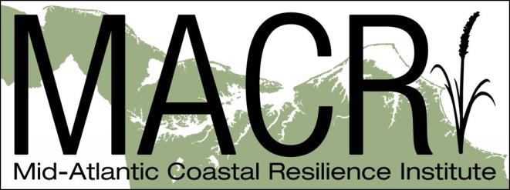
Mid Atlantic Coastal
Resilience Institute
(MACRI)
The Research, Public Policy, and Business Case
MARI & CCPO Old Dominion University
Fall 2014 Seminar Series

Slide 2
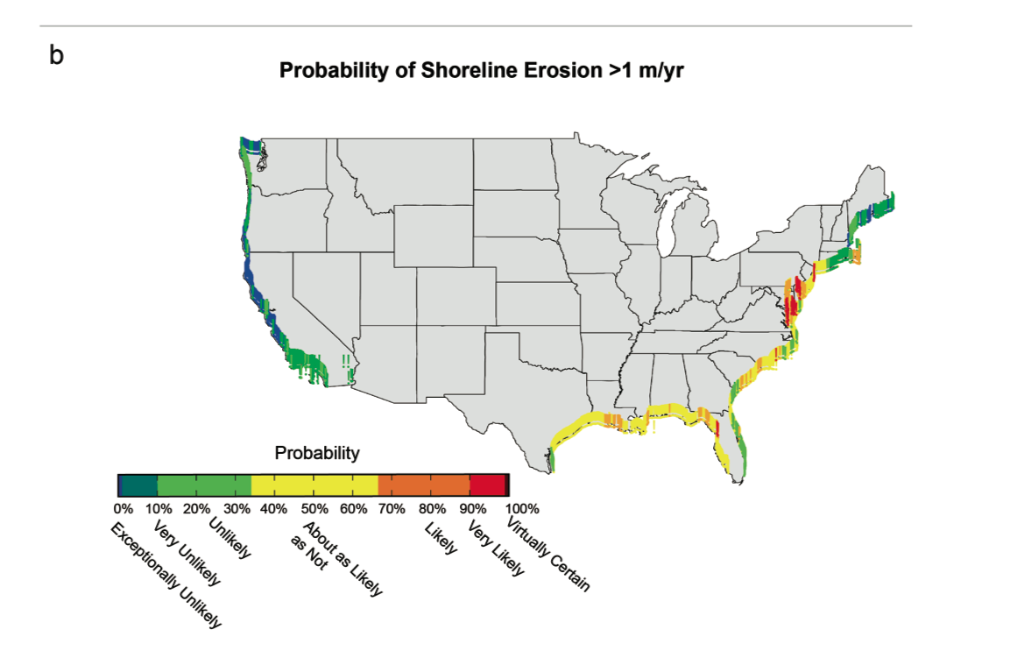
Shoreline Erosion
(Draft National Climate Assessment Released for Public Comment)
Source: http://www.globalchange.gov/what-we-do/assessment

Slide 3
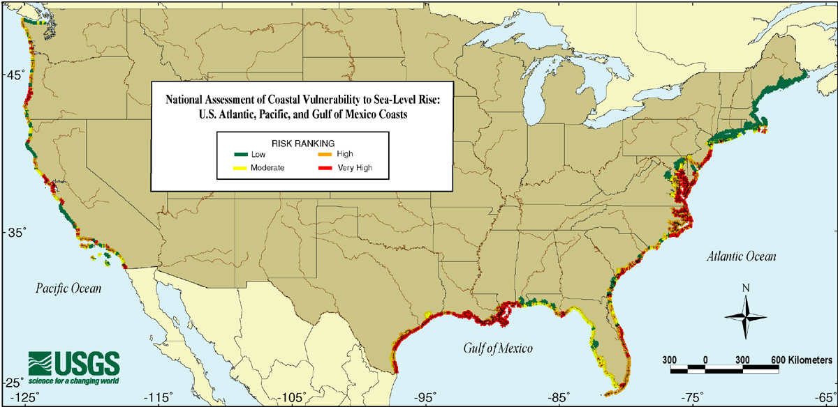
Vulnerability to Sea Level Rise

Slide 4
MACRI: Why Here, Why Now?
The Mid Atlantic is one of the Nations’ most dynamic coastline placing both human and natural systems at risk from climate change.
To understand the impact of climate change elements such as sea level rise, extreme weather, and degraded coastal ecosystems, you must go where the signal is the strongest.
The Mid Atlantic is also one of the Nation’s most unique coastlines with both protected undeveloped ecological coastline and intense coastal development which makes it a perfect living laboratory to understand the natural and human effects at the shore.
The Mid Atlantic is experiencing increases the frequency, duration, and effect of local and regional “action points” from climate change (response to storms, flooding, extreme heat days, land/tax base disappearing, and disaster declarations).
Hurricane Sandy was a major National tipping point focusing public and political leader’s attention on the need for coastal resilience for both human and natural systems.
It is time to move beyond spending tremendous sums fixing damage, to making investments that will sustain and repay themselves over time
Climate change coastal dynamics are a very complex and coupled set of atmospheric, land, and sea interactions. No single entity can understand or predict all system elements on their own. Research must move to studying many variables as an integrated system to provide better predictive modeling, adaptation, and resiliency strategies.
The Mid Atlantic has the strength of existing complementary science research capabilities and infrastructure with many prestigious Federal, Academic, and Non-Governmental organizations doing vital and important, but mostly separate, research in various elements of coastal and other climate change dynamics.
Notes:
On #8 – I would stress more of the engineering that is available……..

Slide 5
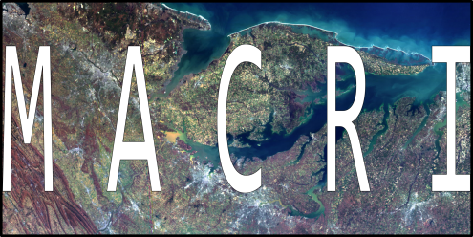
Mid-Atlantic Coastal Resilience Institute
Vision
The Mid-Atlantic will be the best understood coastline in the United States and a destination for coastal science research and public policy integration for coastal resilience worldwide.
Purpose/Outcome
The Mid-Atlantic Coastal Resilience Institute will be the platform to combine and leverage the capabilities of participating institutions to provide an unprecedented integration of science and its applications to understand, predict, and integrate resilience for both human and natural coastal communities into local, state, and regional policy planning.
Objectives
Leverage combined research and asset capabilities of partners
Create an unprecedented, multi-variable prediction model using world-class satellite, in-situ, and precision-scaled data to assist local decision-makers
Flip the research paradigm on its head: allow local and regional governments to participate in an advisory capacity in helping set MACRI research objectives

Slide 6
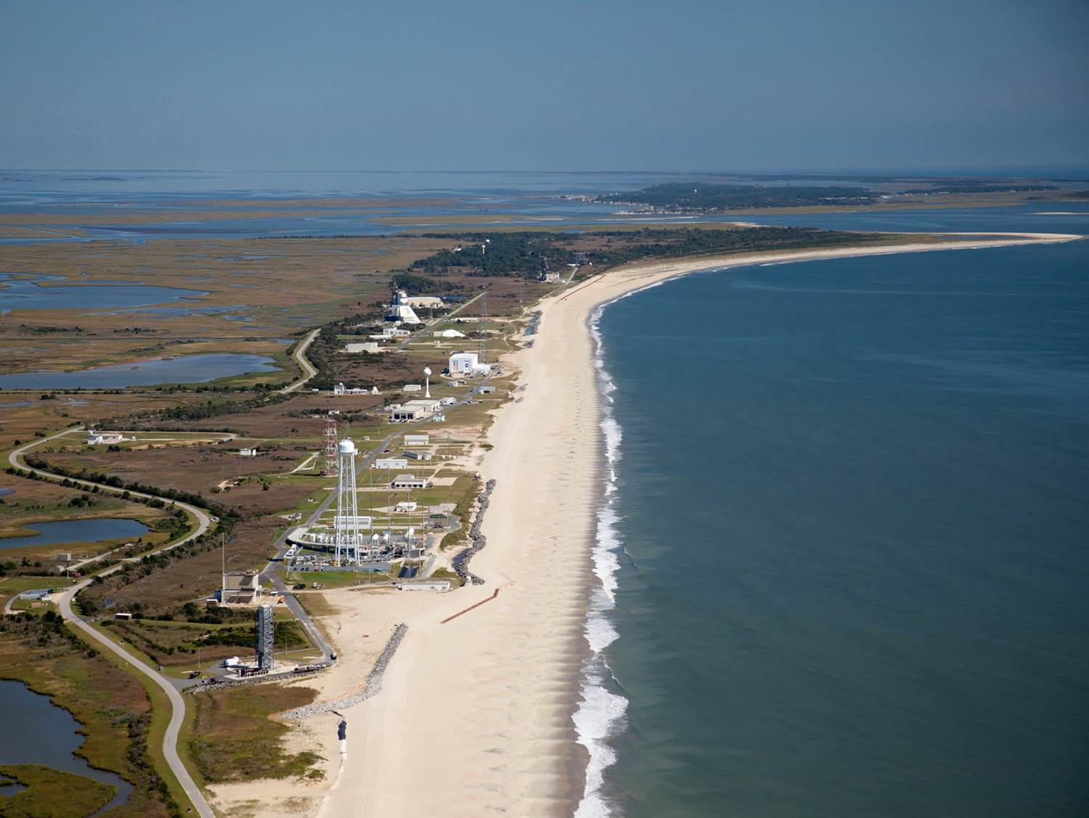
Wallops Island: Launch Range and Living Laboratory

Slide 7
Mid-Atlantic Coastal Resilience Institute
NASA Goddard Space Flight Center
Chincoteague Bay Field Station of the Marine Science Consortium
College of William and Mary
The Nature Conservancy
University of Delaware
University of Maryland
University of Virginia
U.S. Fish and Wildlife Service
U.S. Geological Survey
New Members: Old Dominion University and National Park Service

Slide 8
Mid-Atlantic Coastal Resilience Institute
Inaugural workshop held on September 28, 2014
Discussions on communication, strategic planning, and opportunities for collaboration
Created working groups whose deliverables will feed into the Strategic Plan
Inventory of assets and research projects
Stakeholder advisory group roles and members
Communications and outreach
Established short-term goals
Synthesis of remote sensing capabilities and data
Validation of Global Precipitation Monitoring Mission
Extension of Coastal Flood Monitoring System

Slide 9
Mid-Atlantic Coastal Resilience Institute Next Steps
Amend Agreement for ODU and National Park Service
Strategic Plan Session Late October/Early November
Advisory/Stakeholder Participation
Hosted Research Workshops
GPM/Modeling CASI/MACRI Tool: NASA GSFC/Wallops
Coastal Flood Monitoring System (Univ. of Delaware)
Lidar Working Group
Ongoing Collaboration for National Toolkit Applications and Whole of Government Approach to Climate Resilience

Slide 10
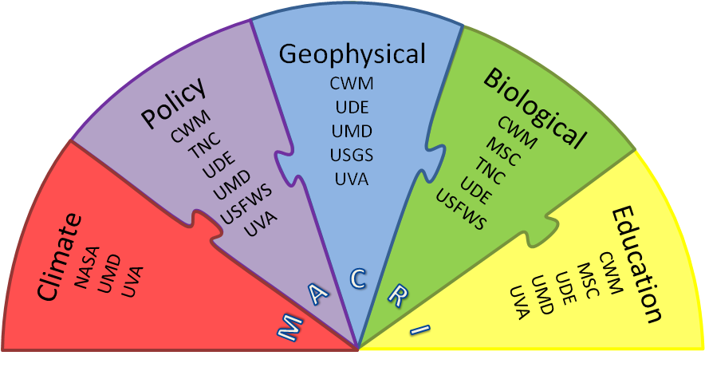
CASI/MACRI Model for Coastal Resilience
Currently aligning existing datasets, multiple disciplines, and both local and regional expertise to create a coastal resilience model scaled for Wallops Island as a beginning
In the future, the model will expand to include, and be ground-truthed in, the other barrier islands in the Mid-Atlantic, owned by our partners
The end goal is a tool that can be used by decision-makers in any of the nation’s coastal areas

Slide 11
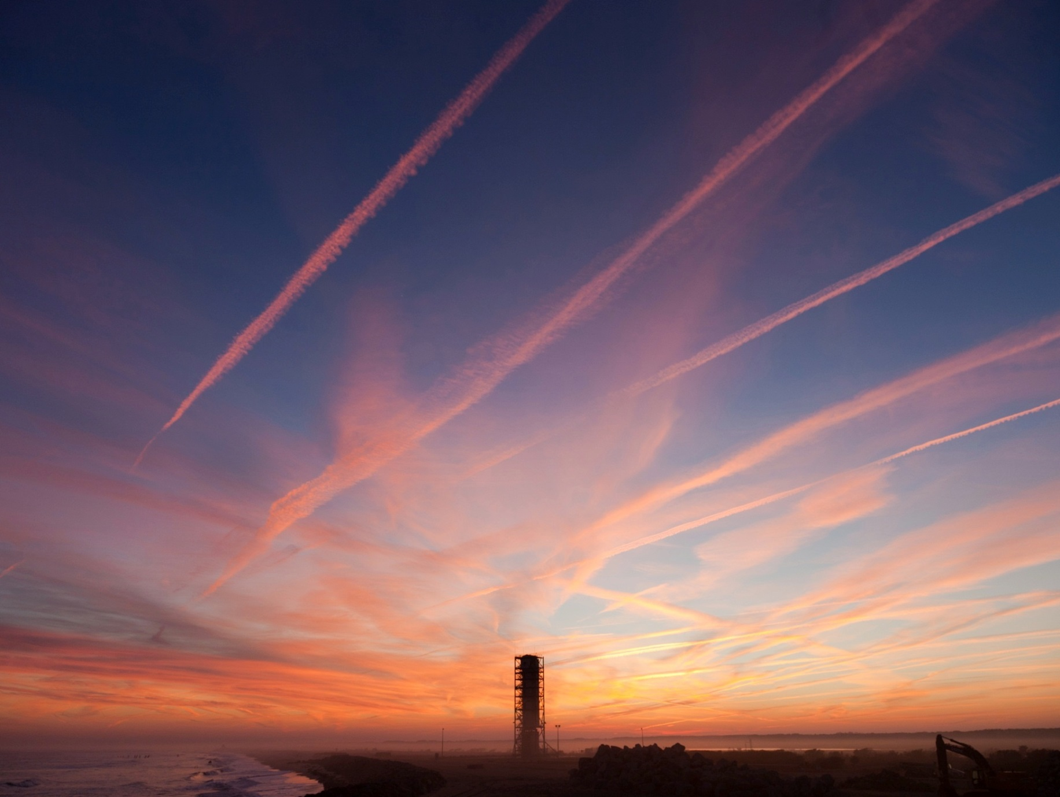
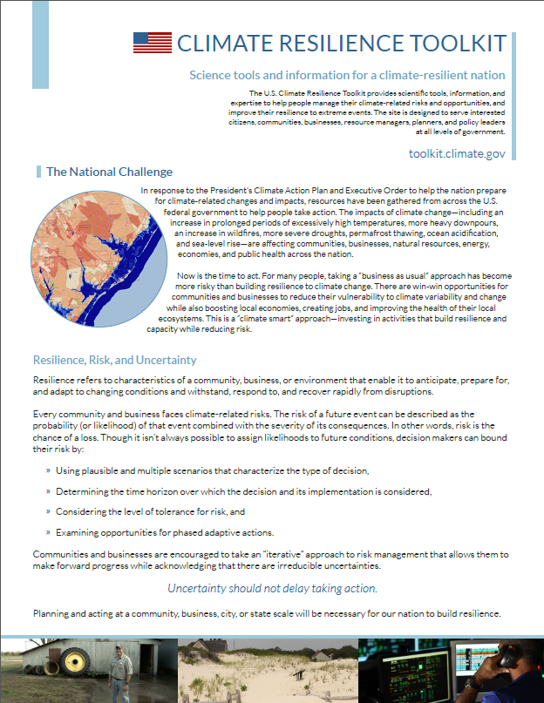
CASI/MACRI Model for Coastal Resilience, cont.
Goddard is excited to lead efforts in developing this tool
Wallops is the ideal testbed – a living laboratory
We will get it right at Wallops so that local decision-makers everywhere can get it right at home
Planning to expand the tool from Wallops Island to the barrier islands north and south
Hoping for inclusion in the White House National Security Council’s Climate Toolkit

Slide 12
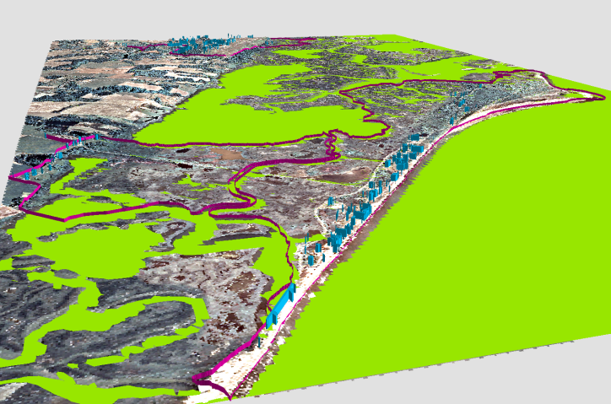
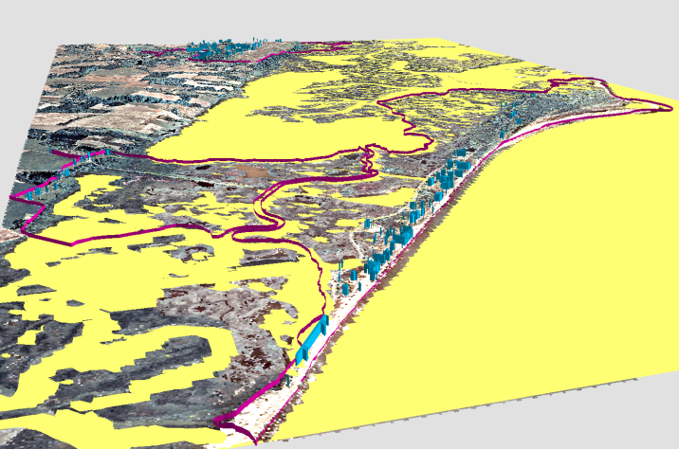
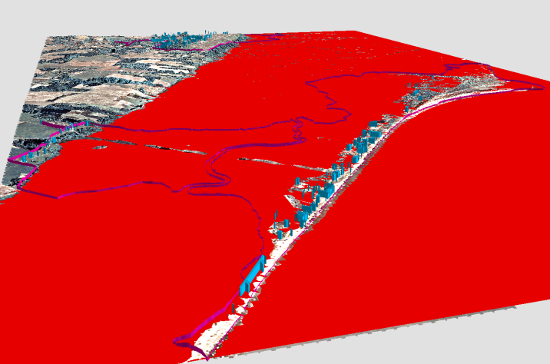
CASI/MACRI Model for Coastal Resilience, cont.
GIS-based SLR impacts to Wallops infrastructure – CASI
+ Marsh accretion – CASI
+ SLAMM – CASI
+ Land subsidence – MACRI
+ Coastal bathymetry – MACRI
+ Coastal Flood Monitoring System– MACRI
Multi-variable, predictive model of coastal resilience to inundation for local decision-makers
2011 Baseline Sea Level
2040 EPA High SLR (0.96’)
2040 EPA High SLR + 2.3’ flooding

Slide 13
Opportunities for Collaboration
USFWS/LTER/NASA – Surface Elevation Table
Marsh accretion
Validation of SLAMM modeling
NPS/UDel/USGS/TNC/NASA – Remote Sensing
LIDAR
Bathymetry
ODU/UMD/NASA – whole of government planning for coastal resilience
Hampton Roads
Wallops Island

Slide 14
Walt.petersen@nasa.gov

Slide 15
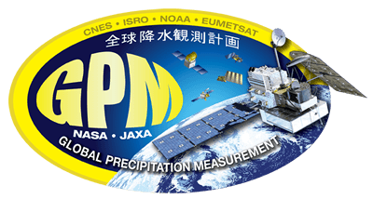
GPM/MACRI Collaboration Opportunities
Hydrologic-related studies in the Pocomoke Basin (radar + gauges)
Sediment runoff and nutrient studies associated with rain events flushing nutrients into the river (radar + gauges)
Variability in the terrestrial hydrologic cycle and coastal estuaries
Surface and ground water fluxes in stream/river systems
Runoff into estuary/delta/coastline for looking at storm impacts on coastal water quality etc.
Aerosol loading profiles via Micro Pulse Lidar (MPL)
Fresh water inputs as mapped by the radar.
Impact on ocean salinity, SST's and energy budgets
Lightning detection/location/forecasting (3-d + time) via Lightning Mapping Array (LMA)
Excessive wind detection/forecast (radar)
Hydrometeor classification/characterization for precipitation (rain/snow/hail) forecasts/nowcasts
Coastal storm characterization (GPM satellite)

Slide 16
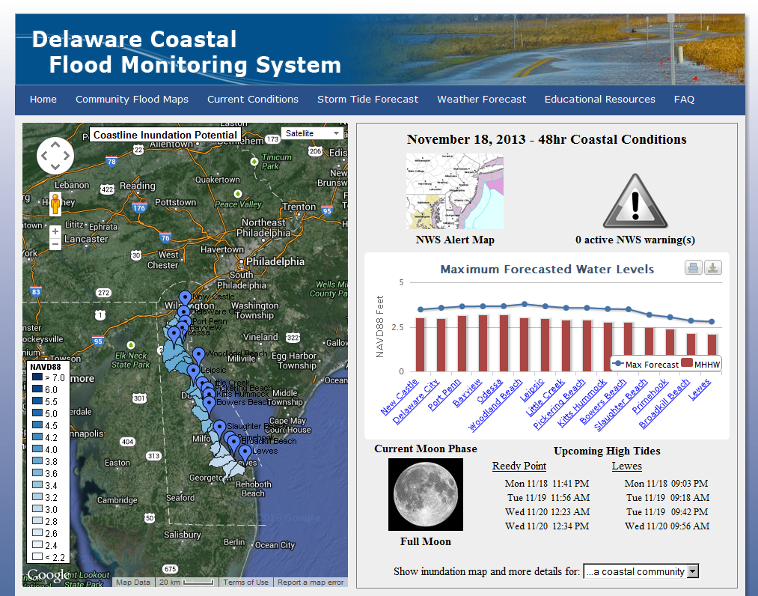
MACRI Regional Dynamic Coastal Flood Monitoring System

Slide 17
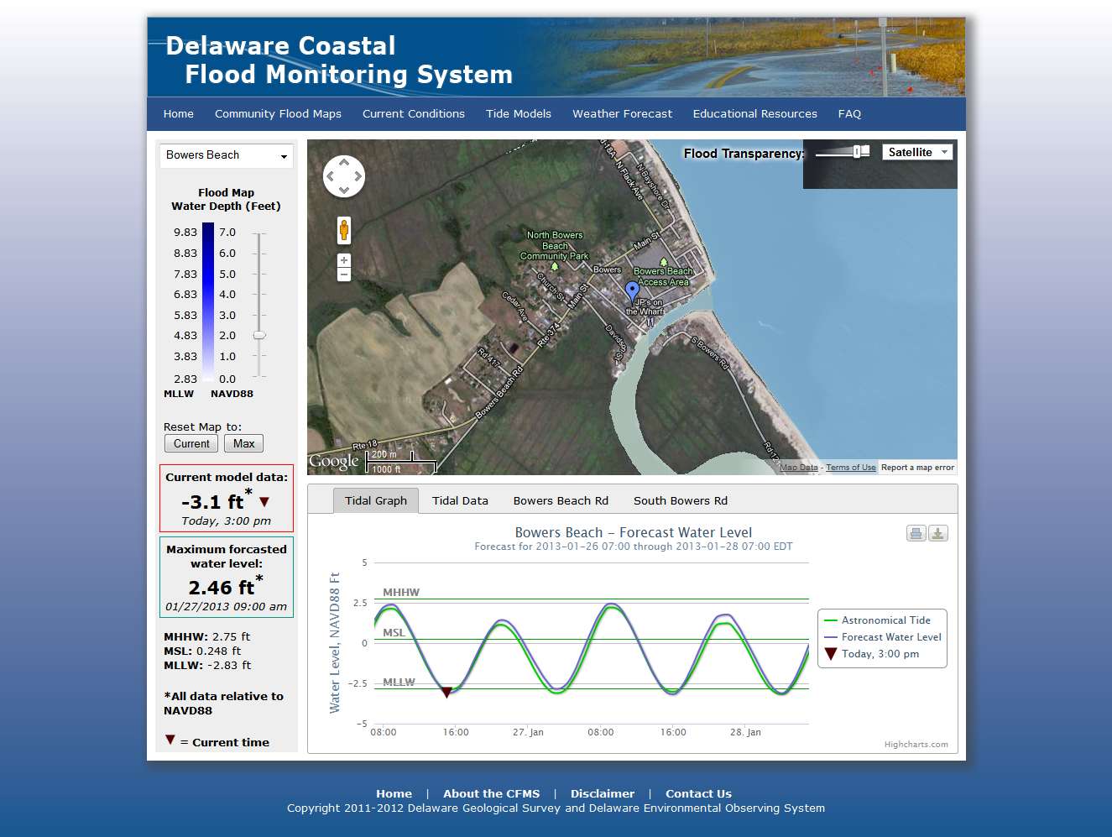

Slide 18
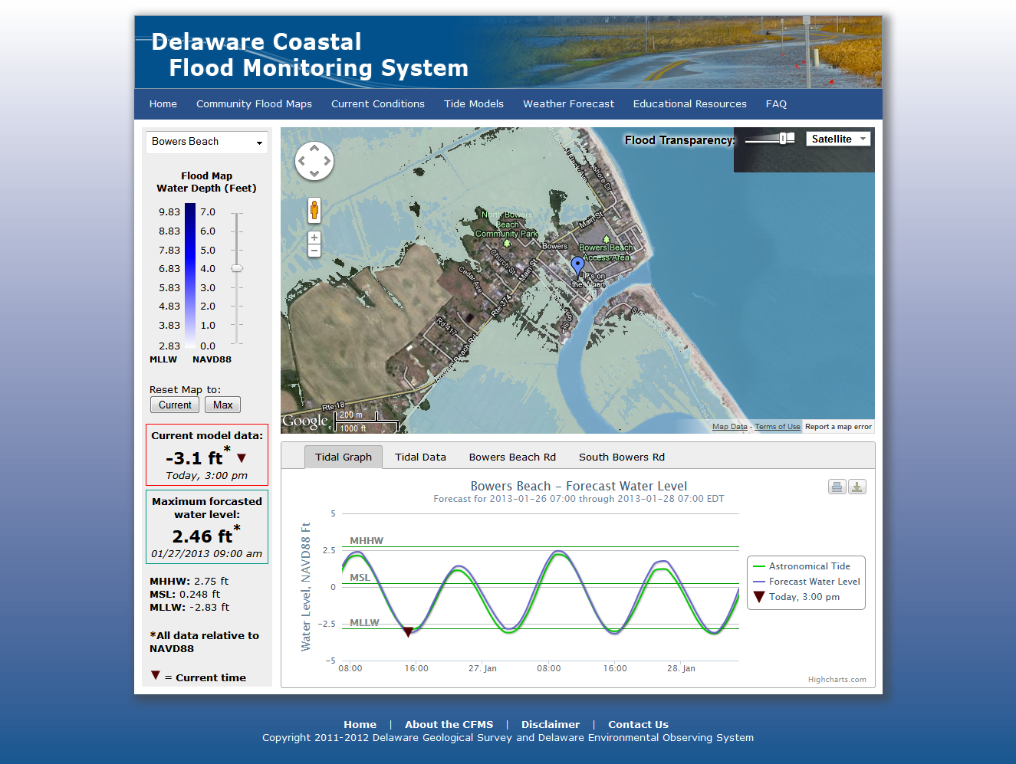

Slide 19
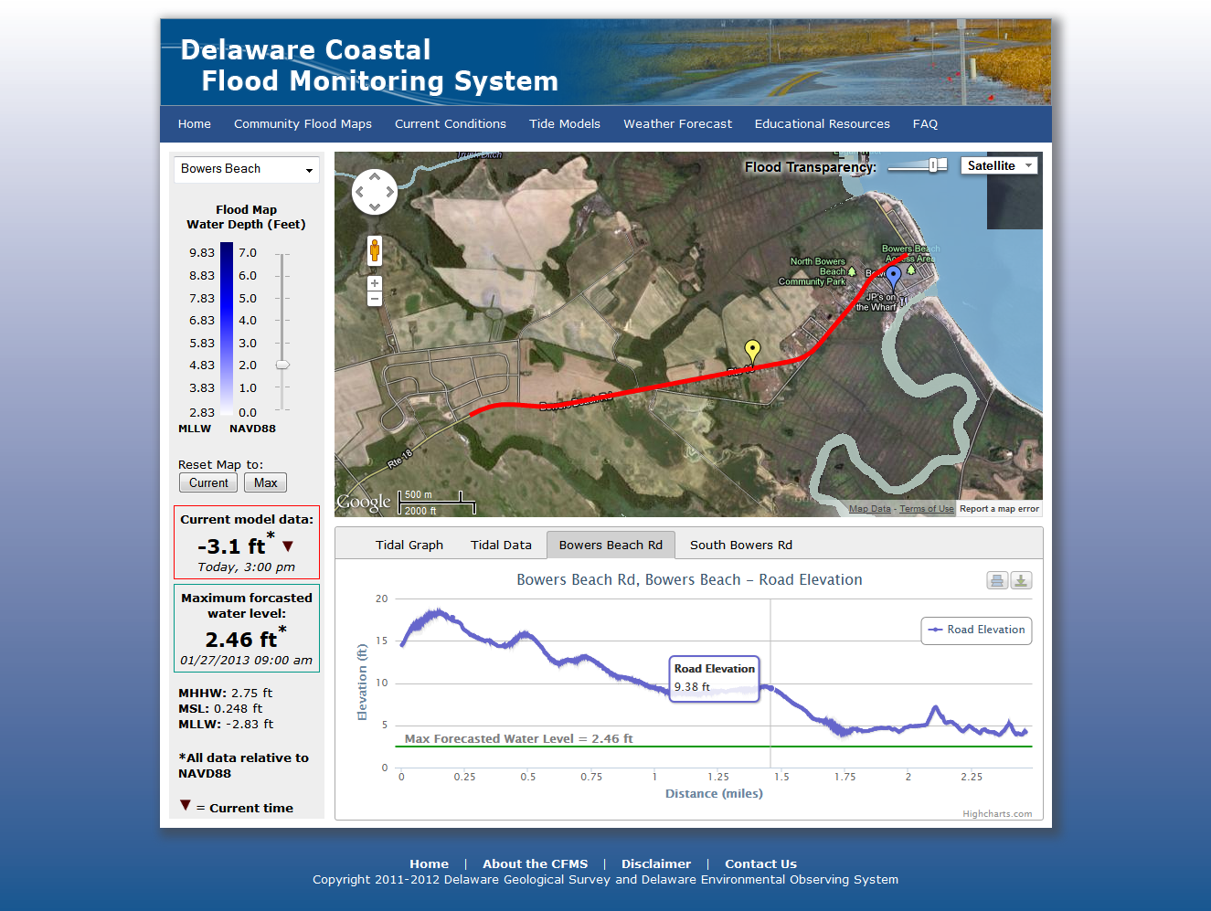

Slide 21
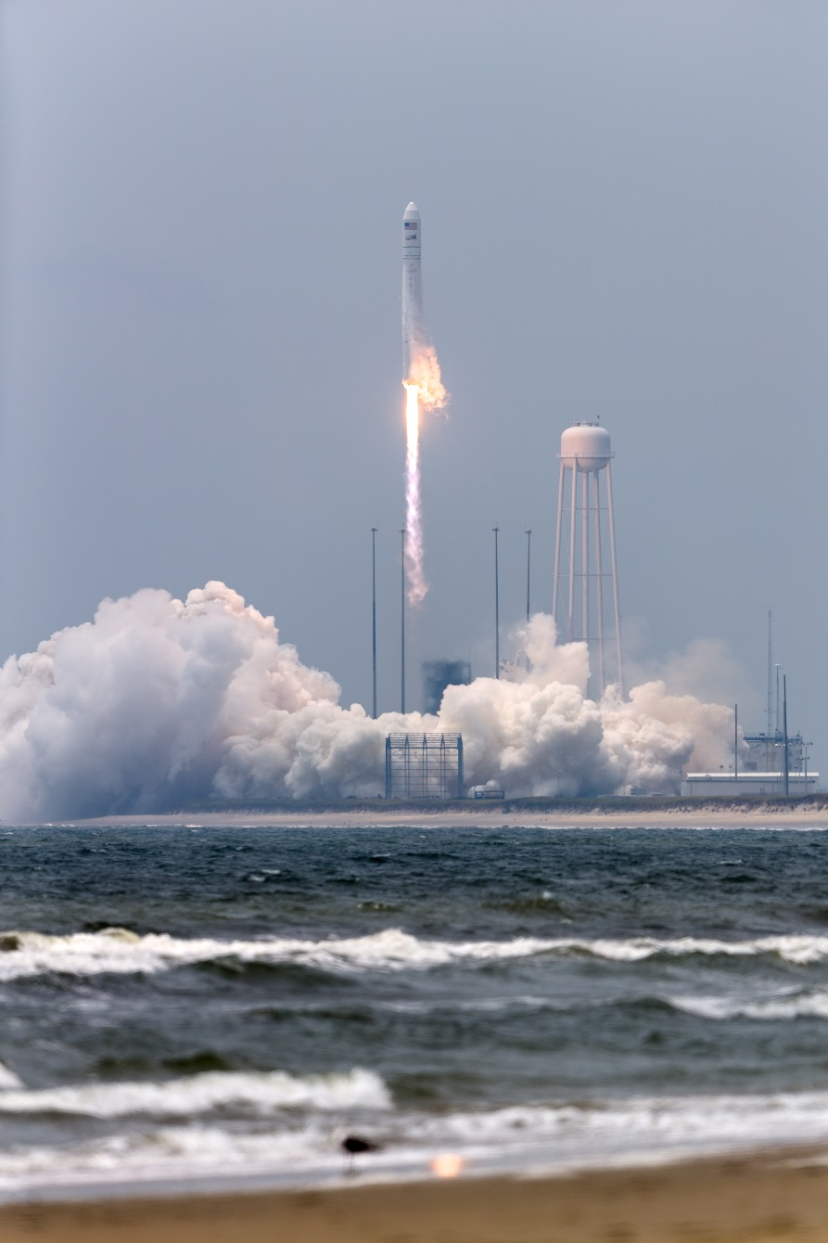
Coming Soon to a Screen Near You: www.nasa.gov/MACRI

