Slide 1

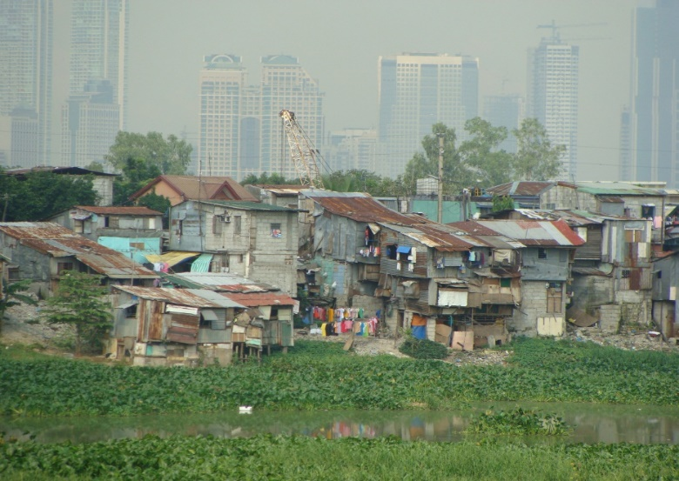
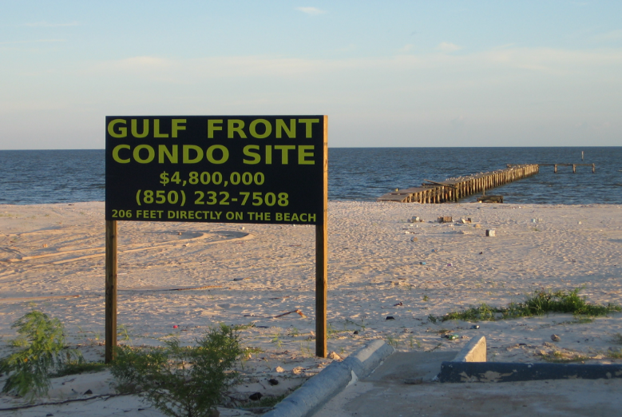
Adapting to Climate Change: Lessons from Natural Hazards Planning
Center for Coastal Physical Oceanography and Mitigation and Adaptation Research Institute Seminar Series
Gavin Smith, Ph.D., AICP
Research Professor
University of North Carolina at Chapel Hill, Department of City & Regional Planning
Director
Department of Homeland Security - Coastal Resilience Center of Excellence

Slide 2
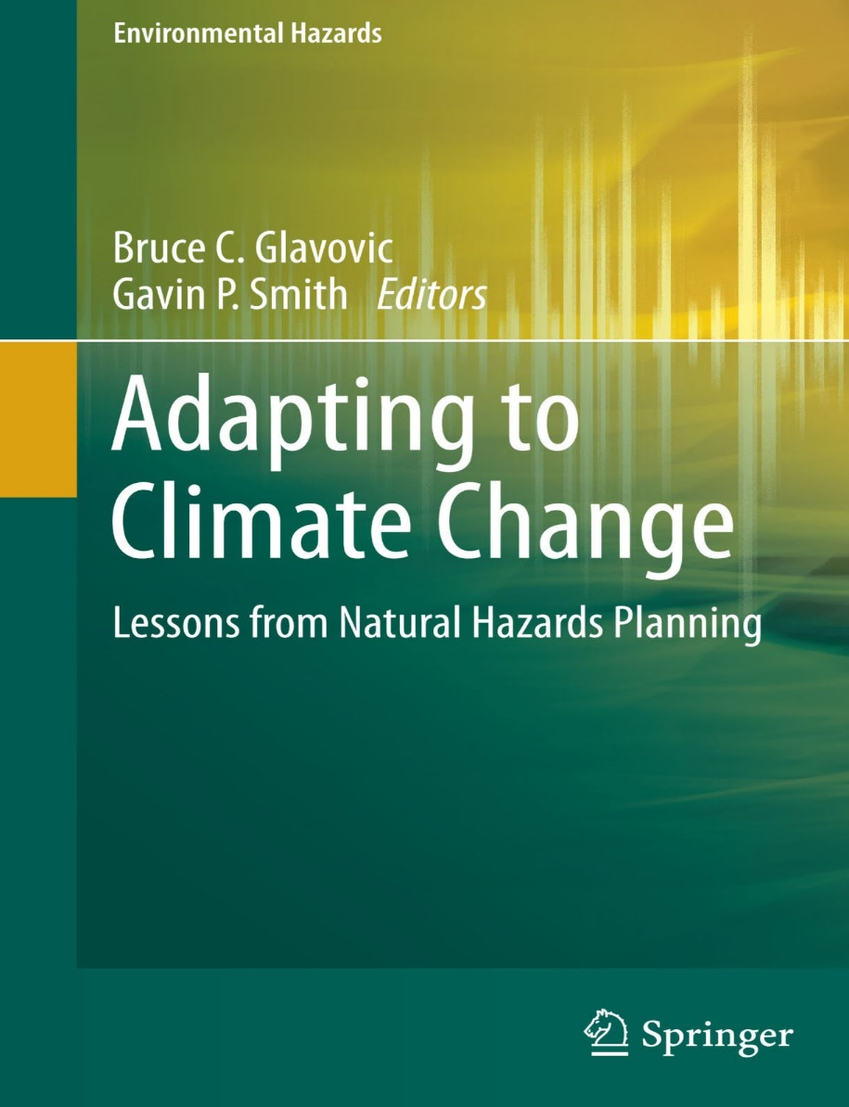
Overview
Adapting to Climate Change: Lessons from Natural Hazards Planning
Linking Natural Hazards Risk Management and Climate Change Adaptation through Planning
Case Study - Mississippi and Hurricane Katrina
Vision, Imperatives, and Lessons

Slide 3
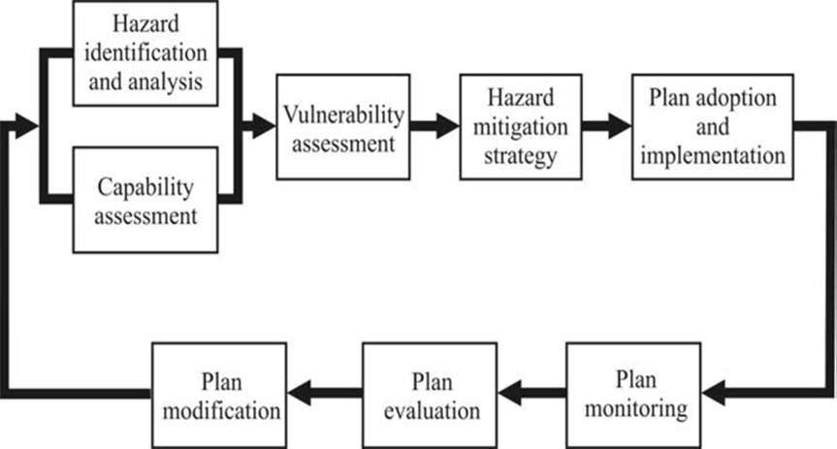
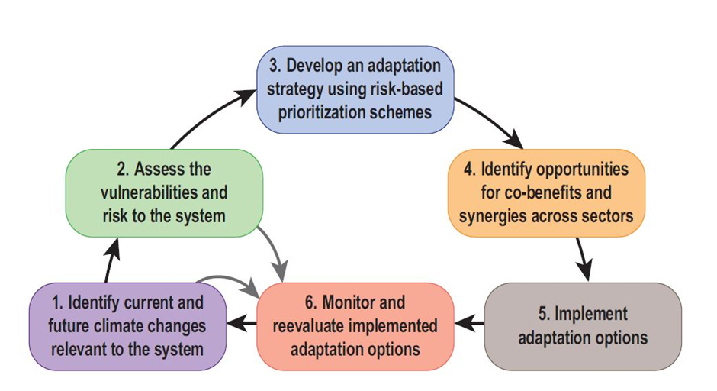
Organizing Principles of Book
Poor Coordination between Climate Change Adaptation and Natural Hazards Risk Management Community (Hazard Mitigation, Disaster Recovery)
Application of International Case Studies
Disasters and Lesson Drawing

Slide 4
Disaster Resilience (Godschalk 2003)
“Designed in advance to anticipate, weather and recover from the impacts of natural hazards”
“…built on principles derived from past experience with disasters”
Comprised of “networked social communities and lifeline systems”
“…adapting and learning from disasters”
“…strong and flexible (rather than brittle and fragile)”
“…new development is guided away from known high hazard areas and their vulnerable existing development is relocated to safe areas”
“…buildings are constructed or retrofitted to meet code standards based on hazard threats”
“…natural environmental protective systems are conserved to maintain valuable hazard mitigation functions”
“…governmental, non-governmental, and private sector organizations are prepared with up-to-date information about hazard vulnerability and disaster resources, as linked with effective communication networks, and are experienced in working together
2015 Natural Hazards Workshop

Slide 5
Section 1. Climate Change Adaptation: Theory and Practice
Introduction: Learning from Natural Hazards Experience to Adapt to Climate Change (Bruce Glavovic and Gavin Smith)
Climate Change Adaptation and Disaster Risk Reduction: Conceptual Approaches, Synergies and Mismatches (Jorn Birkmann and Joanna Pardoe)
Overview of linkages and gaps in climate change adaptation and disaster risk reduction concepts and associated policies
Tackling Barriers to Climate Change Adaptation in South African Coastal Cities (Gina Ziervogel and Sue Parnell)
Describes the issues facing Cape Town and eThekwini (Durban) as a means to understand challenges and opportunities at the city-scale
Identification of key barriers and opportunities to achieving adaptation; importance of developing a broad institutional network for action that is cognizant of the growing base of knowledge; need to recognize and account for varied temporal and spatial scales; develop appropriate mix of flexible and holistic policies and practices that address risk reduction and development

Slide 6
Section 2. The Nature of Disasters and the Role of Hazards Planning in Building Resilient Communities
Climate Change Adaptation and Disaster Risk Reduction in Highland Peru (Anthony Oliver-Smith)
Adaptation as a long-standing cultural phenomenon closely associated with the persistence of societies
Need for meaningful engagement/use of indigenous knowledge
Castles on Sand: The Shifting Sources of Flood Risk and the Implications for Flood Governance (Iain White)
Challenges of urbanization in cities and regions in England
Changing way of thinking-shift from post-event flood defenses to preemptive spatial/land use planning
Planning for Resilient Coastal Communities: Emerging Practice and Future Directions (Tim Beatley)
Vision of resilient coastal communities, including underlying principles
Highlights ways that communities have achieved this objective
Resilience and Adaptation: The Emergence of Local Action in California (Bill Simbieda)
Berkeley and San Francisco – physical and institutional resilience
Emergence of leadership
Rising to the Challenge: Planning for Adaptation in the Age of Climate Change (Phil Berke)
Scenario-based planning – means to confront uncertainty in our understanding of climate change-related impacts while providing necessary flexibility (robust and contingent strategies)

Slide 7
Case Study Themes
Importance of collaborative governance
Influence of pre-event conditions (culture, wealth/poverty, policy frameworks and institutions)
Value of establishing good vertical connectivity between national policy and local plans
Adopting varied and flexible risk management strategies
Viewing disasters as focusing events (including adoption of new policies and practices that reduce exposure to extreme events and confront the drivers and root causes of vulnerability)

Slide 8
Adaptation Challenges and Opportunities
Slow-Onset and Episodic Events
Differing timescales (episodic versus slow onset; Election timescales)
Differing spatial scales (global-local)
Differing camps of researchers and practitioners
Knowledge base and terminology (physical science/engineering, social sciences, planning); hazard mitigation/adaptation
Policy frameworks (while different, both emphasize sustainability and resilience)
Differing analytical tools
Risk assessment and risk communication
Linking global assessments and local impacts (downscaling data)
Differing funding and implementation mechanisms (limited funding for adaptation?)
Costs of Adaptation uncertain (New Orleans Levees)

Slide 9
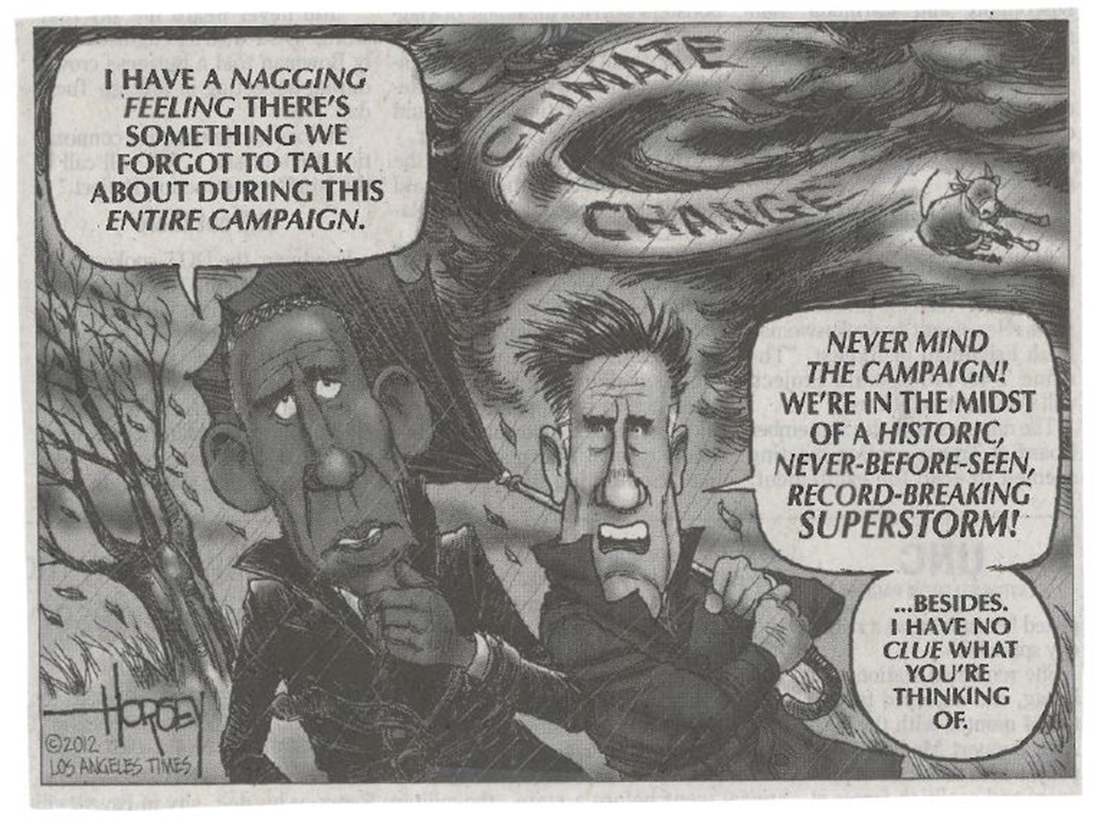
Designing and Implementing Pre- and Post-Disaster Adaptation Strategies
Risk Reduction Options
Natural resource protection
Education and Outreach
Land use
Retrofitting critical public facilities and infrastructure
Relocation and resettlement
Insurance
Disaster Management Policies
Disaster Mitigation Act
National Disaster Recovery Framework

Slide 10
Natural Hazards Risk Management: Hazard Mitigation
Hazard Mitigation
Actions, steps, policies and programs that can be taken to reduce the loss of life and property damage in the event of a natural disaster (Godschalk et. al 1999)
Any sustained action taken to reduce long-term risk to human life and property from natural hazards (FEMA)
Pro-active versus Reactive Approaches
Natural Hazards Planning
Disaster Mitigation Act of 2000
Berke, Smith and Lyles Study
Risk Assessment, Projects and Policies
Land Use as a Risk Reduction Measure is Limited
Limited Reference to Climate Change Adaptation

Slide 11
Scenario Planning / Planning For Uncertainty (Berke)
Traditional Planning Paradigm is Inadequate
Heightened uncertainty
Longer time horizons
Applying Lessons from Hazard Mitigation Planning
Anticipating future impacts / future orientation (anticipatory governance)
Rapid and slow-onset events
Local government paradox (Ray Burby)
New Plans should account for:
Multiple futures based on collaboratively developed scenarios
Clear monitoring and implementation strategies
Flexible strategies (robust and contingent)

Slide 12
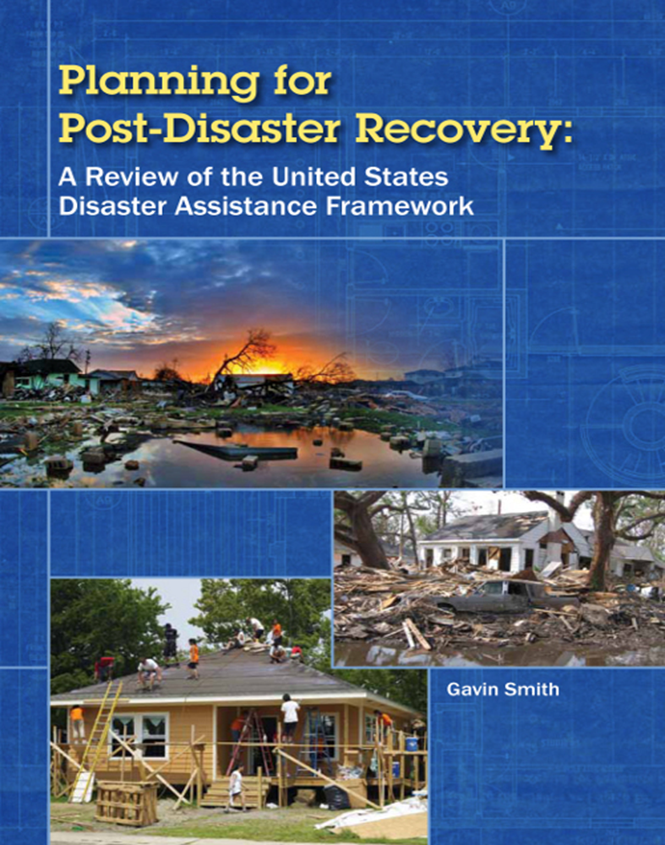
Natural Hazards Risk Management: Disaster Recovery
Disaster Recovery: The differential process of restoring, rebuilding, and reshaping the physical, social, economic, and natural environment through pre-event planning and post-event actions (Smith and Wenger 2006).
Disasters Uncover/Expose Pre-Event Conditions
Hazard vulnerability, including socially vulnerable populations
Planning culture
Unsustainable development
Disaster as “Opportunity”
Incorporation of hazard mitigation/risk reduction/adaptation
Equity/social justice / Opportunity for whom?
Disaster Recovery Planning
Temporal Dimension: Speed versus deliberation, time compression;
pre- and post-disaster recovery planning
Governance, resource distribution and local needs

Slide 13
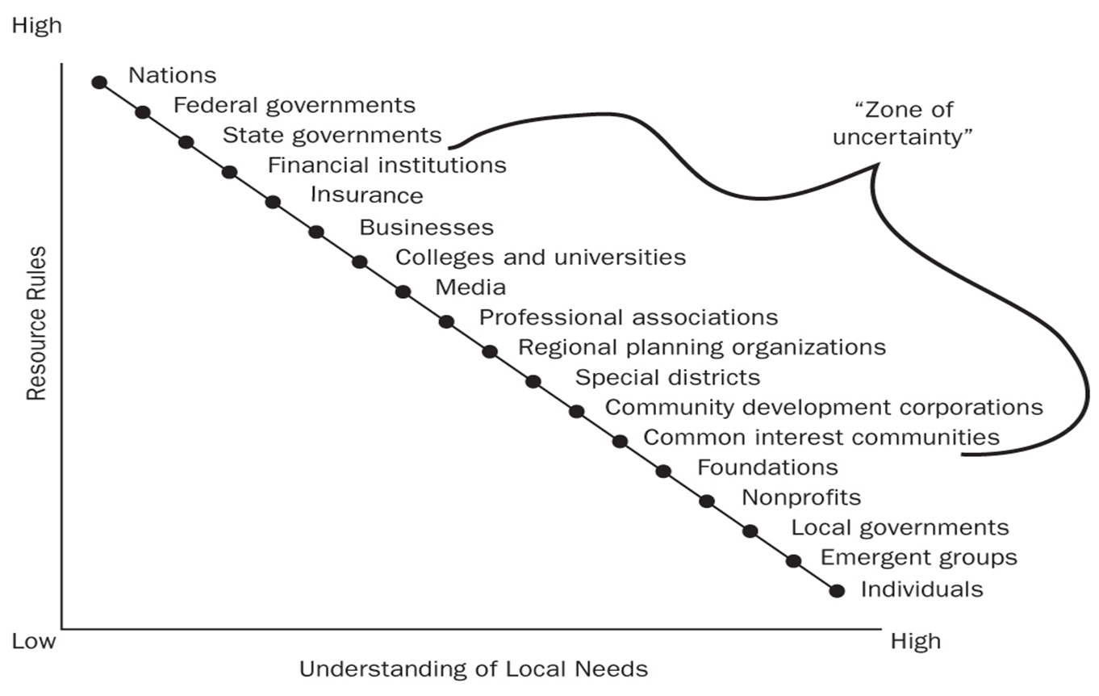
Disaster Recovery Assistance Network

Slide 14
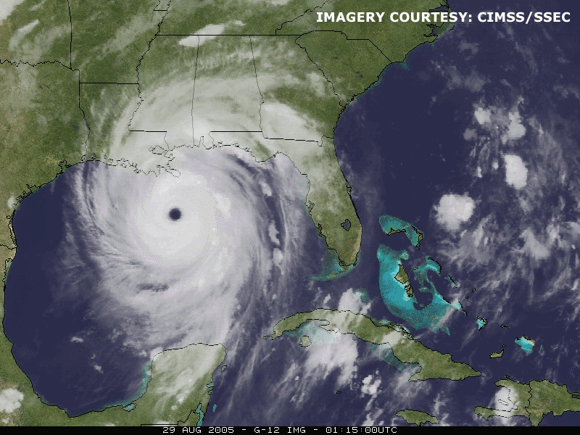

Slide 15
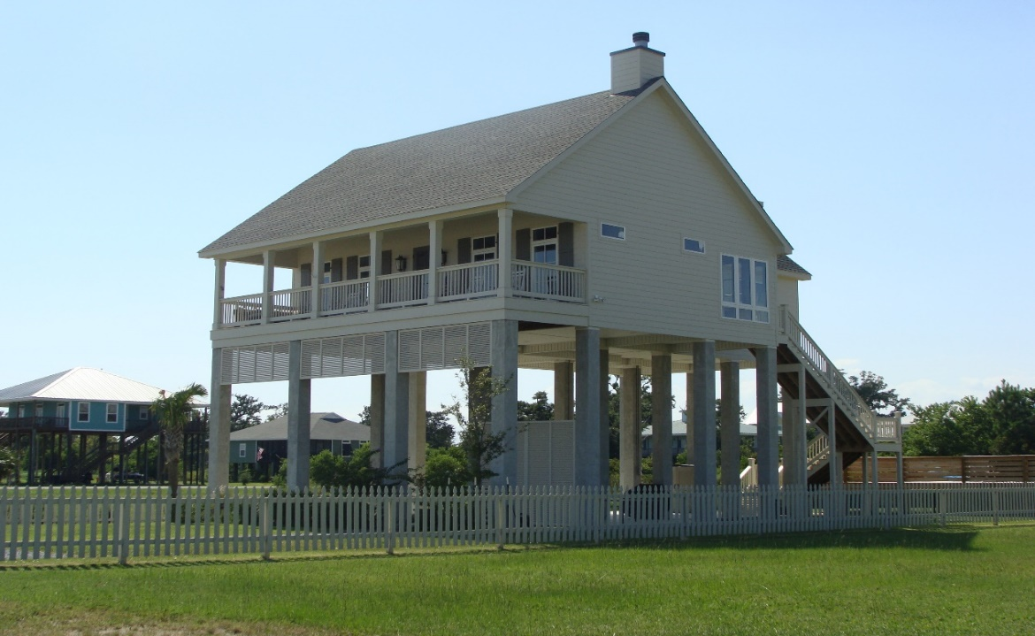
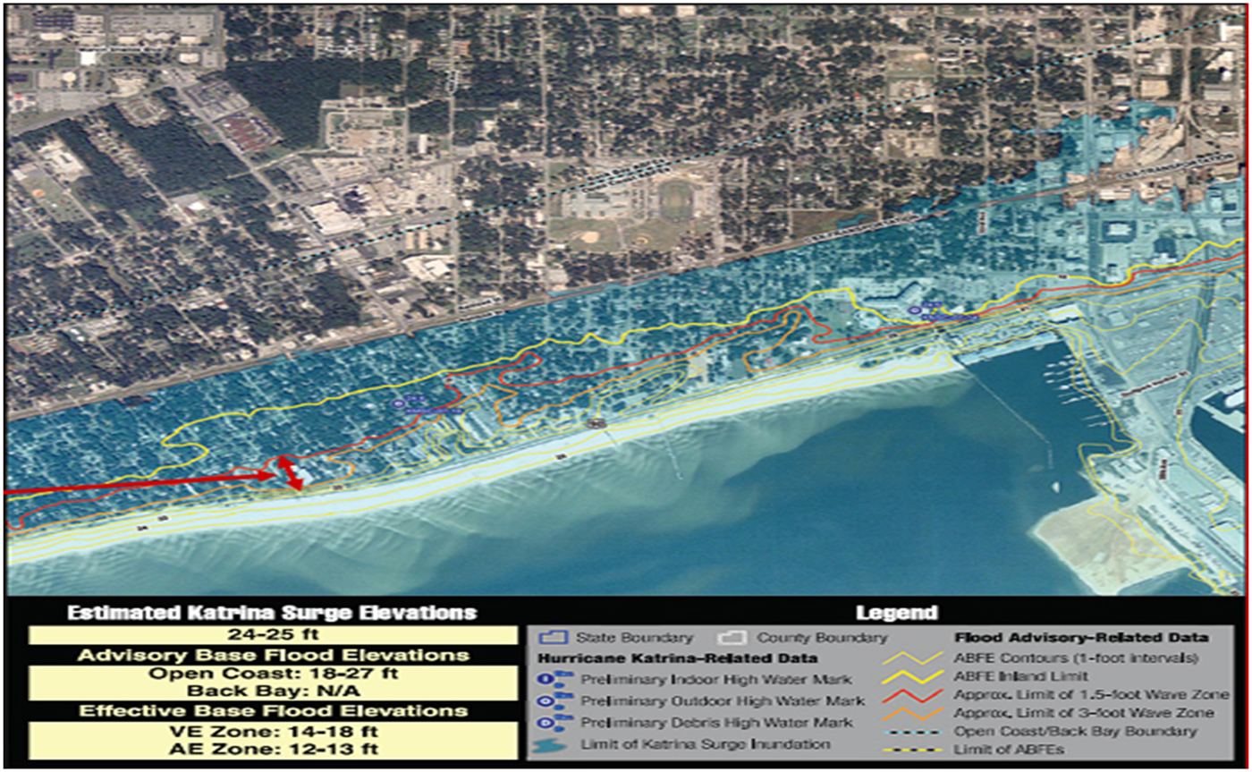
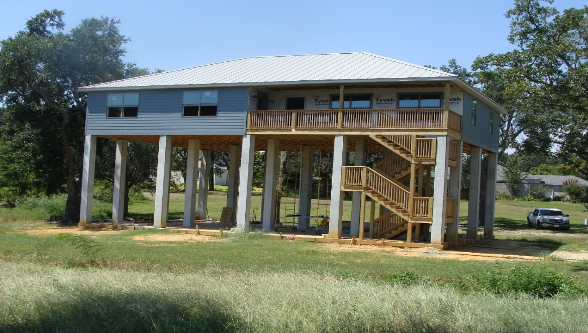
“Planning” for Hazard Mitigation, Post-Disaster
Recovery, and Climate Change Adaptation?

Slide 16
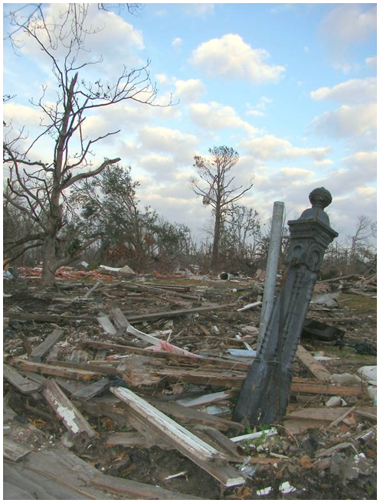
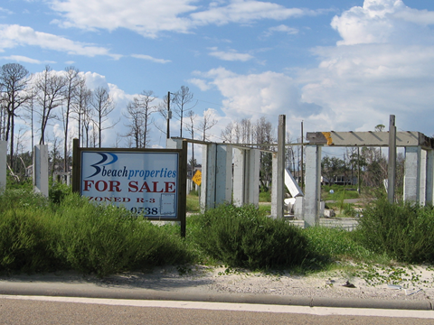
Post-Disaster Recovery, Reconstruction and Resettlement? (Recovery as “Opportunity” -- Hazard Mitigation)

Slide 17
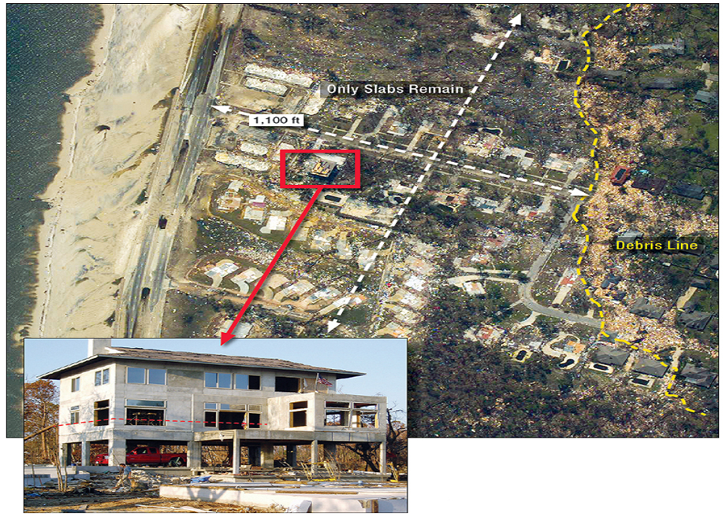
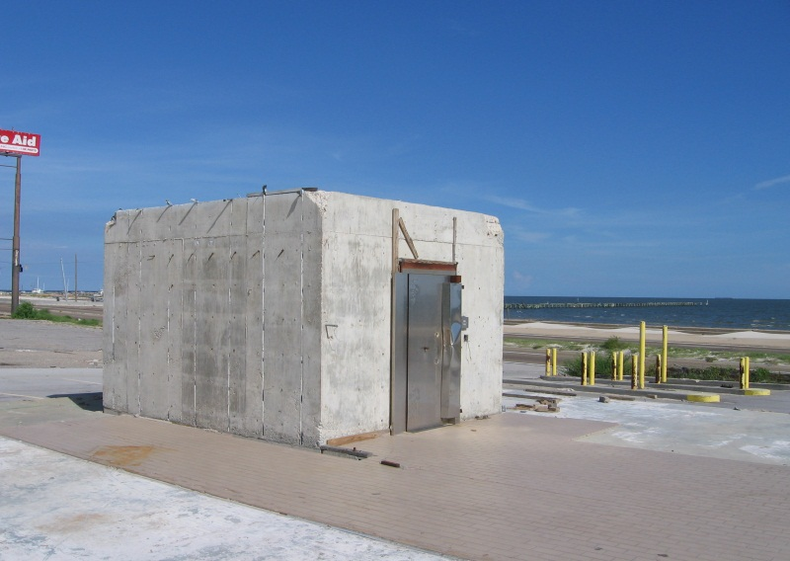
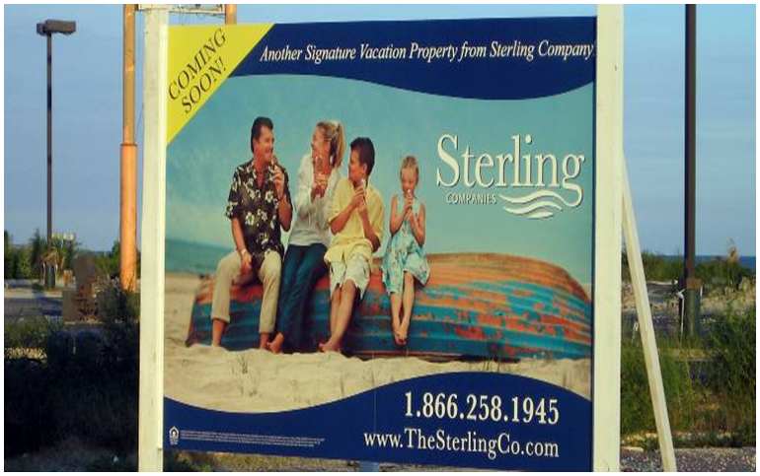
Building Codes and Land Use: What are Appropriate Design Standards in a Era of Climate Change?

Slide 18
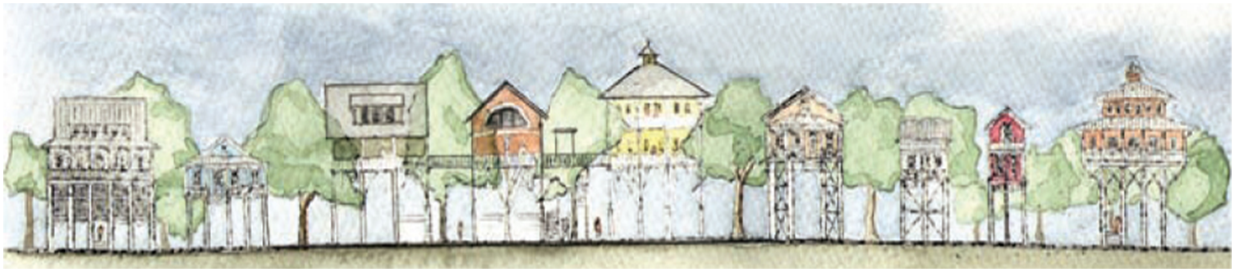
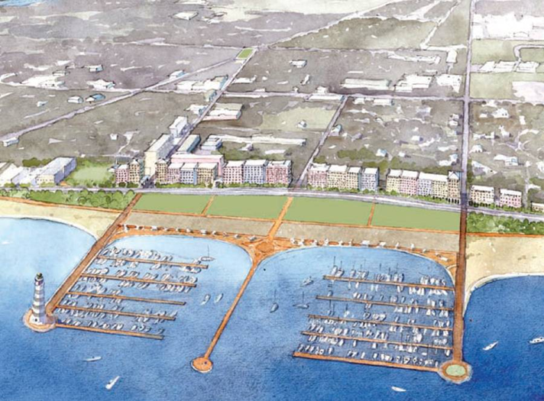
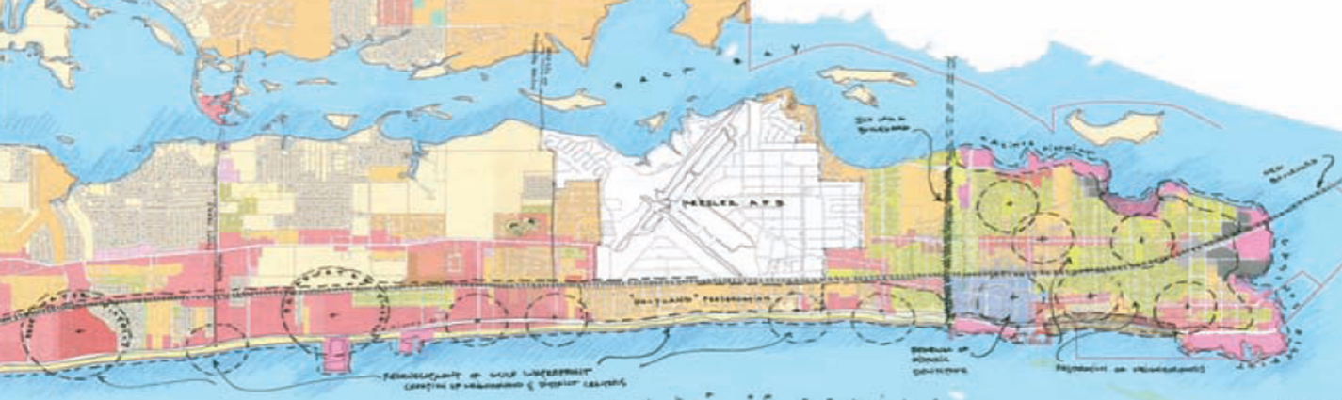
Mississippi Renewal Forum: New Urbanism and Hazard Mitigation

Slide 19
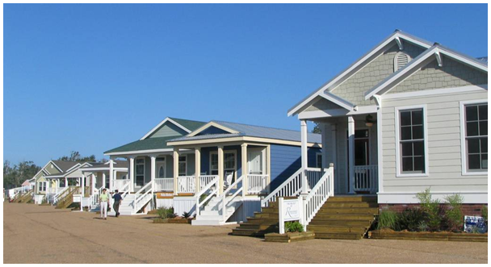
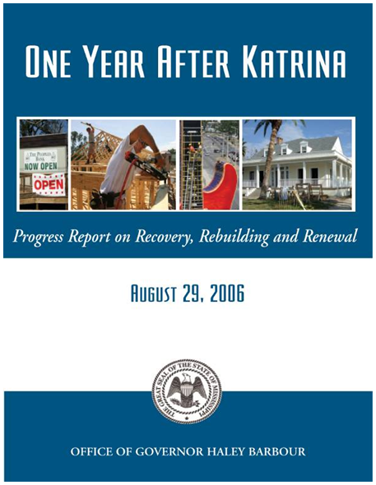
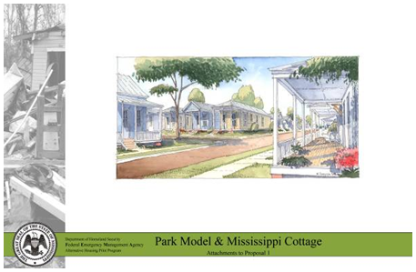
Mississippi Governor’s Office
of Recovery and Renewal
Implementation Focus
Institutionalizing State and Local Capability
Three Objectives
Identification of Funding
Policy Counsel
Education, Outreach, and Training
Boundary Spanning Organization

Slide 20
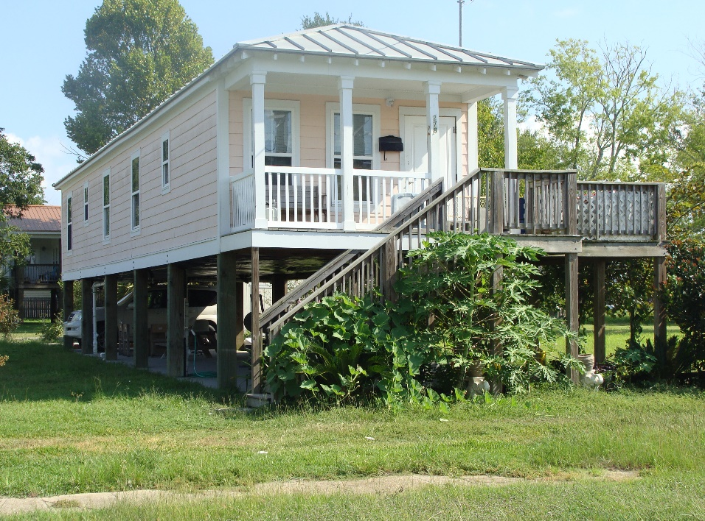
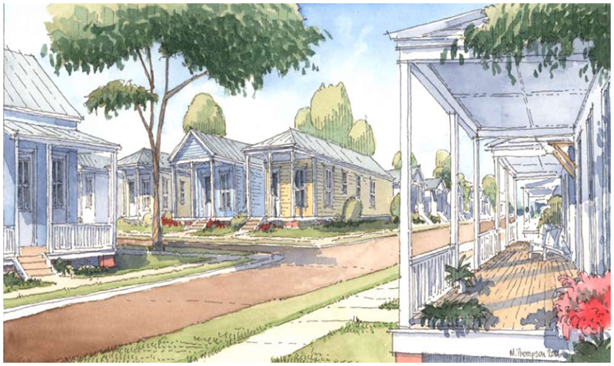
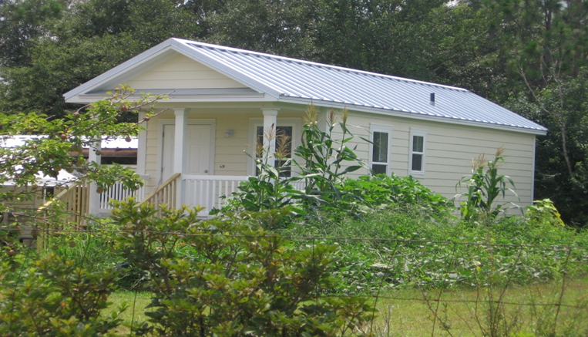
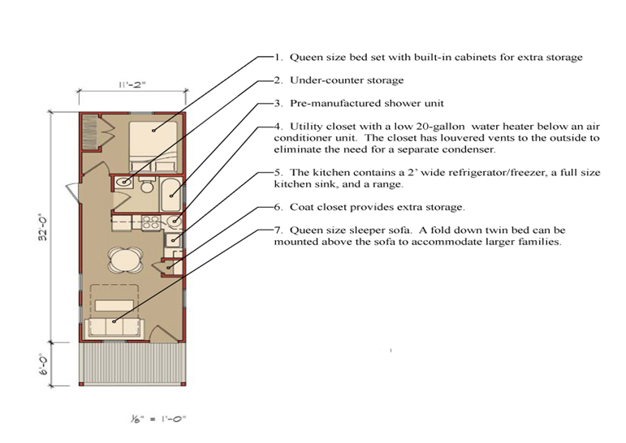
Mississippi Alternative Housing Program
400 Million Dollar Congressional Appropriation
State Pilot to Develop Improved Emergency Housing Alternatives
Mississippi Cottage, Green Mobile and Park Model
Adaptation Lessons?

Slide 21
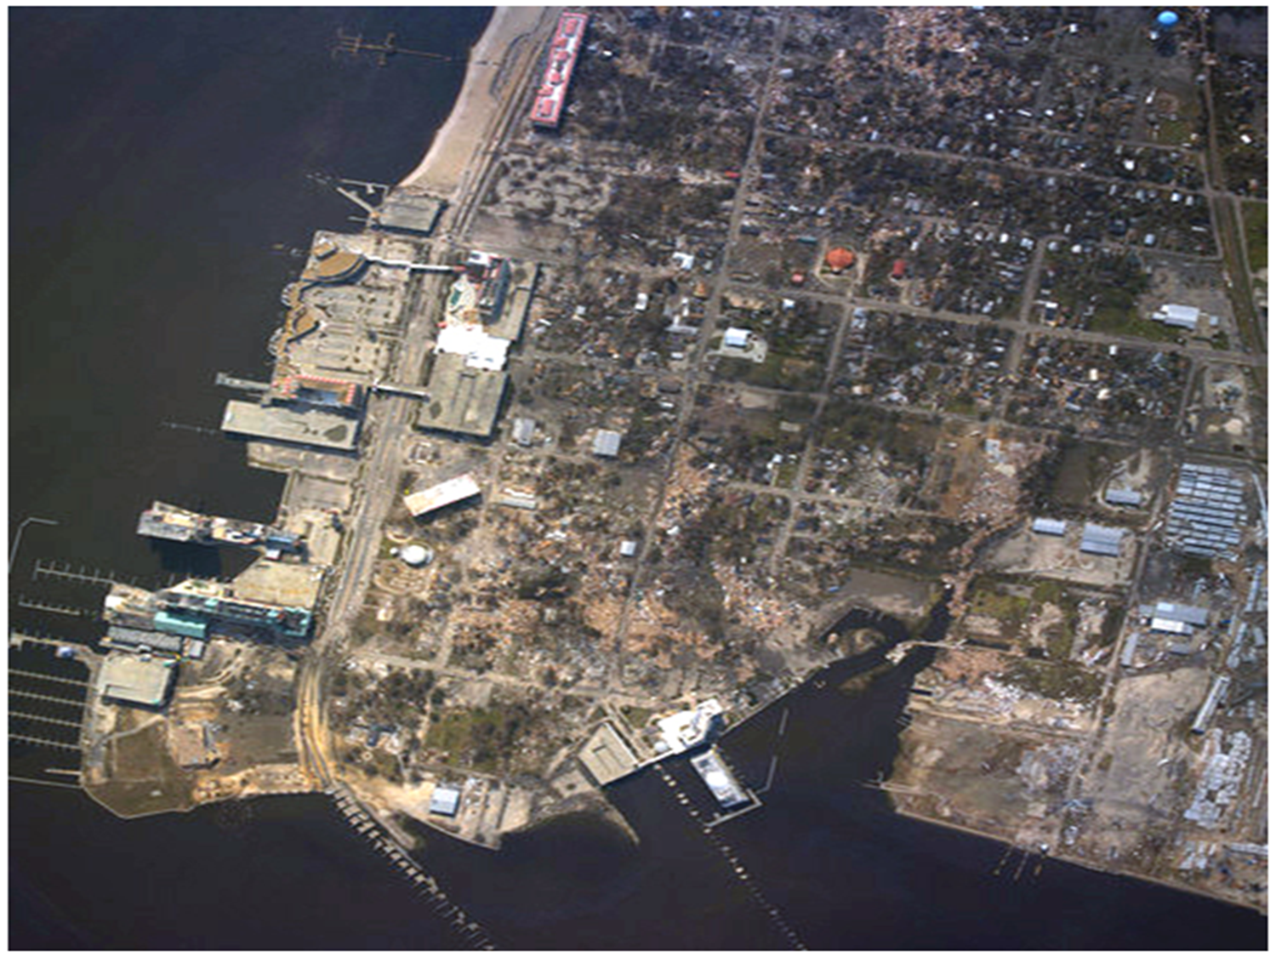
Biloxi, Mississippi: Planning and Design in Recovery (Gulf Coast Community Design Studio)

Slide 22
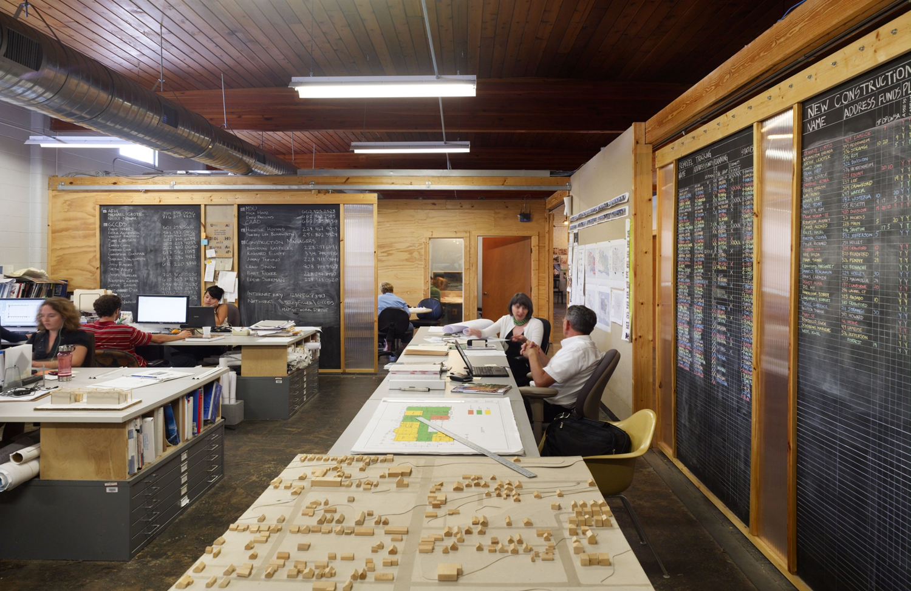

Slide 23
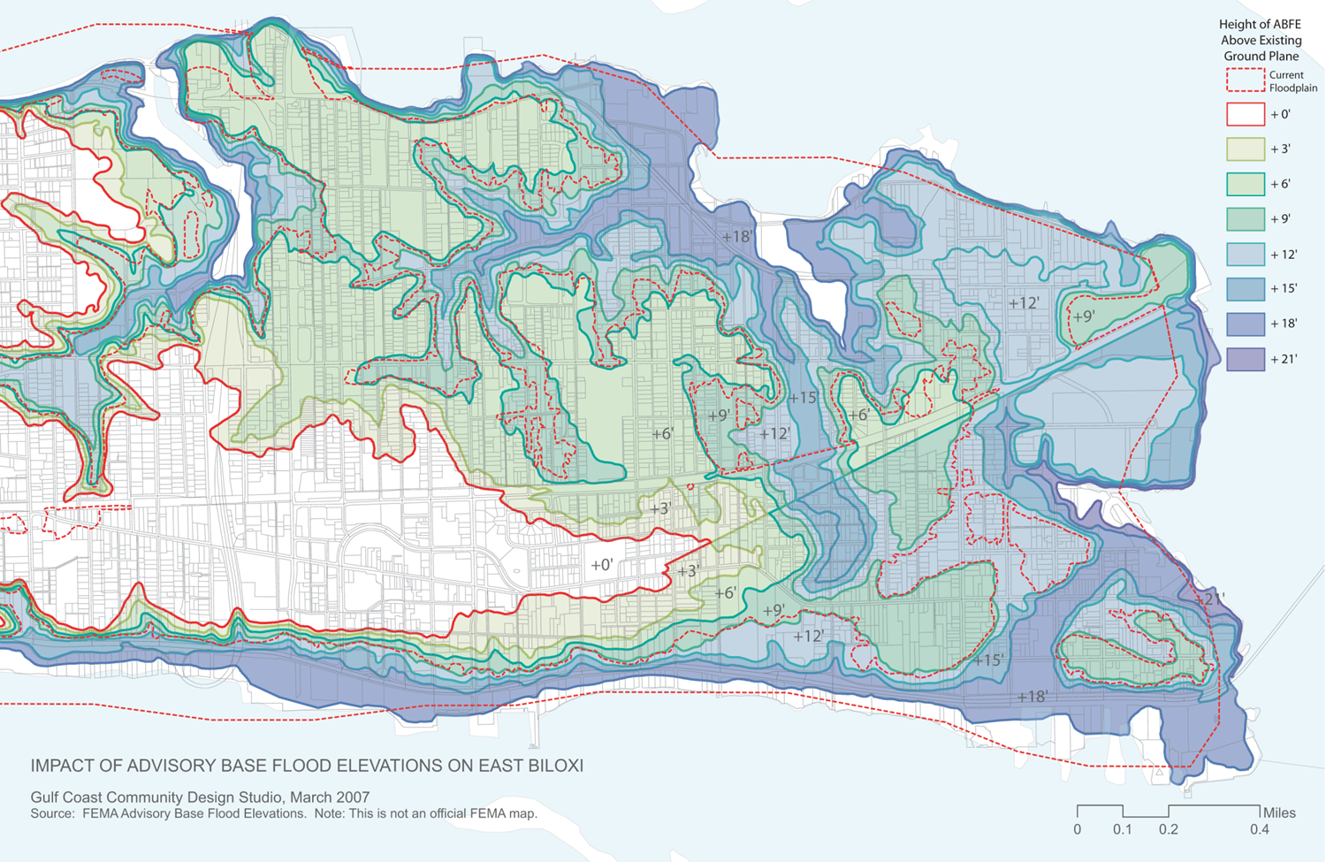
Organizational Culture and Risk Communication

Slide 24
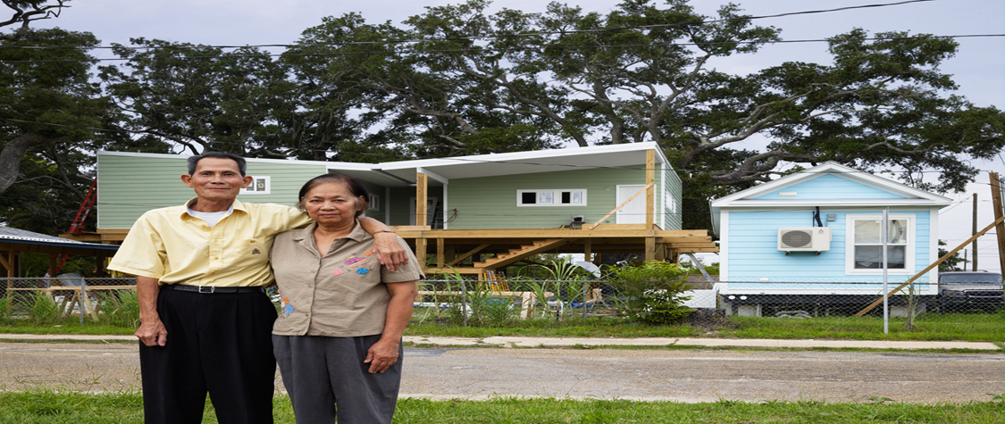

Slide 25
Natural Hazards Risk Hazards Management / Adaptation Lessons in Mississippi
The Remapping of Mississippi’s Coastal Floodplains: Implications for Risk Communications, Hazard Mitigation, Disaster Recovery, and Adaptation.
Secondary policy impacts, migration of coastal residents, and the construction of new inland communities.
The role of the design community in disaster recovery, hazard mitigation, and climate change adaptation.
Innovation and Organizational Culture (government, professional associations, non-profits, universities)
The adoption of new building codes and flood ordinances is not enough; these techniques should be coupled with land use measures.

Slide 26
Adaptation Imperatives and Lessons Learned from Natural Hazards Experience and Scholarship
Governance Imperative: Identify, nurture, and sustain collaborative governance networks that span varied spatial and temporal scales.
Build adaptive governance capacity
Integrate and mainstream development, risk management and adaptation
Clarify governance roles and promote inclusivity, collaboration, and conflict resolution
Bridge varied institutional, spatial, and temporal scales
Create institutional diversity and flexibility to deal with uncertainty
Capability Imperative: Expand the forward-looking use of community assets and pre- and post-disaster resources to enhance risk reduction and adaptation initiatives.
Understand and reduce vulnerability
Confront barriers to adaptation
Develop an expanded network of capacity-builders
Deepen and extend knowledge and understanding through dialogue and deliberation
Develop enduring and integrative policies and practices

Slide 27
Adaptation Imperatives and Lessons Learned from Natural Hazards Experience and Scholarship
Planning Imperative: Invest more in pre-event planning for risk reduction and enhanced collective adaptive capacity.
Develop a supportive institutional framework for building local adaptive capacity
Adopt a planning approach that focuses on spatial implications of land use decisions in light of risk and employs scenario based planning practices
Prioritise pre-event planning and embrace the post-disaster window of opportunity to implement inclusive adaptive strategies and capacity building initiatives
Integrate plans and planning processes
Encourage experimental and innovative governance strategies
Moral Imperative: Adaptation and risk reduction are ethical issues that require practical, actionable and enduring policies, plans and initiatives to build resilience and sustainability.
Build institutional capacity for reaching agreement about a shared vision for the future
Operationalise Resilience and Sustainability through collaborative governance
Engage non-specialists, including those with indigenous and / or local knowledge
Develop enduring deliberative procedures
Foster the conditions for collaborative leadership

