Slide 1
Strengthening Environmental Collaboration in Hampton Roads
Jamie Heffernan | Earth Viability Center| Summer 2026

Slide 2
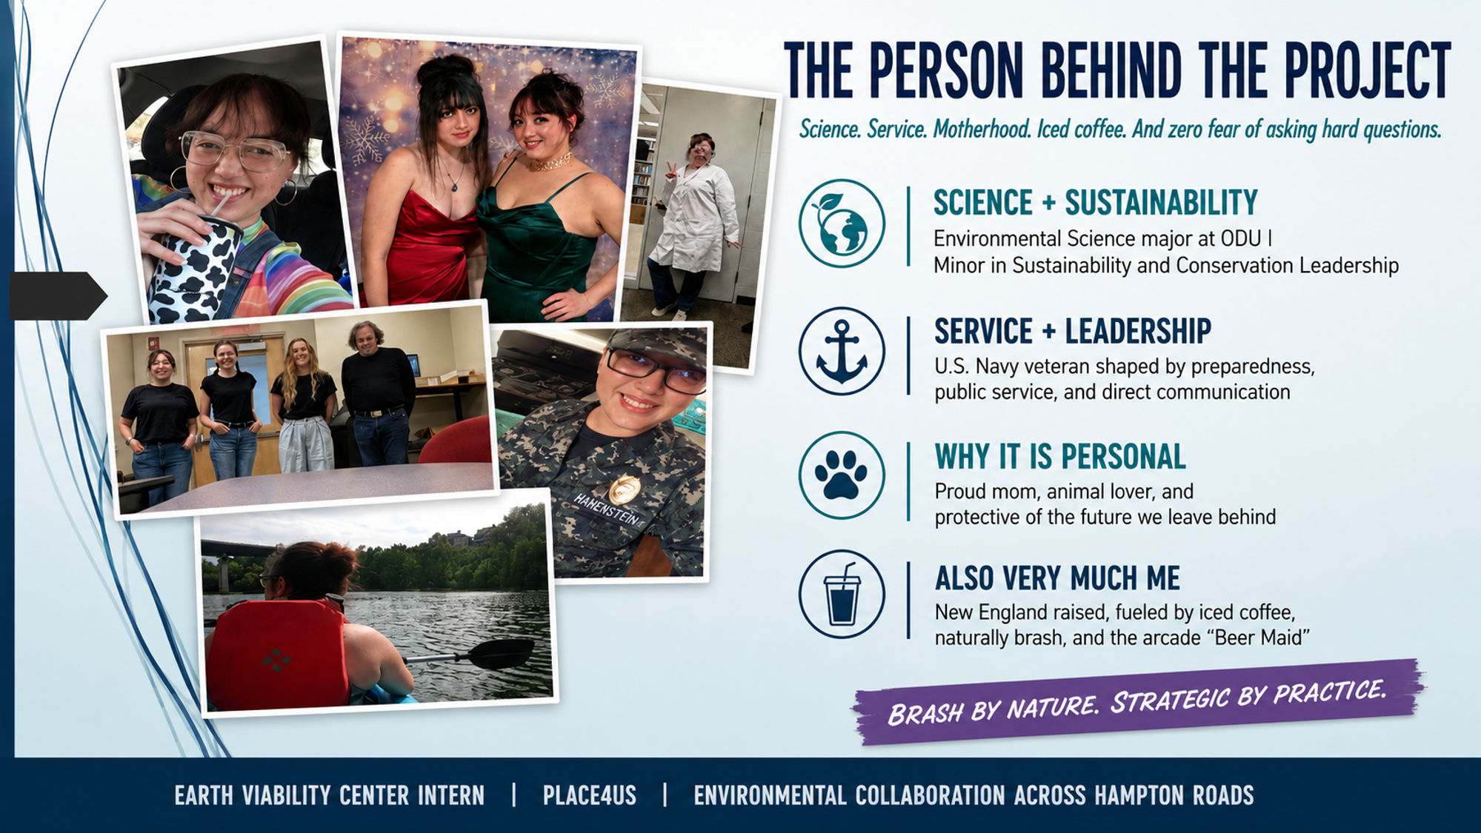
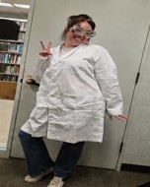
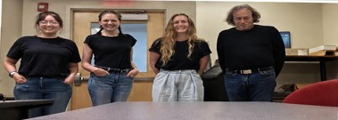
Notes:
Try to establish a rapport with your audience by balancing personal details with relevance. For example, you might be passionate about coin collecting, but unless you’re giving a talk the local chapter of the American Numismatic Society, that may not be relevant to the presentation (<-----See what we did there? Did you even know the word “numismatic” before today?)

Slide 3
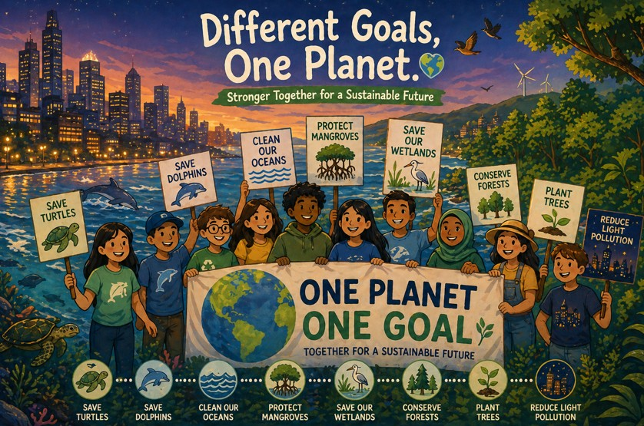
Imagine what Hampton Roads could accomplish if every organization working toward a healthier environment worked together instead of working separately.

Slide 4
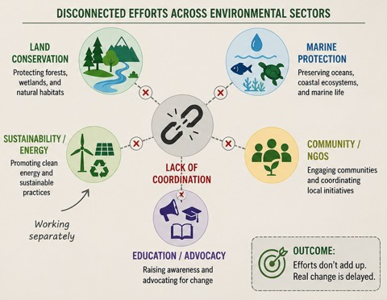
What Do NGOs Gain from Collaboration, and What Do They Need for That?
The Challenge
Hampton Roads has many organizations working toward similar environmental goals, but their efforts are often disconnected.
My Project
Analyzed the regional need for stronger NGO collaboration
Identified gaps in communication, coordination, and resource sharing
Examined what organizations need to collaborate effectively
Explored how Place4Us could help bridge these gaps
Project Goal
Identify practical ways to connect environmental organizations, strengthen regional partnerships, and increase their collective impact.
Notes:
Use the slides as a prompt, not a crutch! You can put additional specifics you might need help remembering here in the notes section. Only you will be able to see it while in slideshow mode.

Slide 5
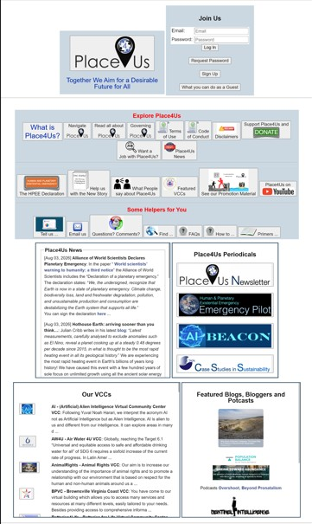
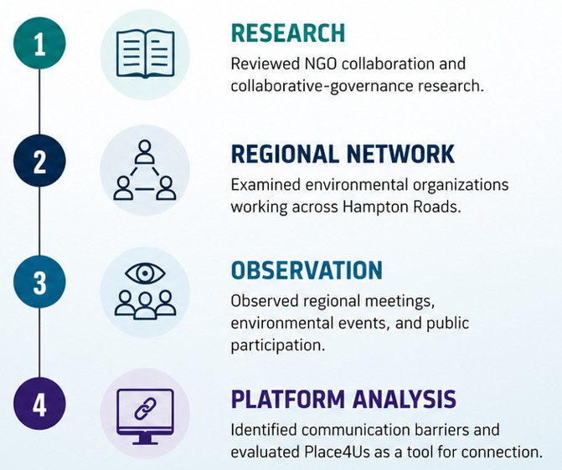
HOW I EXAMINED THE COLLABORATION GAP
Notes:
The number of slides varies (we suggest no more than 15-20) but remember -- Use the slides as a prompt, not a crutch! You can put additional specifics you might need help remembering here in the notes section. Only you will be able to see it while in slideshow mode.

Slide 6
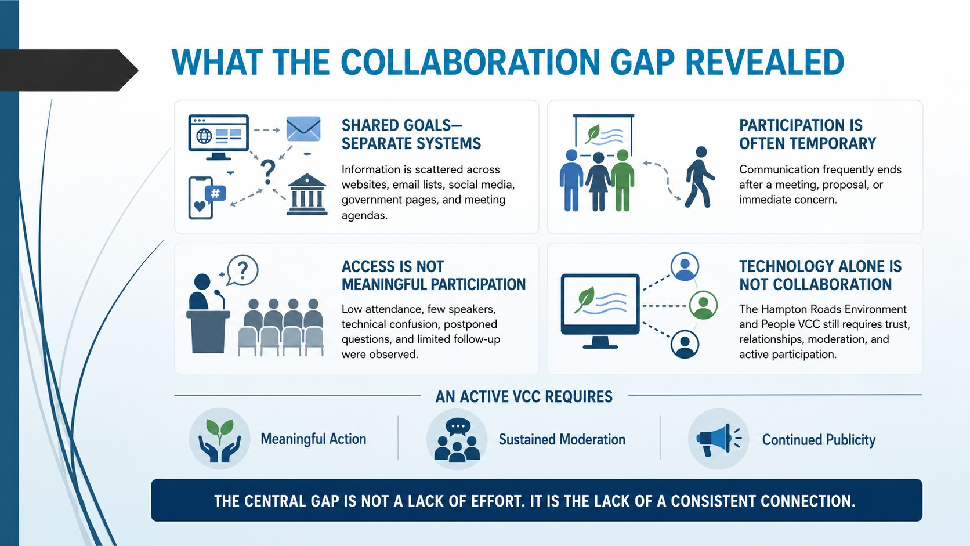

Slide 7
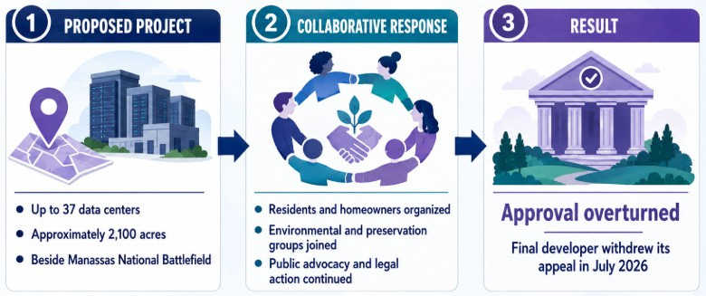
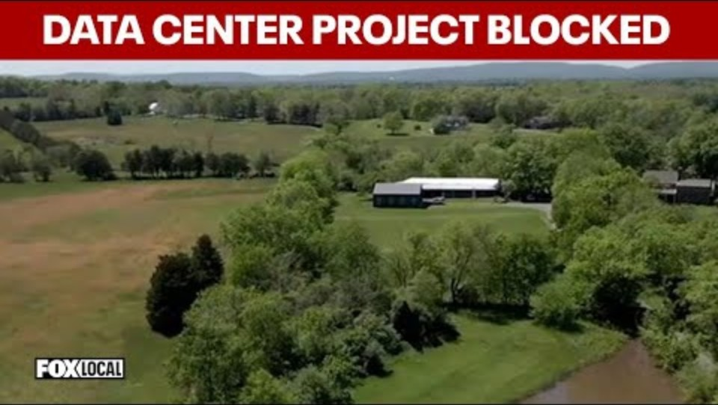
Collaboration in Action: When Communities Work Together, Decisions Can Change
Prince William Digital Gateway project in Virginia: July 2, 2026
FOX 5 Washington DC. (2026, March 31). Virginia court blocks Digital Gateway data center project [Video]. YouTube. https://www.youtube.com/watch?v=SvSB4Mf_Lc8
Notes:
Other examples of presentation enhancements might include audio clips, charts and graphs, or accompanying handouts or worksheets.

Slide 8
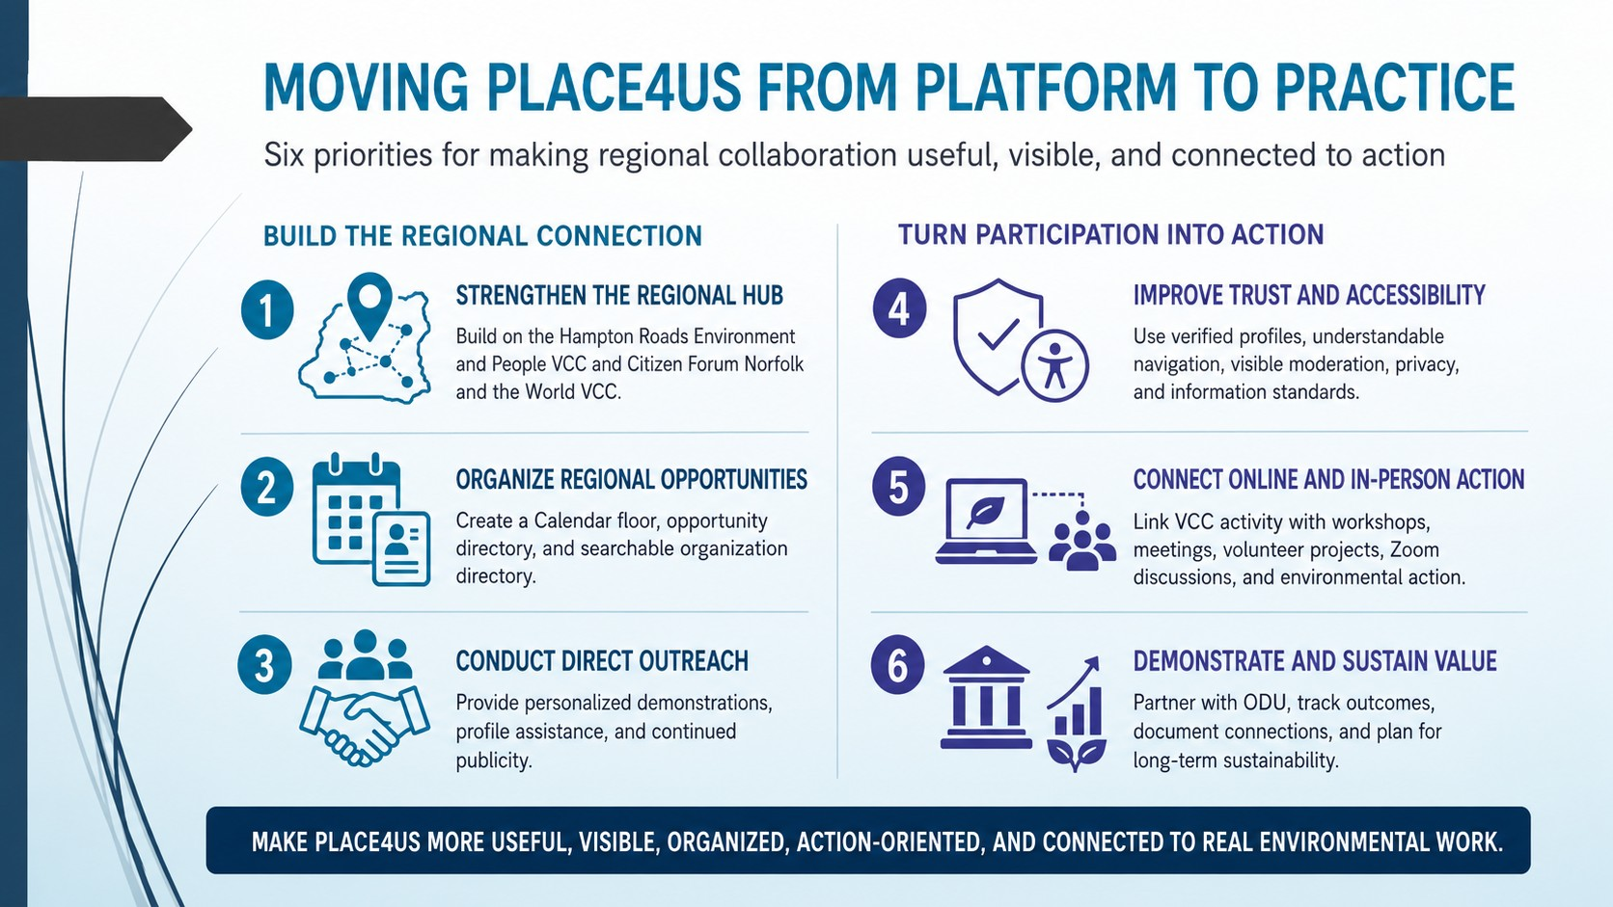

Slide 9
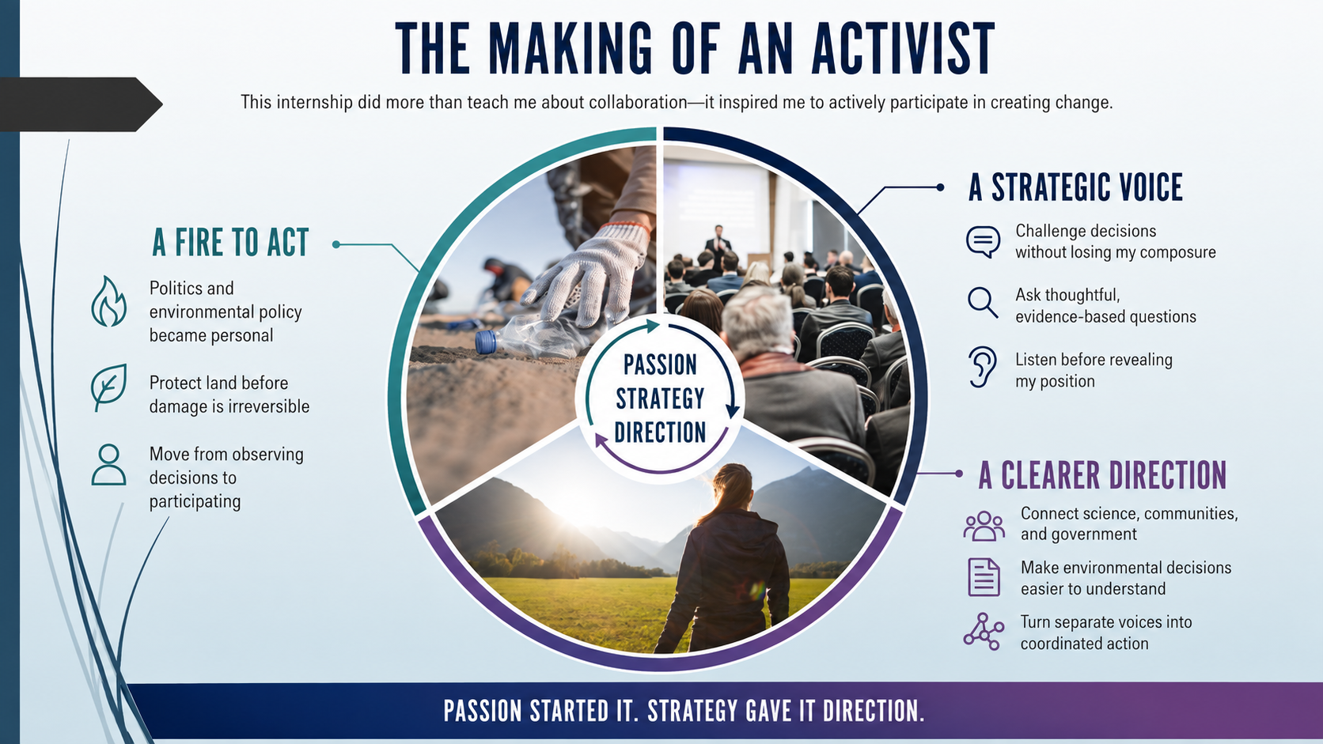
The Making of an Activist
This internship did more than teach me about collaboration; it inspired me to actively participate in creating change.
Notes:
What’s the “take home” message for your audience? What do you REALLY want them to walk away knowing?

Slide 10

Thank you
I want to give a big thanks to the Earth Viability Center for giving me the opportunity to study environmental collaboration and be part of the continued growth of Place4Us. This internship allowed me to take what I have learned in school and apply it to real environmental challenges while contributing ideas that could make the platform more useful, visible, and active. I truly believe Place4Us has the potential to become an important space where organizations, communities, researchers, and public institutions can connect and work toward shared environmental goals. I am grateful that I was able to contribute during this stage of its development, and I am genuinely excited to see what Place4Us becomes in the future.
Notes:
Always include a closing slide with “thanks” and contact information.

