Slide 1
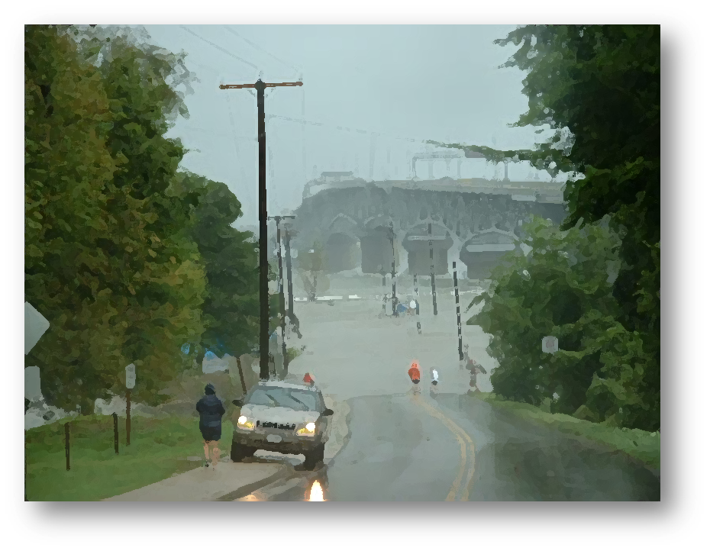


Moving Forward: Next Steps for Confronting Increased Flood Risks
Hampton Roads Sea Level Rise/Flooding Adaptation Forum
Oct 2, 2013
Norfolk, VA
Molly Mitchell

Slide 2
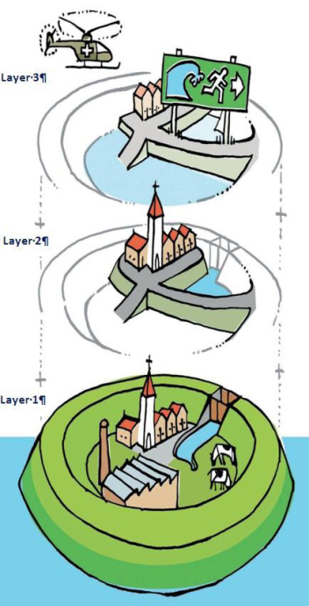
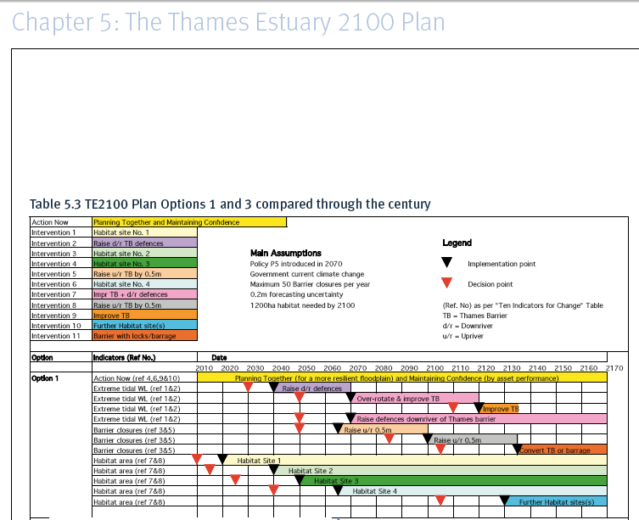
Multilayered Flood Protection & Flexible Adaptation
Netherlands, National Water Plan, 2010
Layer 3 = Disaster Management
Layer 2 = Spatial Development
Layer 1 = Prevention
Monitor 10 indicators: MSL, peak surge tide level, conditions of flood defense structures, developed area, intertidal habitat, etc.
Adaptable because:
Timing can be changed
Can switch between options
Structures designed to be upgraded
Land planning includes potential future uses
Considers new infrastructure planning

Slide 3
Adaptation Planning for the National Estuary Program – EPA 2009
Assessment of vulnerability to climate change
Summary of considerations used to set priorities and select actions
Planning typically requires some narrowing of the scope to focus efforts on areas or resources that are most at risk, have the greatest chance of success
Key considerations:
Timing of projected impacts (e.g., short-term, mid-term, long-term) relative to the timing of management decisions and actions.
Probability of occurrence of different impacts.
Description of specific adaptation actions for implementation
Plan for communicating with stakeholders and decision makers
Plan for monitoring and evaluating results.

Slide 4
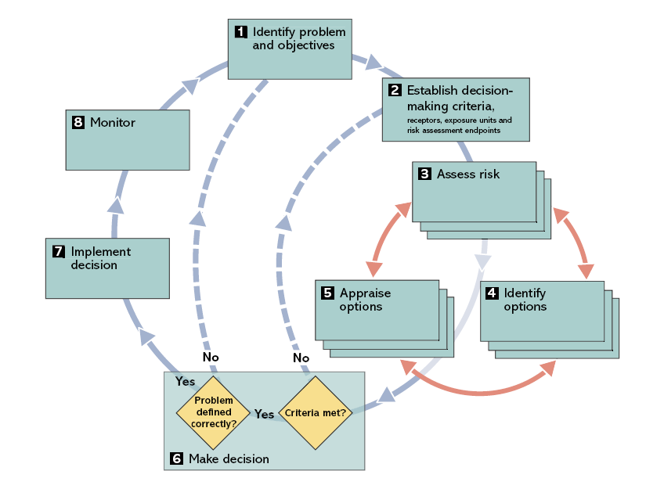
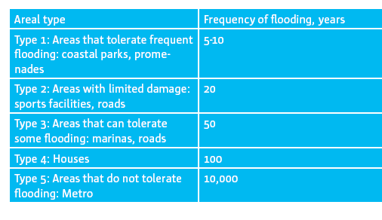
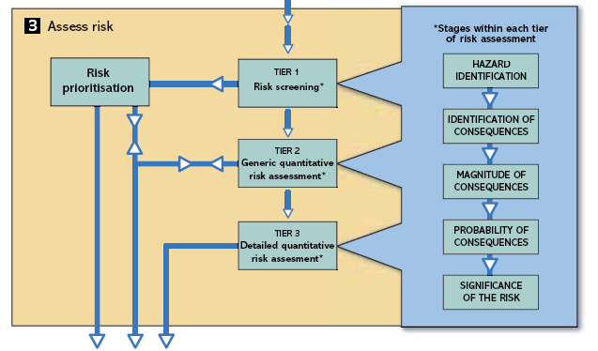
Copenhagen Climate Adaptation Plan. Copenhagen 2011. www.KK.DK/KLIMA
Willows, R.I. and Connell, R.K. (Eds.). (2003). Climate adaptation: Risk, uncertainty and decision-making. UKCIP Technical Report. UKCIP, Oxford.

Slide 5
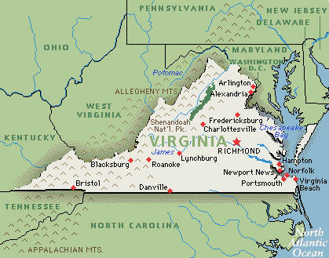
Creating the topographic surface
LIDAR data was acquired from VGEN and individual localities
Source data was processed into consistent datum's & units
Data were projected into Virginia State Plane HARN with units of feet (for end users)
MHW (from NOAA) was used as the shoreline boundary
Land elevations were referenced to MHW using Vdatum
“Filling” was used to remove isolated, land-locked low spots

Slide 6
Generating the flood levels
Used the raster calculator tool to extract all raster cells below given elevation levels
These raster cells are the different “lifetime” coverages
A raster collection called a mosaic dataset was created for each timeframe
Mosaic dataset
Image service
Image Server, ESRI
The web applications were developed in Microsoft Visual Studio 2010 Professional and Microsoft Expression Blend 4 and run in a Silverlight framework
Notes:
The image service is a GIS dataset which allows one to serve raster data efficiently in a web mapping application

Slide 7
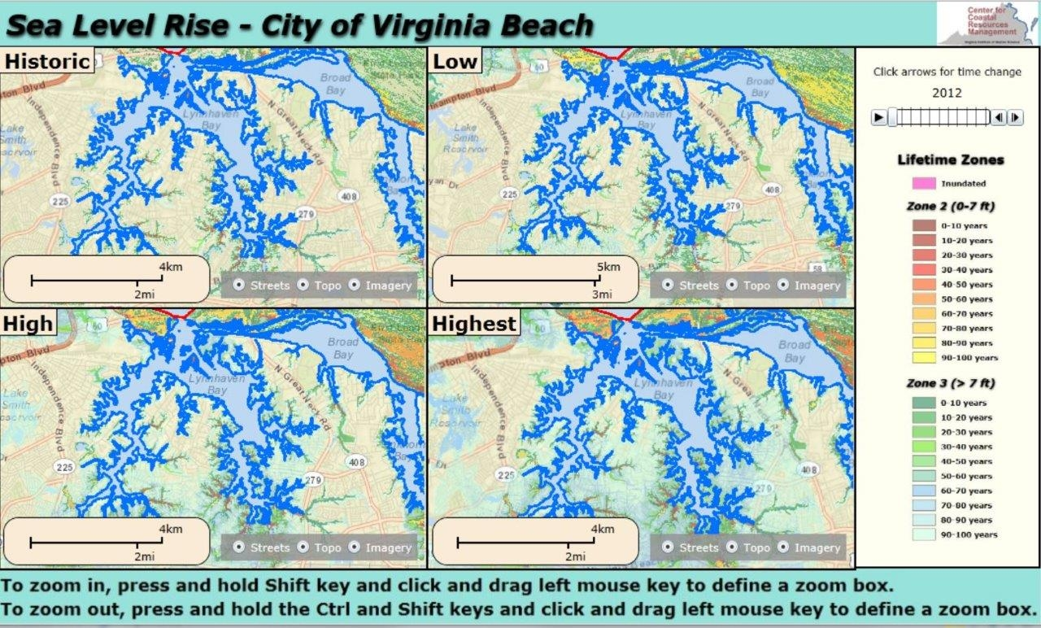

Slide 8
Time progression slider
The slider moves forward in time from 2012- 2112 in 10 year increments.
Press the solid arrow to see an animated time progression.

Slide 9
Areas inundated constantly or by daily tides
These are areas that (in the absence of protection) will be underwater.

Slide 10
Storm surge zone. Shows how many years until inundation.
These areas are vulnerable to storm surge. Adaptations for flooding should be considered. Areas that are more red, will shortly be inundated. Protection strategies or retreat actions should be considered.

Slide 11
Upland zone. Shows how many years until storm surge zone.
These areas are currently safe (except from extreme storms); however, the green areas will shortly be in the storm surge zone. These areas should be considered for management and accommodation strategies.

Slide 12
SLR Demonstration

Slide 13
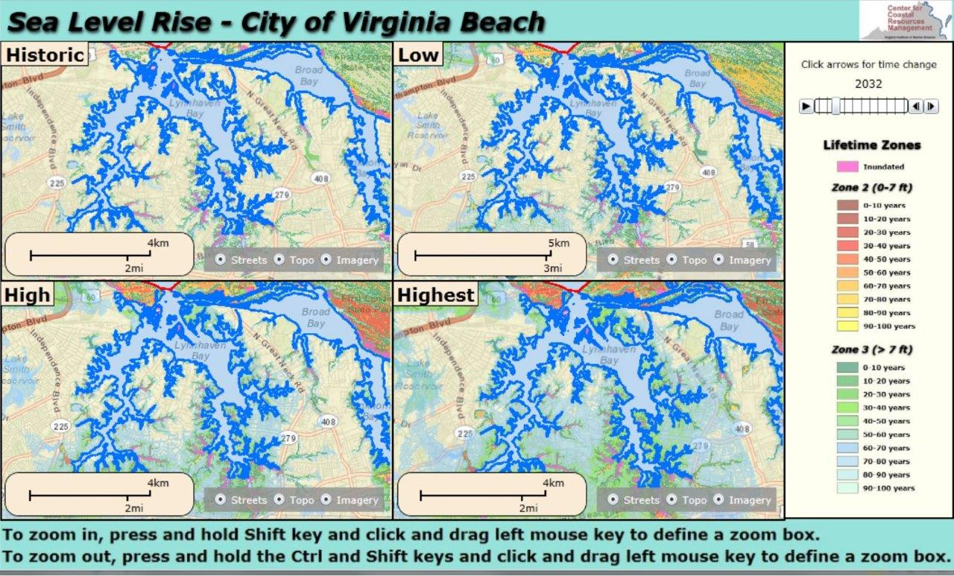
SLR Demonstration

Slide 14
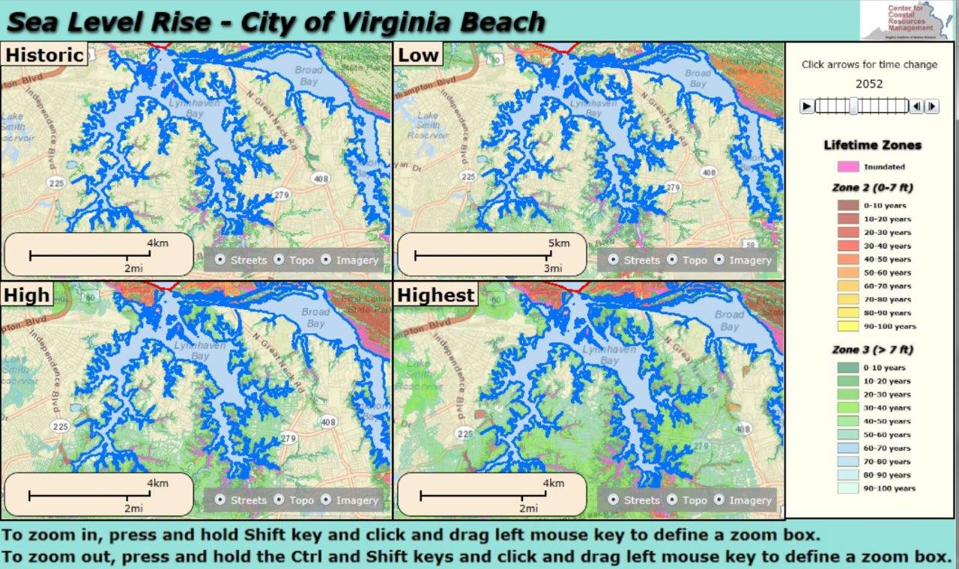
SLR Demonstration

Slide 15
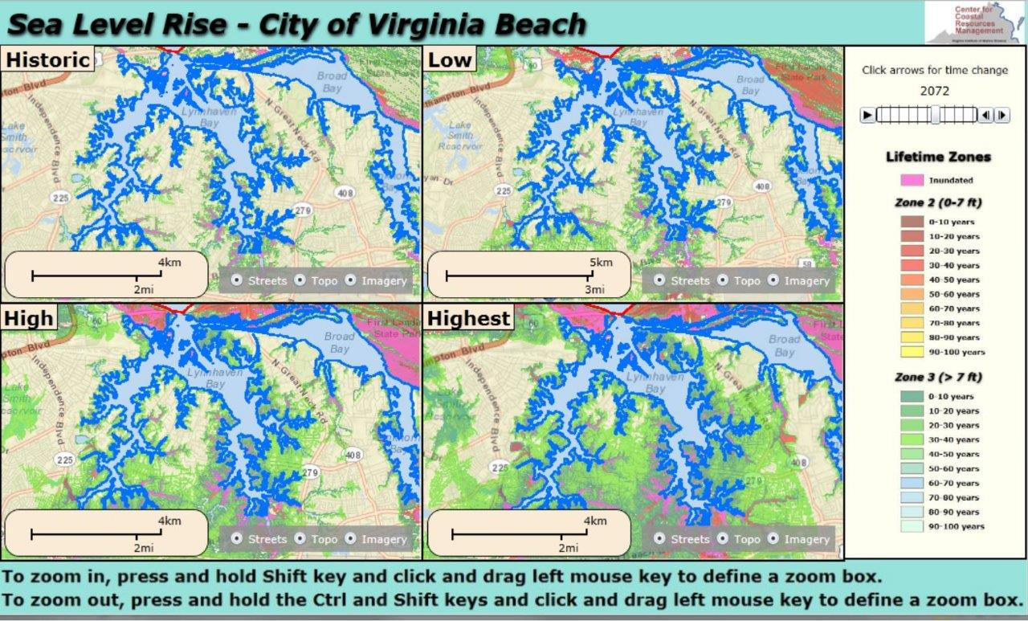
SLR Demonstration

Slide 16
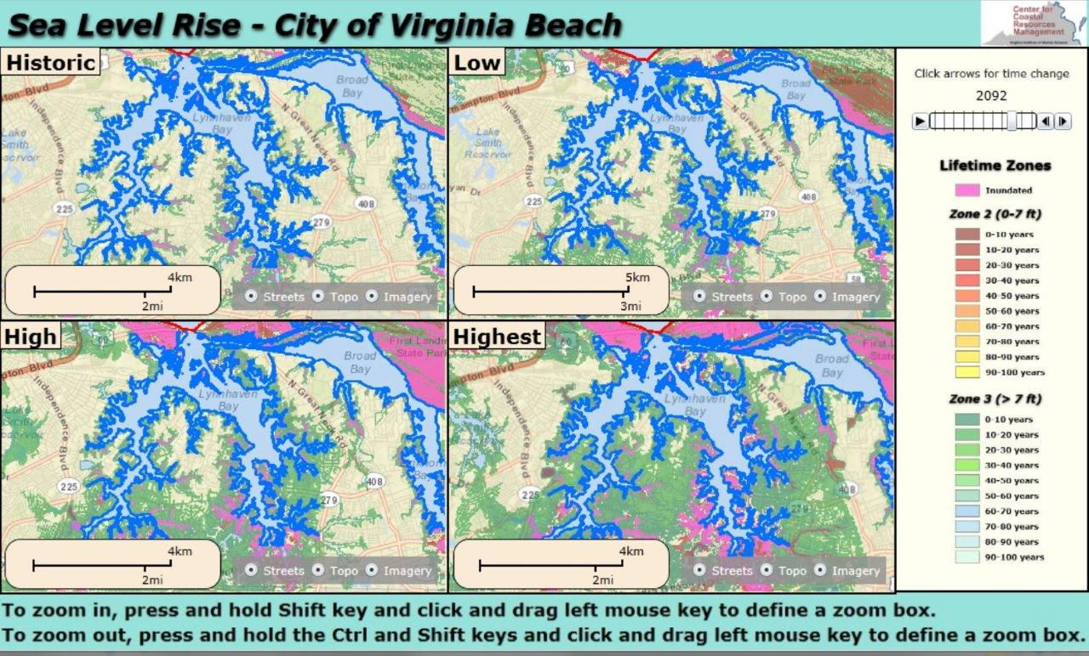
SLR Demonstration

Slide 17
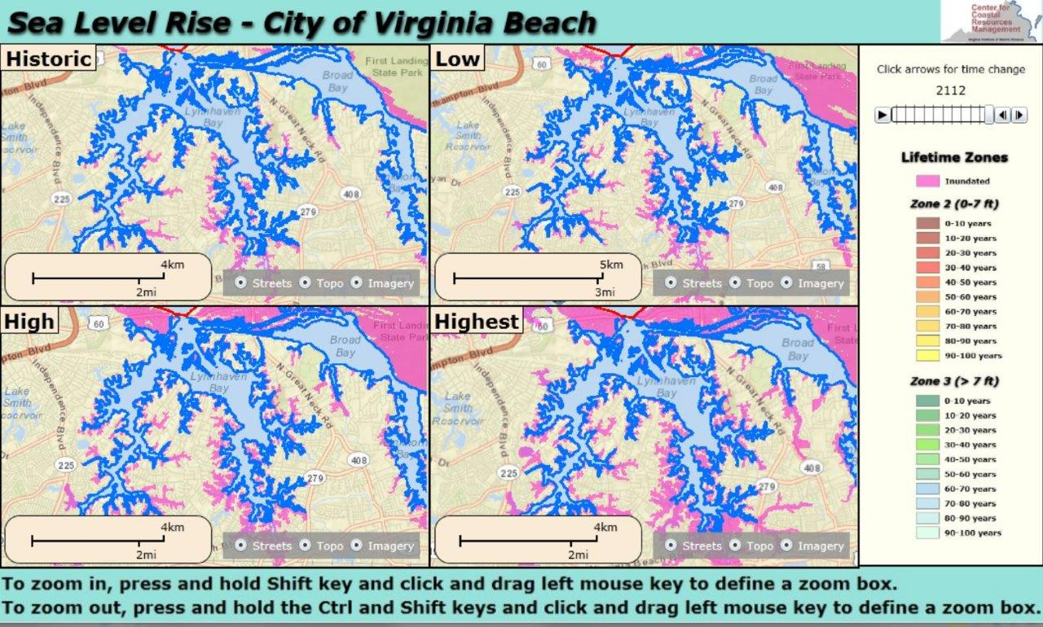
SLR Demonstration

Slide 18
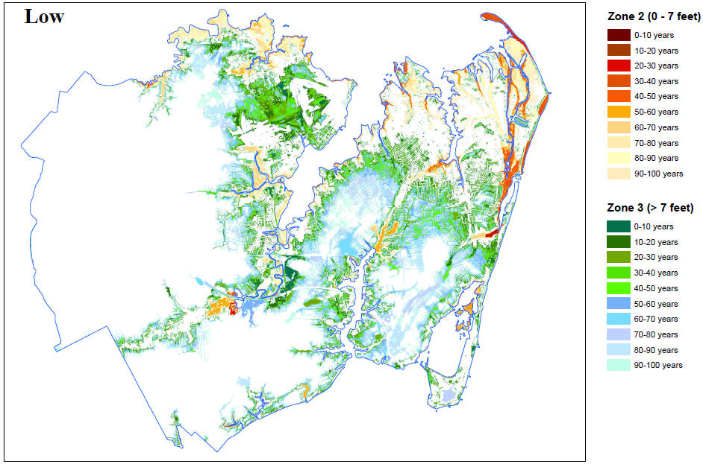
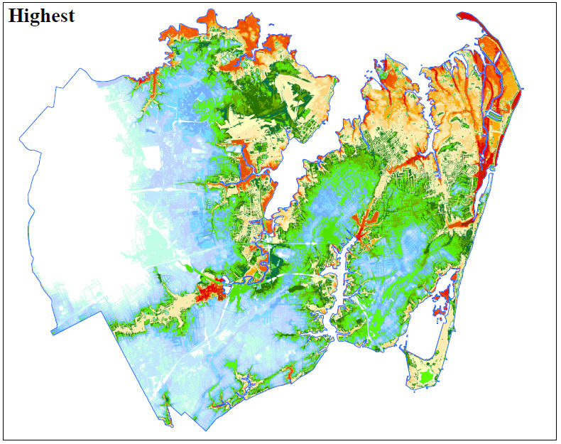
Hampton Virginia
This begins to answer the question of probability of flooding…
Next step: HAZUS-type analysis of impacts from flooding at different time scales
Risk = Probability x cost

Slide 19
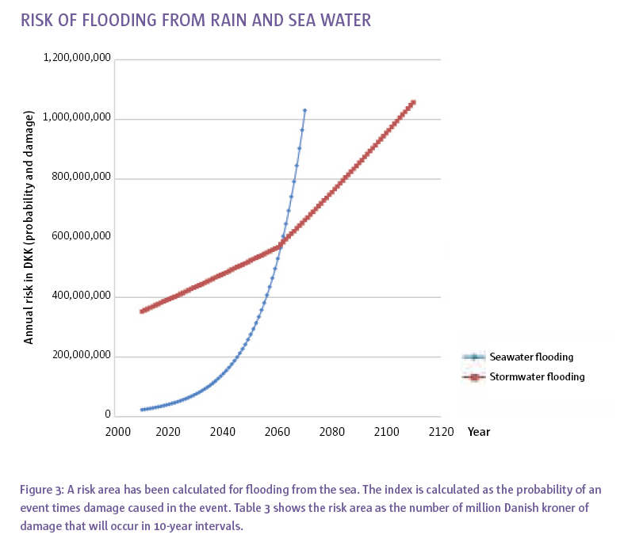
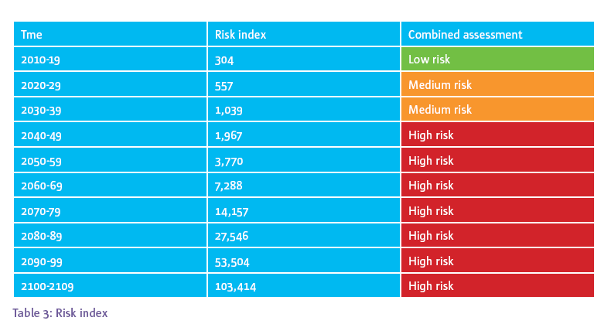
The risk of damage depends on the assets in the areas affected by flooding and can be assessed on the basis of land use. To assess the risk in those areas that may be subject to flooding, a calculation has been made of vulnerability based on the costs associated with damage at high waters.
Copenhagen Climate Adaptation Plan. Cowi, Deloitte, Rambøl, Dmi, Ku-life, Dhi AND Gras. Copenhagen 2011. www.KK.DK/KLIMA

Slide 20
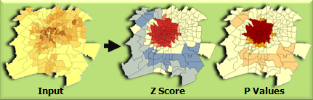
Hot spot analysis – time series
Look for clusters of areas where there is a nexus between probability of flooding and cost (impacts)
Consider options – maybe test out the impact of some structures?
Clusters help prioritize areas for action
Can be done separately for storm surge risk and SLR risk

Slide 21
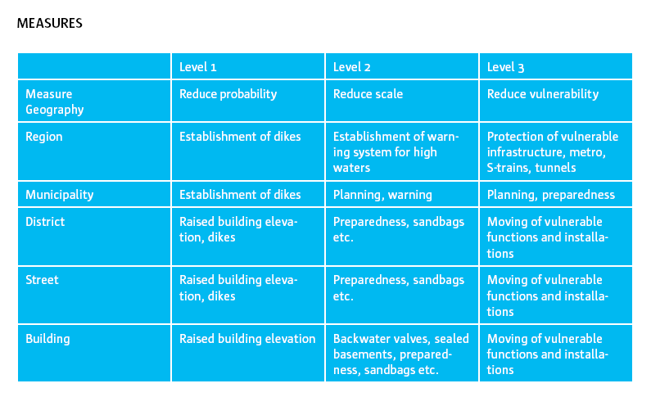
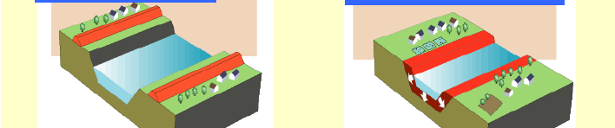
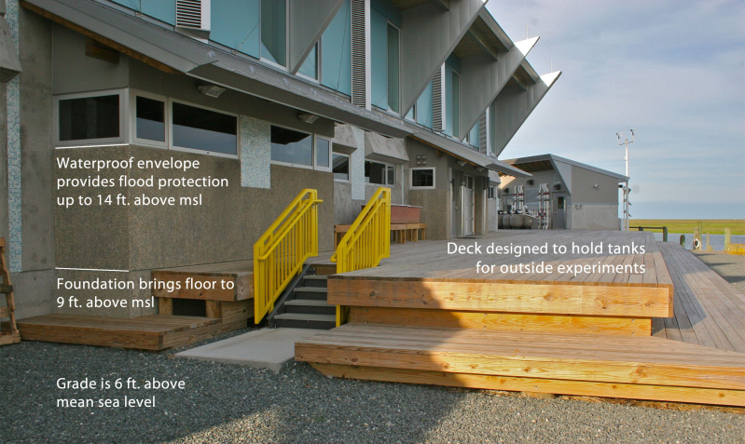
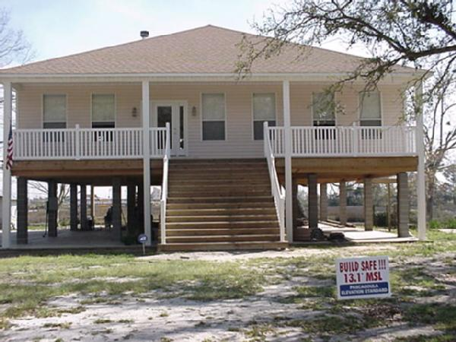
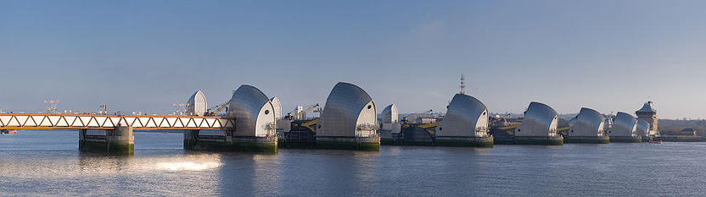
Target appropriate measures
Consider measures at all levels of planning.
Build in redundancy where necessary
Coordinated across multiple scales

Slide 22
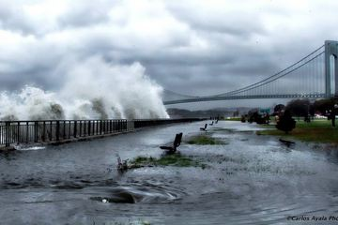

“Large Scale Storm Tide and Super-High Resolution Local Inundation Modeling for Hurricane Sandy”
Harry V. Wang¹, Derek Loftis¹, David Forrest¹, Aron Roland²
Zhuo Liu¹ and Joseph Zhang¹
¹Virginia Institute of Marine Science ²Institute of Hydraulic and Water
College of William and Mary Resources Engineering, Technische
Gloucester Point, VA 23062 Universität, Darmstadt, Germany
*hvwang@vims.edu; 804-684-7215

Slide 23
Outline
Large scale Storm tide modeling using un-structured grid model SELFE
Linked with wind wave model WWM II
Super-high resolution, local inundation modeling using ‘sub-grid’ for directly coupling with LIDAR data

Slide 24
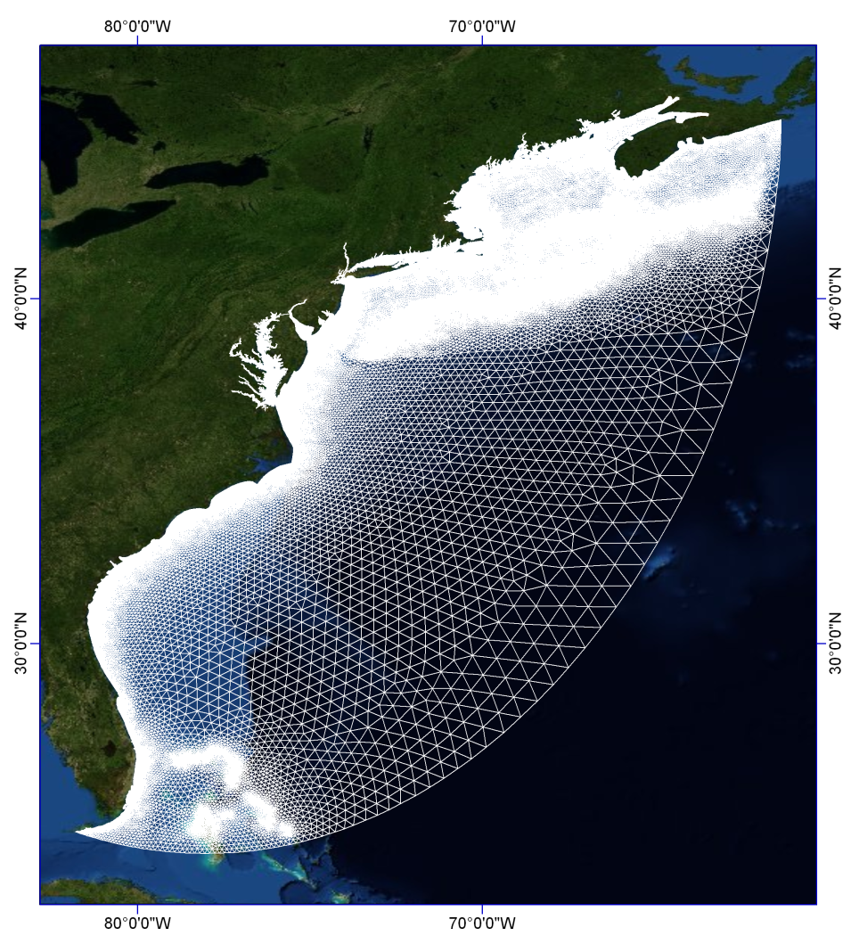
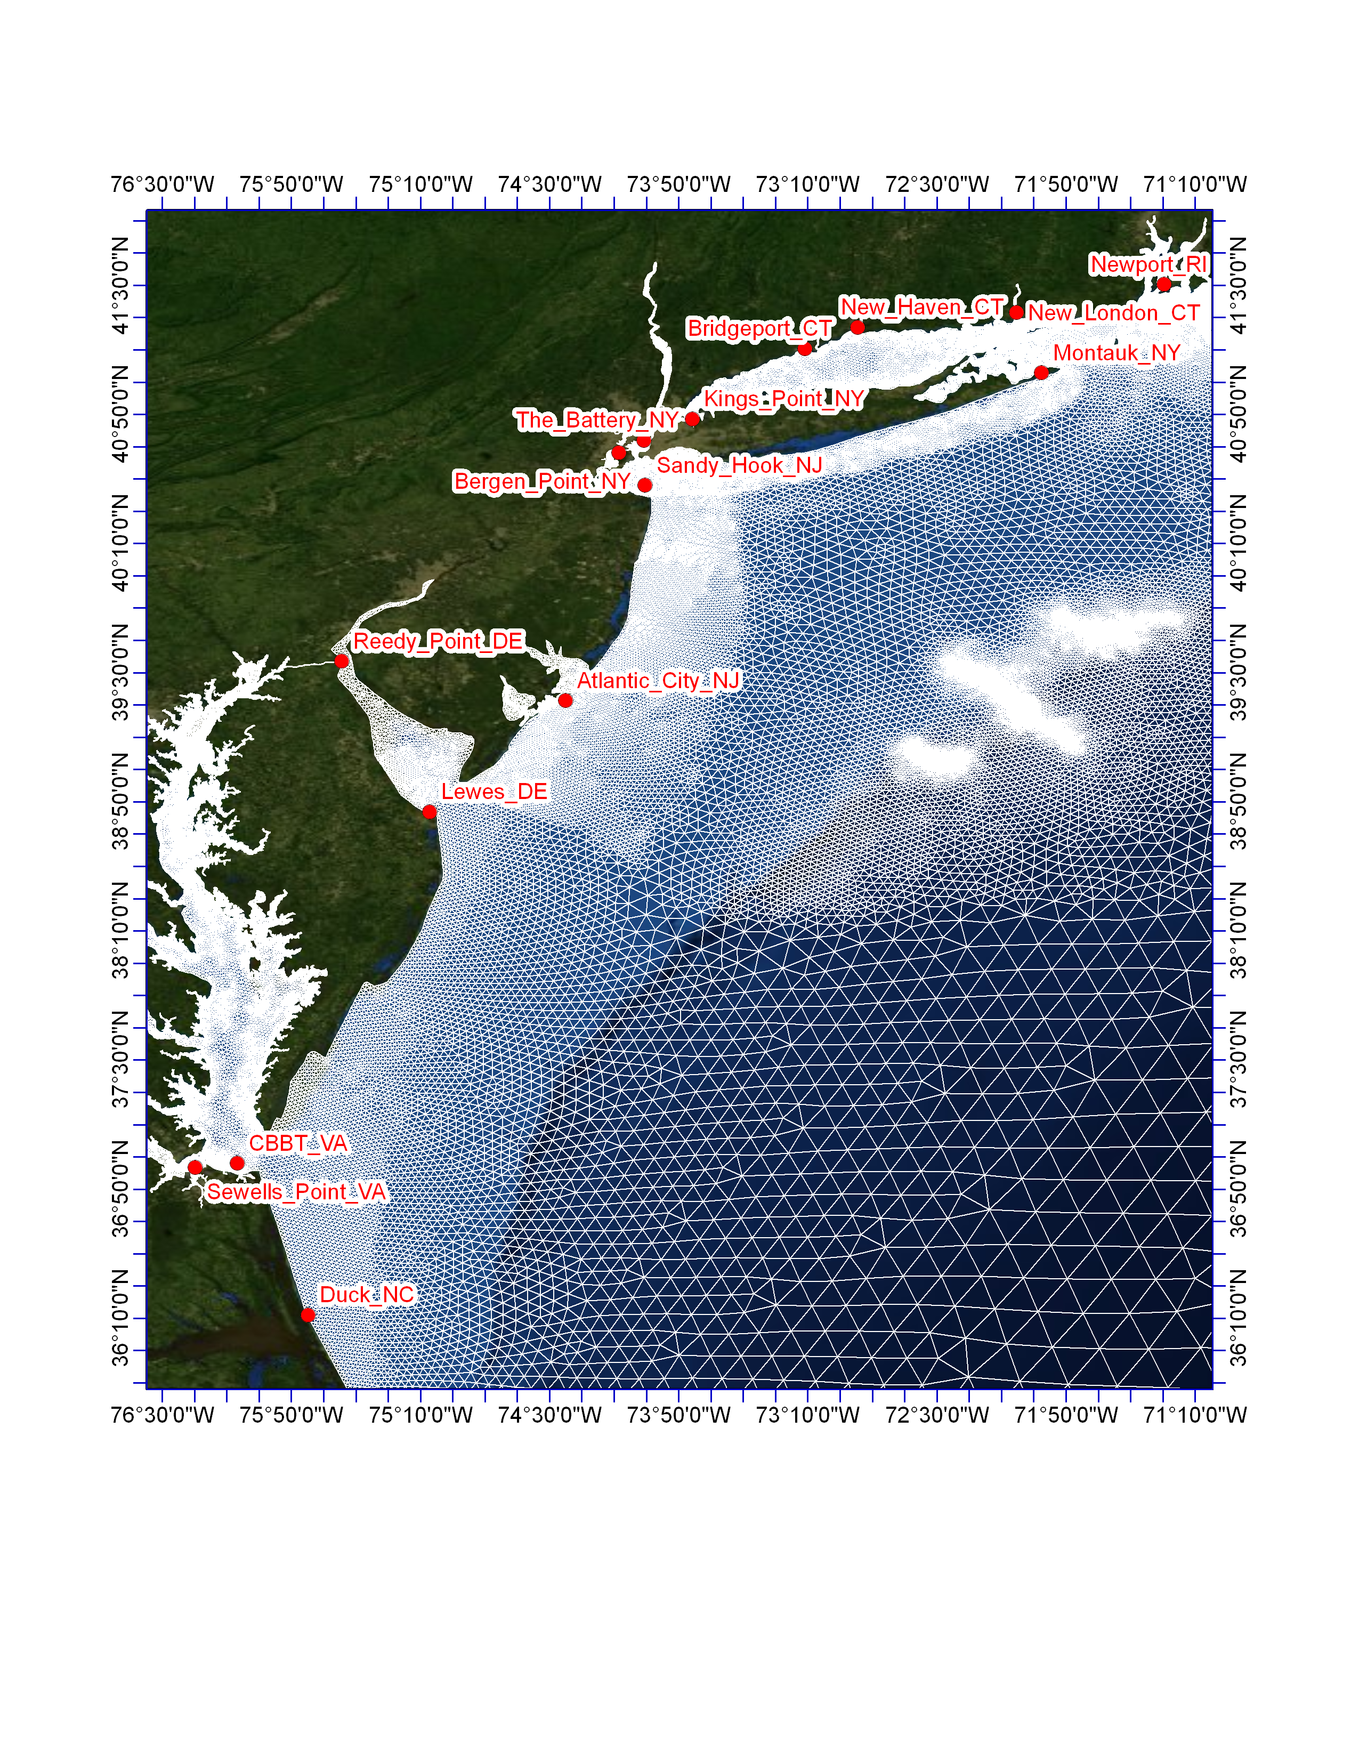
Time step: 6 minutes
The model is forced at its open boundary by 8 tidal constituents: M2, S2, N2, O1, K1, Q1, P1, and K2
Winds: NOAA NCEP NARR (24km) and NAM (5km) wind fields; both every 3 hour interval

Slide 25

I. Large-scale Storm Tide modeling
The model used is SELFE (Semi-implicit, Eulerian-Lagrangian, Finite Element) http://www.ccalmr.ogi.edu/CORIE/modeling/SELFE/)
Key Features:
Unstructured triangular grid in the horizontal
dimension & hybrid SZ coordinates in the vertical
dimension.
Semi-implicit finite-element Eulerian-Lagrangian
algorithm to solve the Navier-Stokes equations
not constrained by CFL stability -> numerical
efficiency.
It is naturally incorporate simulation of wetting-and-drying
process.
• Several related codes constitute an interdisciplinary modeling system
that is growing organically around SELFE.

Slide 26
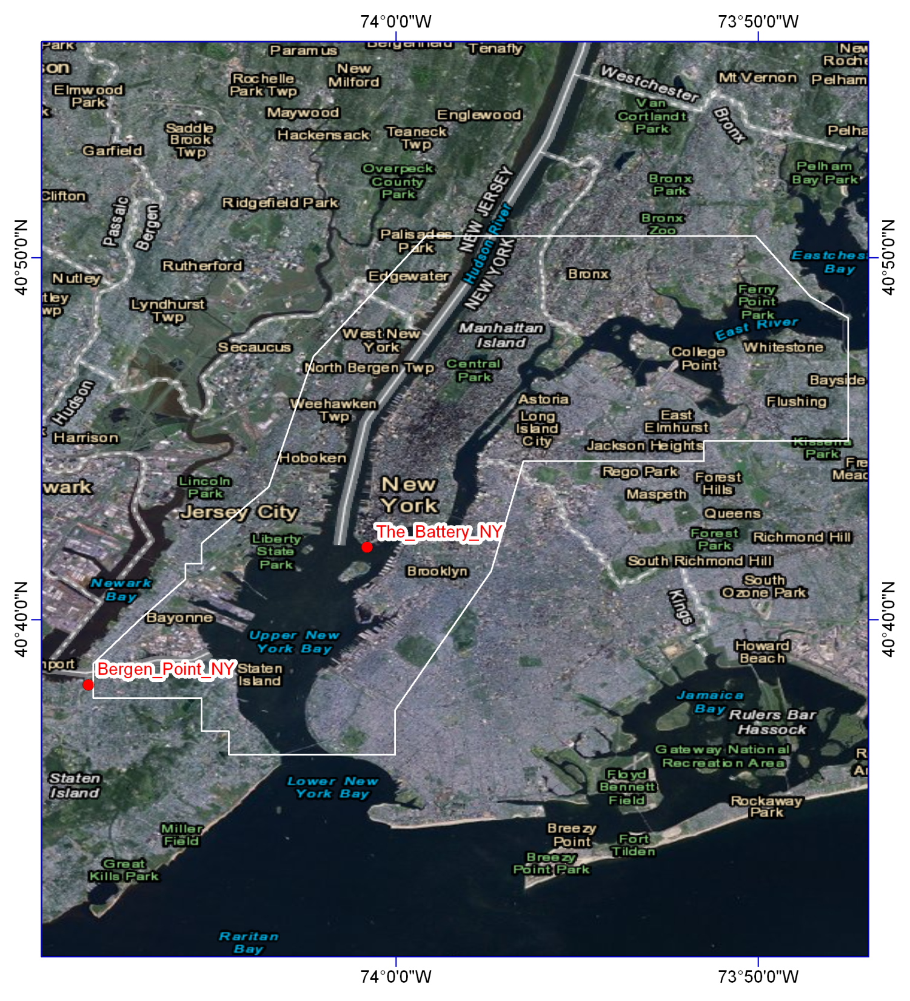
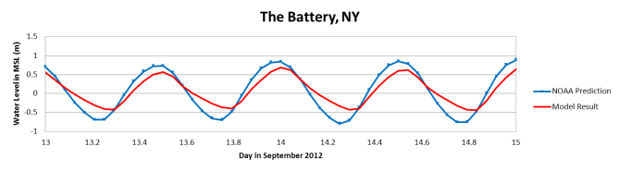
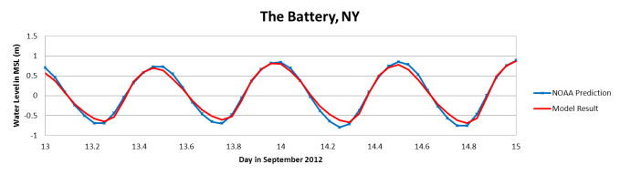
Friction formulation using Manning coefficient
Manning n = 0.025 everywhere except
New York Harbor
n=0.010
East and Harlem Rivers
n= 0.045
Kings_Point_NY

Slide 27
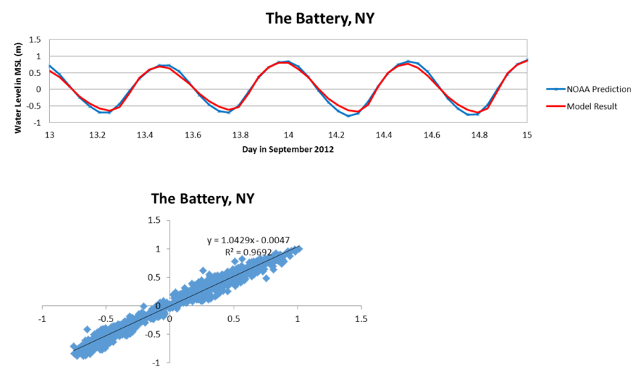
Tide only

Slide 28
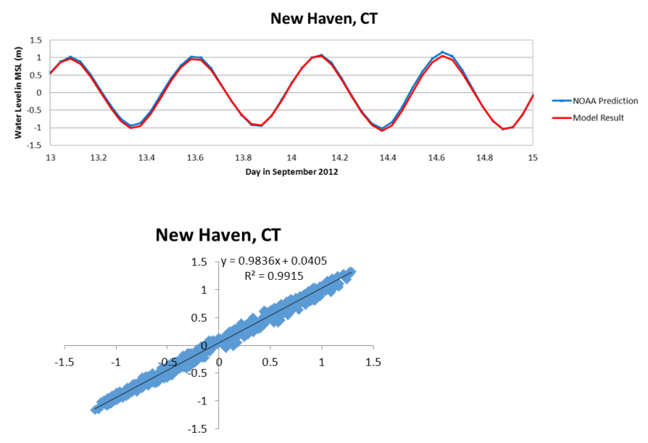
Tide only

Slide 29
Benchmark for large scale SELFE model:
There are 208,029 nodes and 392,062 elements in the large scale SELFE storm tide model. It covers the domain along the US East Coast from Florida to Maine.
The finest grid resolution is about 75 m Inside the New York Harbor and
10 km further offshore. Given the efficiency of semi-implicit, Eulerian-
lagrangian scheme the time step used was 6 minute for this application.
3. For tidal simulation, SELFE finished 30 days runs within 6 hours using 64
processors in Linux cluster – It translates to about 120: 1 real time: CPU
hour ratio. For storm tide, when wind fields were internally
interpolated every 3 hour, the real time: CPU hour is 62:1. It translates
to 30 minutes for ~30 hour forecast
4. The overall relative mean error for the storm tide prediction is around
5% - 8 %, if the quality of wind field is adequate.

Slide 30
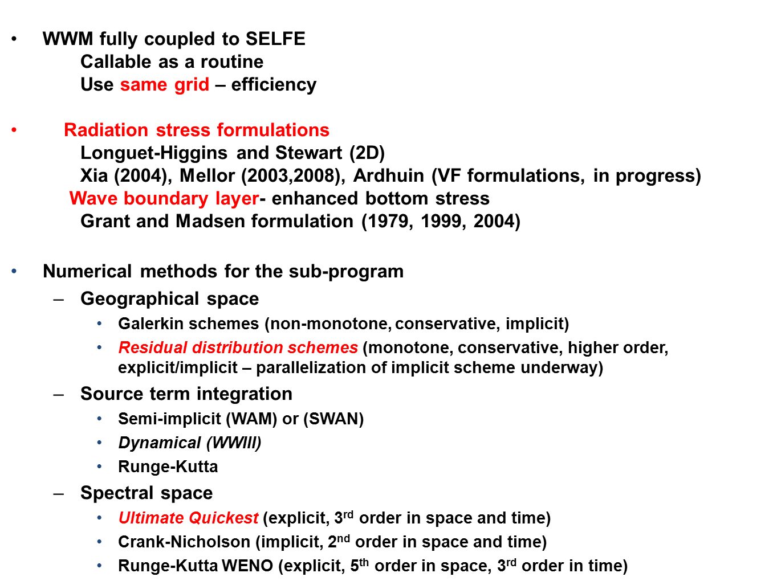
II. SELFE link with wind wave model

Slide 31
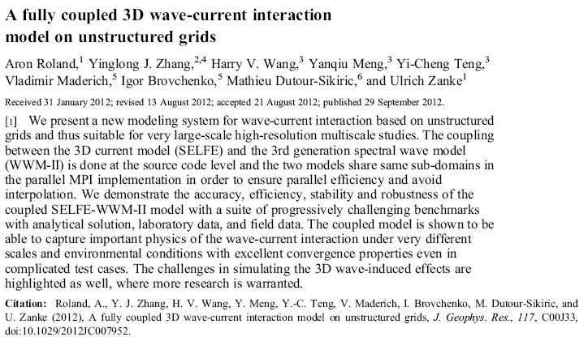
For the Chesapeake Bay work, refer to:

Slide 32
Figure 31: Model forecast tracks for Sandy at 0000 UTC 23 October (a), 000 UTC 24 October (b), 000 UTC October 25 (c), and 000 UTC 26 October, (d).
The ECMWF is in coral, the GFS ensemble in yellow, the GFS in cyan, and the TVCA model consensus is in red
From: Blake, Eric, et al. (2013): Tropical Cyclone Report: Hurricane Sandy, National Hurricane Center,

Slide 33
Preliminary recommendation from WWM II
Wind wave is quite sensitive to the quality and resolution of the wind fields
Collaborating with Germany who have the access to European ECMWF
The long-term goal is to fully coupled wave, current and atmosphere model as it is now being developed in Germany putting COSMO (LM Atmosphere) into SELFE-WWMII.

Slide 34
III. High-resolution, sub-grid dynamic modeling
Fundamental Idea of “Subgrid Modeling”
The availability of super computing power, solid and stable semi-implicit methods, structured or flexible unstructured grids , are useful tools but, alone, are still insufficient to faithfully account for complex topographic features.
The availability of detailed bathymetry data within a coarse grid model can and should be used to further improve a model accuracy
The Key elements for the sub-grid modeling *Casulli and Sterlling (2011) are:
A differential form of conveyance formulation implemented on a sub-grid scheme
Nonlinear semi-implicit solver for surface elevation
*Casulli V. and Stelling, G. S (2011): Semi-implicit subgrid modelling of three-dimensional free-surface flows. International Journal for Numerical Methods in Fluids, Vol, 67, p441-449.

Slide 35
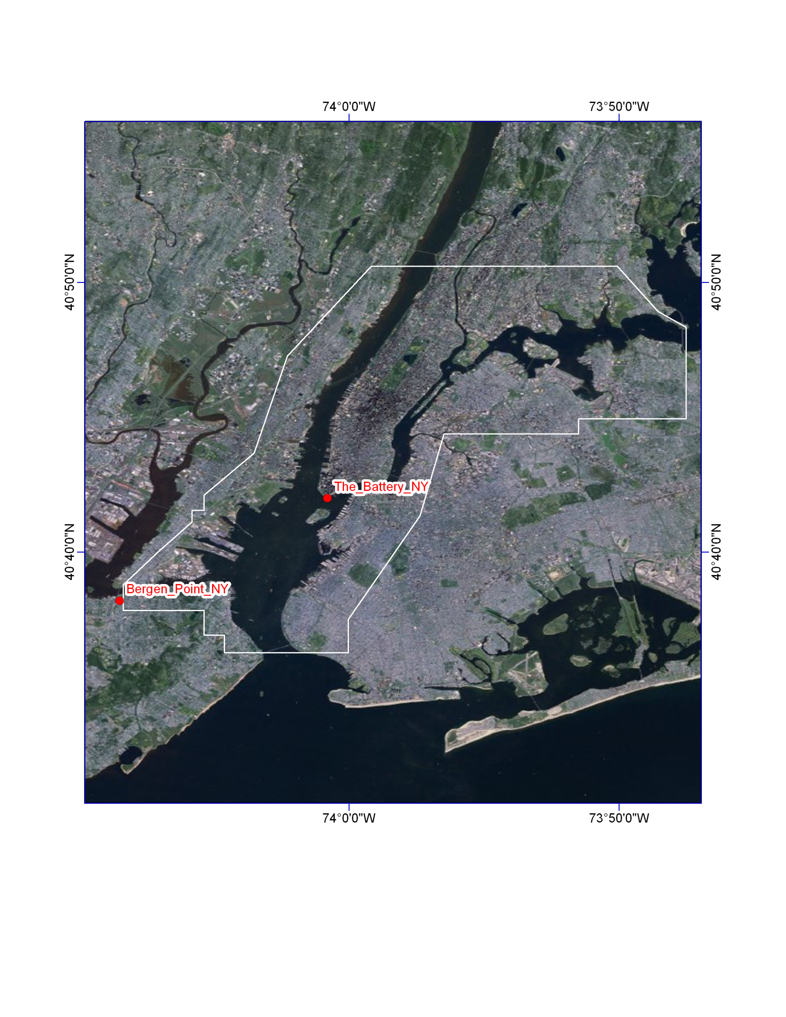
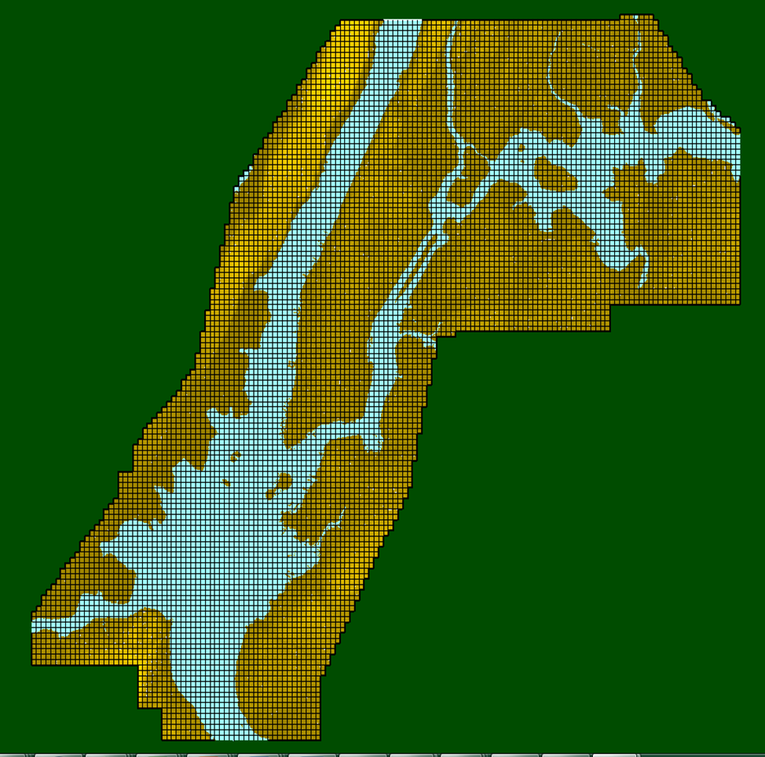
High resolution, local inundation dynamic model on sub-grid scale
Kings_Point_NY
Base-Grid Nodes: 9,946
Base-Grid Cells: 9,663
Sub-Grid Cells: 3,865,200

Slide 36
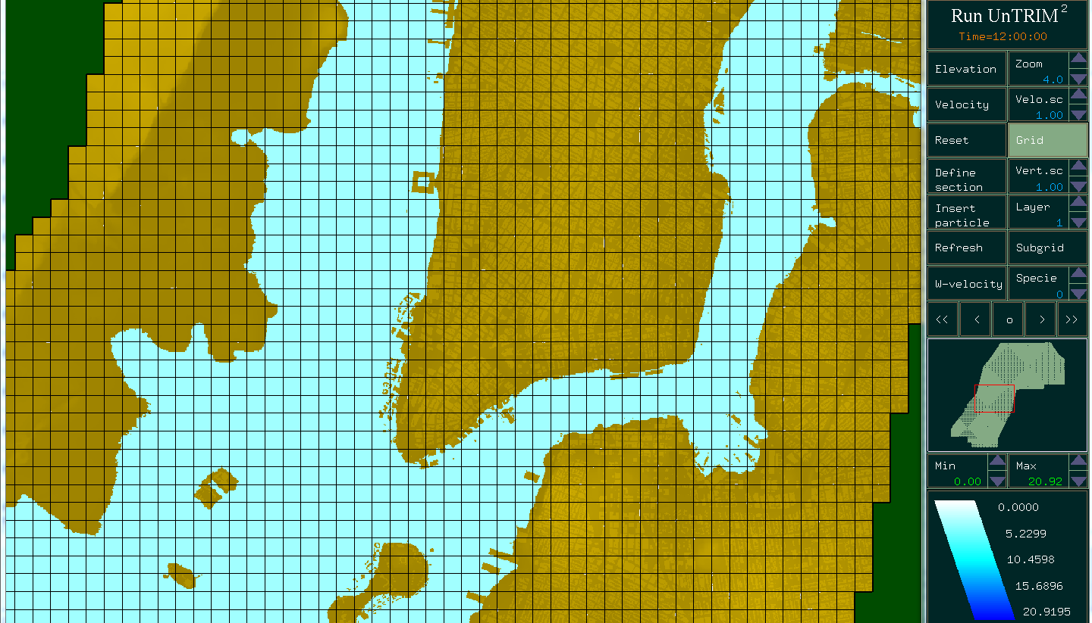

Slide 37
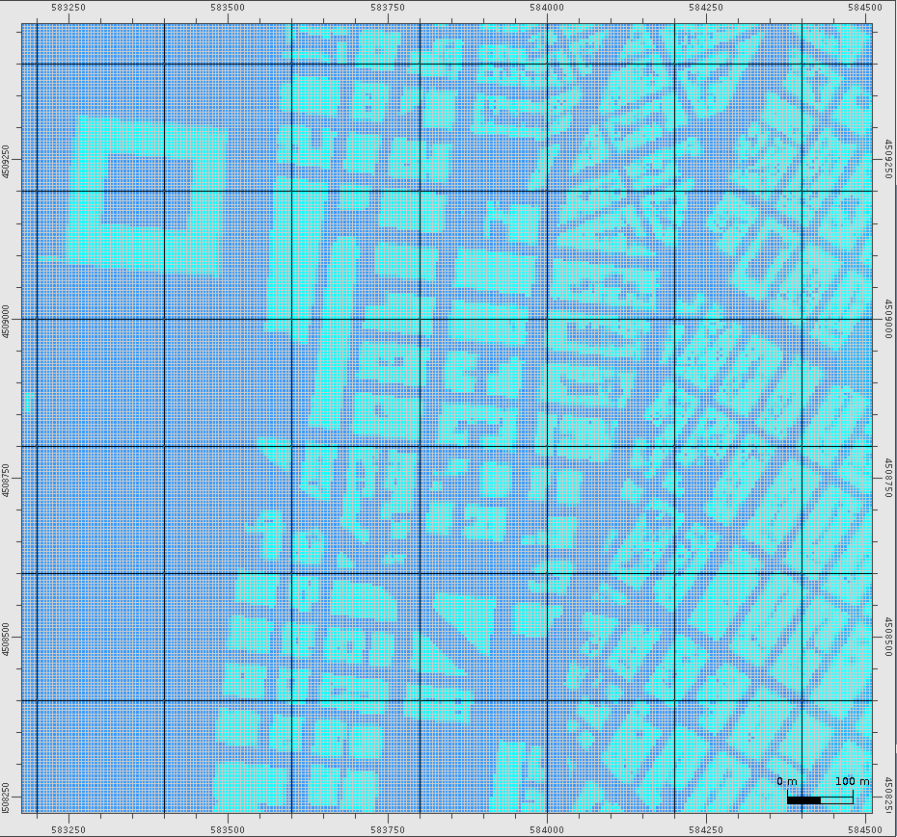

Slide 38
High-resolution, sub-grid setup for Hurricane Sandy
Open Boundary Forcing from NOAA Stations
West Boundary: Bergen Point, NY NOAA Station #8519483
East Boundary: Kings Point, NY NOAA Station #8516945
South Boundary: near Sandy Hook, NJ NOAA Station #8531680
Flux Boundary Forcing from USGS Station
North Boundary: Hudson River near Wappinger Falls USGS Station #01372500
Model Setup for 10 days from 00:00, 10/25/2012 to 00:00, 11/04/2012
Atmospheric pressure and wind data retrieved from Bergen Point, NY, at NOAA Station #8519483
Runtime: 68 minutes on Dell Precision T-3500 Workstation with Intel Xeon W3670; Windows 7 64-bit OS; 24 GB RAM

Slide 39
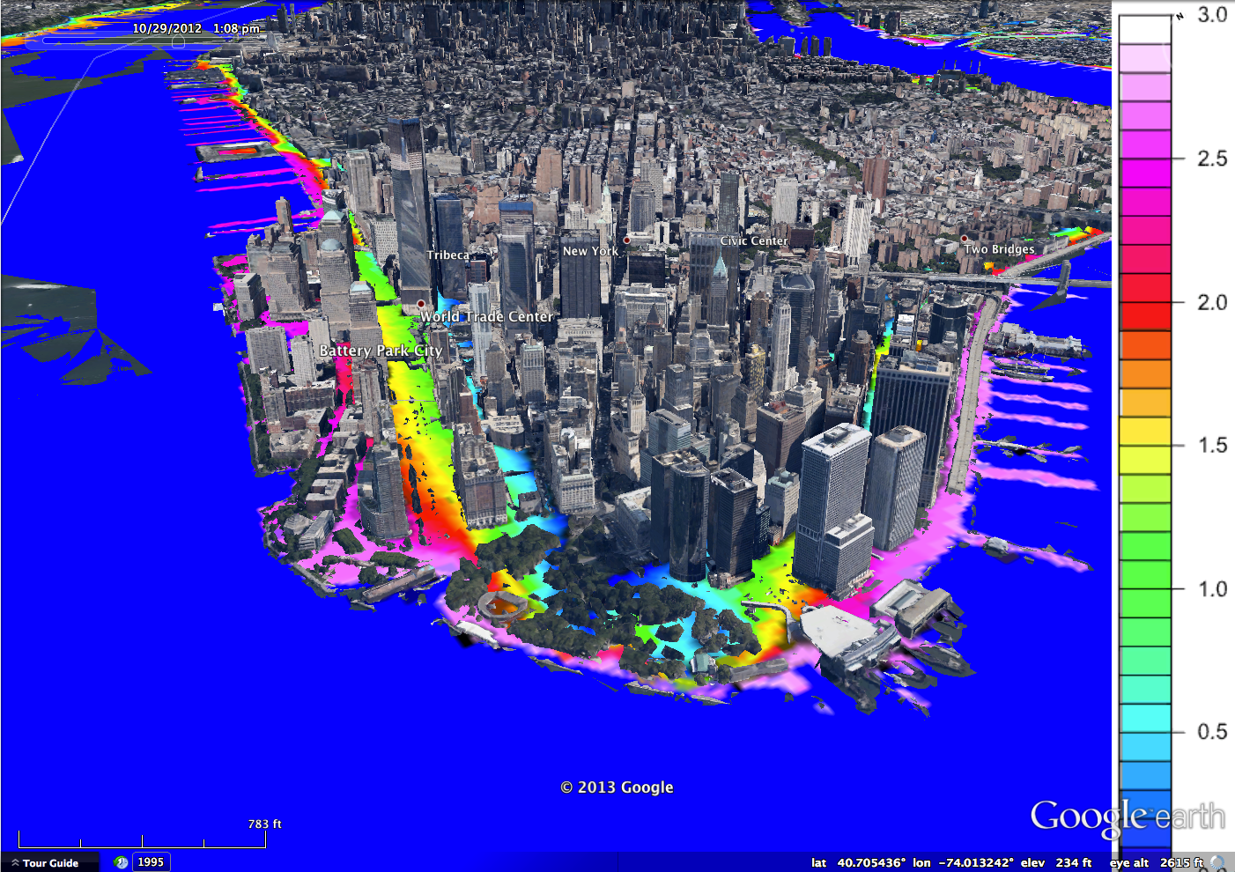
Manhatten

Slide 40
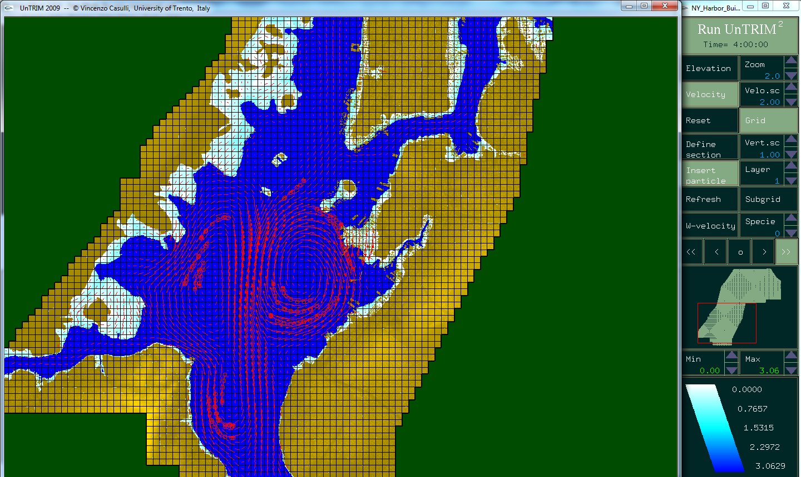

Slide 42
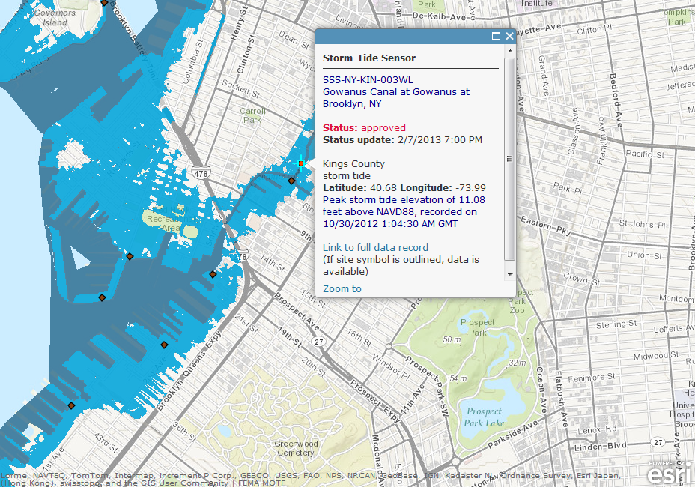
USGS Rapid Deployment Gauge Comparison

Slide 43
Video time

Slide 44
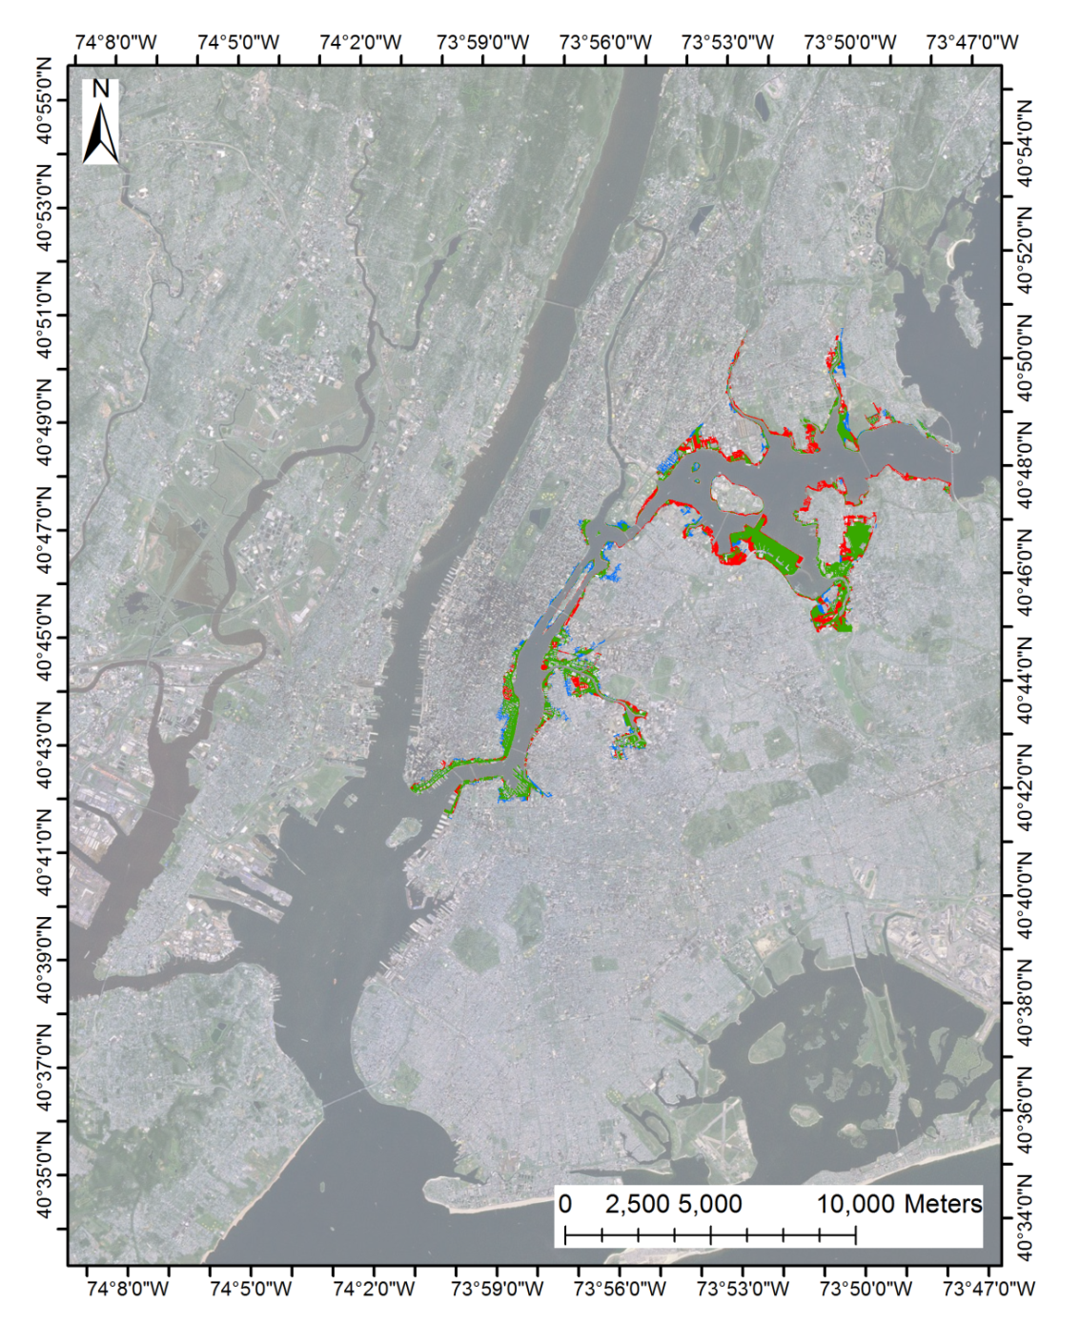
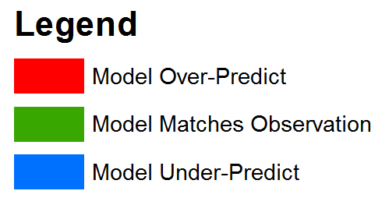
Measure of Uncertainty
East River, NY

Slide 45
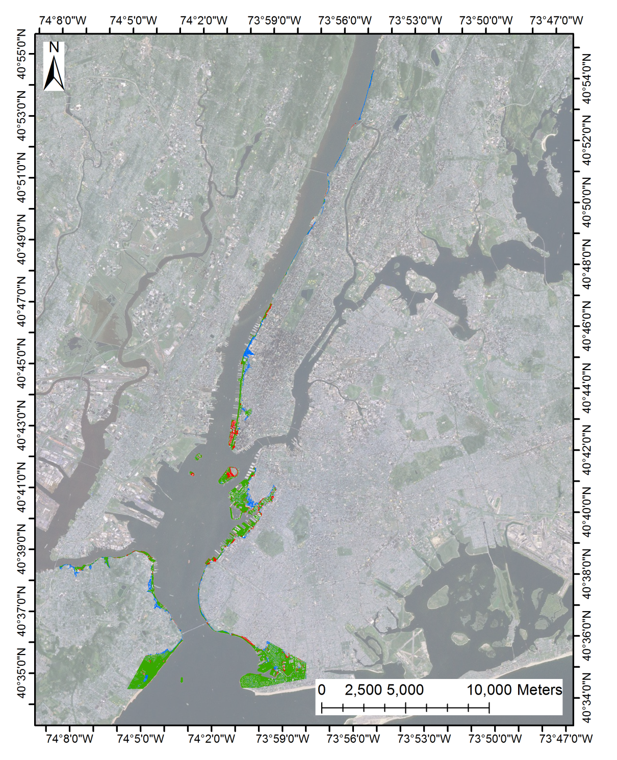
Hudson River, NY
Measure of Uncertainty

Slide 46
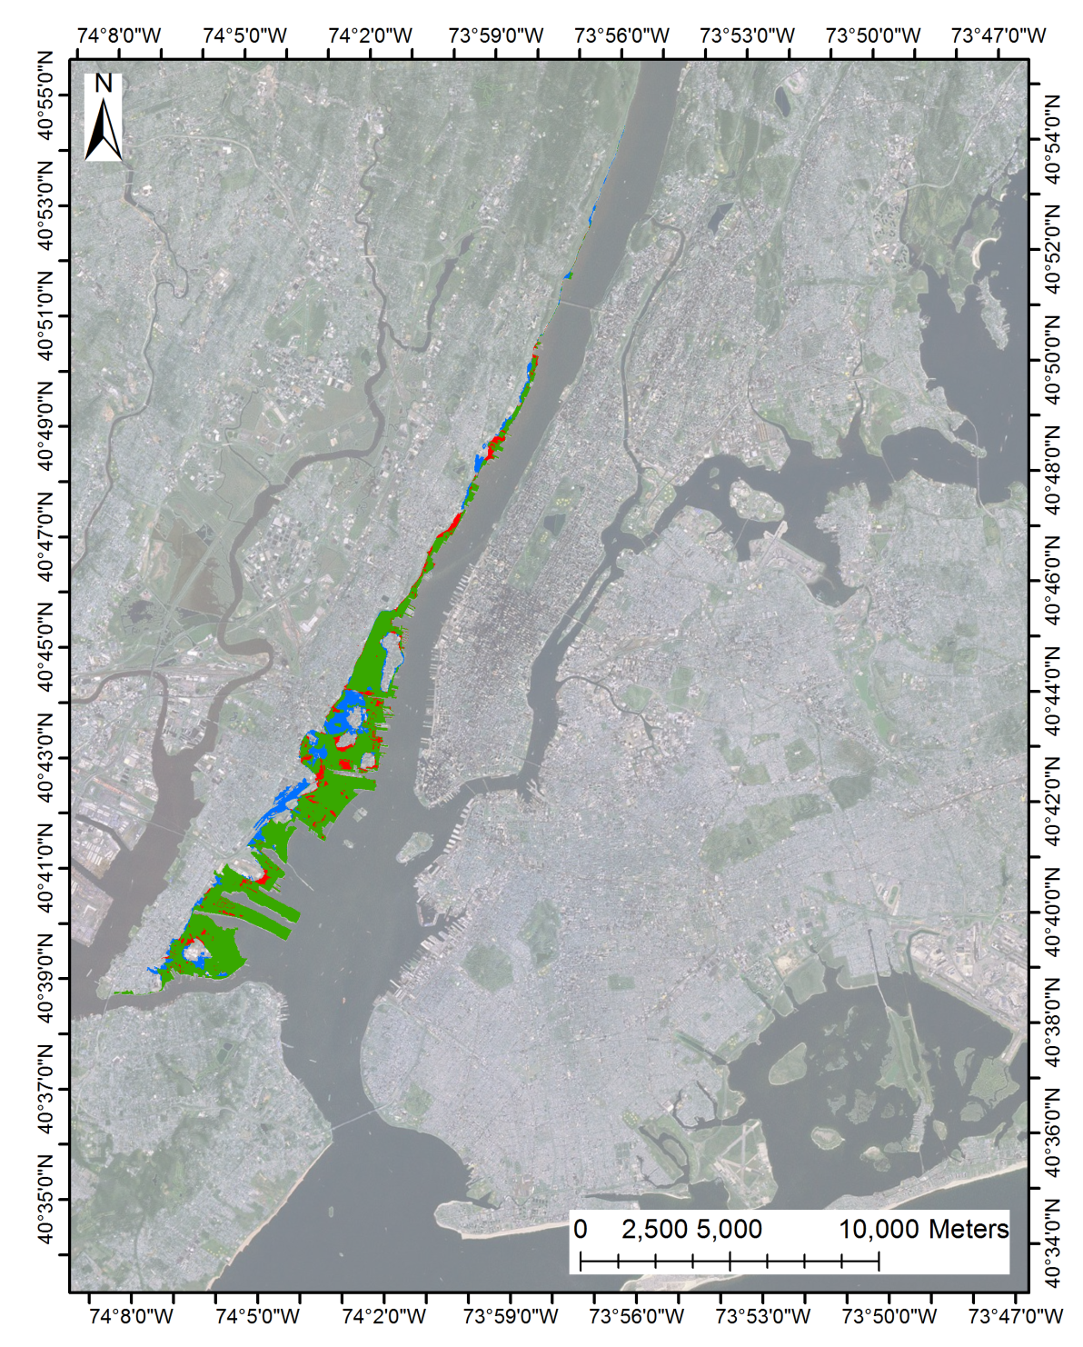
Measurement of uncertainty
Hudson River, NJ

Slide 47
Measure of Uncertainty (all areas)

Slide 48
Summary
The capabilities of a suite of a large scale storm tide, wind wave, and high resolution, sub-grid inundation models were presented.
The large-scale storm tide and wind wave model covering the entire US East Coast is feasible for use in forecasting mode with efficient solver and moderate computing resources.

Slide 49
3. The high resolution, sub-grid model can incorporate LIDAR data directly without interpolation and was demonstrated to generate very accurate inundation results on a street-level scale, as demonstrate by the Hurricane Sandy application. The model can run on high-end PC.

