Slide 1
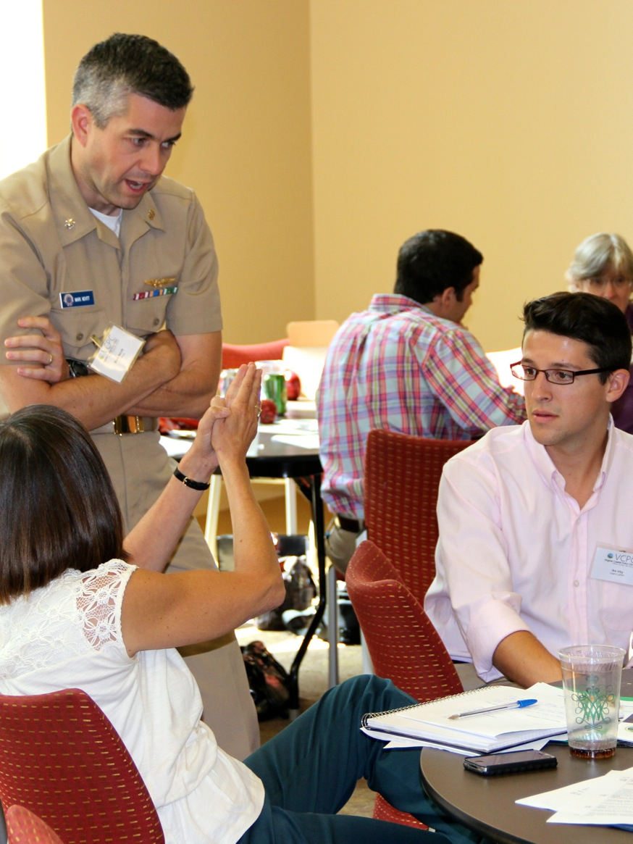
Adaptive Planning for Flooding and Coastal Change in Virginia: Legal and Policy Issues for Local Government
Molly Mitchell
Oct. 3, 2013
Norfolk, VA
All photos by David Malmquist
Presentations, background materials and more: http://law.wm.edu/academics/programs/jd/electives/clinics/vacoastal/conferences/adaptiveplanning/index.php

Slide 2
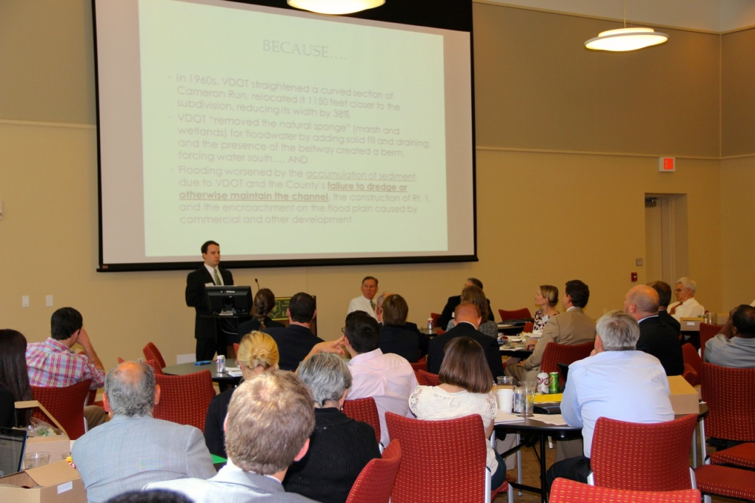
Adaptive Planning for Flooding and Coastal Change in Virginia: Legal and Policy Issues for Local Government
Hosted by:
Virginia Coastal Policy Clinic (VCPC) at William & Mary Law School Center
Coastal Resources Management at VIMS
In collaboration with:
the Commonwealth of Virginia
Major Funders:
Virginia Environmental Endowment.
Additional supporter:
Virginia Sea Grant
Greehan, Taves, Pandak & Stoner
Virginia Chapter, American Planning Association.

Slide 3
Adaptive Planning for Flooding and Coastal Change in Virginia: Legal and Policy Issues for Local Government
To help address concerns of local governments regarding their legal authority to address flooding and sea level rise issues through regulatory channels
Over 230 people registered, representing various localities, agencies, and the public
Speakers represented a wide variety of backgrounds, including political leaders, academics and industry consultants

Slide 4
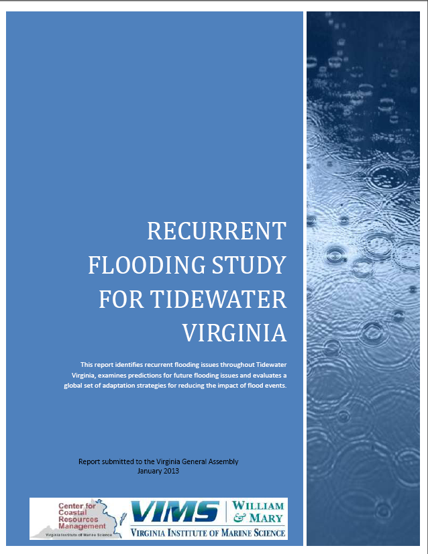
Adaptive Planning for Flooding and Coastal Change in Virginia: Legal and Policy Issues for Local Government
Addressing concerns from the Recurrent Flooding Study for Virginia
What statutory authority do local governments have?
What legal responsibilities do they have?
What are the risks involved with taking action?
How can they craft a coordinated approach to adaptation that incorporates all the major stakeholders?

Slide 5
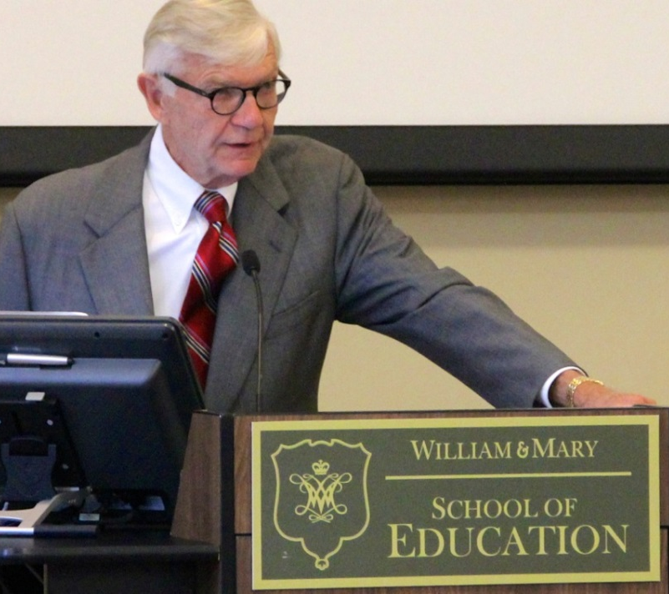
Adaptive Planning for Flooding and Coastal Change in Virginia: Legal and Policy Issues for Local Government
Speakers discussed:
The extent of the threat facing localities as well present and future adaptation methods.
The need for state involvement, leadership, and funding with regard to recurrent flooding.
Incorporating all stakeholders--including public and private actors--into one cohesive adaptation strategy.
Legal issues facing localities seeking to implement adaptation strategies—including possible tort and takings liability.
Local perspectives on recurrent flooding: specifically the need for legal authority to act and the need for educating the population.

Slide 6
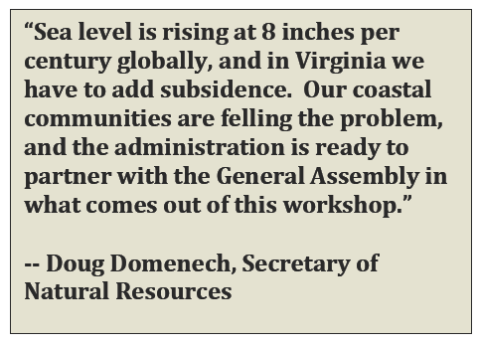
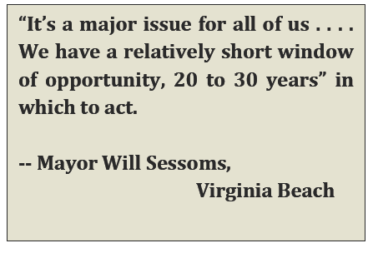
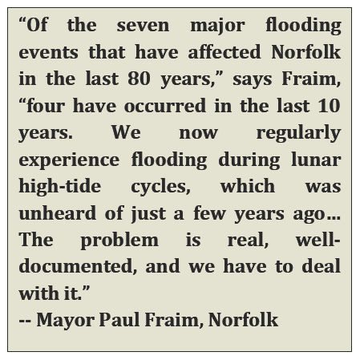
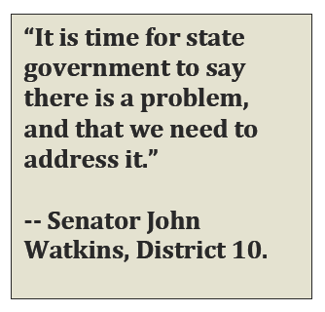
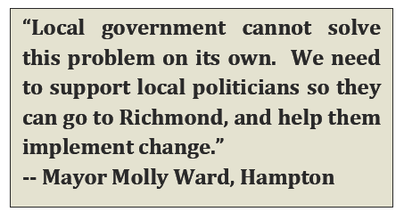
Quotes from the Conference

Slide 7
Advice from the consultants
David Bookbinder
it is important for localities to avoid both alarmism and complacency during their adaptation planning
Environmental groups should be brought into the planning process early
The presence of the military is a big asset to the Hampton Roads area. Engage them.
Consider issues of environmental justice while planning
David Bailey
There are two types of adaptation policy: (1) reactive, which is usually a large and extremely costly project following a disaster and (2) proactive and anticipatory
Localities help businesses by providing them with short term projections of sea level rise impact, addressing the worst problems first, and looking for cheap, effective solutions.
When making adaptation decisions, localities shouldn’t fight the market. If a property needs to be abandoned, then it may be best to abandon it.

Slide 8
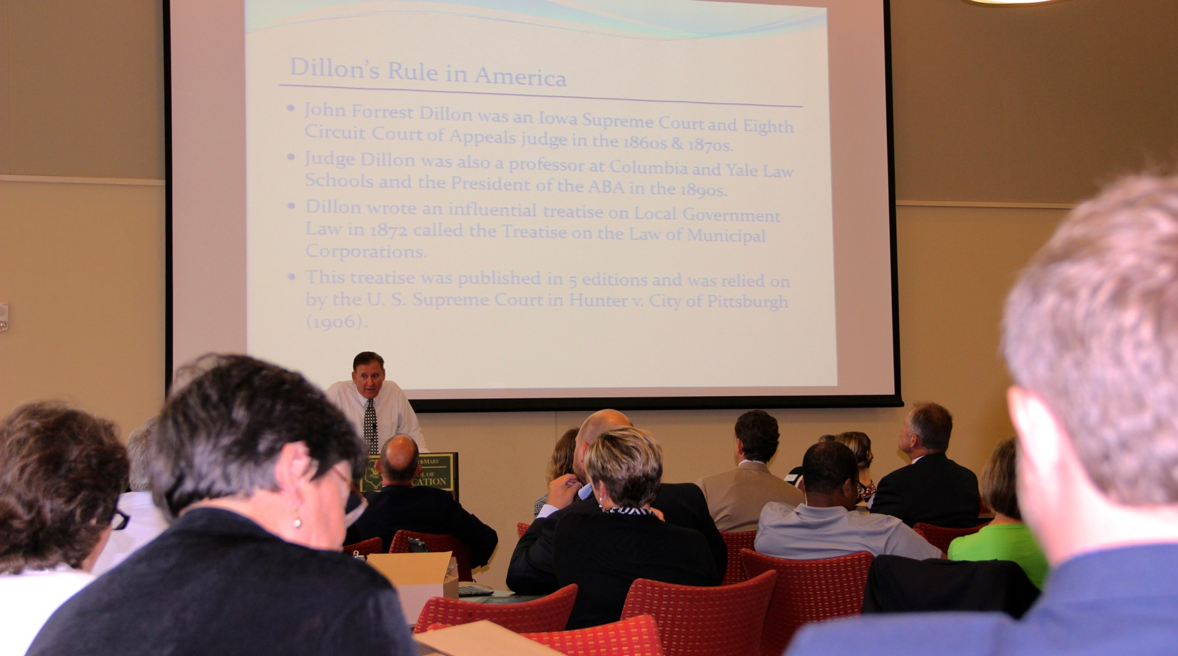
Legal Issues: Between a Rock and a Hard Place? Local Government Authority, Duties, and Regulatory Responsibilities
Speaker Pollard, Christian & Barton, LLP
Recommends holistic management of sea level rise with TMDL and stormwater requirements
Provided some great resources: http://law.wm.edu/academics/programs/jd/electives/clinics/vacoastal/docs/adaptive%20planning%20conference%20documents/pollardlegalstrategiesoutline.pdf
Professor Ron Rosenberg, William & Mary Law School
Elucidated the impact of the Dillon Rule on localities ability to manage floodwaters
Emphasized that localities have extensive authority under in the Virginia Code to address flooding and floodplain management

Slide 9

Legal Issues: Between a Rock and a Hard Place? Local Government Authority, Duties, and Regulatory Responsibilities
Shana Jones, VCPC Director and Chris Olcott, Virginia Sea Grant Summer Legal Fellow
Virginia Code § 15.2-970 provides localities with sovereign immunity for failing to maintain drainage, erosion, and flood control works.
However, a recent case suggests that localities may incur takings liability where they fail to maintain drainage, erosion, and flood control works and private property is damaged

Slide 10
Legal Issues: Between a Rock and a Hard Place? Local Government Authority, Duties, and Regulatory Responsibilities
Professor Lynda Butler, Chancellor Professor of Law, William & Mary Law School
Two recent takings cases heard by the Supreme Court may hamper the ability of local governments to respond to recurrent flooding
Sharon Pandak, Greehan, Taves, Pandak & Stoner, PLLC
In order to regulate coastal land use with less risk of takings liability, localities should:
Frame land use regulations as needed for public safety, health, and welfare (as opposed to regulating to limit damage to property)
Avoid regulations that prevent all uses of the property.

Slide 11
A locality perspective
Jim Redick, CEM Director, Norfolk Emergency Preparedness and Response
Sea level rise and recurrent flooding should be treated as any other sort of disaster -- including hurricanes and terrorist attacks. Localities should share resources and coordinate with one another in order to most efficiently deal with flooding threats.
Joseph DuRant, Deputy City Attorney, City of Newport News
Localities are facing a barrage of costs due to risks from recurrent flooding, new stormwater regulations, Chesapeake Bay TMDL, and consent decrees for sewage treatment. As such, they are put in a difficult situation of having to allocate scarce resources
Dave Hansen, Deputy City Manager, City of Virginia Beach
In responding to the threat of recurrent flooding, localities will need to balance political, environmental, and economic considerations.
Localities need to know the extent of potential liability for damage caused by failed flood- control infrastructure -- no feat of engineering is fail-safe.
Lewie Lawrence, Executive Director, Middle Peninsula Planning District Commission
Education is needed, for constituents as well as local government leaders, in order to provide the scientific background that will enable those groups to acknowledge the problem and begin to produce solutions.

Slide 12
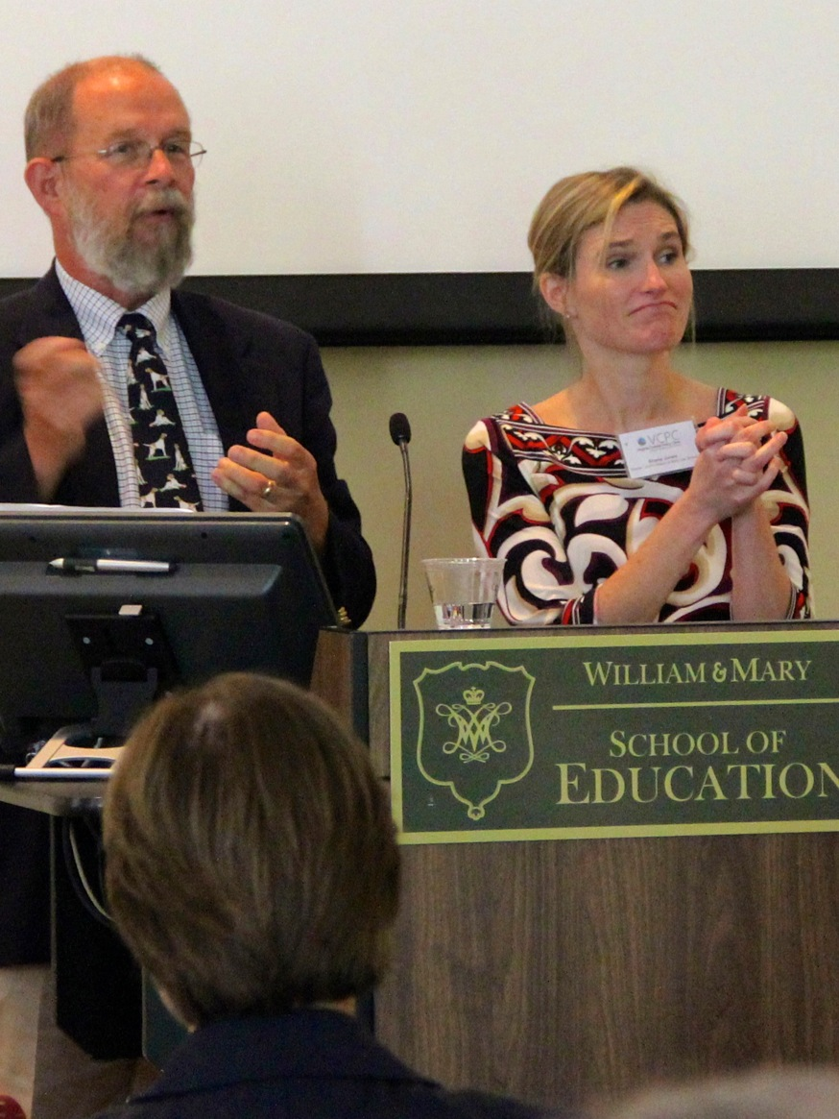
Next steps:Where do we go from here?
Senator John Watkins, 10th Senatorial District
The state government needs to engage the issue in a deliberate and proactive manner. Regional coordination is a must, and the state is in the best position to provide such structure as well as seek federal funding for flood control measures.
Joe Lerch, Virginia Municipal League
Localities need some certainty with regard to funding. Local governments may be hampered in their ability to limit flooding damage if the Federal Government eliminates tax-exemptions for municipal bonds. Further, localities would greatly benefit from funding for state primary roads within urban borders. They could have greater leeway to implement adaptation measures if the state shares the cost.

