Slide 1
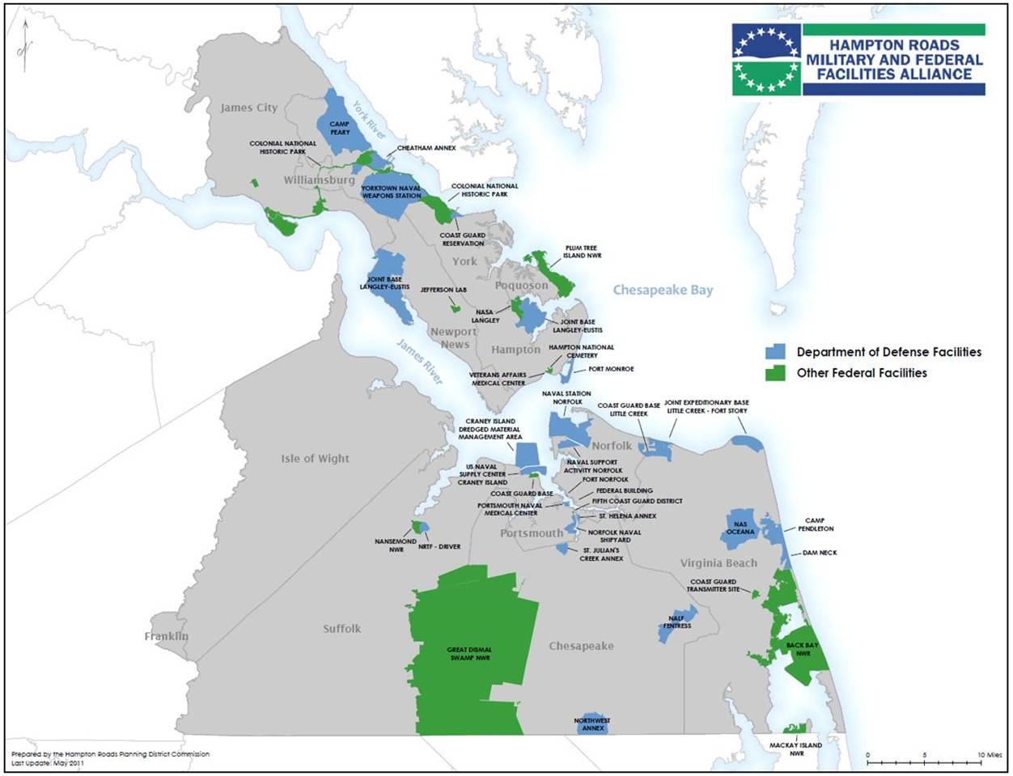
Hampton Roads Military Bases

Slide 2
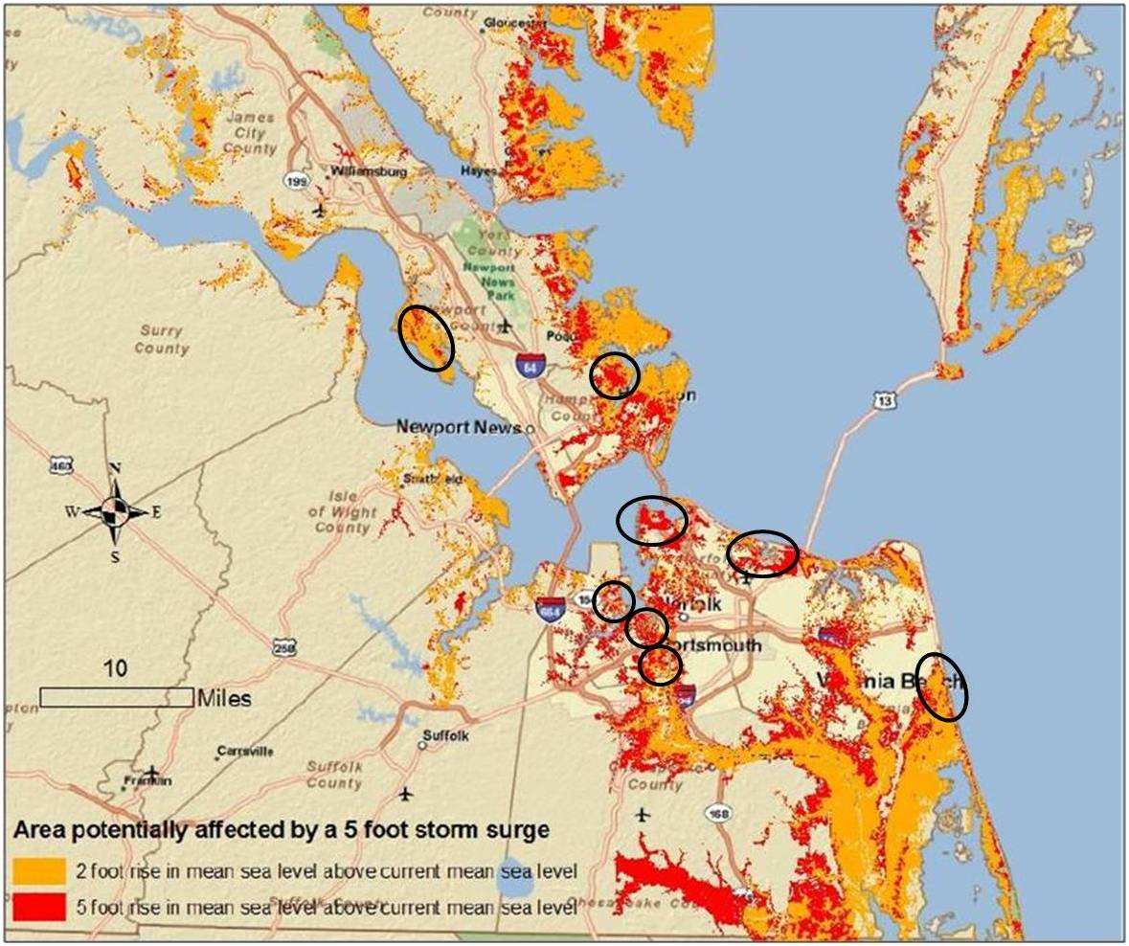
Sea Level Rise Increases Storm Surge Threat to Military Bases

