Slide 1
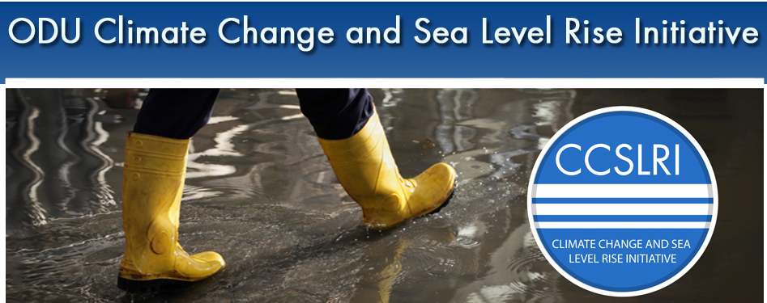


Access-EU, SLR conf, Oct 30-31, 2013
http://www.odu.edu//research/initiatives/ccslri
CCPO/OEAS
Panel 1: The Physical Threat: State of the Science of Rising Sea Levels and Extreme Storms
Tal Ezer, ODU: physical aspects of sea level rise & flooding
Robert Tuleya, ODU: hurricanes and tropical storms
Kelly Burks-Copes, USACE: risk assessment modeling
David Titley, PSU: Navy's task force on climate change

Slide 2

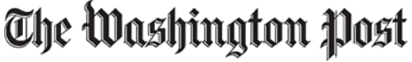
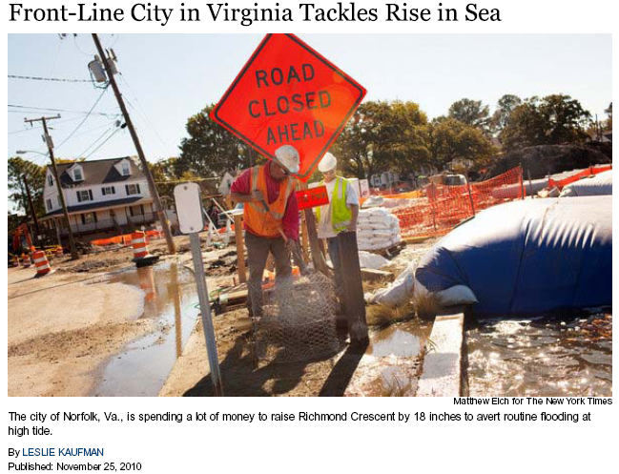
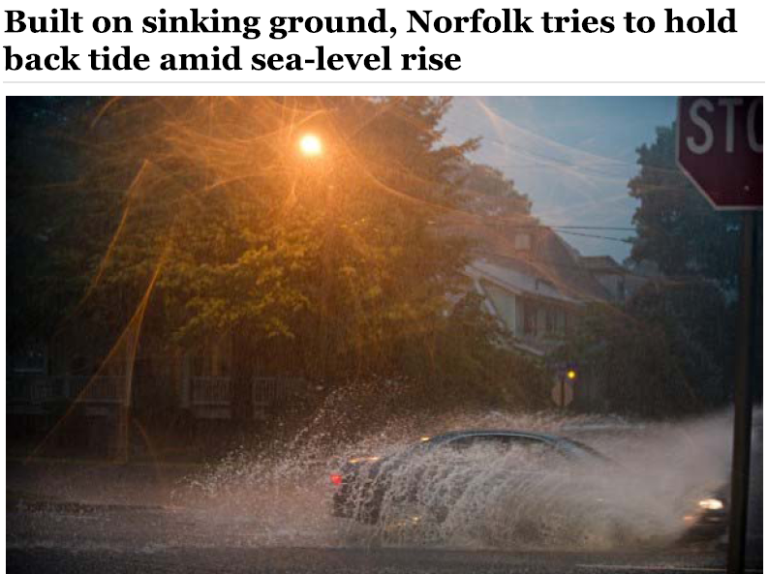
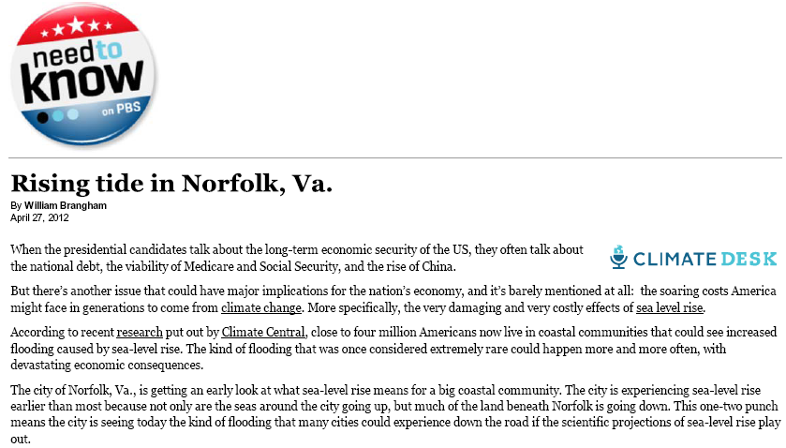
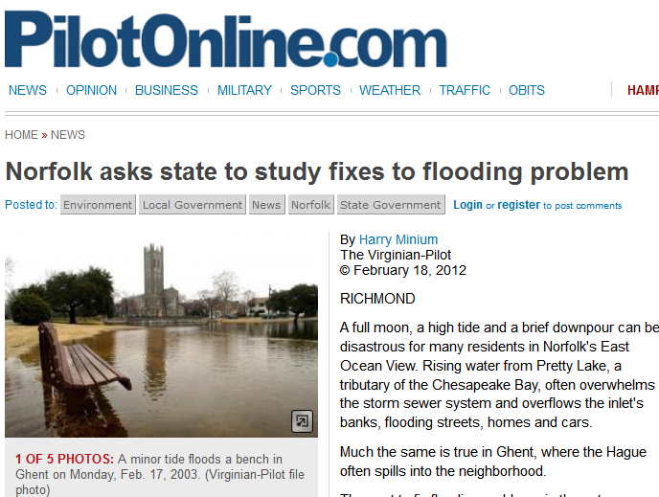
, November, 2010
, June, 2012
“Norfolk- second only to New Orleans among U.S. cities threatened by flooding”
Norfolk in the News
PBS, April, 2012
Virginian Pilot, February, 2012

Slide 3
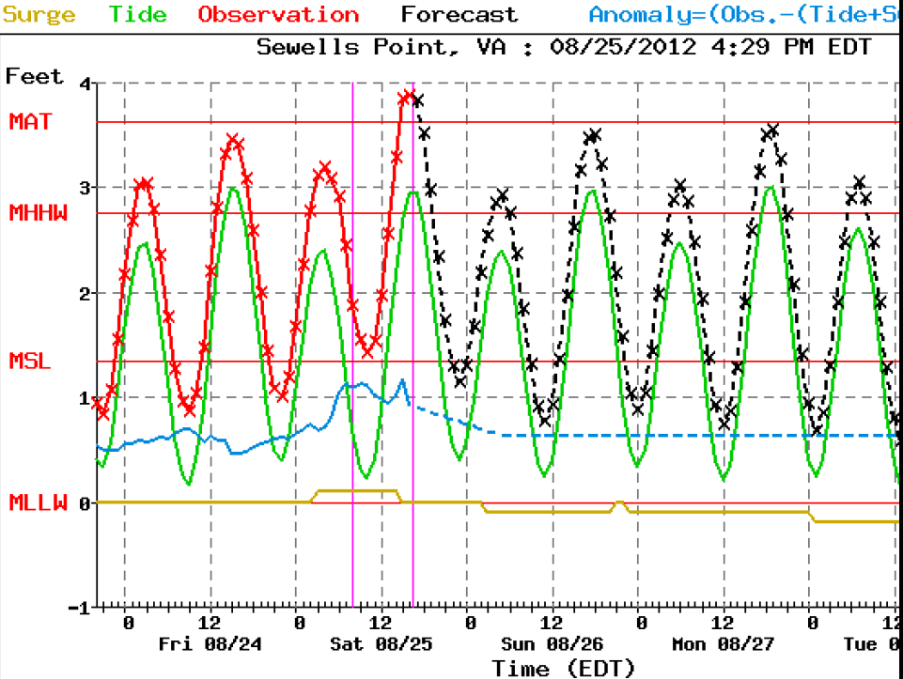
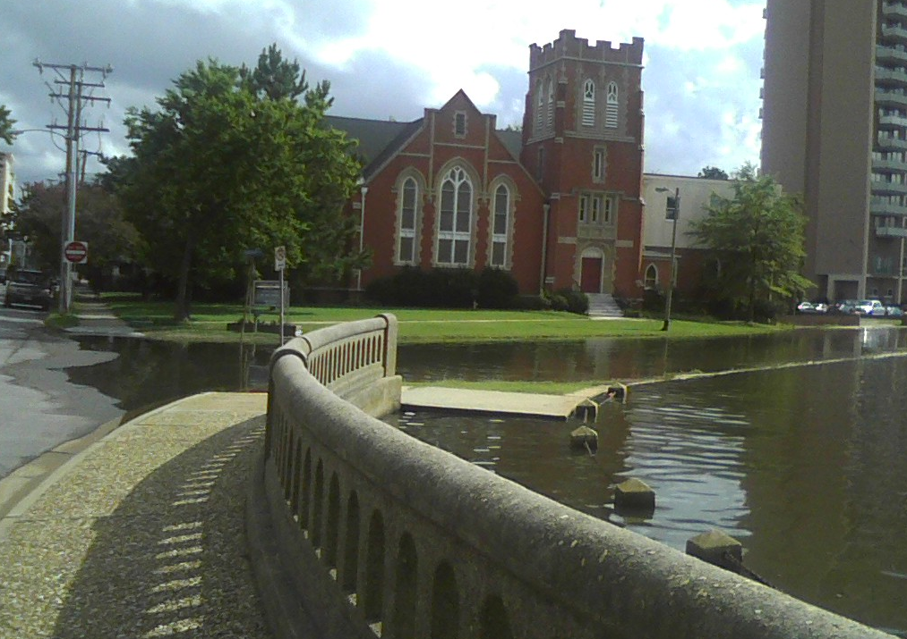
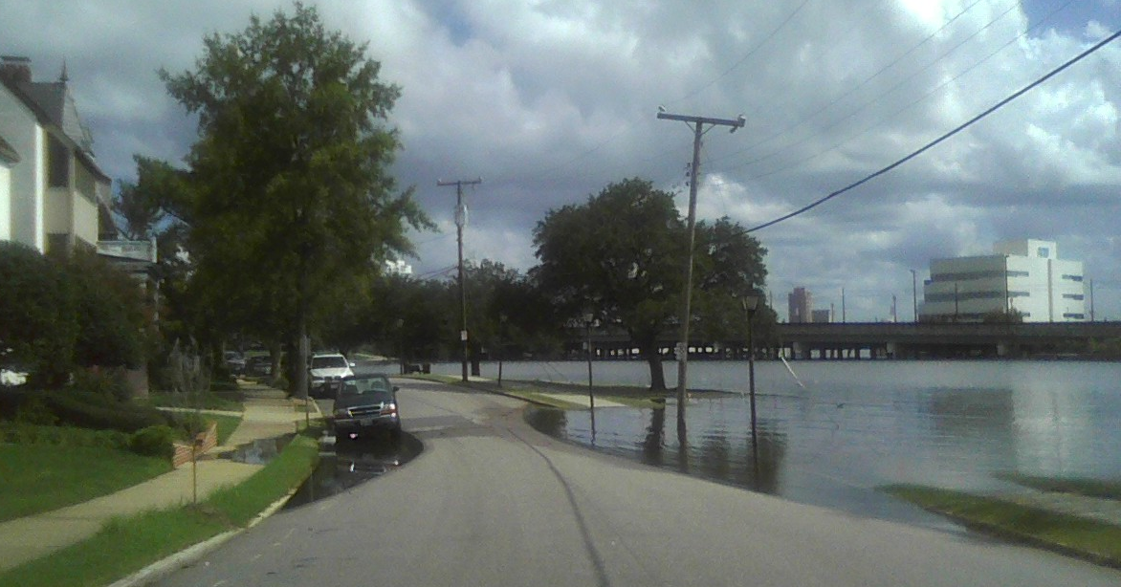
4-foot flood (high-tide, no storm, 8/25/2012)
Historic Hague district of Norfolk
Minor Tidal Flooding:
Used to be a rare event, now almost every month…
flood wall

Slide 4
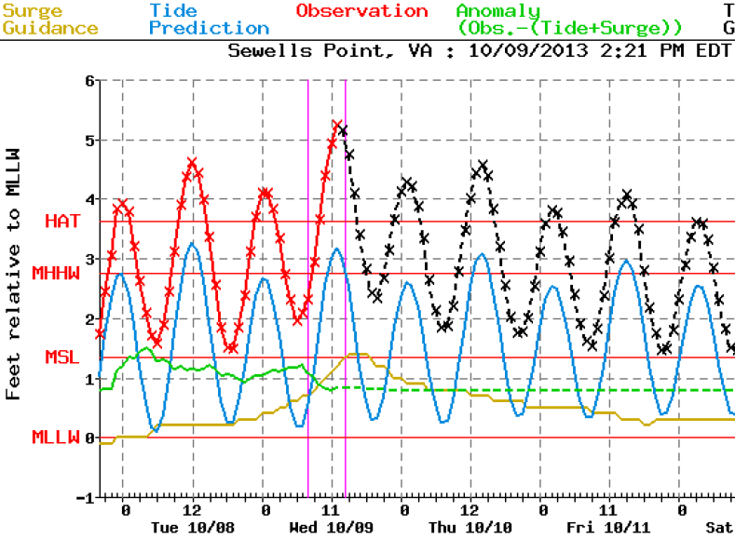
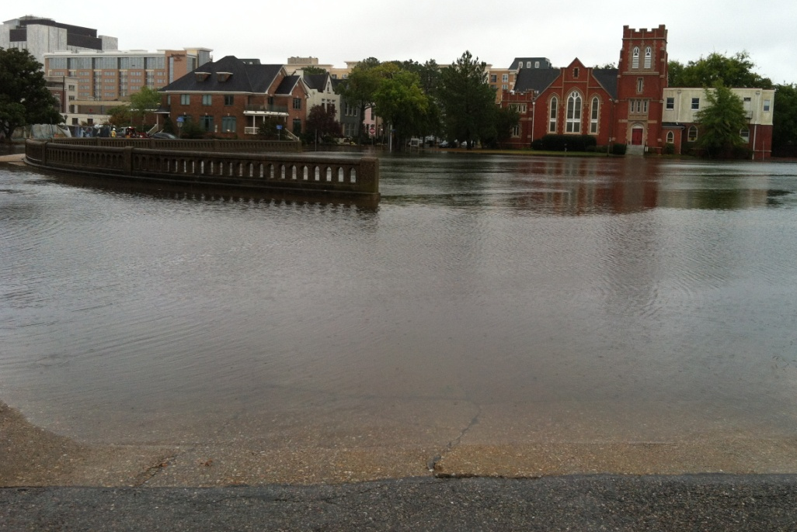
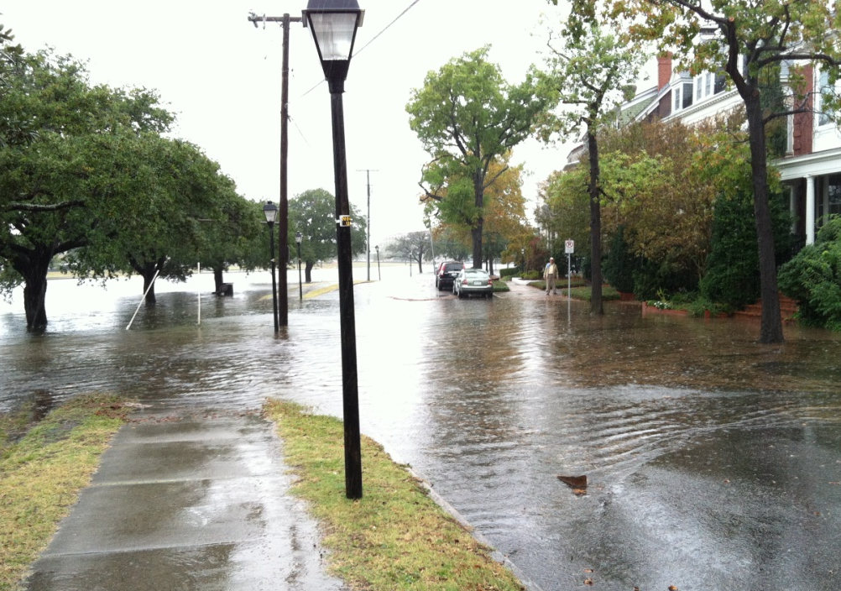
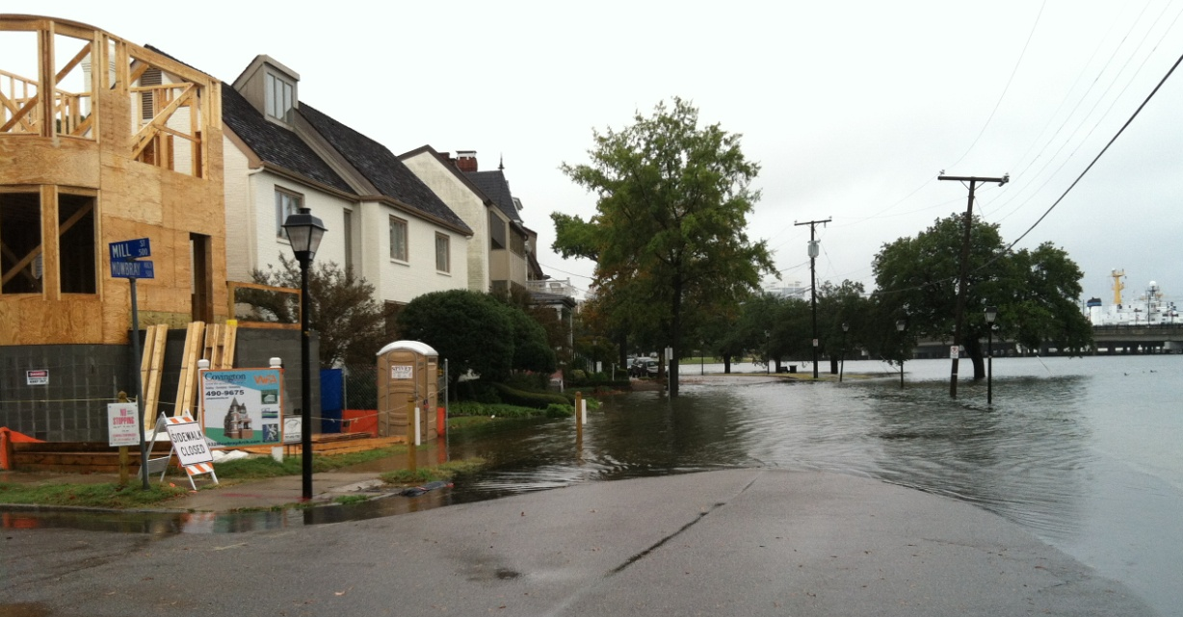
5-foot flood (high-tide & small storm, 10/09/2013)
flood wall
Medium Flooding:
Until 1960s- once in 2y event
Now- several times a year

Slide 5
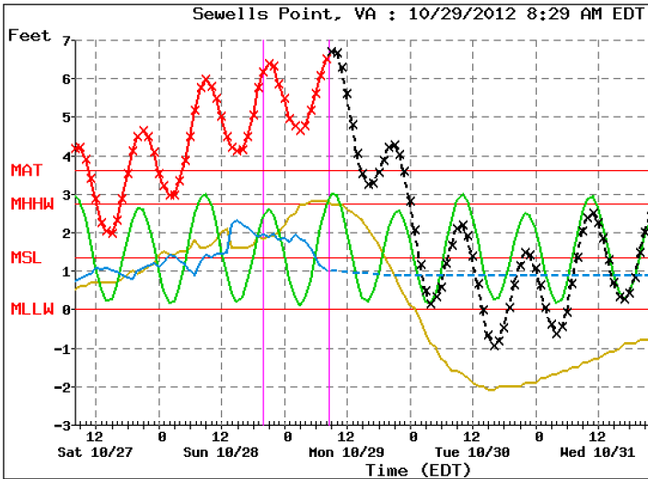
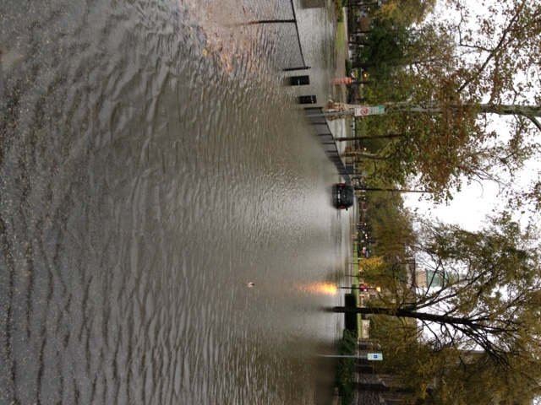
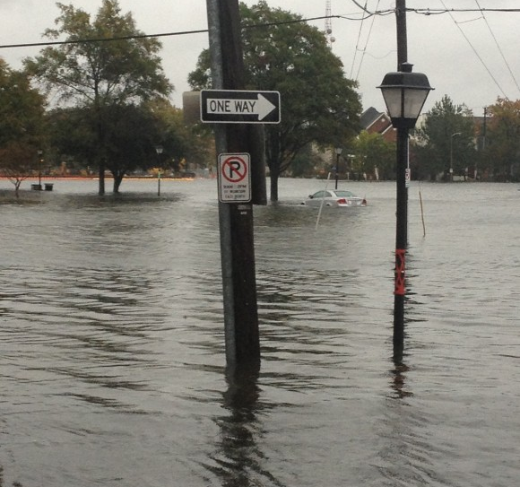
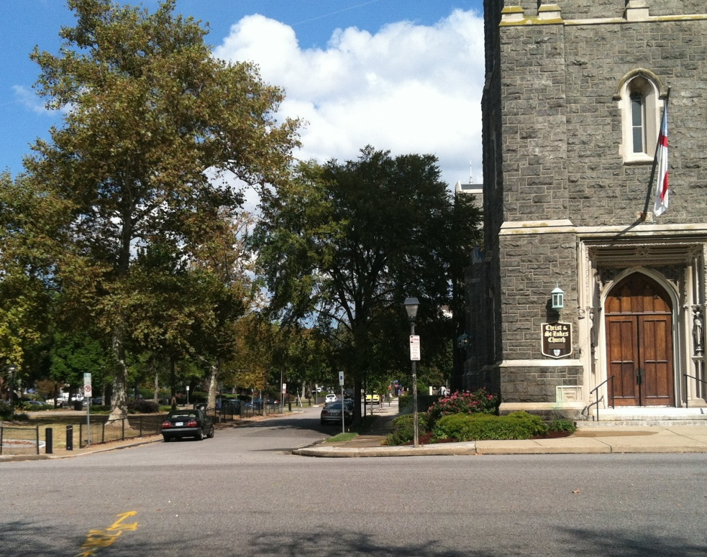
7-foot flood (hurricane Sandy, 10/29/2012)
Major Flooding:
Past- once in 30y event
Now- once in 2y event
after
before

Slide 6
Questions:
What causes Sea Level Rise (SLR)?
How do SLR and storms affects flooding?
Why sea level is rising faster at some places (e.g., along the U.S. East Coast) than others?
How can we make SLR projections? and use the information to plan future adaptation or mitigation

Slide 7
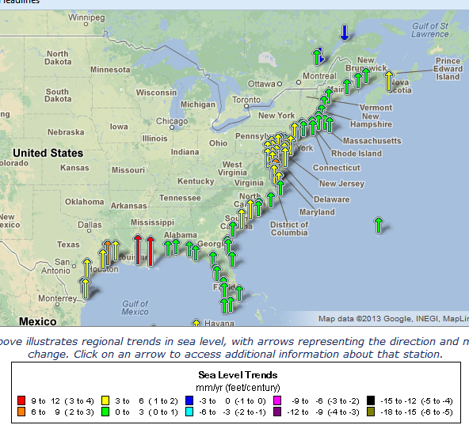
Sea level rise rates at points along the US East Coast are relatively higher than in other places
“hotspot of accelerated sea level rise”
(Sallenger et al., 2012; Boon, 2012;
Ezer et al., 2013; Kopp, 2013)
SLR in the mid-Atlantic ~3-6 mm/y
compared with global SLR of past century of ~1.7 mm/y

Slide 8
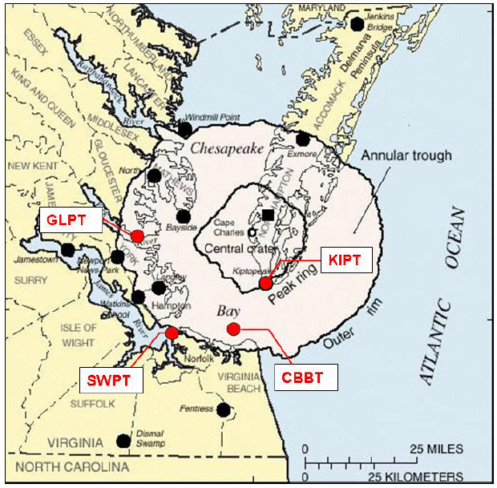
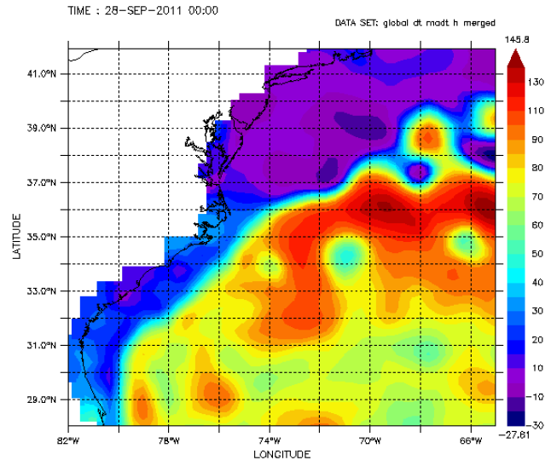
Global vs. Local Sea Level Rise:
Local (relative) SLR =
Global SLR ± Land Subsidence/Uplift ± Ocean Dynamics
thermal expansion
melting ice sheets & glaciers
volume change
Low water
High water
Gulf Stream
Land is sinking around the Chesapeake Bay:
Postglacial Rebound
Chesapeake Impact Crater
Groundwater removal
Climate change in ocean currents may slowdown the Gulf Stream and increase sea level along the mid-Atlantic coast (Ezer et al., 2013)

Slide 9
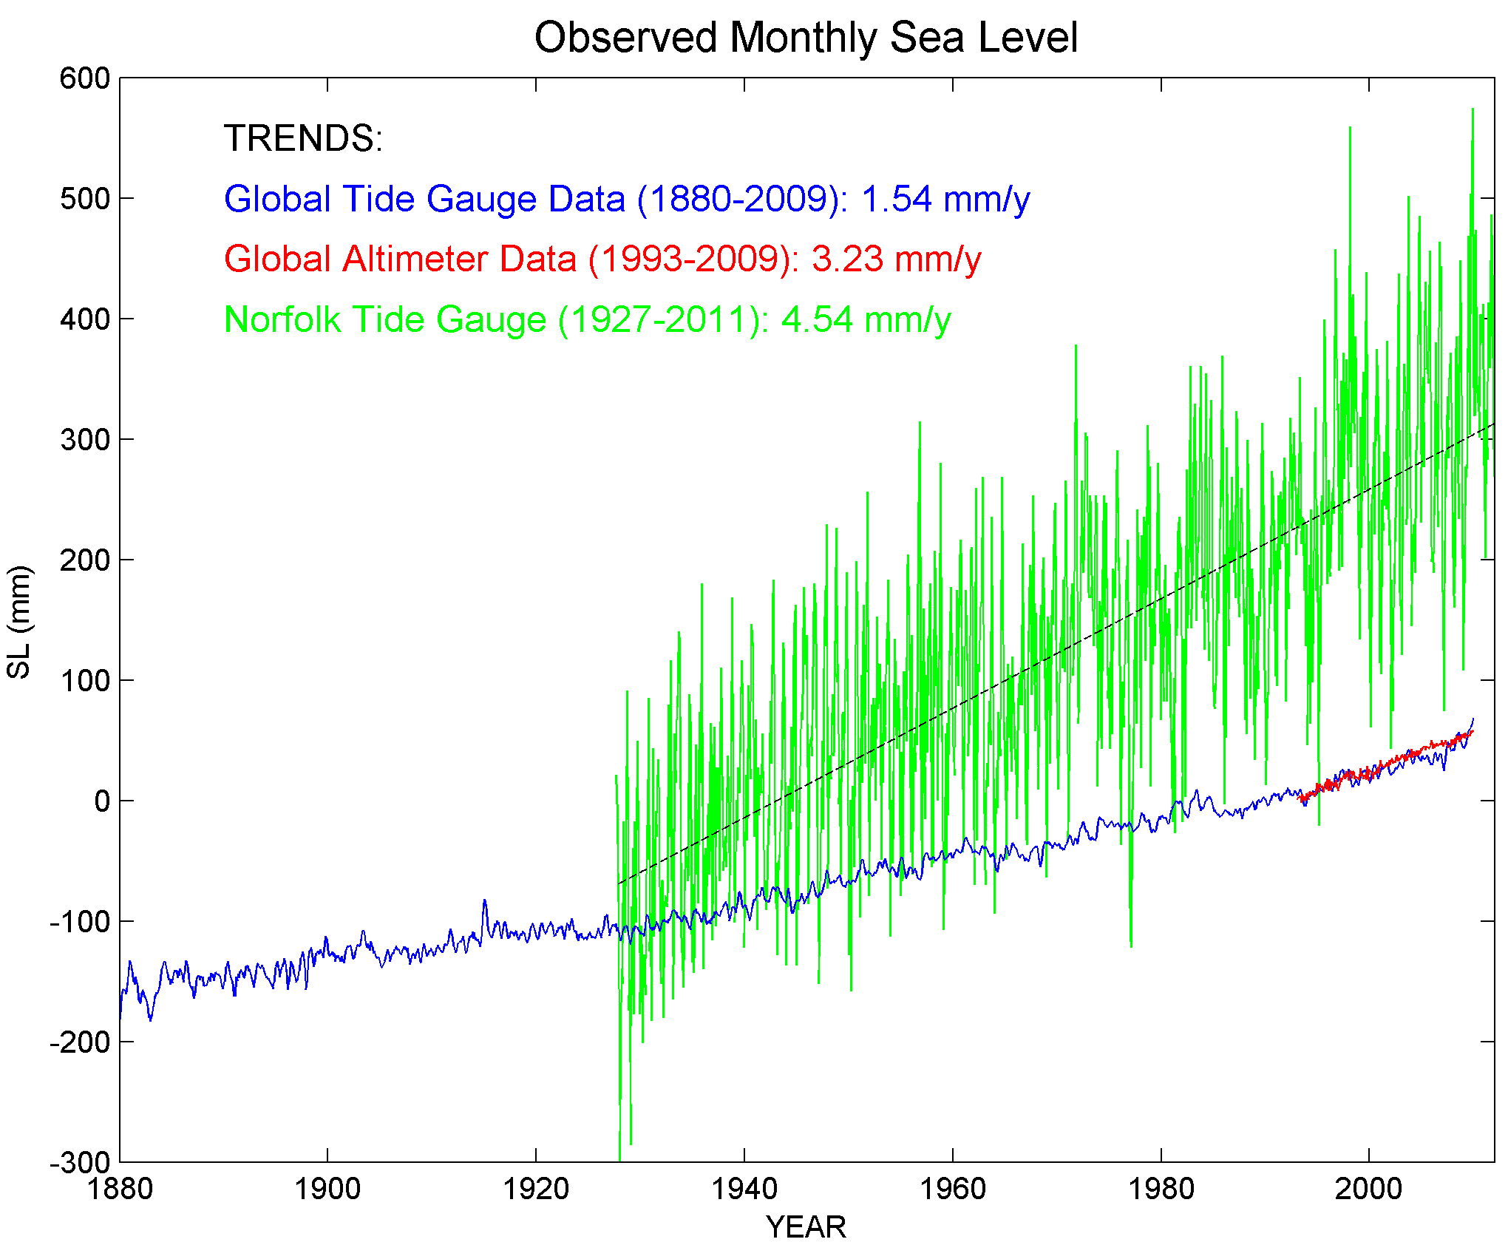
Sea Level Rise over the past 130 years
Storm surge →
Storm+Tide
Local tide gauge (Norfolk)
Local SLR
Satellite
data
Tide gauge data (global)
Global SLR

Slide 10
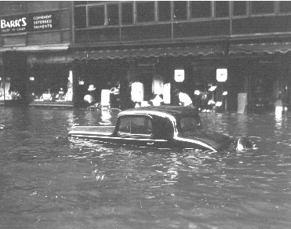
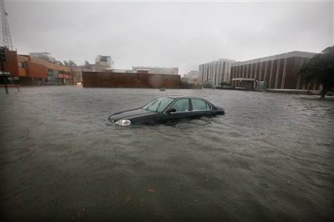
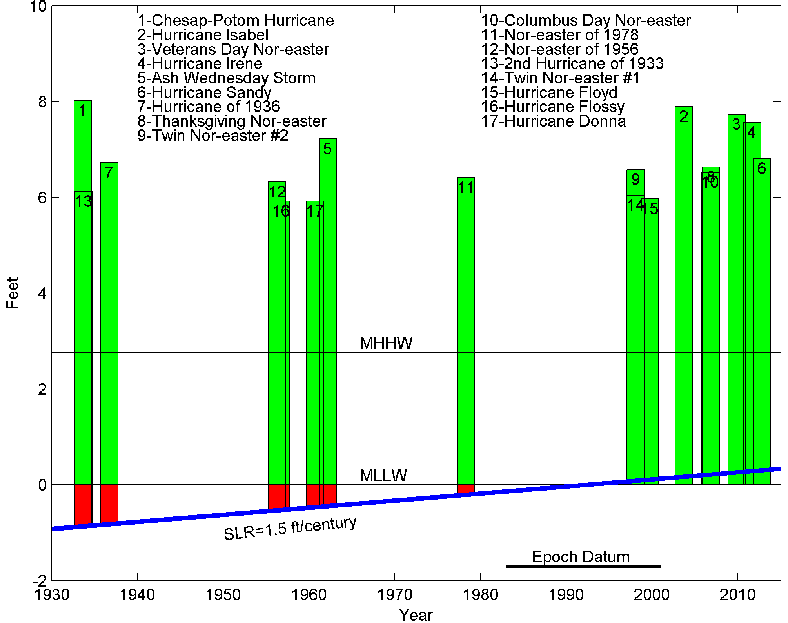
Top storm surges in Norfolk, VA
1933
2009

Slide 11
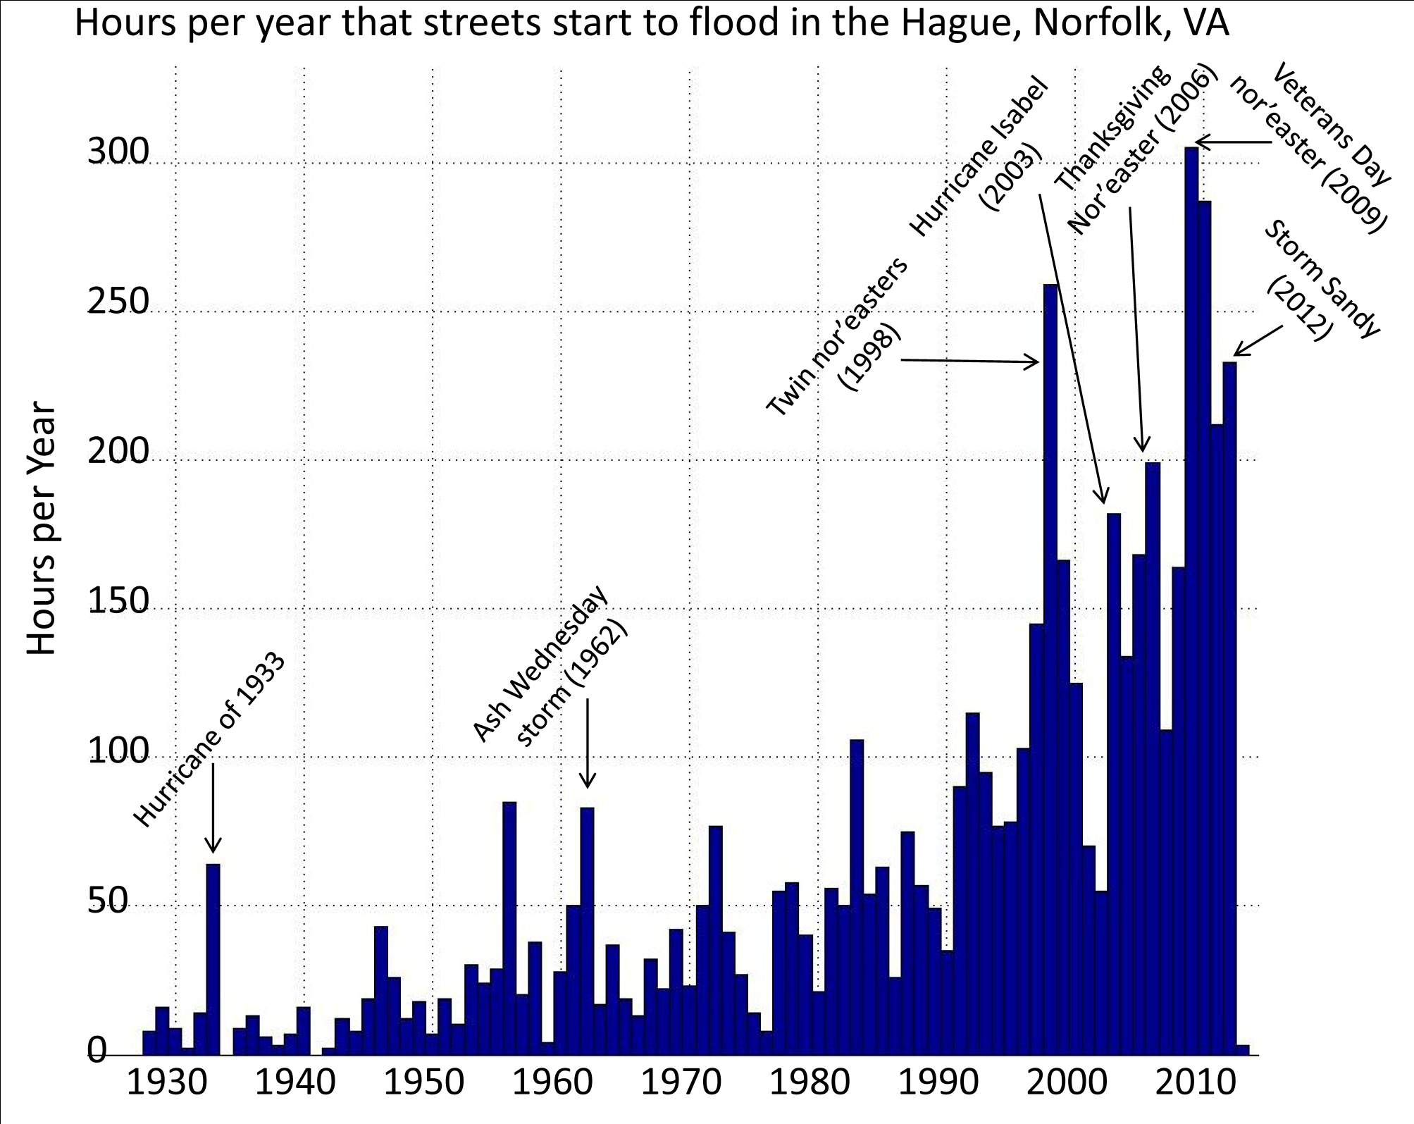
- What causes this dramatic increase in flooding?
Sea level rise
~36cm
(1.2ft)

Slide 12
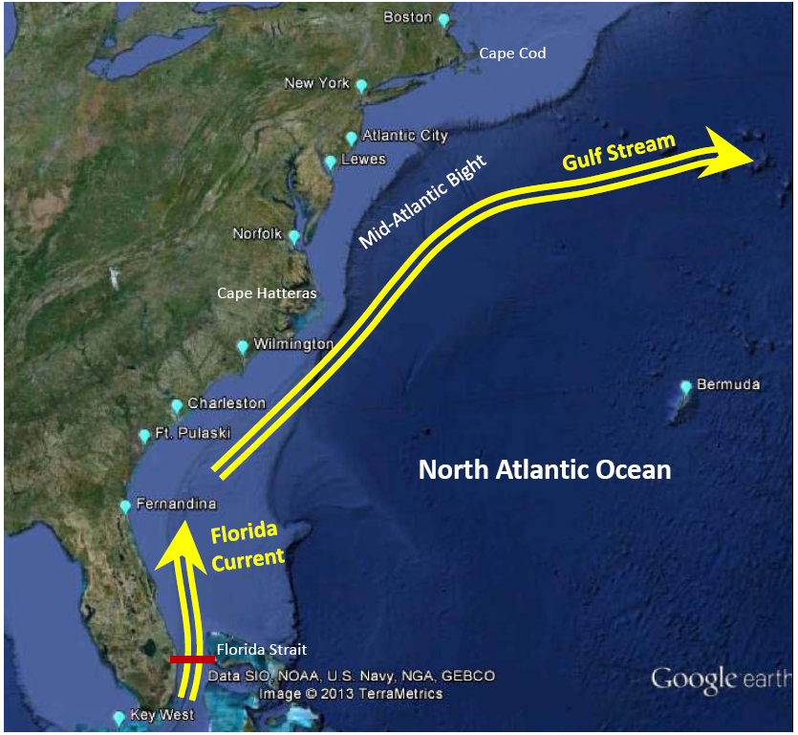
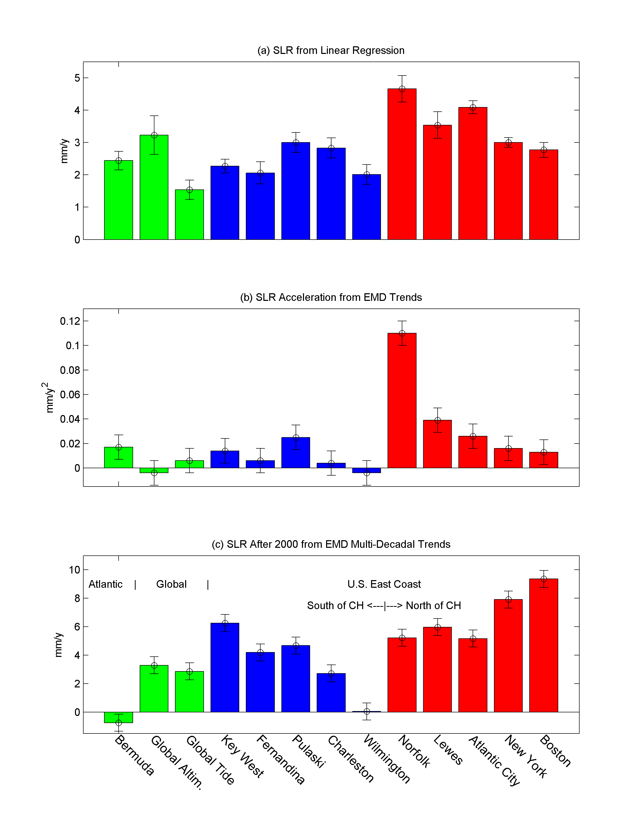
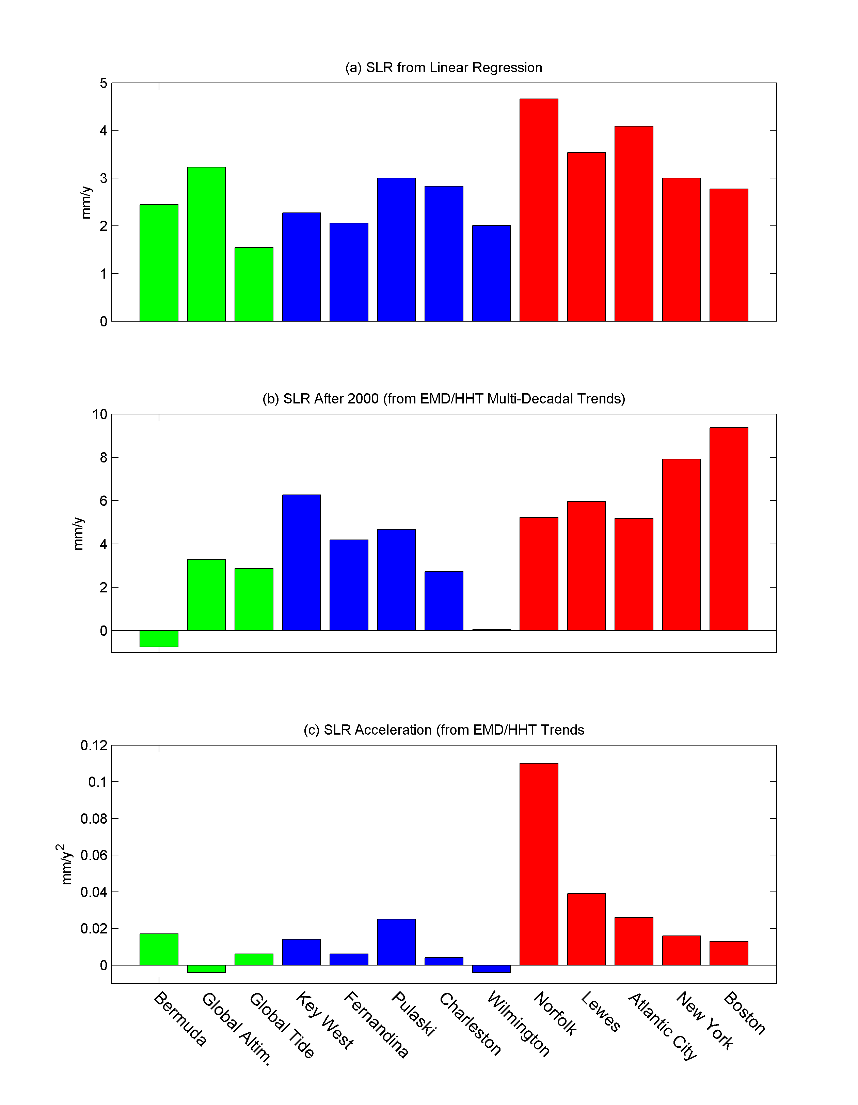
Mean Sea Level Rise Rates
(from linear regression)
linear local land subsidence
+
linear global SLR
Cape Hatteras →
North of Cape Hatteras
Global
South of Cape Hatteras
Atlantic
mm/y

Slide 13
Sea Level Rise Acceleration
(SLR will be faster in the future than it was in the past)
Eliminates the long-term geological land movement which is constant
Cape Hatteras →
North of Cape Hatteras
mm/y²
Atlantic
South of Cape Hatteras
Global

Slide 14
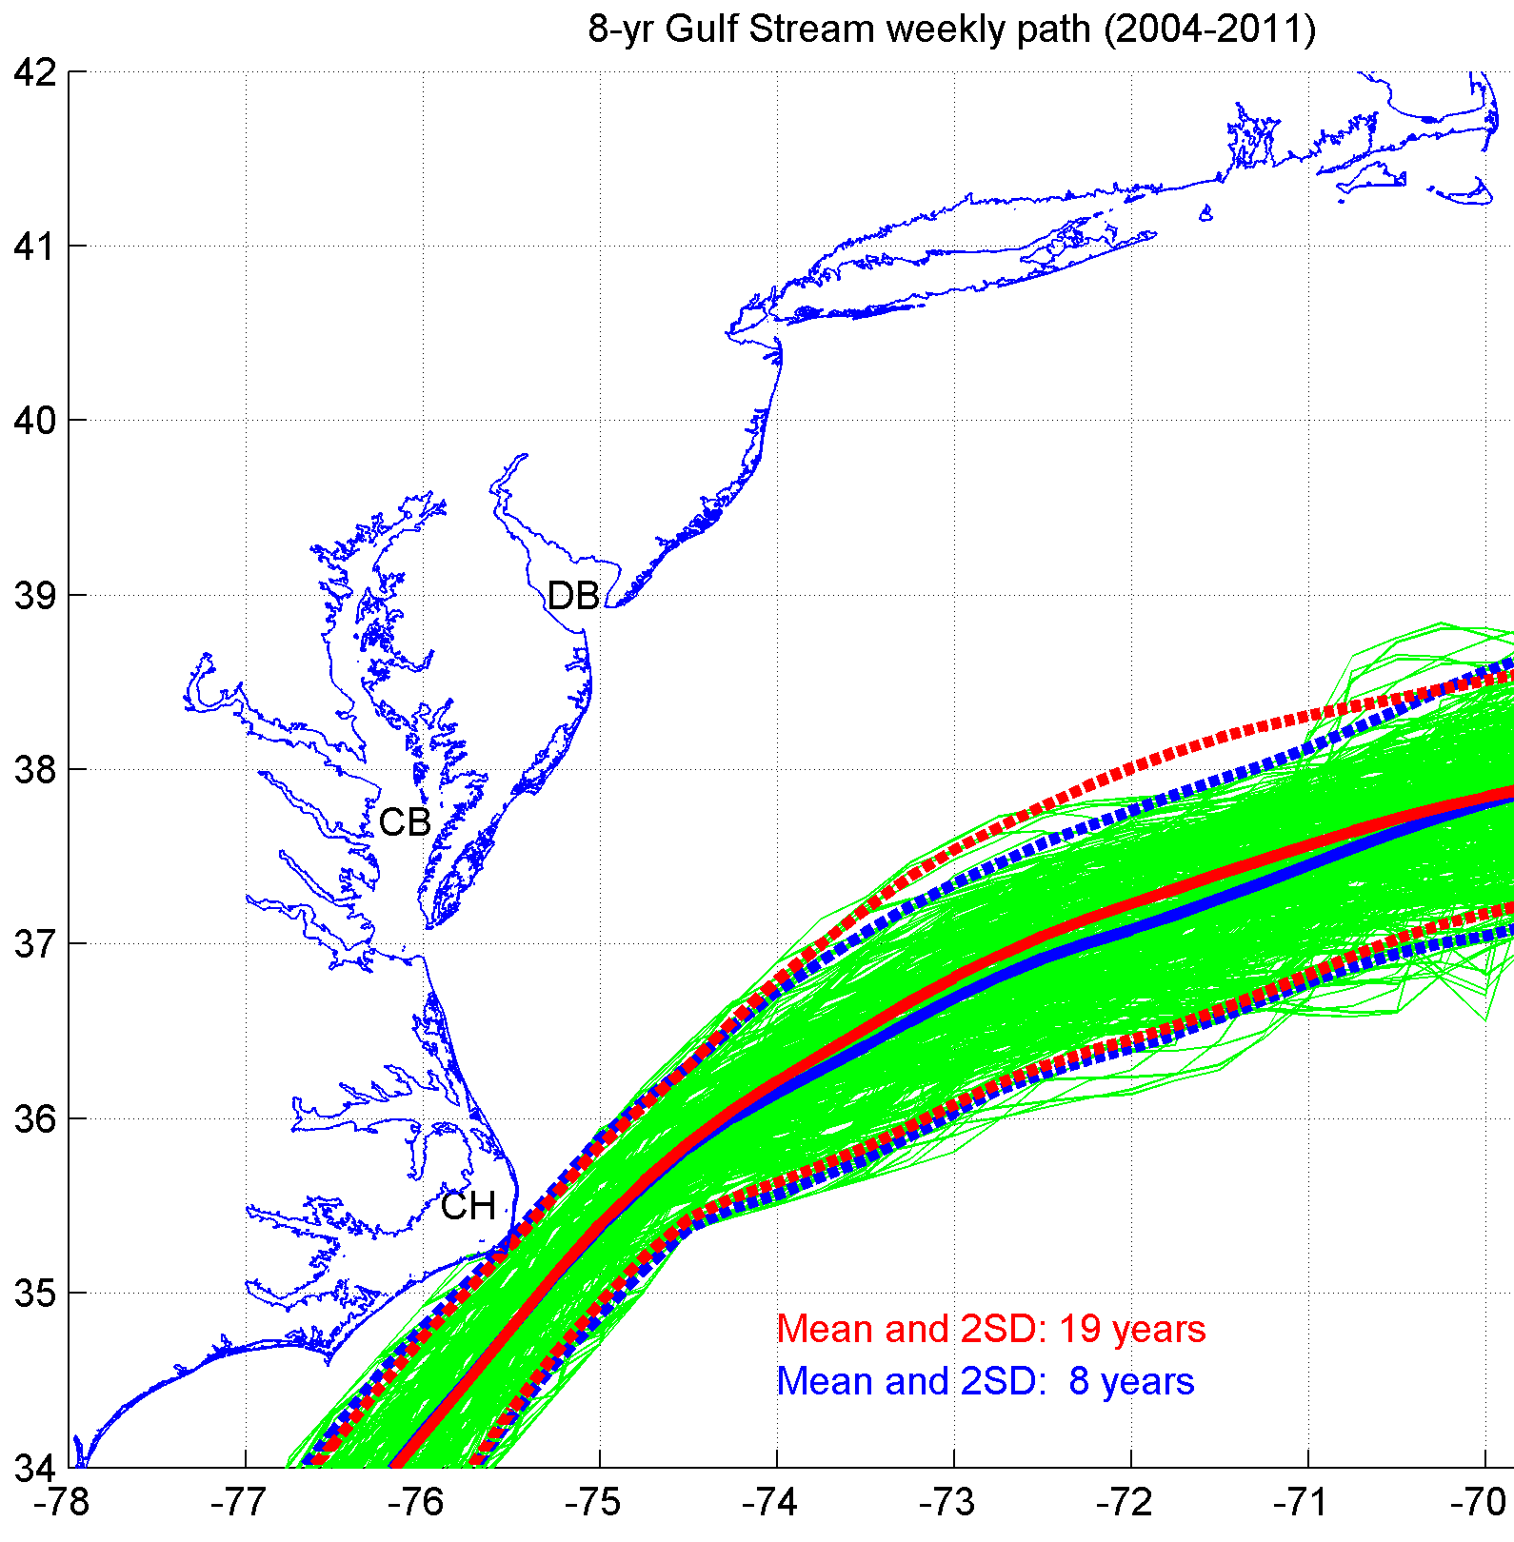
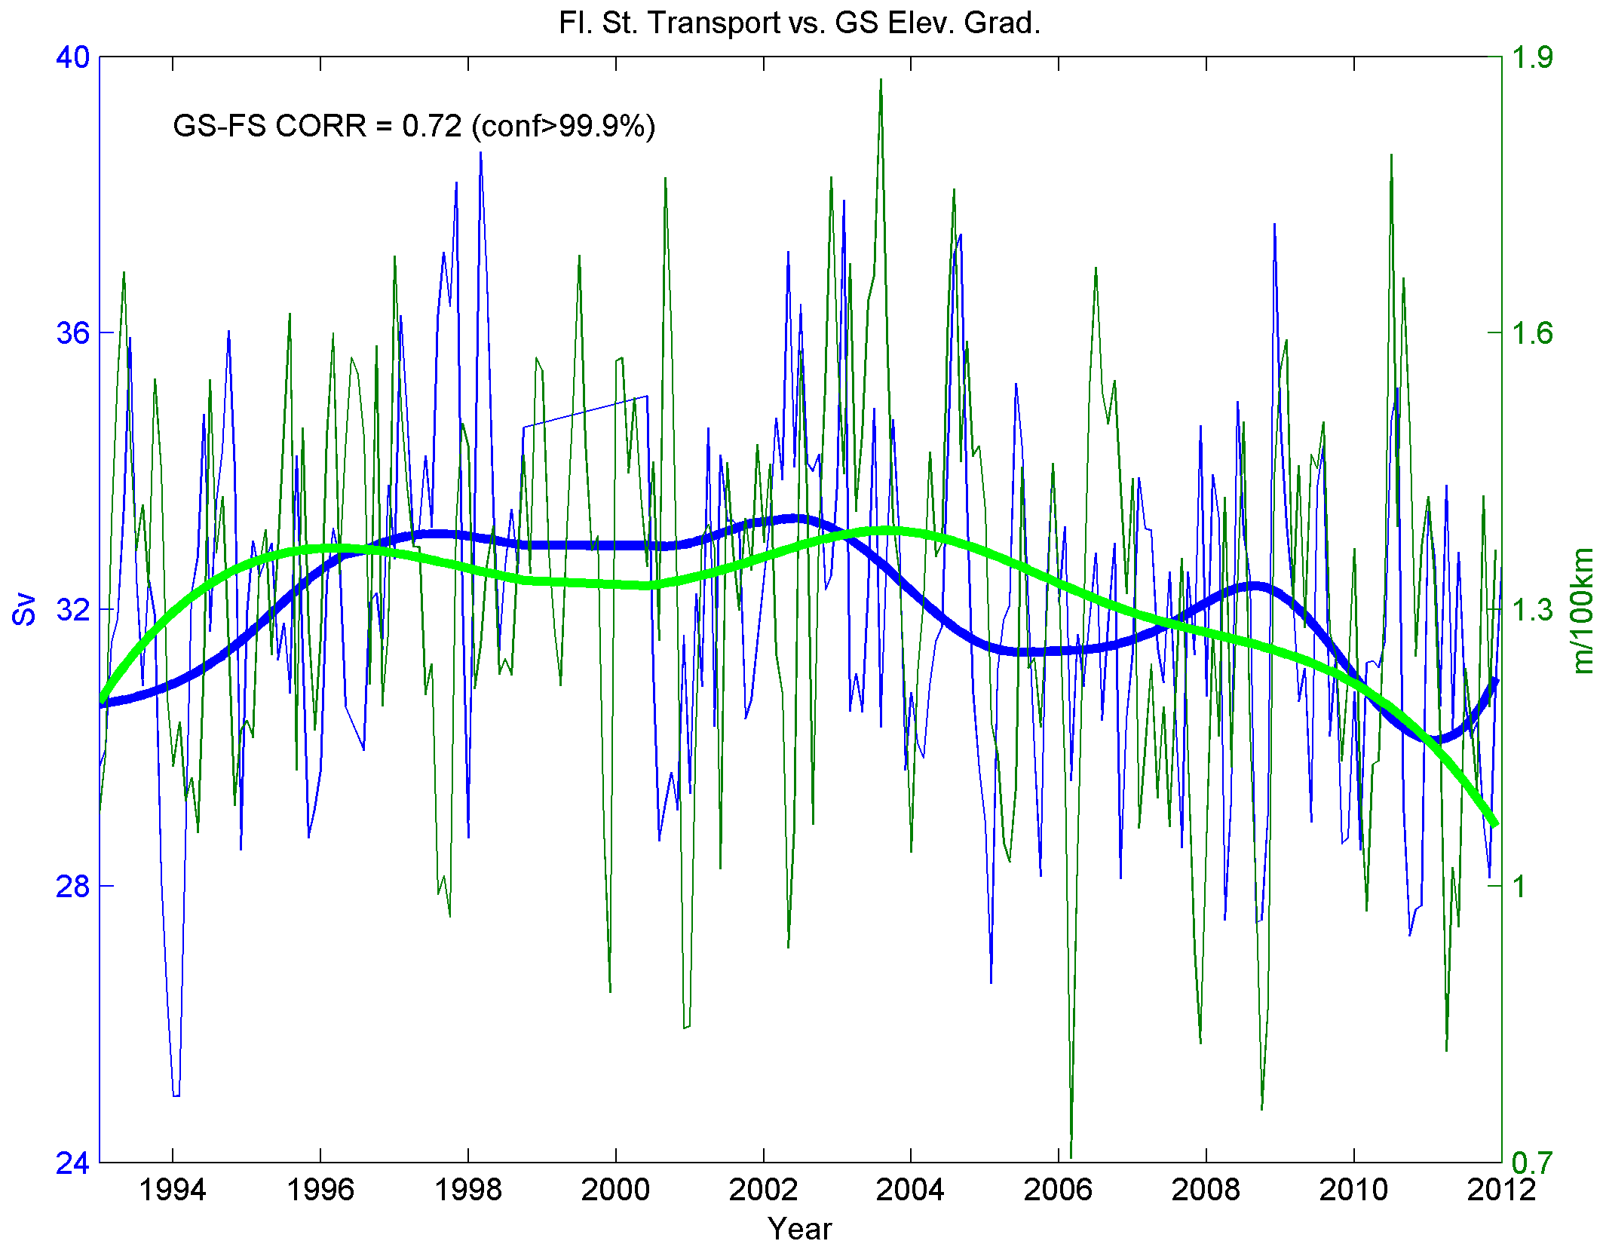
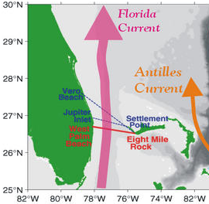
Gulf Stream measurements:
from satellite altimeter
from cable across the Florida Straits
Is the Gulf Stream weakening after 2004?
Florida Current Transport
Gulf Stream Gradient

Slide 15
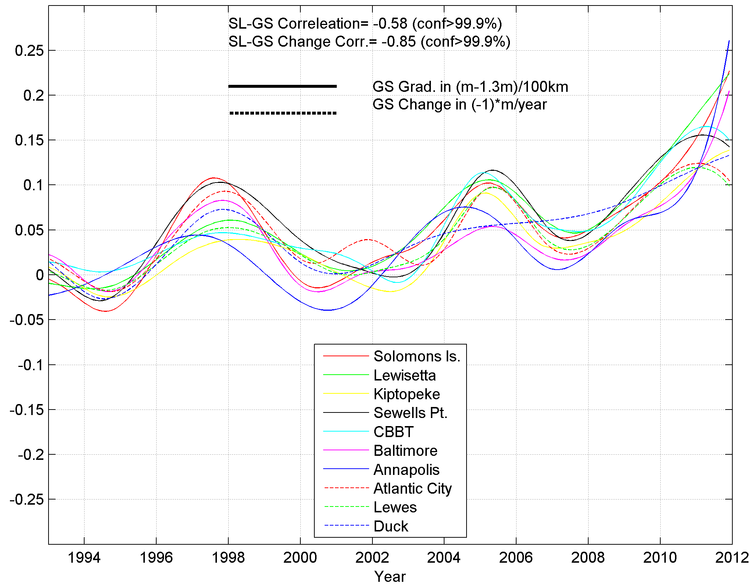
Sea level rise is not constant:
Why do stations in different locations show the same pattern?
Acceleration in sea level
Sea Level
Gulf Stream
SL (m)
Chesapeake Bay
Decline in Gulf Stream strength since 2004
Atlantic Coast

Slide 16
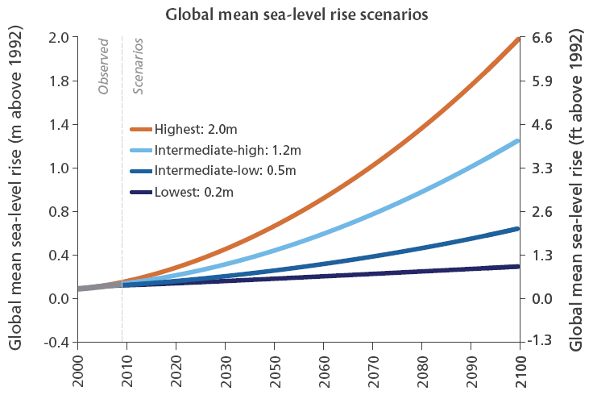
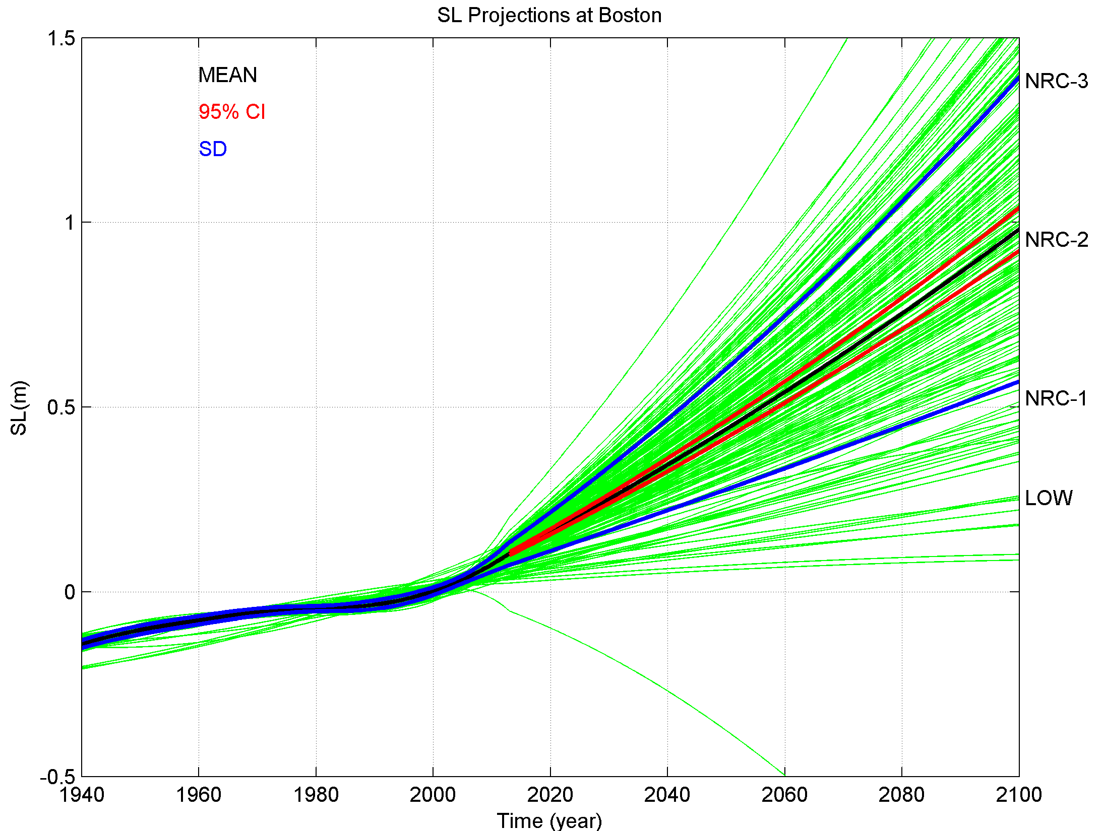
Global sea level scenarios
(based on climate models)
Main Points:
sea level is not rising evenly
sea level is not rising in a constant rate (decadal variations & acceleration)
global projections have large range (different scenarios)
need accurate local/regional SLR projections for planning purposes
Local projections (Boston, MA)
(based on statistical models)

