Slide 1
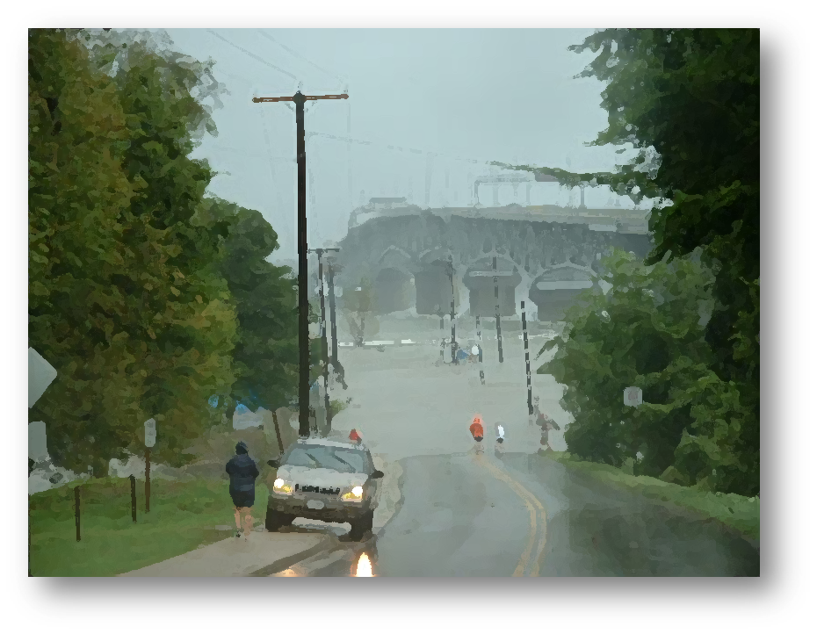
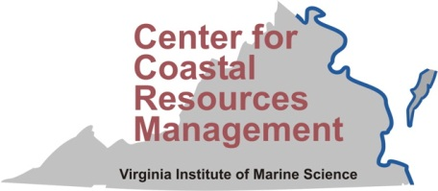

Recurrent Coastal Flooding:
Planning to Adapt

Slide 2
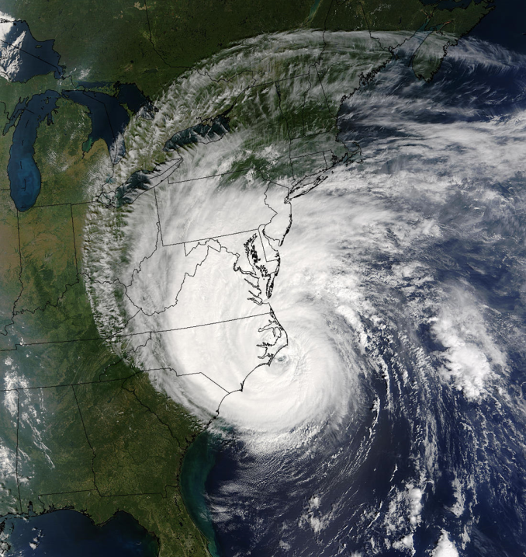
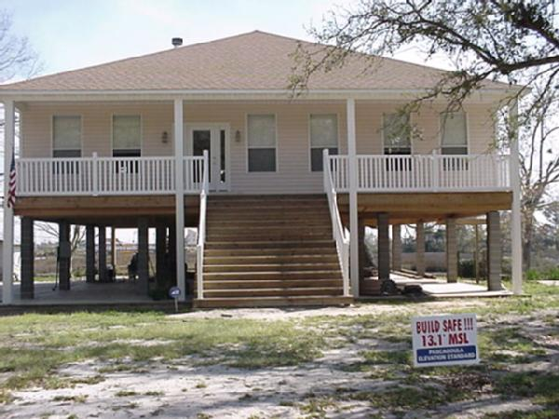
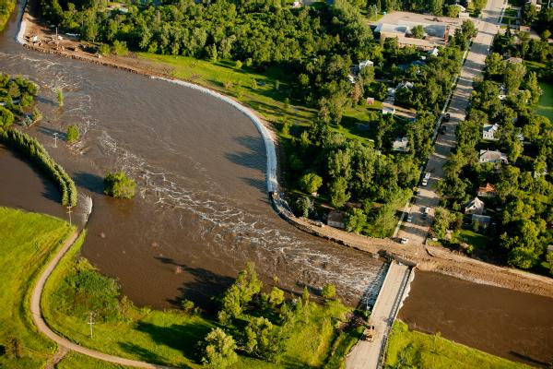
Adaptation Strategies
Management/ Retreat
Accommodation
Protection
Levee in North Dakota
Photo by Andrea Booher/FEMA
Elevated house in Mississippi
Photo by Robert Harris/FEMA

Slide 3
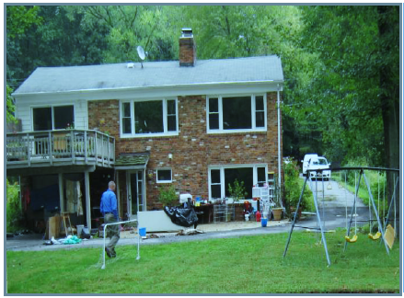
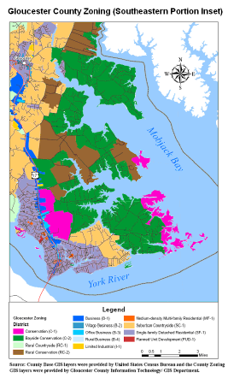
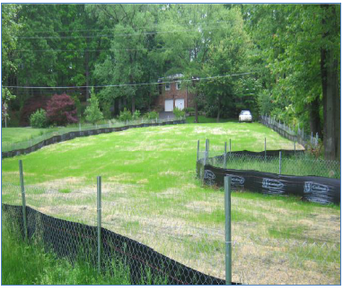
Management

Slide 4
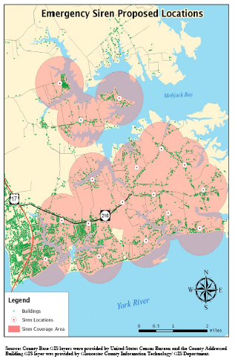
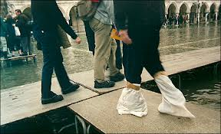
Accommodation
Elevated house in Mississippi
Photo by Robert Harris/FEMA

Slide 5
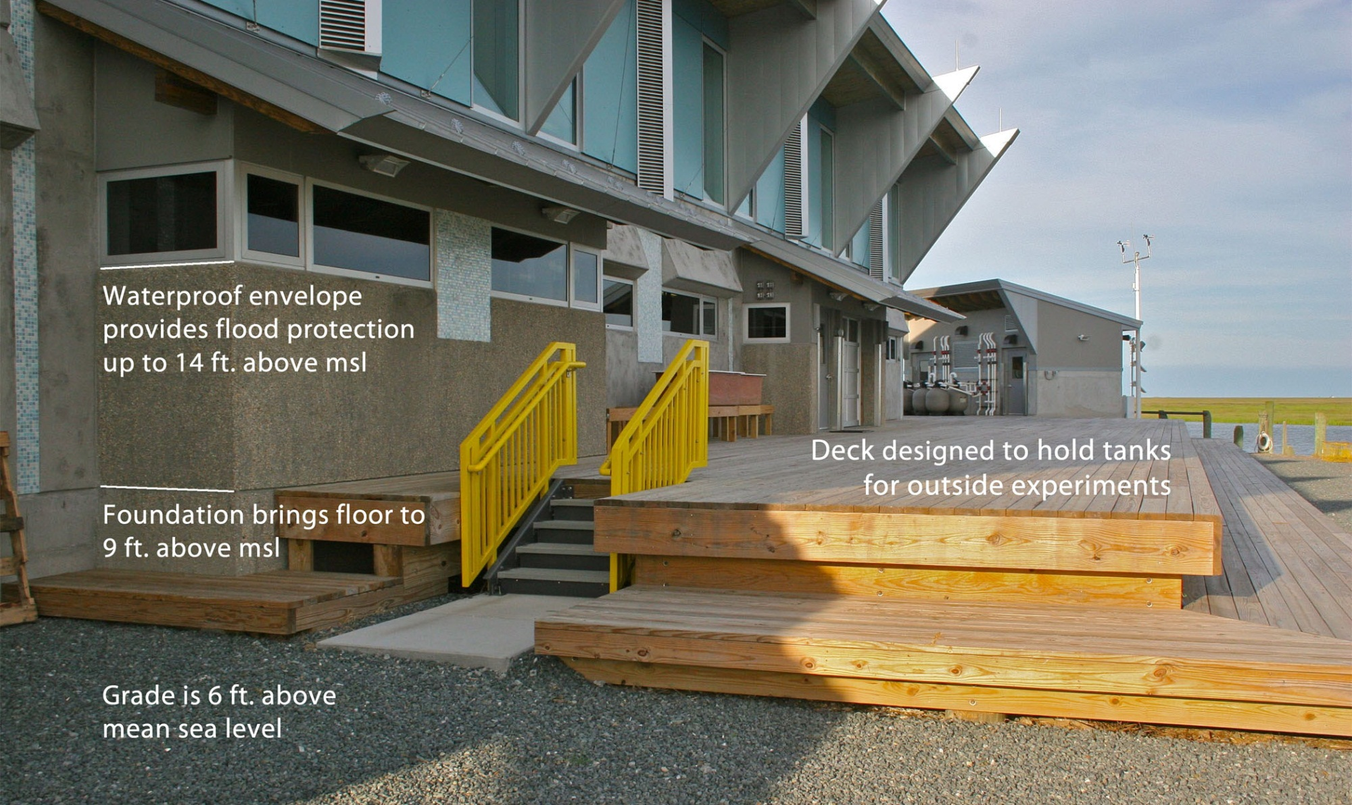
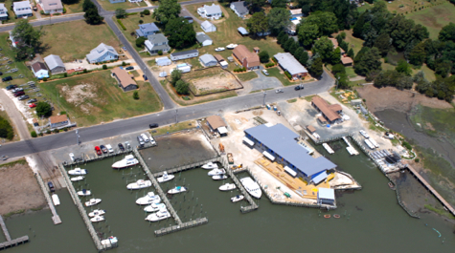
VIMS Eastern Shore Seawater Lab
FEMA Zone VE (Coastal High Hazard)

Slide 6
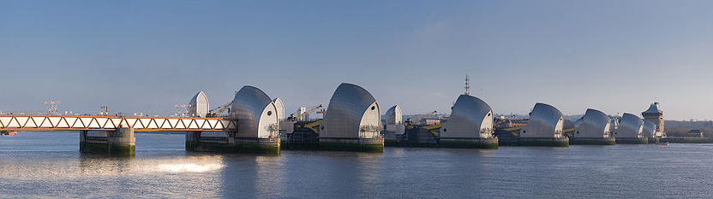
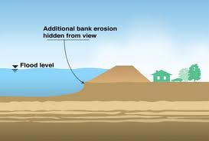
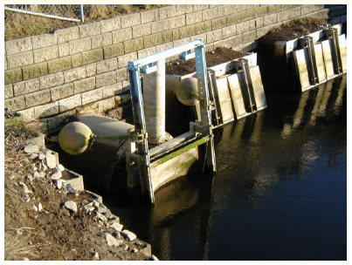
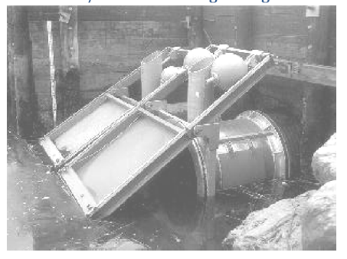
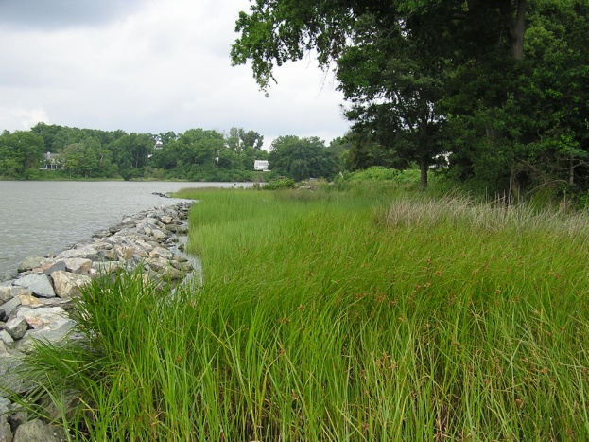
Protection
Photo by DAVID ILIFF. License: CC-BY-SA 3.0
Created marsh in Virginia
Photo by K. Durhing

Slide 7
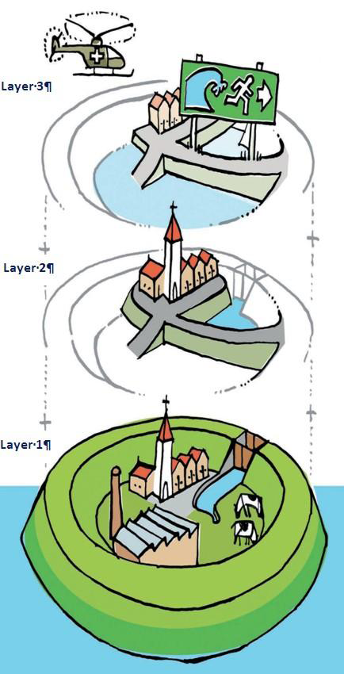
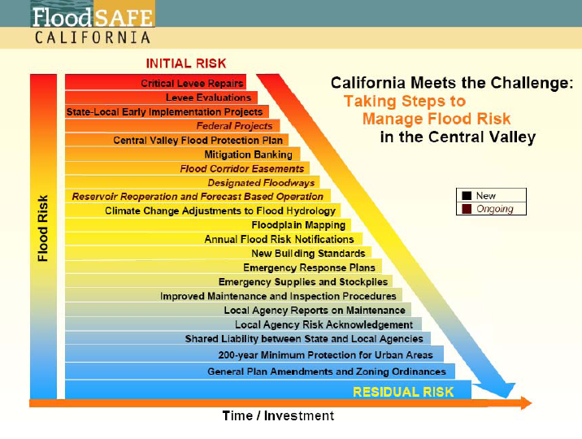
Multilayered Flood Protection
Recommendations
Use multiple protection layers to “buy down” risk and reduce the consequences if adaptation fails

Slide 8
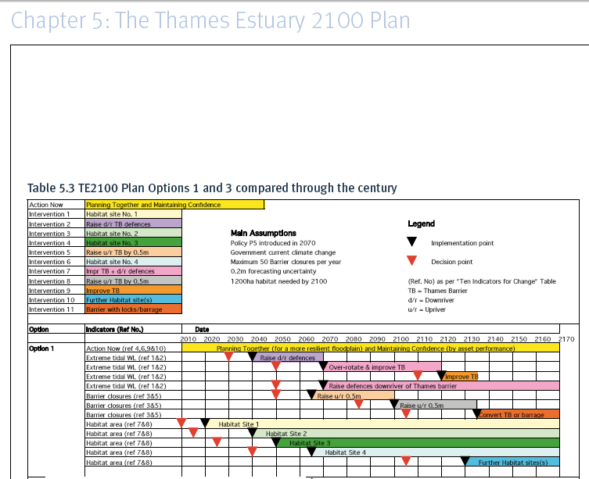
Recommendations
Flexible adaptation plans
Adaptable because:
Timing can be changed
Can switch between options
Structures designed to be upgraded
Land planning includes potential future uses
Considers new infrastructure planning
Monitor 10 indicators: MSL, peak surge tide level, conditions of flood defense structures, developed area, intertidal habitat, etc.

Slide 9
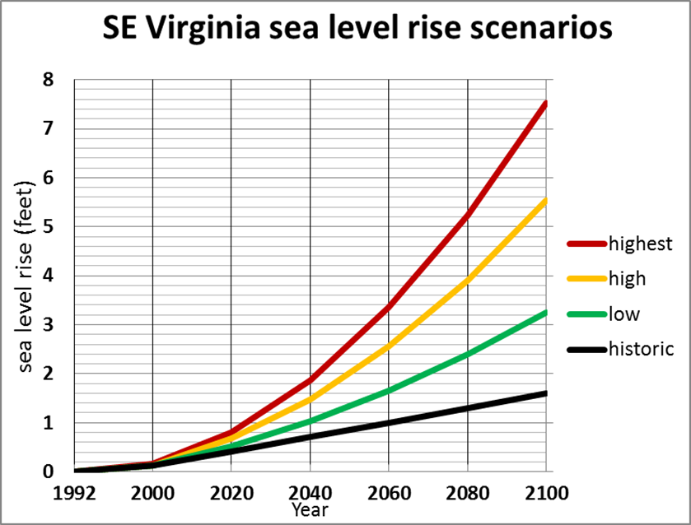

Slide 10
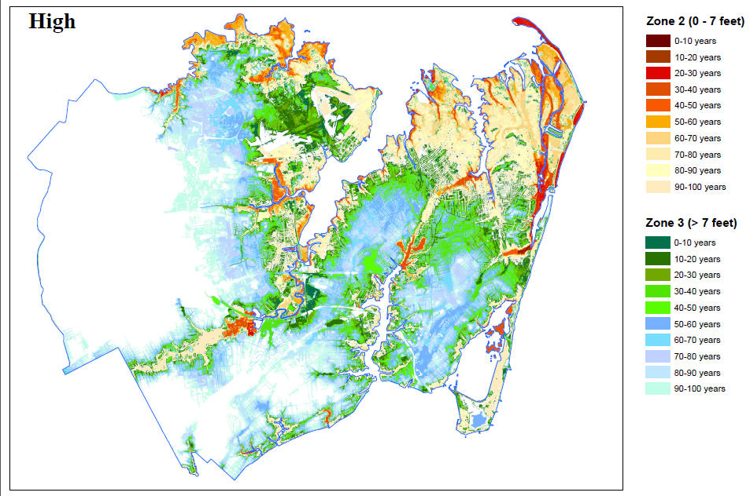

Slide 11

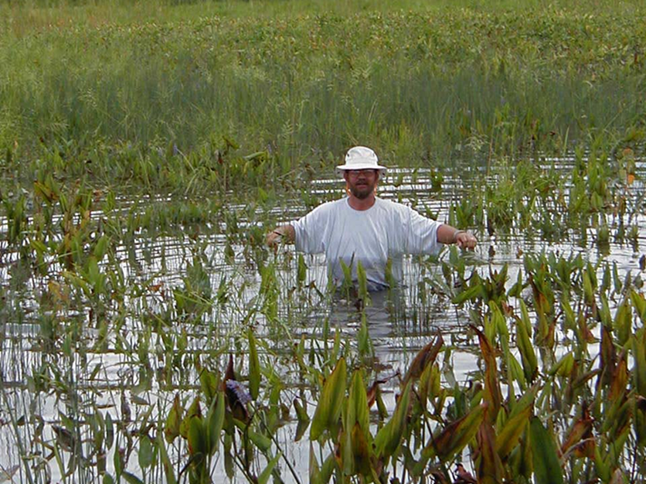
Carl Hershner
Center for Coastal Resources Management
Virginia Institute of Marine Science
College of William and Mary
carl@vims.edu

