Slide 1
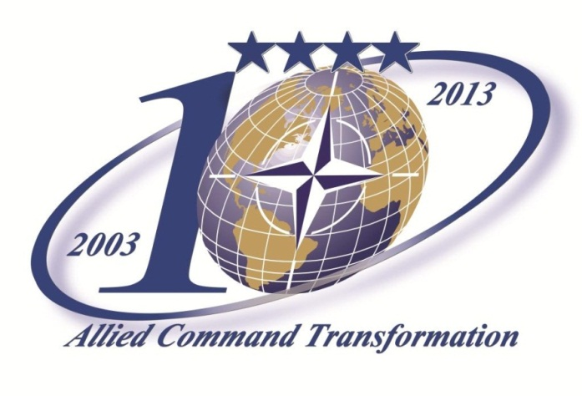
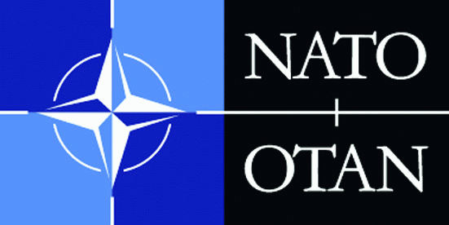
Sea Level Rise
&
NATO’s Future Security Environment
COL Janos Szonyegi, ACT SPP SA BH
30 October 2013

Slide 2
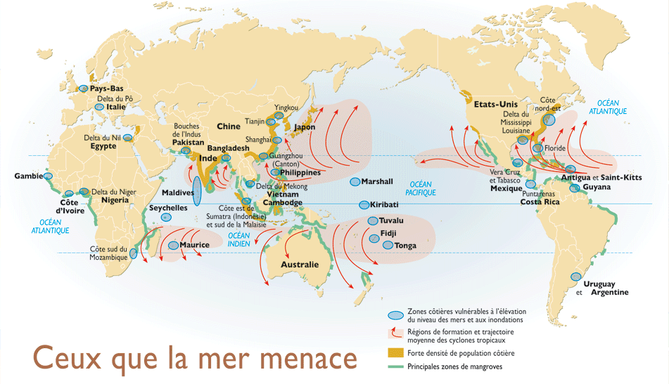
Strategic Spaces in the Future
Coastal areas vulnerable to sea-level rising and flooding
Development areas and trajectories of tropical storms
Threatened by Sea
High population density coastal areas
Main mangrove areas
*Source: Le Monde Diplomatique, Feb. 2005

Slide 3

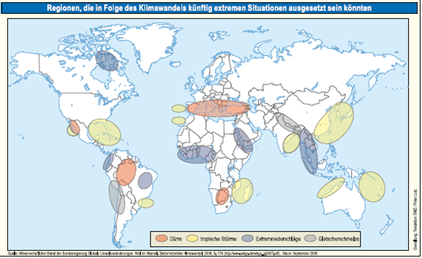
Regions Affected from Sea Level Rise
*Source: Wissenschlaflicher Beriat der Bundesregierung Globale Umweltveranderungen: Welt im Wandel. Sicherheitsrisiko Kimawantel, 2008, S. 174

Slide 4
Projections of Sea Level Rise
Increase of Sea Level Rise (by 1 meter)
Loss of 1,5% of agricultural lands
  Example: Vietnam
Intrusion of salt water into ground water
Increase of severe storms

Slide 5
Impacts of Sea Level Rise
On Lives
On Budget
Security Vacuum
On Infrastructure
“Climate Change is a threat to international peace and security.” (UN SecGen)

Slide 6
Impacts of Sea Level Rise
On Lives:
Sea level rise will affect low-lying coastal areas with large populations.
Nuclear Power plants in the vicinity of shoreline
Infectious diseases increase
On Budget:
Cost of Adaptation may reach 5-10 % of GDP
Onshore facilities are at risk.
  Nuclear Power plants in the vicinity of shoreline
  Oil exploration
On Infrastructure:
Increase of severe storms
Coastal infrastructure damage
NATO UNCLASSIFIED

Slide 7
Security Implications of Sea Level Rise
Possible Impact of Sea Level Rise | Security Implications
Reduced Agricultural Lands and changes in agricultural productivity | Decreased Economic Welfare
Intrusion of Salt water to Ground Water | Increased potential conflict due to water scarcity
Increasing food prices | Increased poverty, Demonstrations
Increasing oil prices, combined with higher energy demand | Weakened economy
Urbanization around coastal zones | Population displacement (IDPs and Migration)
NATO UNCLASSIFIED

Slide 8
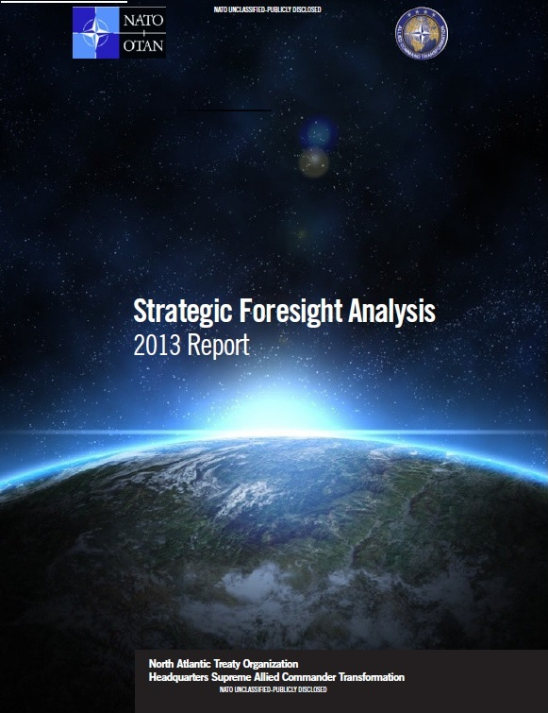
Strategic Foresight Analysis
2013 Report
1- Themes (5)
- Political
- Human
- Technology
- Economics/Resources
- Environment
2- Trends (15)
- Climate Change
- Natural Disasters
3- Defence and Security Implications (34)
Notes:
Defence and security implications for the Alliance to 2030 and beyond.

Slide 9
Sea Level Rise as a Threat-Multiplier
Human Theme
Urbanisation
Primarily in littoral areas.
By 2050 85% of global population in those littoral urban areas.
Large population living in grey areas surrounding cities
Increased potential for NATO involvement in urban areas.
Environmental/Climate Change.
- Unpredictable effects on sea, land, atmosphere.

Slide 10
Defence and Security Implications
Increased humanitarian assistance and disaster relief operations due to extreme weather events.
Increased access to the Arctic region, driving competition.
Increased potential conflict due to water scarcity.
  Developing countries are already experiencing this.
  Competition for access and control of water sources increase the possibility of conflict and instability.

Slide 11
Challenges
Protection of growing mega-cities near coastlines
Providing fresh water in certain areas
Reshaping the environmental landscape
Agricultural Patterns
Human habitation
Post-event recovery
  International aid and assistance

Slide 12
Conclusion
NATO is aware that sea-level-rise is one of the possible future issues that will present security challenges
Climate change and other environmental trends are included in NATOs Futures Work and the transformation process
ACTs Long term Military Transformation effort is a process that aims to cover future challenges

