Slide 1

The Sea Level Rise Inundation Tool
Part of the Comprehensive Coastal Resource Management Portal
Center for Coastal Resources Management
Molly Mitchell
Sept 2014
Hampton Roads Adaptation Forum

Slide 2
Virginia Senate Bill 964 (2011)
VIMS shall…Develop comprehensive coastal resource management guidance for local governments to foster the sustainability of shoreline resources by December 30, 2012. The guidance shall identify preferred options for shoreline management and taking into consideration the resource condition, priority planning, and forecasting of the condition of the Commonwealth's shoreline with respect to projected sea-level rise.
Notes:
Senate Bill 964 was passed and became law on July 1, 2011. It included three mandates, 2 for the Virginia Marine Resources Commission and one for VIMS. Here are two of the three mandates.

Slide 3
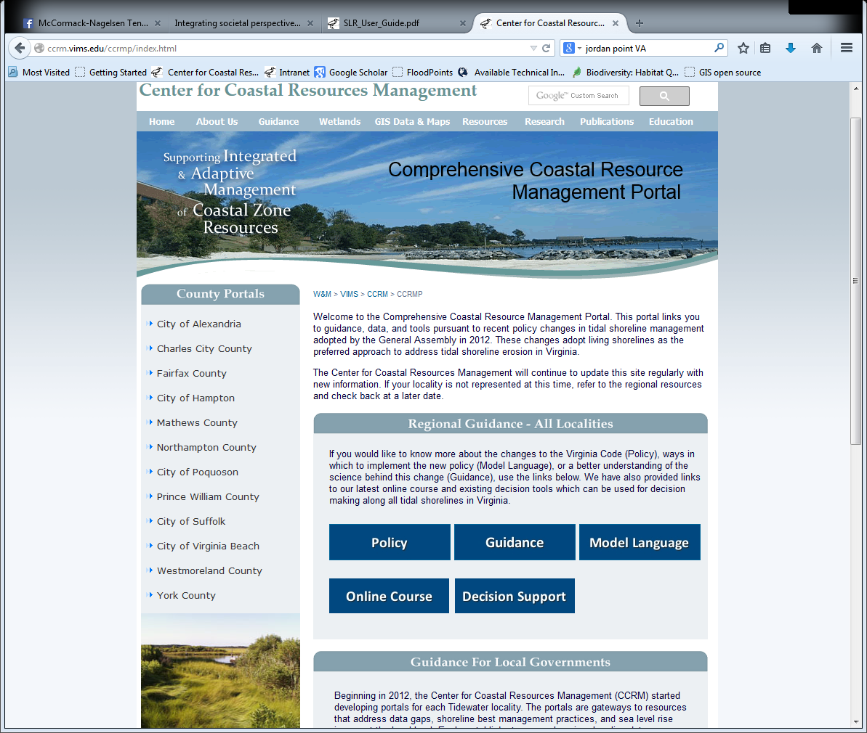
Comprehensive Coastal Resource Management Portal
Beginning in 2012, CCRM started developing portals for each Tidewater locality
  Right now there are 12 available with 5 more completed by the end of 2014
The portals are gateways to resources that address data gaps, shoreline best management practices, and sea level rise issues at the local level

Slide 4

Creating the topographic surface
LIDAR (elevation data) was acquired from VGIN and individual localities
  The most accurate LIDAR available was used
    Where no LIDAR available, VBMP was used
  The topo surface will be updated as higher resolution LIDAR becomes available
Data were merged into seamless layers for larger regions and then clipped to the locality boundaries
Data were projected to Virginia State Plane HARN (ft)

Slide 5
Modeling Sea Level
A digital Mean High Water shoreline (NOAA) was used as the current locality shoreline
  Used tidal datum for reference rather than elevation datum because it allows for variation in local tides
  Converted land elevation to MHW reference using NOAA’s Coastal Service Center tool (Vdatum)
Sinks were “filled” in the land surface
Sea level rise scenarios were selected and raster calculator was used to create mosaic datasets of different time frames

Slide 6
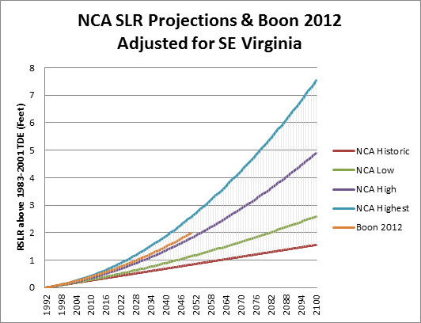
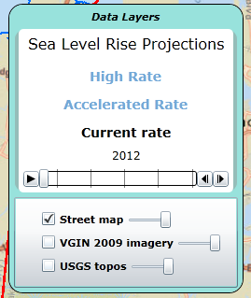
Relative Sea Level Rise

Slide 7
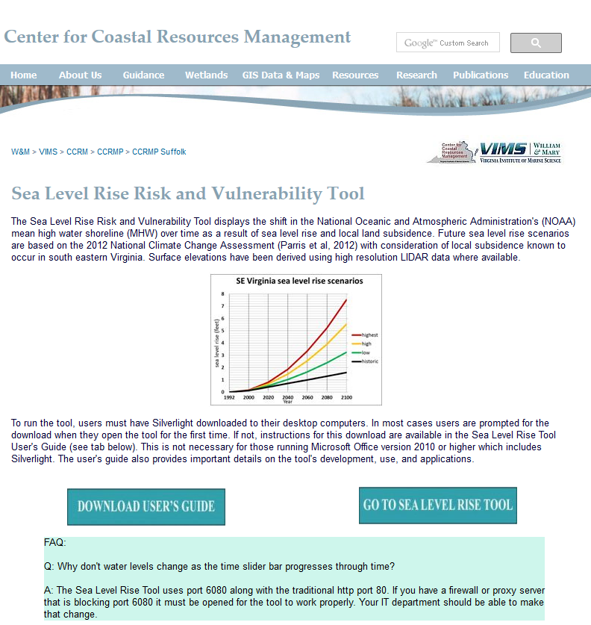
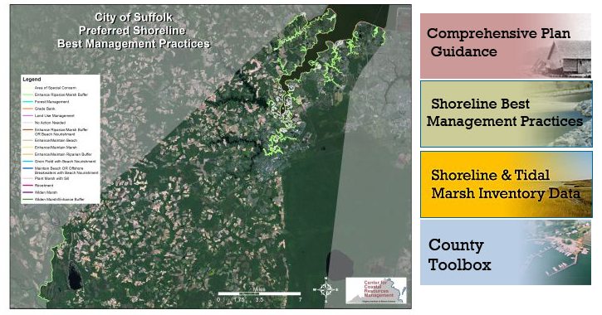
http://ccrm.vims.edu/ccrmp/index.html

Slide 8

Tour of the viewer
Suffolk County map & Comprehensive Viewer

Slide 9
Tour of the viewer
Suffolk County map & Comprehensive Viewer
What can you do with this info?

Slide 10
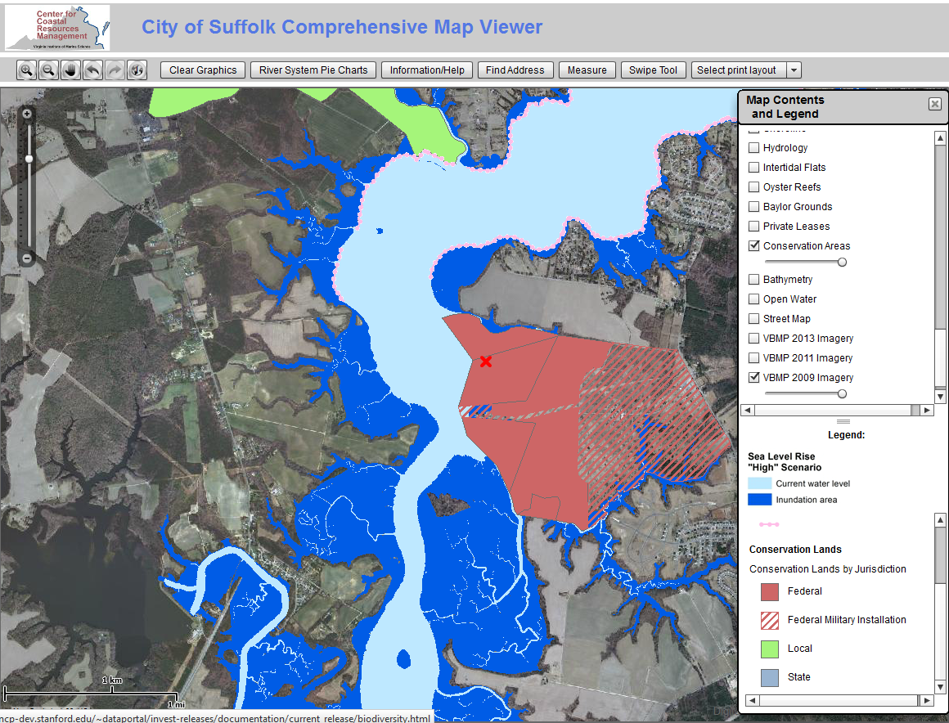
Compare changes between 2 years
Find specific addresses

Slide 11
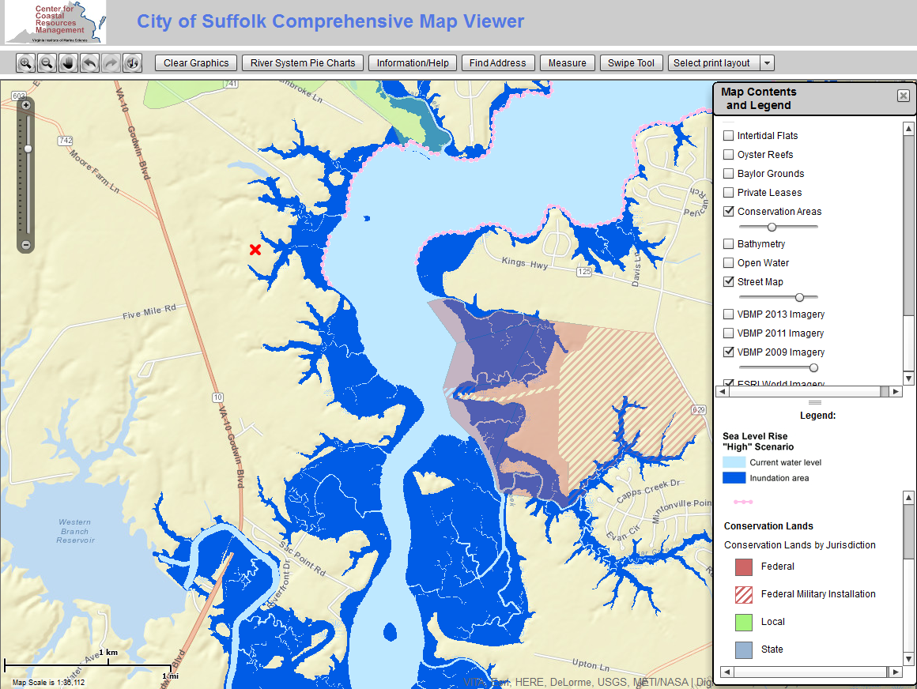
Consider longevity of conservation areas
Look at impacts to roads under different flooding scenarios

Slide 12
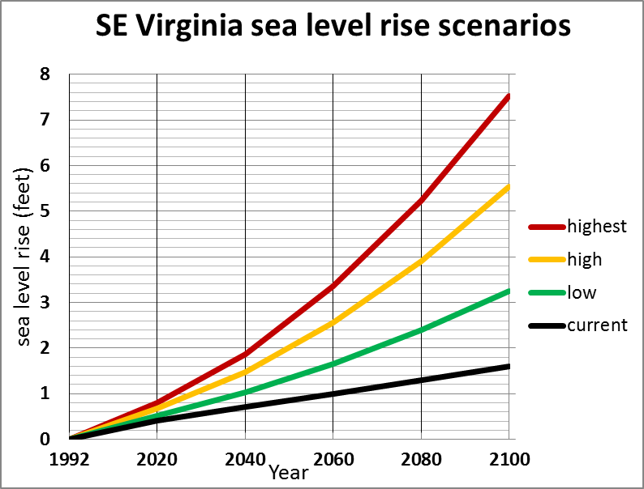
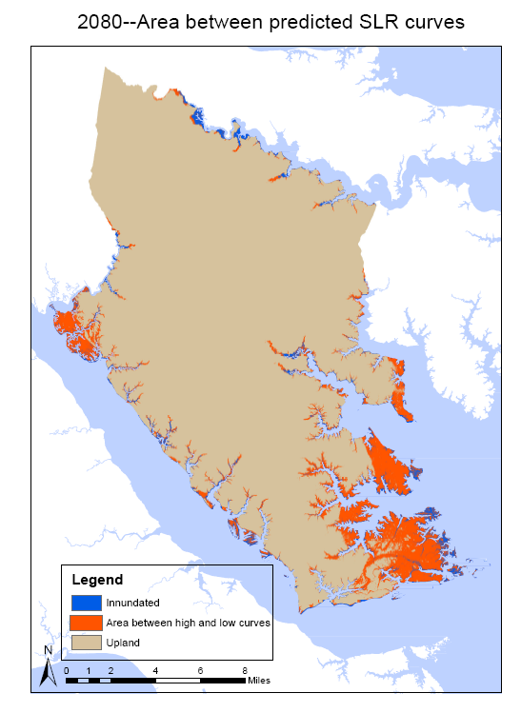

Slide 13


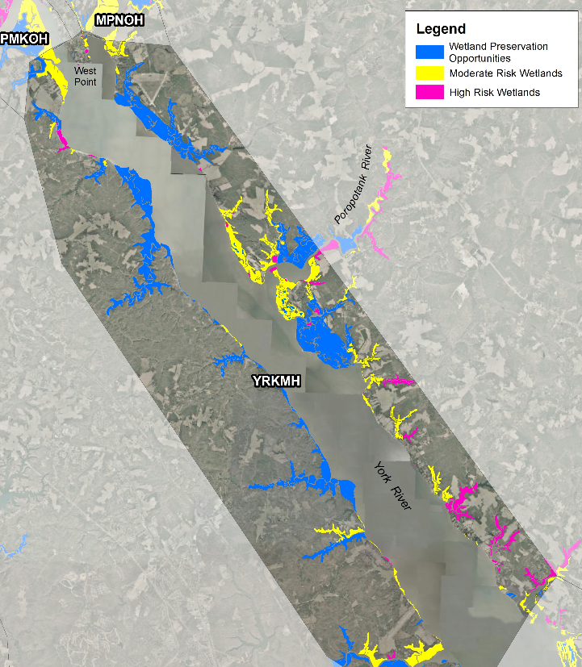
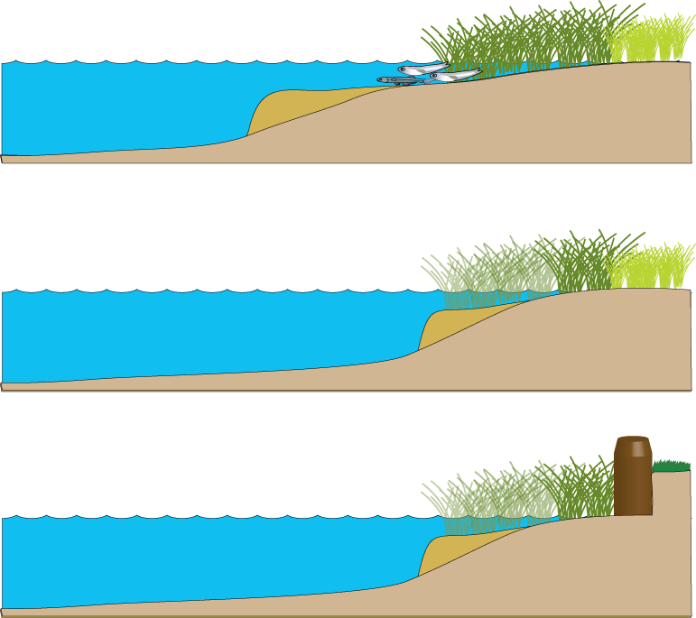
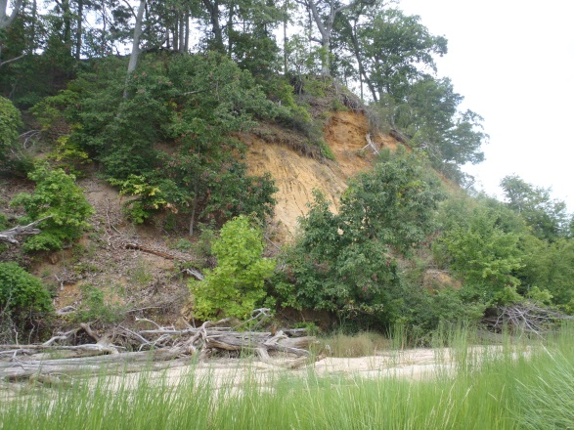
Projected marsh impacts
Bilkovic et al. 2009 Vulnerability of shallow tidal water habitats in Virginia to climate change
Marshes are at high risk when:
1. They can’t retreat landward due to shoreline structures
2. They can’t retreat landward due to the height of the bank
~ 2 ft increase in relative sea level

Slide 14
Questions?
Future plans
Update SLR models on new LIDAR as available
Update SLR models as new NCA reports are issued
Continue to explore the impact of SLR on management actions and the impact of management actions on SLR
www.vims.edu
www.vims.edu

